Slide 1
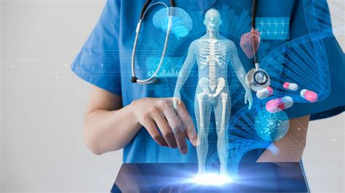

MEDICAL BODY AREA NETWORK

Slide 2
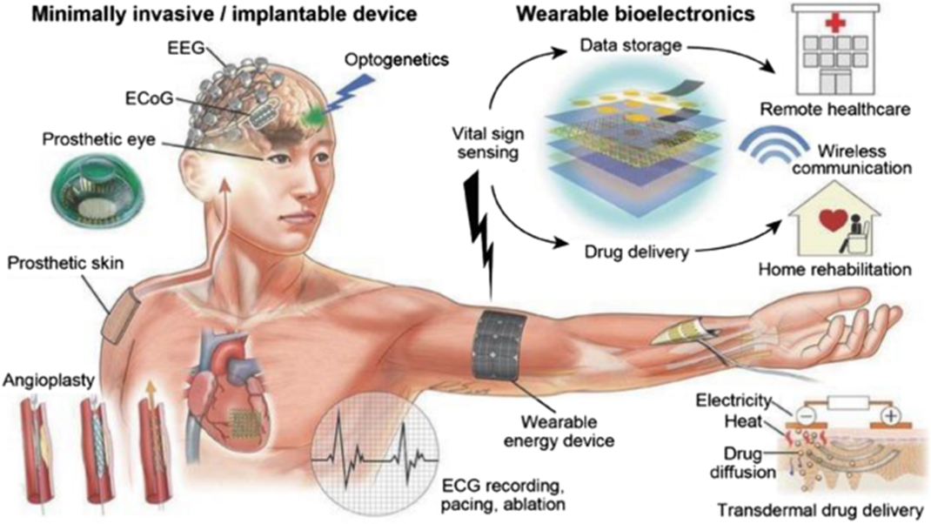
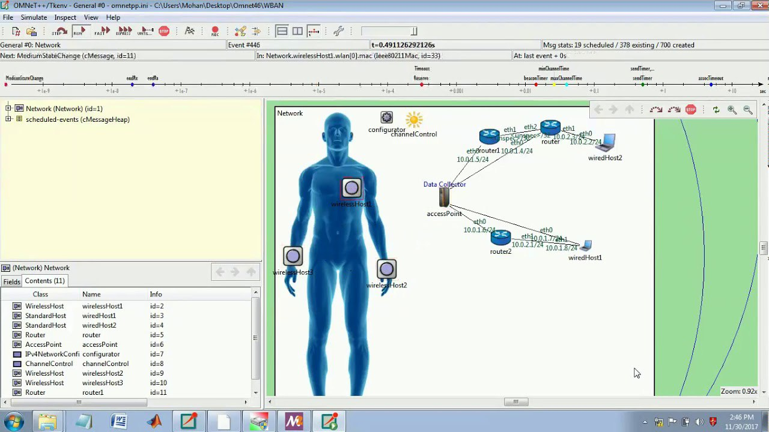
MEDICAL BODY AREA NETWORKS DEFINED
MBANs are networks of wireless sensors, often no bigger than a Band-Aid, which can transmit data on a patient's vital health indicators to their doctor or hospital. The FCC mandated the MBAN in 2014. MBAN is a Subset of the WBAN.
The first use of MBANs will likely be in hospitals, but a longer term application could be remote monitoring devices that allow doctors to check on patients at home.\
The networks can potentially alert doctors to problems before the patient’s condition becomes critical, thus avoiding the need for acute intervention.
The technology has more laws allowing it to do whatever it wants to your body than you do. All the regulatory agencies have been very busy creating the legal structure for wBAN, MBAN, Wireless drugging, and patient compliance for many years now.
This is the reason why humans now have mac addresses. Its for this network. We are all patients to this satanic medical system now. It also clearly states that this network follows you to your house. Which is your kill box.
WIRELES BODY AREA NETWORK SOFTWARE OMNET HOW THEY LOG IN AND OUT OF YOUR BODY:
Hospitals use Medical Body Area Networks and a software called OMNET to report data from human bodies up to the cloud. This was done in hospitals during COVID.
The MBAN technology will provide a flexible platform for the wireless networking of multiple body transmitters used for the purpose of measuring and recording physiological parameters and other patient information or for performing diagnostic or therapeutic functions, primarily in health care facilities. This platform will enhance patient safety, care and comfort by reducing the need to physically connect sensors to essential monitoring equipment by cables and wires. Our decision herein is the latest in a series of actions to expand the spectrum available for wireless medical use. FCC Regulations
WWW.FTWPROJECT.COM

Slide 3
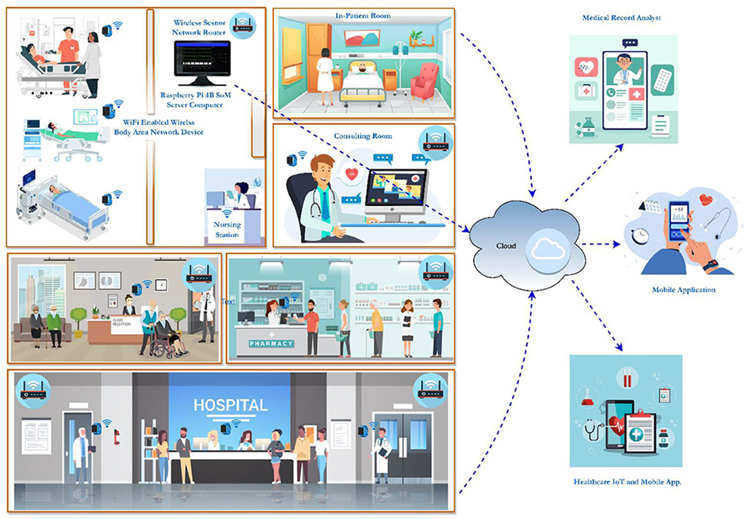
MBANS: HOW THEY WORK
FROM: Frontiers in Sustainable Cities 2022
This is a model of a biosensor network using WBANs and WSNs to identify early symptoms and monitor air quality. The patient's wearable device, built using the IoT module, is equipped with various biosensors. The biosensor nodes are equipped with minimal storage and processing power, and they use the IEEE 802.15.6 protocol to transfer information with the base station (BS). The BS has a powerful Raspberry Pi 4 B computer with Graphical Processing Unit (GPU) capabilities and IoT connectivity.
The whole WBAN database, including all patient information, is stored on an NVIDIA 128 Core Jetson Nano server computer. Using a smartphone app and IoT connectivity, physicians, medical analysts, and other authorized users can access patients' medical histories stored on a server.
The first use of MBANs will likely be in hospitals, but a longer term application could be remote monitoring devices that allow doctors to check on patients at home.
WWW.FTWPROJECT.COM

Slide 4
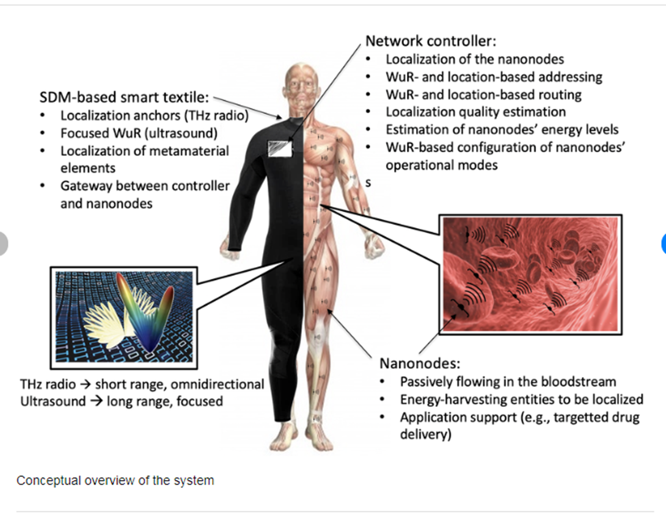
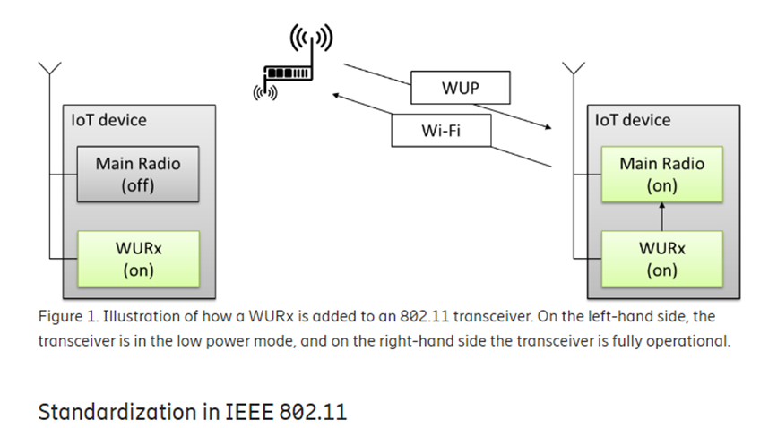
BIOSENSORS USE WAKE UP RADIO TECHNOLOGY
Wake Up Radio
Imagine a receiver in a very low power mode that would, in a magical way, wake up just in time for the data to be received.
This is what they have designed the biosensors that are inside of our bodies to do.
From:
Wake-Up Radio – A key component of IoT?
https://www.ericsson.com/en/blog/2017/12/wake-up-radio--a-key-component-of-iot
WWW.FTWPROJECT.COM

Slide 5
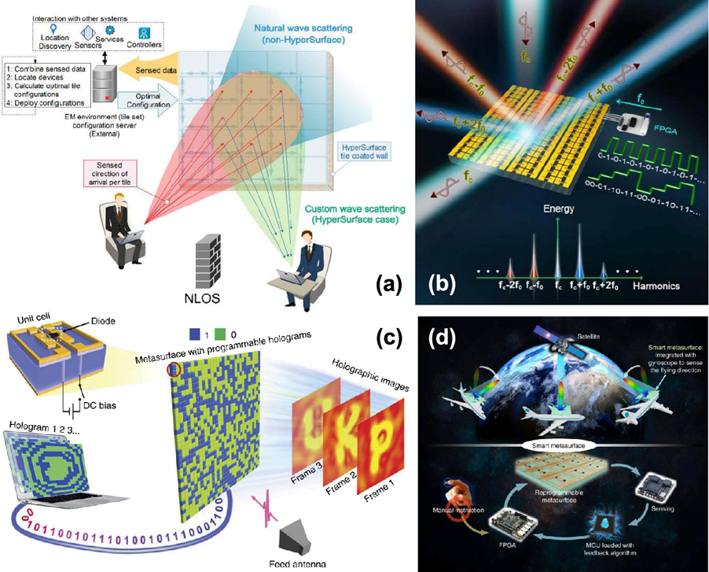
Software Defined Metamaterials are the suite of nanoscale technologies that operate in the terahertz frequency range.
METAMATERIALS enable electromagnetic control over electromagnetic waves in fields such as imaging, radar, or wireless communications.
Metamaterials and their two-dimensional analogues, metasurfaces have powerful control over electromagnetic waves from microwave to visible range and can become programmable.
Programmable metamaterials may not only host multiple EM functionalities that can be chosen or combined through simple software directives, but also be provided with means to adapt to the environment or communicate with other metamaterials, thereby enabling a myriad of applications in sensing, imaging, or communications.
WE ARE SATURATED IN METAMATERIALS SINCE THE UPGRADE THAT STARTED IN 2017 WITH THE 4TH INDUSTRIAL REVOLUTION CYBER PHYSICAL BACKBONE
WWW.FTWPROJECT.COM

Slide 6
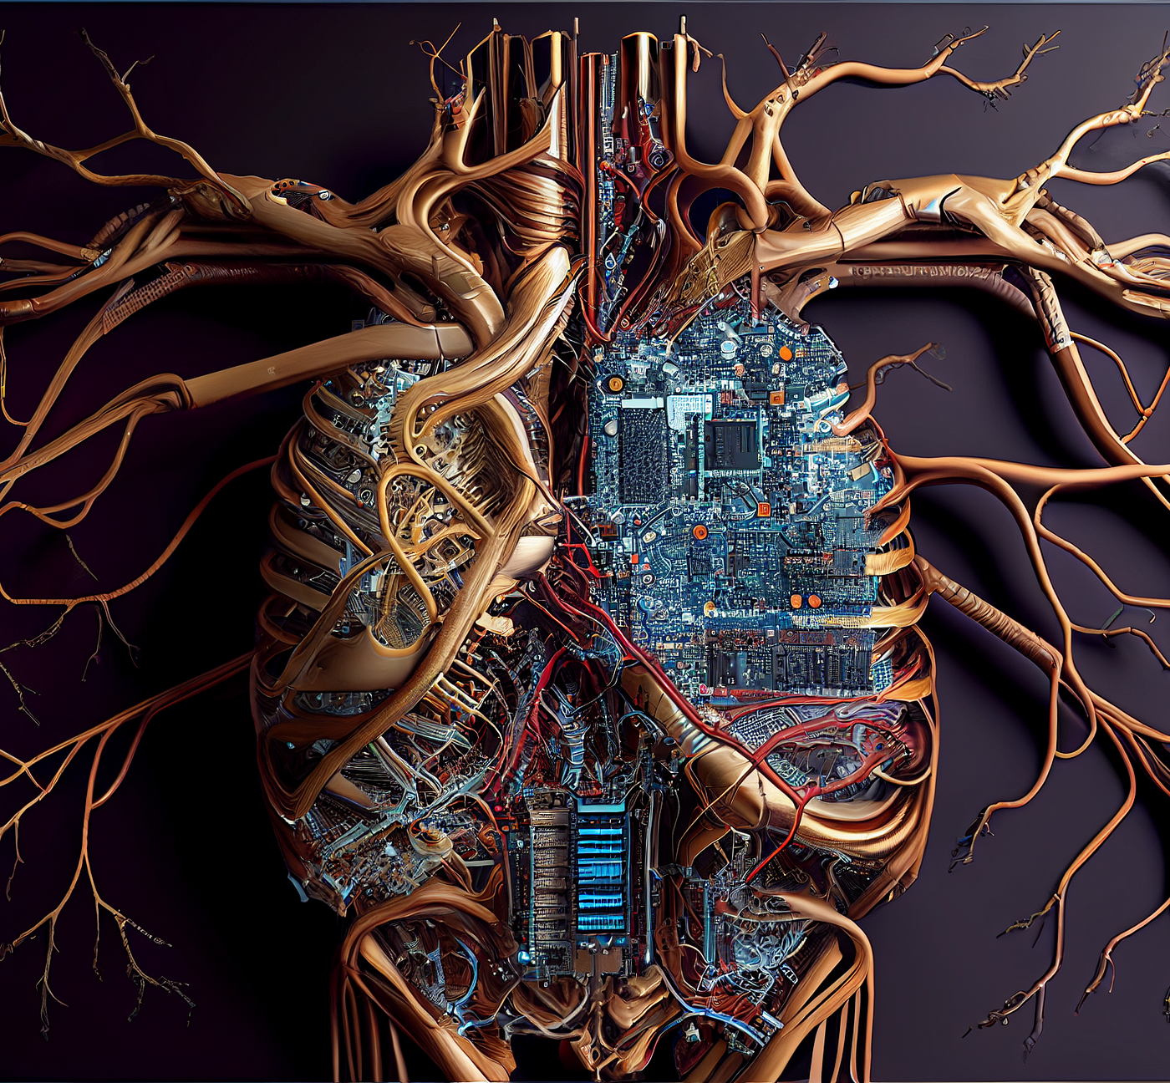
WIRELESS DRUGGING AND THE DIGITAL NERVOUS SYSTEM
DIGITAL DRUG DELIVERY USING AI DECISION MAKING
The digital nervous system (DNS), a smart healthcare body-area network (BAN). Separate nodes on the human body work in unison to sense and communicate health parameters and actuate medical treatments. Sensor nodes (e.g., breathing/sweat, pulse, motion) convert physiological information into digital signals which are wirelessly relayed to a central decision-making base unit, and actuator nodes, exemplified by an implantable drug delivery device, convert digital signals into biochemical fluxes. Data transferred from the BAN to cloud data handling services can be utilized for direct contact with care providers or emergency services, as well as decision making, analysis, and improved treatment schemes (which can be relayed back to the BAN).
Body area networks (BANs), cloud computing, and machine learning are platforms that can potentially enable advanced healthcare outside the hospital. By applying distributed sensors and drug delivery devices on/in our body and connecting to such communication and decision-making technology, a system for remote diagnostics and therapy is achieved
From: A digital nervous system aiming toward personalized IoT healthcare
WWW.FTWPROJECT.COM

Slide 7
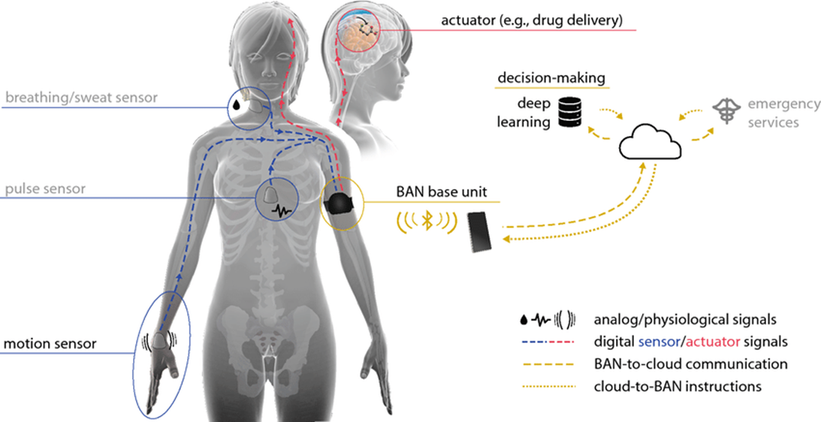
WIRELESS DRUGGING AND THE DIGITAL NERVOUS SYSTEM
Here we see the actuator in the brain for the bio electronic drug delivery. The Body Area Network Base unit that can be activated through a wearable, your breathing and sweat censor to watch your interstitial fluids with a pulse sensor, which will be on the inside of your body to verify the drug delivery. On the right is a data base for decision making with an artificial intelligence making the decision on when to drug you all connected to your medical industrial complex “emergency services” personnel.
WWW.FTWPROJECT.COM

Slide 8
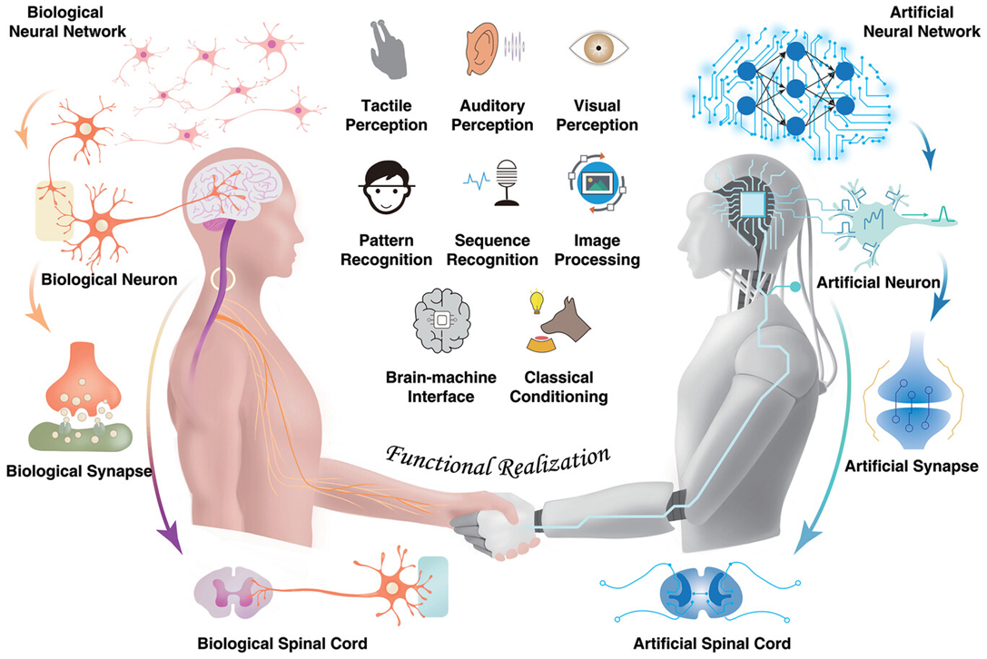

DIGITAL TWINS IN HEALTH CARE
A digital twin is a virtual model of a physical entity, with dynamic, bi-directional links between the physical entity and its corresponding twin in the digital domain. Digital twins are increasingly used today in different industry sectors. Applied to medicine and public health, digital twin technology can drive a much-needed radical transformation of traditional electronic health/medical records (focusing on individuals) and their aggregates (covering populations) to make them ready for a new era of precision (and accuracy) medicine and public health. Digital twins enable learning and discovering new knowledge, new hypothesis generation and testing, and in silico experiments and comparisons. They are poised to play a key role in formulating highly personalized treatments and interventions in the future.
From: Digital Twins: From Personalised Medicine to Precision Public Health
and Memristor-Based Intelligent Human-Like Neural Computing
Note the Aleister Crowly Hexagram which is a symbol equivalent to the pentagram or pentacle. The two symbols together represent the interweaving of the planetary and elemental forces.
Merging man and machine-Transhumanism
WWW.FTWPROJECT.COM

Slide 9
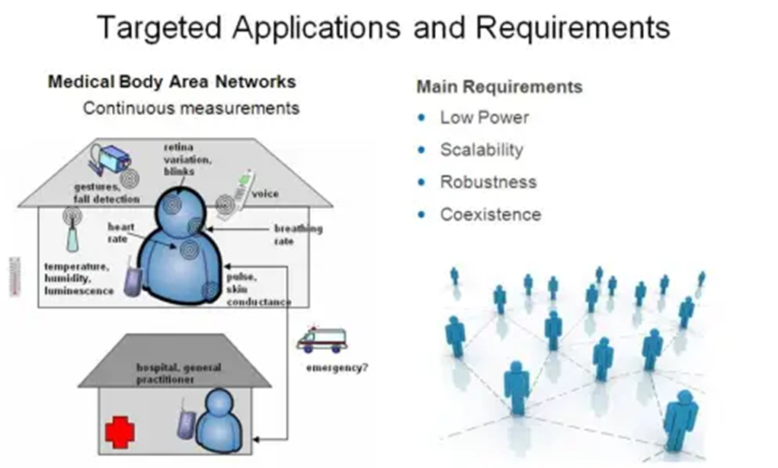
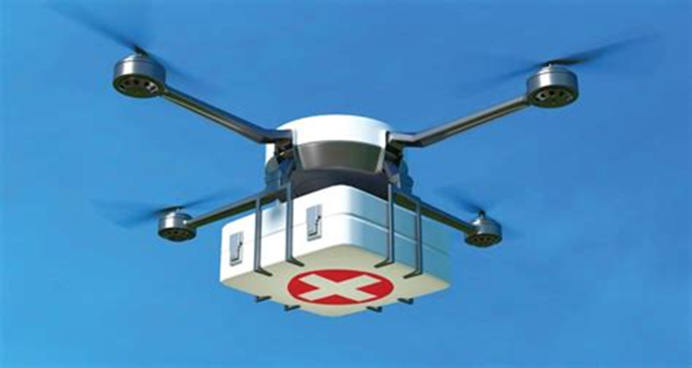
TELEHEALTH TECHNOLOGY AND REMOTE HEALTH MONITORING
Telehealth is the use of digital information and communication technologies to access health care services remotely and manage your health care. Technologies can include computers and mobile devices, such as tablets and smartphones. This may be technology you use from home. Or a nurse or other health care professional may provide telehealth from a medical office or mobile van, such as in rural areas. Telehealth can also be technology that your health care provider uses to improve or support health care services.
The Issue with Telehealth is in Remote Monitoring
Technology that allows your provider or health care team to check your health remotely: Web-based or mobile apps for uploading data to your provider or health care team. -Devices that measure and wirelessly send data, such as blood pressure, blood sugar and oxygen levels.-Wearable devices that automatically record and send data (heart rate, blood sugar, how you walk, your posture, tremors, physical activity or your sleep).-Home monitoring devices for older people or people with dementia that can find changes in daily activities such as falls.-Devices that send notifications to remind you to do exercises or take drugs
Software for Remote Patient Monitoring Systems
WWW.FTWPROJECT.COM

Slide 10
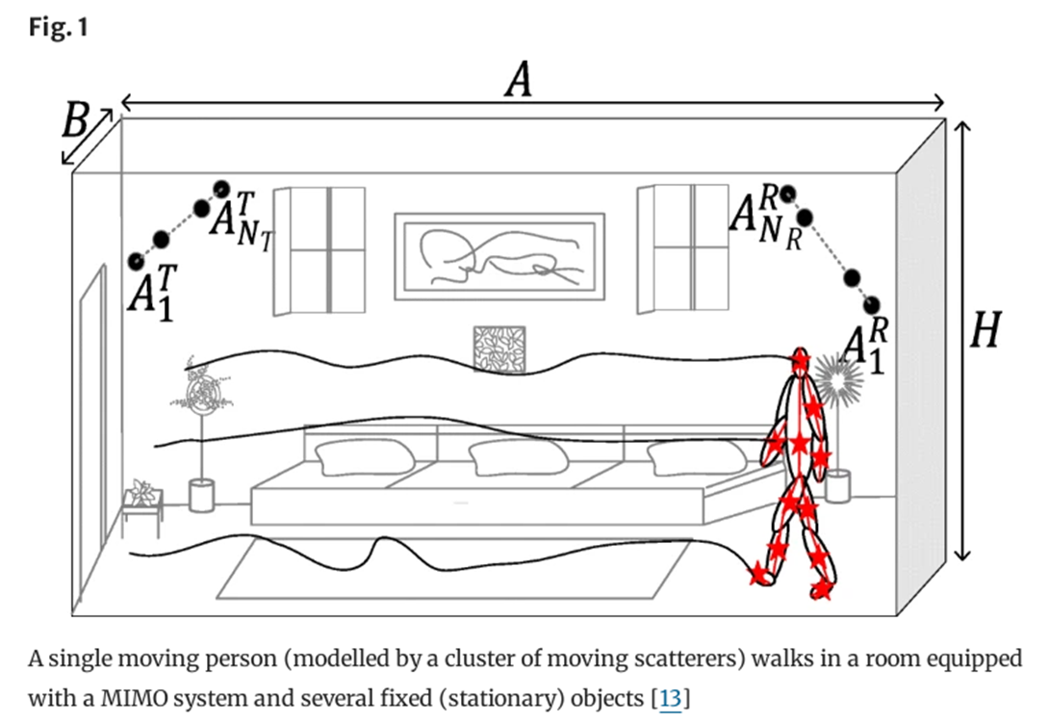
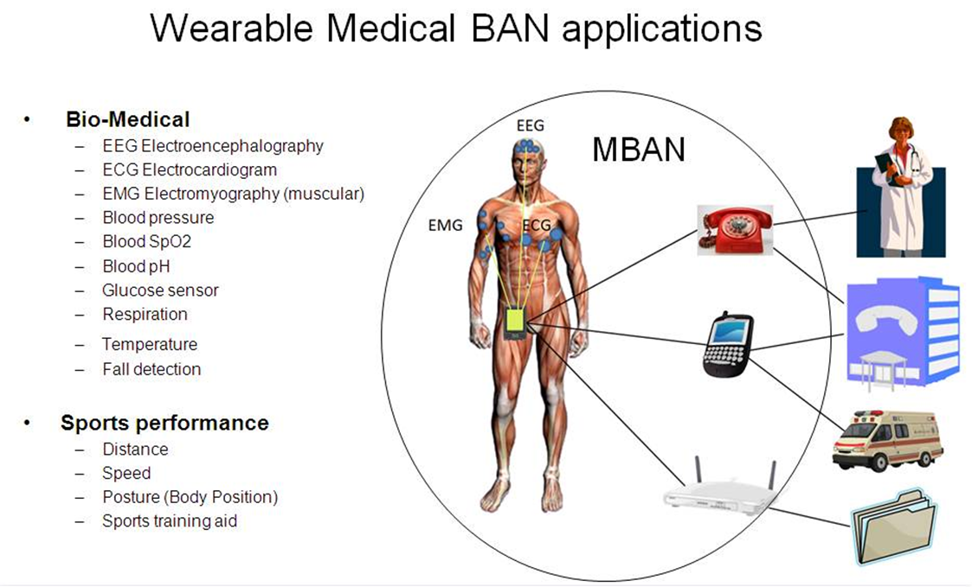
HUMAN ACTIVITY RECOGNITION SYSTEMS: HOW THEY TRACK YOUR EVERY MOVE WHILE IN YOUR HOME USING “MARKERS” SURVEILLANCE AND RADIO FREQUENCY SIGNAL PROCESSING.
Abstract
Extensive research showed that the physiological response of human tissue to exposure to low-frequency electromagnetic fields is the induction of an electric current in the body segments. As a result, each segment of the human body behaves as a relay, which retransmits the radio-frequency (RF) signal. To investigate the impact of this phenomenon on the Doppler characteristics of the received RF signal, we introduce a new three-dimensional (3D) non-stationary channel model to describe the propagation phenomenon taking place in an indoor environment. Here, the indoor space is equipped with a multiple-input multiple-output (MIMO) system. A single person is moving in the indoor space and is modelled by a cluster of synchronized moving point scatterers, which behave as relays…
From “A non-stationary relay based 3D MIMO channel model with time-vairant path gains for human activity recognition in indoor environments”
WWW.FTWPROJECT.COM

Slide 11

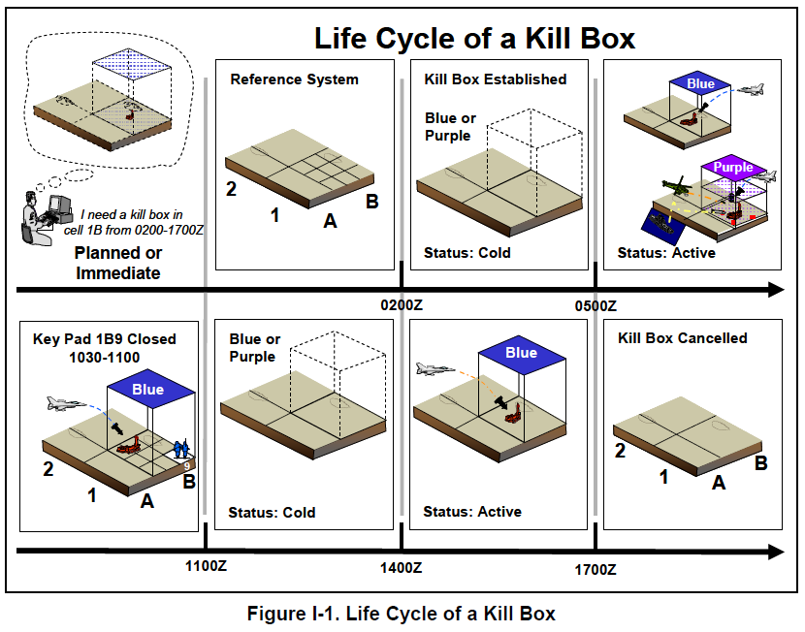
C40 KILL BOX CITIES AND REMOTE MONITORING
A Kill Box is a military strategy or procedure used in warfare where a three dimensional area is set up to enable timely coordination control and facilitate rapid attacks.
Effectively, they are using the MBAN and WBAN to turn your home into a Kill box. The network is connected to an autonomous weapon system where electronic warfare of various kinds can be carried out on civilians. For the ultimate control and extinction of the population.
The C40 network is a set of major cities around the world that have committed to fighting “climate change.”
-15 minute cities
-You’ll own nothing and you’ll be happy.
WWW.FTWPROJECT.COM

Slide 12
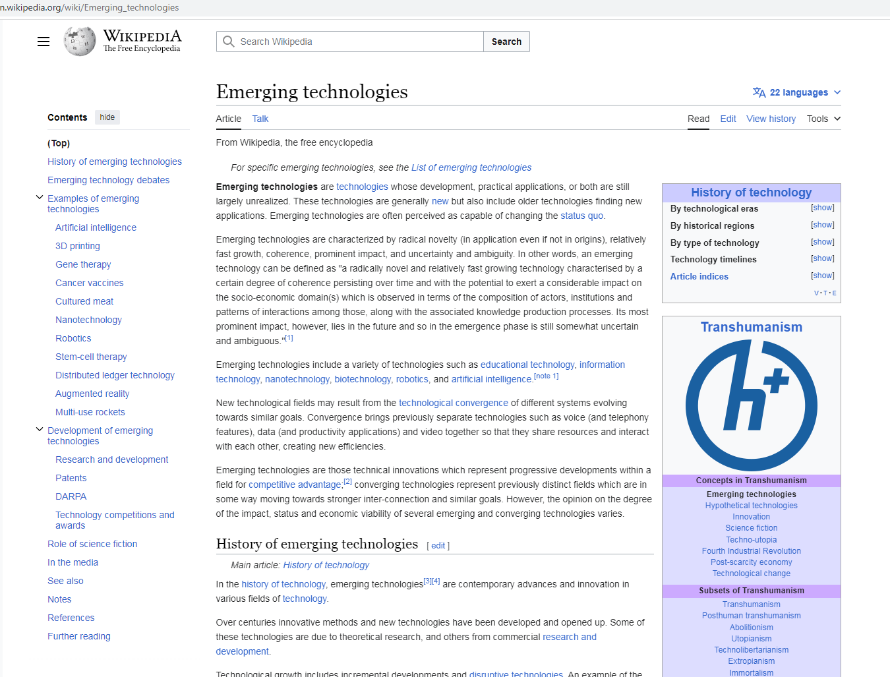
EMERGING TECHNOLOGIES IS TRANSHUMANISM
LOOK HOW THE CLASSIFY EXAMPLES OF TRANSHUMANISM
THEY BOAST ABOUT THIS…THEY ARE SO PROUD!!!
THIS IS CRYPTOCURRENTY
WWW.FTWPROJECT.COM

Slide 13

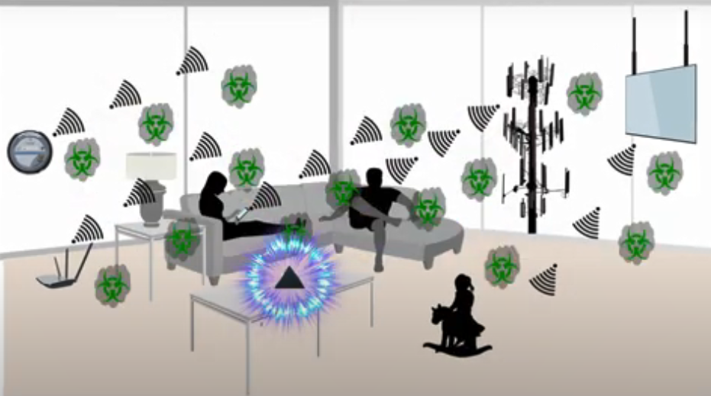
PROTECT YOURSELF FROM EMERGING TECHNOLOGIES BY PROTECTING YOURSELF FROM EMF
We make our products by hand mixing, shungite, iron oxide, steel, brass, and quartz crystal (powder form) into an epoxy resin. When the epoxy cures into a solid plastic state it puts pressure on the surface area of the ingredients. This causes something known as the piezoelectric effect, which emits a harmonizing field generated by the specific properties of the ingredients. It is this field that transforms the harmful energy from EMF’s into healthy life preserving energy. Place our products all around yourself and your environment for the best effect.
BENEFITS OF OUR EMF PROTECTION PRODUCTS
-Better sleep
-Stress relief
-Pain relief
-Healthy home environment
-Better seed germination and plant growth
-Preserves fresh food and extends shelf life
-Maintain Healthy Blood
Full length explanatory videos on our Website! FTWProject.com

Slide 14
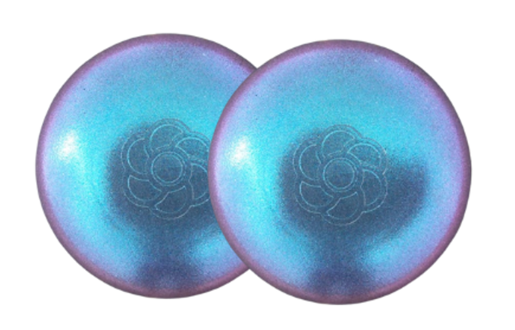

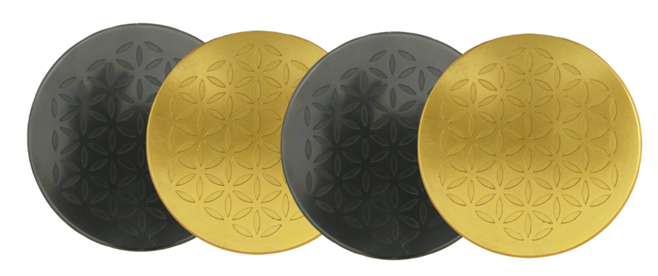
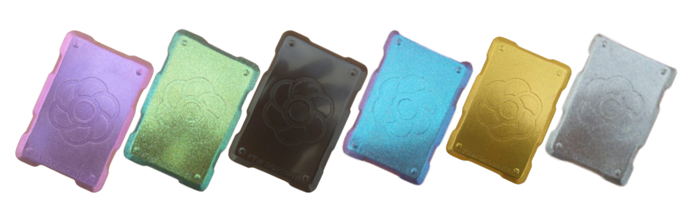
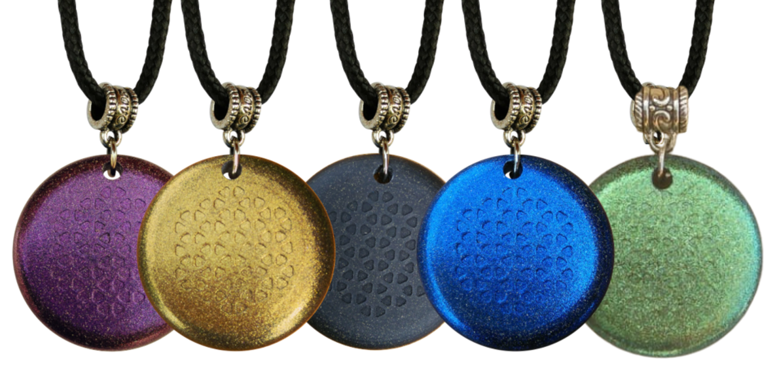
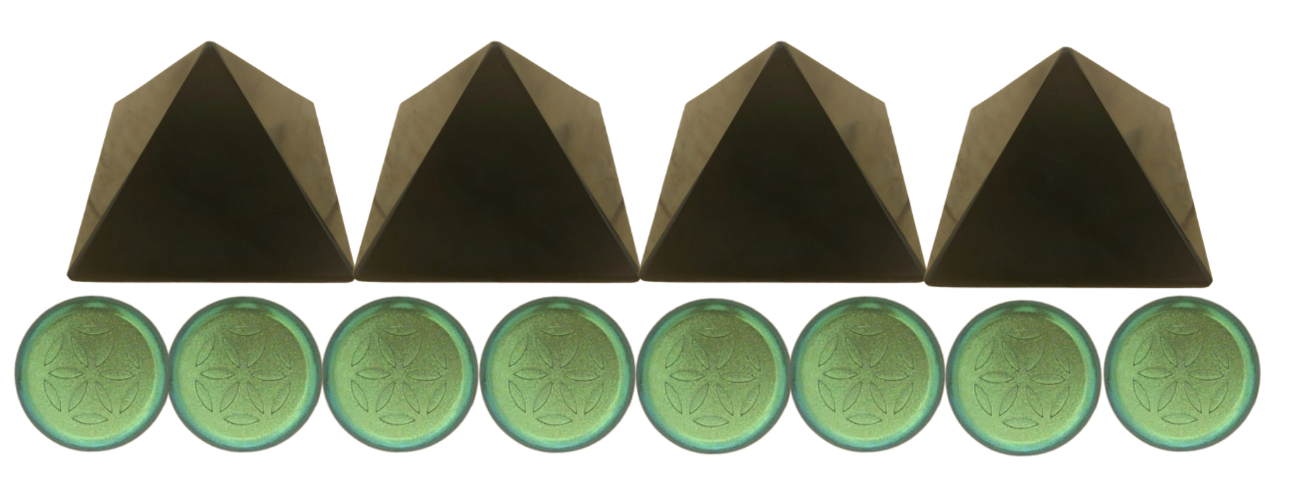

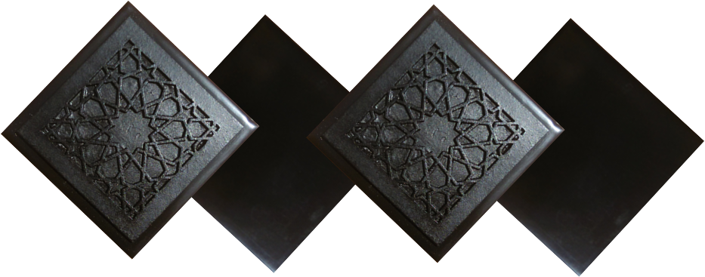
ABOUT OUR EMF PROTECTION PRODUCTS
SLEEPING PODS For a good nights sleep
Support Vaxxchoice By Shopping at this link: https://ftwproject.com/ref/493/
CHARGE PLATES for use around the home, to preserve food and more
“I carry my sleeping pod with me at all times in my front pocket, this and the pyramids are the only thing that have helped the targeting and stopped my heart palpitations.” -Connecticut
PHONE SHIELDS to put on your cell phone, laptop and routers
PENDANTS for personal emf protection on your body
PYRAMIDS and garden sets for gridding your home / property / garden for emf protection on a large scale
SCIENTIFIC STUDIES AND DOCUMENTATION DESCRIBING HOW OUR PRODUCTS WORK AVAILABLE ON OUR WEBSITE.
TILES for incorporating emf protection into construction projects
WWW.FTWPROJECT.COM

Slide 15


