Slide 2
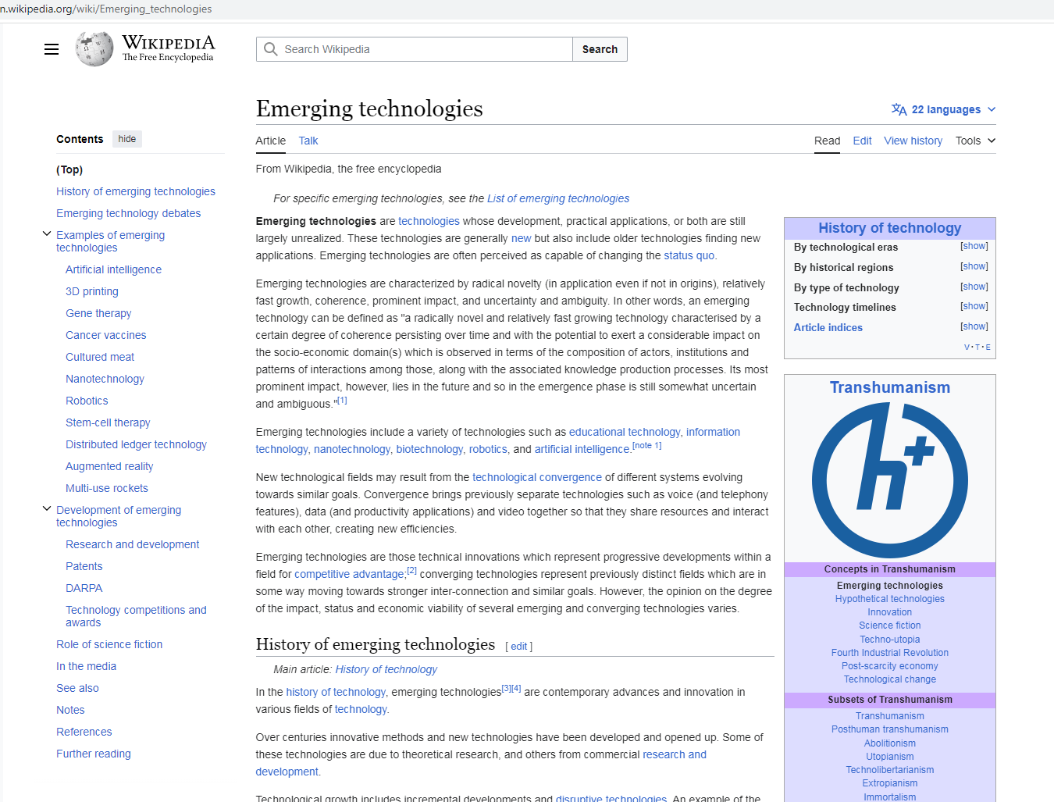
EMERGING TECHNOLOGIES IS TRANSHUMANISM
LOOK HOW THE CLASSIFY EXAMPLES OF TRANSHUMANISM
THEY BOAST ABOUT THIS…THEY ARE SO PROUD!!!
THIS IS CRYPTOCURRENTY
WWW.FTWPROJECT.COM

Slide 3
BACKGROUND SUMMARY= EMERGING TECHNOLOGY CONTROL GRID
They have established a control grid that consists of emerging technology (transhumanism) that connects human bodies to the internet and also to an autonomous weapons system. This is being done by a trillion dollar industry under the IEEE which is the Institute of Electrical and Electronics Engineers, with millions of engineers, scientists, chemists and biomedical engineers working over the decades that have published countless white papers documenting the advancement and deployment of these emerging technologies which have been deployed on humans without their knowledge or consent. This control grid overrides and violates every human right, every law, and every local government and constitution of every country in the world. It is what I believe the bible refers to as the beast in the end times.
WWW.FTWPROJECT.COM

Slide 4
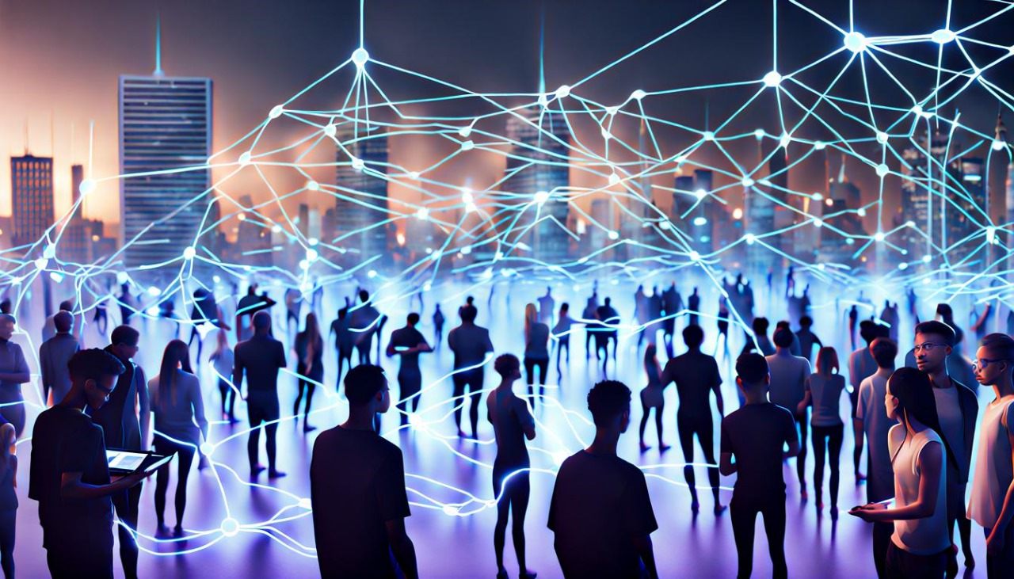
BACKGROUND SUMMARY= BIOFIELD, BIOSENSORS, WBAN
Our human bodies are electrical, its how God made us. Our hearts are electrical, our brains are electrical, human bodies are on the electromagnetic spectrum, the electrical field around the human body is called the biofield.
Knowledge of the biofield was taken away from humanity through the Flexnor report in 1910 and replaced with the Satanic medical industry created by John Rockfeller. The human biofield has been hijacked by the emerging technologies industry.
Since 1956 biosensors have been put into people’s bodies and their environment. Some of these biosensors are partially made up out of your DNA. They then use these biosensors to run computer networking through human bodies. This is called the wireless body area network (WBAN) which was created in 1995.
The WBAN uses various forms of nanotechnology to operate. The nano.gov website shows nanotechnology used by the wireless body area network going back to the 4th century. This is an ancient plan that goes back to the seed war in the bible.
WWW.FTWPROJECT.COM

Slide 5
The last 4 years of COVID have been a massive project to get everyone tracked and traced in their upgraded system. While this technology has been in development for decades, it wasn’t working well enough. They needed to upgrade the system to go from dialup to broadband on the entire network.
In 2017 the infrastructure for the upgraded system was laid out and all the emergent technology was put into place, the satellites went up at this time, the towers went up, and lots of small nano materials known as metamaterials were put into place. No one even noticed in the normal world. But in the industry everyone knew about it and hundreds of thousands of papers and technology patents were created around this new grid infrastructure. It was called the cyber physical backbone and it was what they considered to be the launch of the 4th industrial revolution.
They needed to increase the signal to make their tech work, so they graphenated the population through the covid injections. The graphene was the load balancing on the new upgraded system. Now their upgrade is complete and there are all sorts of things that they can do to people.
METAMATERIALS
Professor Ian Akyildiz is the leader in the industry when it comes to the creation of these metamaterials, known as Internet of Nanothings, Internet of Bionanothings, Internet of Space things, Internet of Bodies, Internet of Bahaviors etc.)
WWW.FTWPROJECT.COM

Slide 6
There is a pentagon directive updated in January of 2023 DOD Directive 3000.09 which means all systems are go now on the autonomous weapons system, which will be used on the public.
The Presidents 2023 budget requests nearly $2 Billion for the national nanotechnology Initiative, the largest ever request since its inception.
An executive order in September 2022 calls for advancing biotechnology and biomanufacturing innovation. This is what they are calling biodigital convergence.
They have used technology to create a prison system that has control over our bodies that is hooked up to an electronic warfare system.
WWW.FTWPROJECT.COM

Slide 7
The Wireless Body Area Network is how they access your human body to transmit and receive data. This network also uses your body’s electricity to power its nanotech and transmissions. They are using the WBAN to make cryptocurrency from your body’s energy. In the following slides we will show you how.
“GREEN ENERGY” IS SOYLENT GREEN ENERGY: ENERGY HARVESTING YOUR BODY TO RUN A TERAHERTZ NETWORK “Nanoscale wireless networks are expected to revolutionize a variety of domains, with significant advances conceivable in in-body healthcare. In healthcare, these nanonetworks will consist of energy-harvesting nanodevices passively flowing through the bloodstream, taking actions at certain locations, and communicating results to more powerful Body Area Network (BAN) nodes. From Paper Below.
WWW.FTWPROJECT.COM

Slide 8
BASIC COMPUTER NETWORKING OSI MODEL AND CRYPTOCURRENCY
To simplify, the way cryptocurrency is made: A building full of computers using electricity to power those computers has those computers solve very complex math equations at the fastest speed they can. When they solve an equation it results in a token. This is their form of money. They claim the money is highly encryted and decentralized and that no government authority is controlling it.
In ALL COMPUTER NETWORKING utilized by everyone you have an Open Systems Interconnection System (OSI Model), this is how you route all data through a computer network. If you didn’t use this OSI model then your data wouldn’t route. This model has seven layers.
WWW.FTWPROJECT.COM

Slide 9
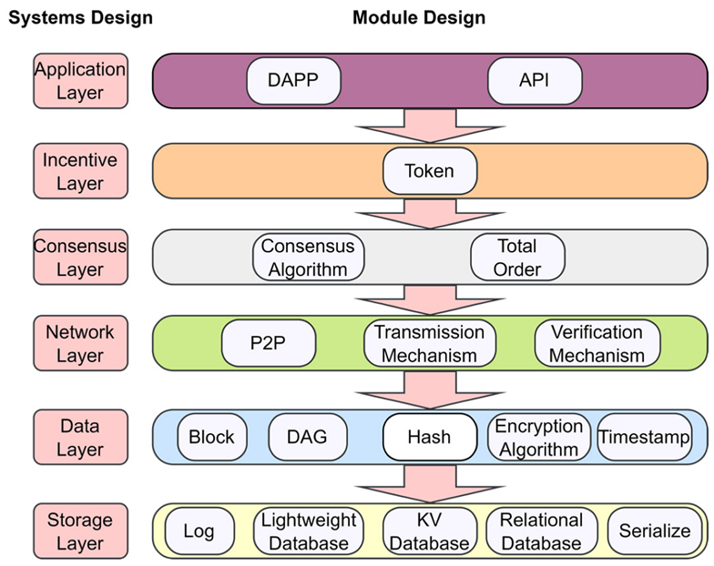
BLOCKCHAIN LAYERS
Software developers who are working in the blockchain will be doing things like: Proof of stake protocols, or consensus mechanisms, or different ways of trading tokens or gaining blockchain viability. They do these things in one of the layers of the Blockchain Model. Here are the layers of the blockchain model that cross over into the layers of the OSI model, because they have to if they are running any kind of routing through any computer network.
All the consensus work done on blockchain cryptocurrencies is done through Peer to Peer Networking. The consensus layer of blockchain HAS to use Peer to Peer in order to verify itself. The peer to peer layer uses the first two layers of the OSI, which is the physical layer (meaning your body in this case) and the data layer, (remember they use DNA for its storage capabilities) In fact the majority of the work (all the encryption mechanism for cryptocurrencies) is done at the physical and data layer. The work for this is done through ubiquitous computing, which is a computer science term that refers to computing that is done on any device, in any location in any format.. in contrast to desktop computing. Ubiquitous computing is also where your artificial intelligence is operating.
THE WBAN RUNS ON THE 1ST AND 2ND LAYERS OF THE OSI -physical layer and data layers
WWW.FTWPROJECT.COM

Slide 10
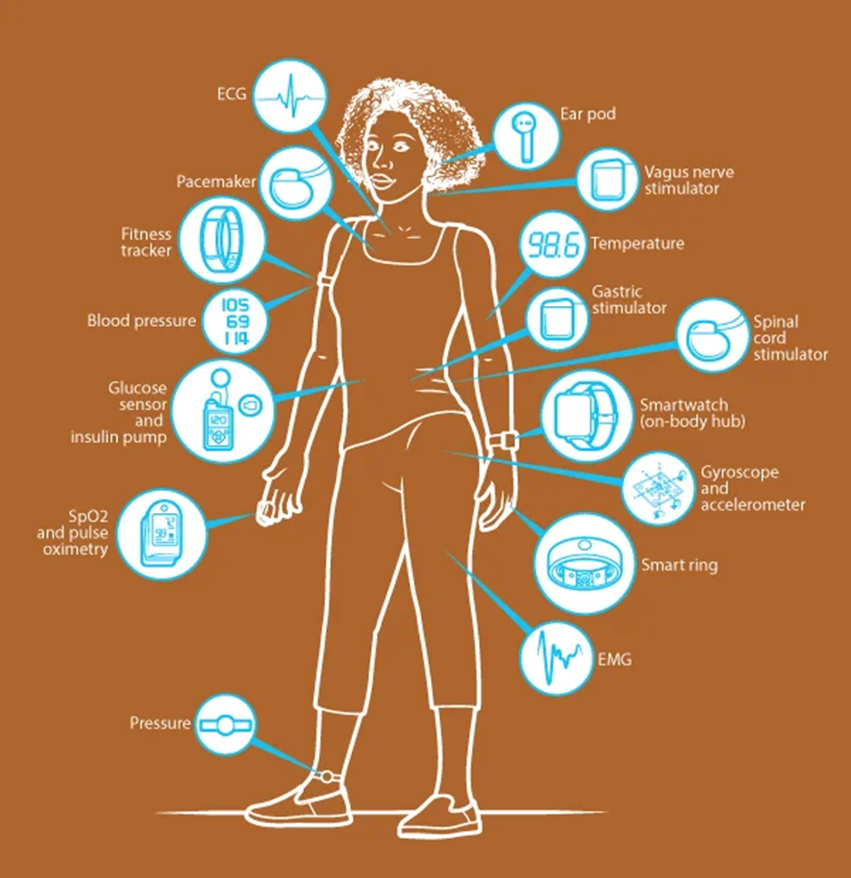
Any time you are using peer to peer networking, it uses the data and physical layers of networking, which is where the human body is. Blockchain is using peoples physical bodies to transmit data on a wireless body area network. These are all computer networks. Blockchain is biomimetic, meaning it is using a biological system (our bodies) as models for the design of materials and machines. Blockchain encryption is done through computer networking which is going through your body. The reason why they want intrabody galvanic only blockchain (using the electricity generated by human bodies) is because of cyber-security. It is not easily hacked. Also because they are using human bodies as a free energy source to power their crypto mining. No more buildings with computers.
WWW.FTWPROJECT.COM

Slide 11
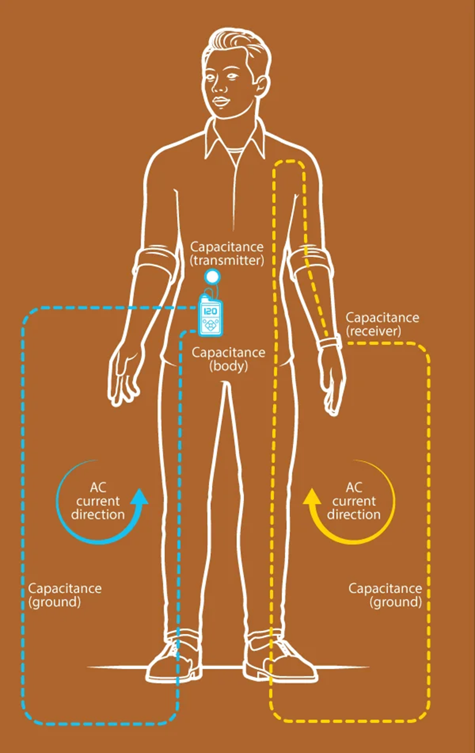
“Through our research at Purdue University, we have developed a new method of communication that will keep medical devices, wearables, and any other devices on or near the body more secure than they are using low-power wireless signals to communicate with one another. The system capitalizes on the human body's innate ability to conduct tiny, harmless electrical signals to turn the entire body into a wired communication channel. By turning the body into the network, we will make IoB devices more secure. Using the body as the communications channel for IoB devices avoids the fundamental problem with radiative technologies like Wi-Fi and BLUETOOTH by keeping the electrical signals under the skin.
Because we've developed a system that is low loss at low frequencies, we can send information between devices using far less power.”
(November 2020 Article) IEEE spectrum NOTE: SOMEONE HAS THE KEYS TO ALL THESE NETWORKS AND BLUETOOTH CODES. = AUTONOMOUS WEAPONS SYSTEM?
WWW.FTWPROJECT.COM

Slide 12
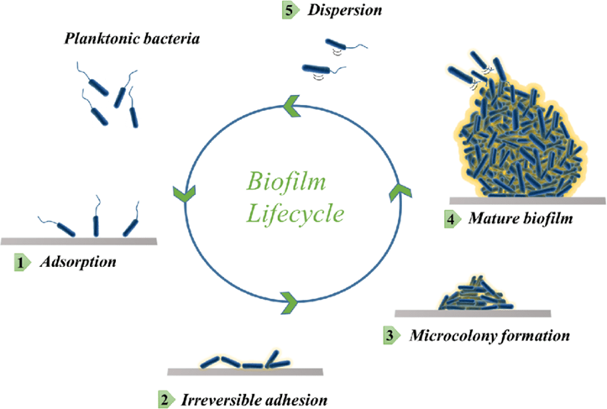
Is weaponized bacteria being used to usher in Transhumanism?
(Zeee Media interview: “Dr. David Nixon & Karl C. – New Nanotechnology Findings Will SHOCK the World!”)
Is genetically modified, altered, and patented biofilm the workhorse of the Synthetic Biology and 4th Industrial Revolution?
Biofilms are ubiquitous communities of tightly associated bacterium, parasites and/or fungus encased in an extracellular, growing, self-replicating matrix. It is created by, protects and sustains the colony. It is thousands of times more difficult to destroy pathogens in biofilm than in free-floating fluid. All of this has been synthesized and weaponized!
WWW.FTWPROJECT.COM

Slide 13
Is weaponized bacteria being used to usher in Transhumanism?
WWW.FTWPROJECT.COM

Slide 14
Is weaponized bacteria being used to usher in Transhumanism?
- Bacteria can survive in harsh environments by changing its morphology and forming biofilms
- Bacterias (i.e. Geobacter and Shewanella oneidensis ) create conductive ‘nano-wire’ networks from their cell membrane that can span through and far beyond the biofilm layers.
- E.coli can be instructed organize self-assembling amyloid-based materials and gold nanoparticles either by external control or ‘autonomous patterning’.
- Such bacteria can be programmed to assemble structures from gold particles
- Bacteria nanowires grown in an electric field have 1000 time higher electrical conductivity than ambient. Such wires can take turn mechanical and chemical signals into detectable electrical signals
- “Bacillus subtilis is the workhorse in industrial biotechnology and well known for its secretion potiental. Efficient secretion of recombinant proteins still requires extensive optimization campaigns and screening with activity-based methods”
- Various species of cells and bacteria and attracted to biofilms through Electrical Signaling
WWW.FTWPROJECT.COM

Slide 15
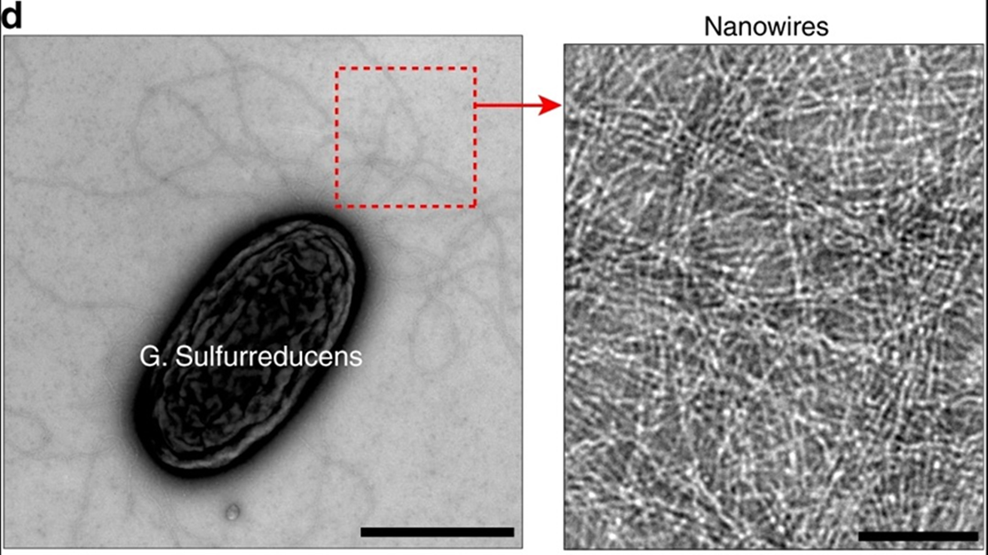
BASIC COMPUTER NETWORKING BLOCKCHAIN MODEL AND OSI MODEL OVERLAP
WWW.FTWPROJECT.COM

Slide 16
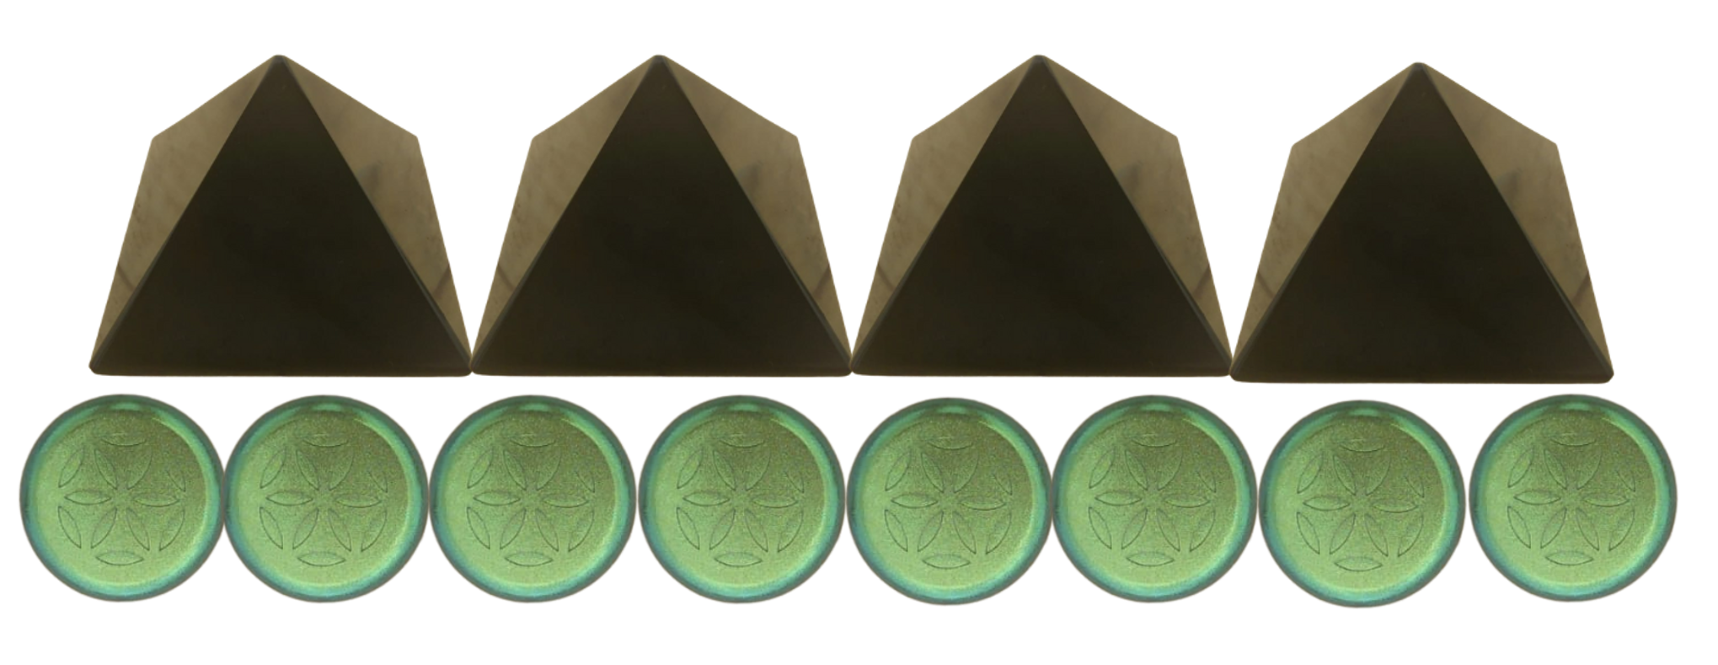
FIGHTING EVIL TECH WITH GOOD TECH ON THE SAME TECH LEVEL
We make products by hand here for EMF protection. These products are based on orgone energy, which is a healthy life preserving energy field generated by a composite of metal powders mixed in an epoxy resin. The end result is something called orgonite. Orgonite uses piezoelectricity, surface area, morphogenetic fields, and backscatter to preserve energy. It can also help fight back against the bad tech.
Piezoelectric
Back Scatter
THEIR TECH
OUR TECH
Morphogenetic Field
Surface Area
WWW.FTWPROJECT.COM

Slide 17
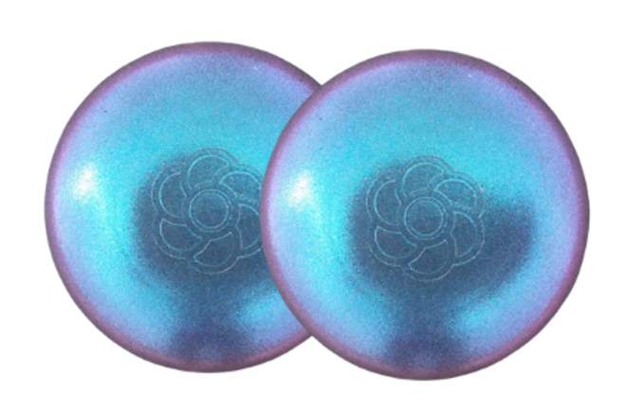
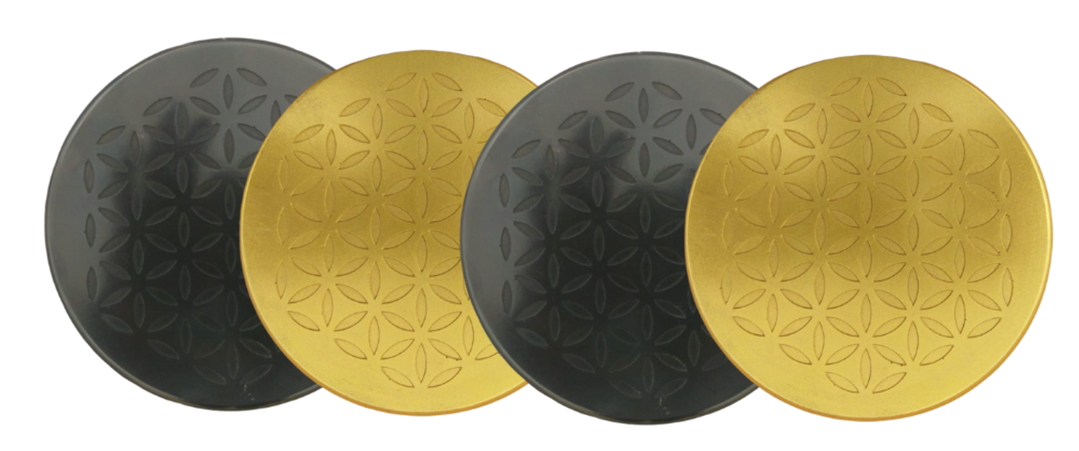
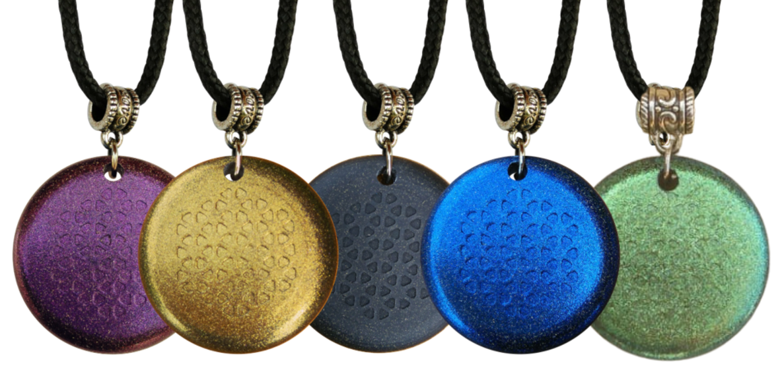
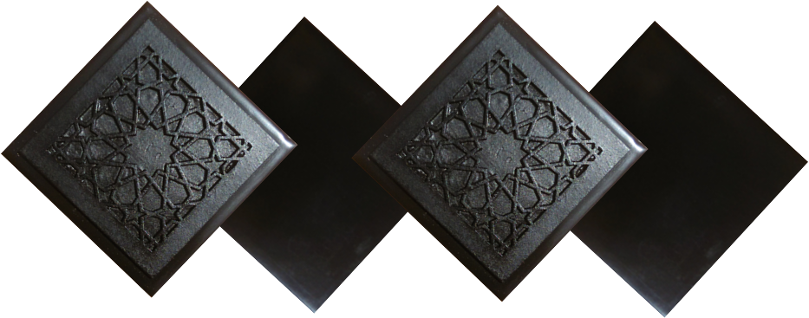
ABOUT OUR EMF PROTECTION PRODUCTS
SLEEPING PODS For a good nights sleep
Support Vaxxchoice By Shopping at this link: https://ftwproject.com/ref/493/
CHARGE PLATES for use around the home, to preserve food and more
“I carry my sleeping pod with me at all times in my front pocket, this and the pyramids are the only thing that have helped the targeting and stopped my heart palpitations.” -Connecticut
PHONE SHIELDS to put on your cell phone, laptop and routers
PENDANTS for personal emf protection on your body
PYRAMIDS and garden sets for gridding your home / property / garden for emf protection on a large scale
SCIENTIFIC STUDIES AND DOCUMENTATION DESCRIBING HOW OUR PRODUCTS WORK AVAILABLE ON OUR WEBSITE.
TILES for incorporating emf protection into construction projects
WWW.FTWPROJECT.COM

