Slide 1

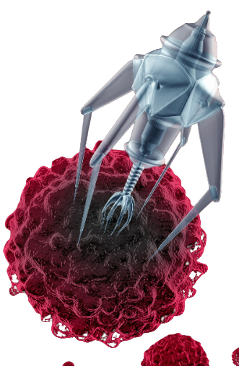




COVID TRUTH EDUCATIONAL SERIES
HOPEGIRLBLOG.COM
FTWPROJECT.COM

Slide 2
COVID TRUTH EDUCATIONAL SERIES
This video is one of several videos we are calling the COVID Truth Educational Series. It has been put together in a step by step educational format. The purpose of these videos is to help clear up the confusion of the lies that have been told to the public through the COVID agenda. We believe that educating people about the truth of what was done to the human population through COVID is the best defense humanity has against this ever happening again, and those who planned COVID are definitely planning to do something again in the near future.
This video is meant to be free and uninterrupted. It is put together as a public service by FTWProject.com We are Engineers, Scientists and Researchers that run a handmade EMF protection products business. We are also Authors of the Book “Forbidden Tech The Complete Guide To Energy, Social, And Biological Technologies That They Did Not Want You To Know About”
We Hope You Benefit From this Presentation and Share it / Mirror It To Help Spread The Word.
HOPEGIRLBLOG.COM
FTWPROJECT.COM

Slide 3




This Video Contains The combined research of:
Karen Kingston
Hope and Tivon FTWProject
Dr. Ana Maria Mihalcea
Dr. Ana Maria Mihalcea, MD, PhD
Dr. Ana’s thoughts about health and the plandemic Award Winning Author “Light Medicine-A New Paradigm- The Science of Light, Spirit and Longevity
Forbidden Tech
Engineers, scientists and researchers. Authors of Forbidden Tech, the complete guide to Energy, social, And Biological Technologies That They Did Not Want You To Know About.
HOPEGIRLBLOG.COM
FTWPROJECT.COM

Slide 4

The Kingston Report
An evidence-based, med-legal analysis of mRNA technologies and the dangers of the rapidly growing synthetic biology industry.
The governments and pharma companies lied to the public. They used nomenclature to change the names of things in the Covid 19 vaccines to make people believe they were being injected with something that was biological that was going to help their immune system and fight off the coronavirus.
The components that are in the vaccines are not biological, they are advanced nano technology that fuse with your body’s cells and create new biosynthetic lifeforms in your body.
A lot of this research comes from the ground breaking work of Karen Kingston. We are founding members of her sub stack and highly suggest others to follow her work.
WWW.FTWPROJECT.COM

Slide 5
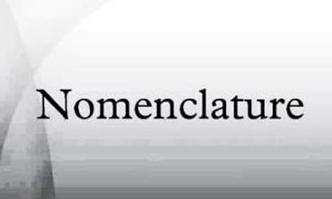


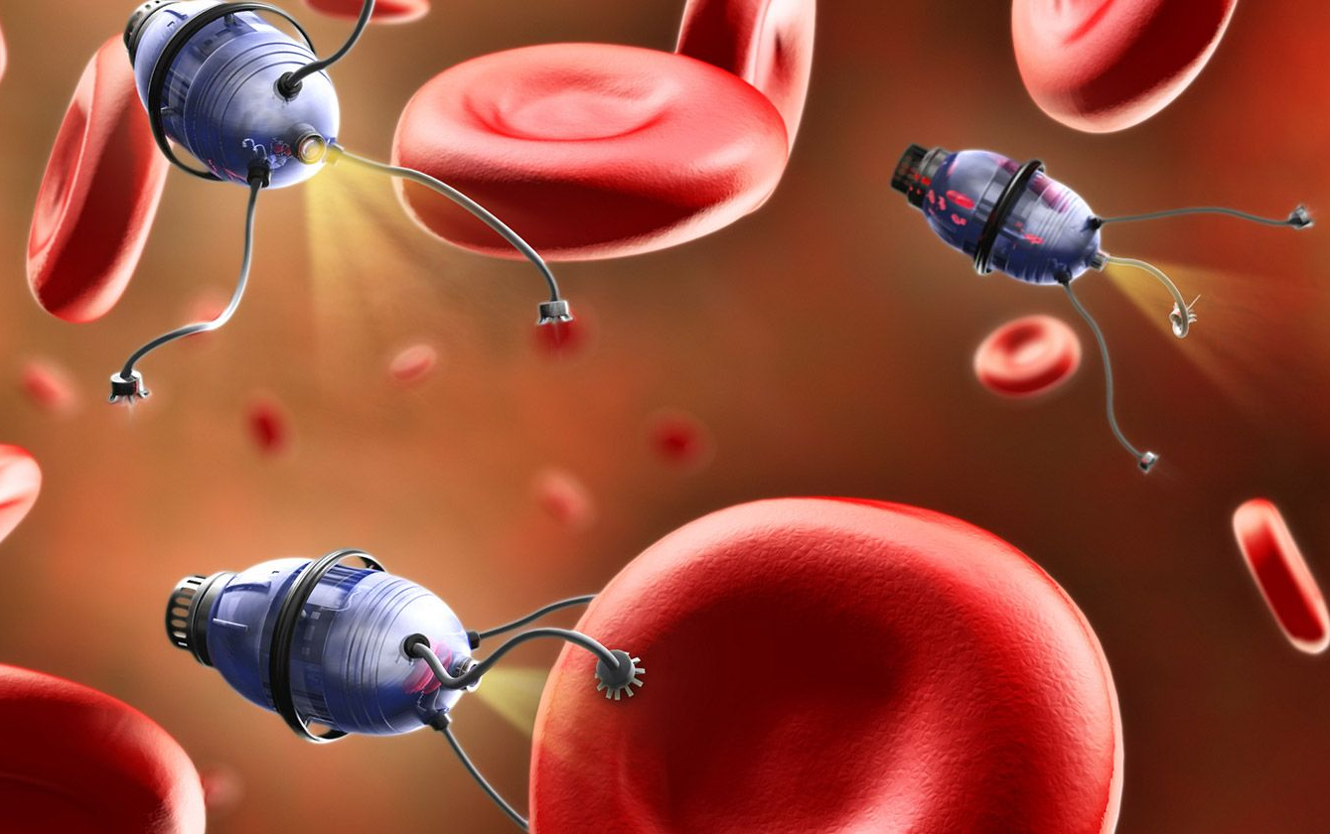

Here are the words they changed to deceive the public
MRNA IS SOFTWARE
What mRNA really is, is a software program. The mRNA are the instructions or computer codes that program the lipid nanoparticles. The mRNA injections do not contain a biological virus or portion of a biological virus. There is truly nothing about Pfizer’s mRNA technology that meets the FDA’s definition of a vaccine.
SEQUENCES ARE COMPUTER GENERATED PROGRAMMING
When Pfizer refers to mRNA, they are referring to the computer generated genetic sequences that can program a human cell to produce viruses, spike proteins, CANCERS, or nearly anything. Per Pfizer’s FDA approval application, they used the computer generated Wuhan code in the Covid Vaccines. All sequences are ordered from a company called Sino Biological which is headquartered in Beijing China. Sino Biological manufacturers and sells over 280+ SARS-CoV-2 mRNA variants.
“SPIKE PROTEINS” ARE LIPID NANOPARTICLE TECHNOLOGY BIOWEAPONS
What they call “spike proteins” are actually the result of lipid nanoparticle technology destroying your cells. When you take a magnetic hydrogel and you infect a biological cell you can see that the cell is covered with all of these little spikes. This is what they are calling the spike protein. Your not infected with a virus, your infected with nanolipid particle technology that then reprograms that cell to give off these bio synthetic toxins in your body.
“LIPIDS” ARE NANOTECHNOLOGY
What they are calling “Lipids” are actually self assembling nanoparticle technology that is fully programmable. These “lipids” have a cationic charge you don’t find that in nature.
THEY CHANGED THE WORDS TO FOOL THE PUBLIC
In the early publications (2008) the mRNA ‘vaccine’ technology was just called ‘nanoparticles’ or was appropriately labeled as cationic polymers. The blanket application of the term ‘lipid’ was applied before nanoparticle to make the technology more appealing to the masses
WWW.FTWPROJECT.COM

Slide 6
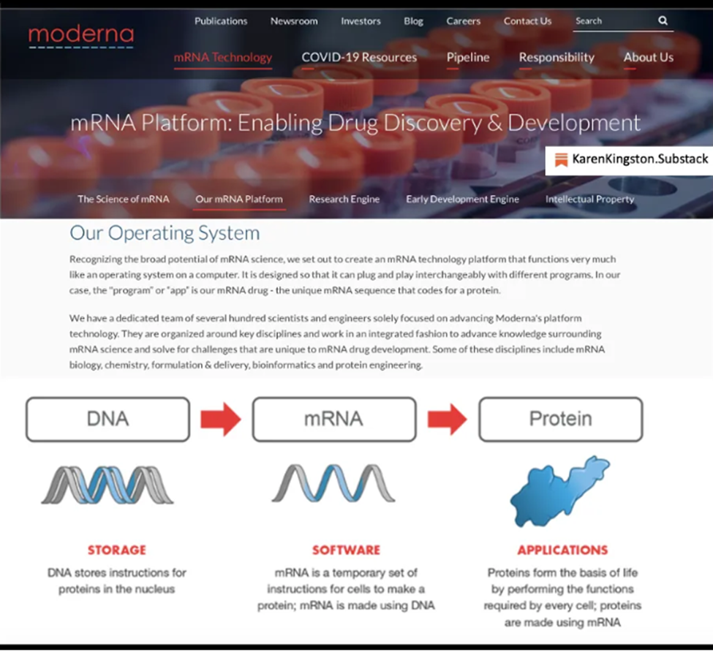
HOPEGIRLBLOG.COM
FTWPROJECT.COM

Slide 7
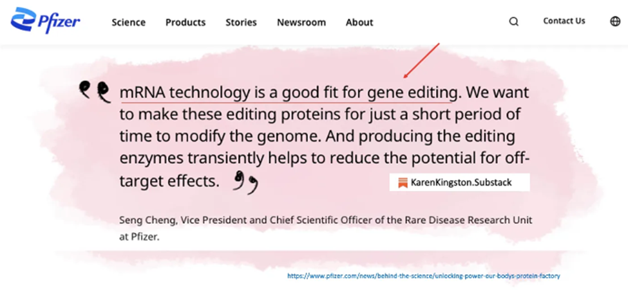
HOPEGIRLBLOG.COM
FTWPROJECT.COM

Slide 8
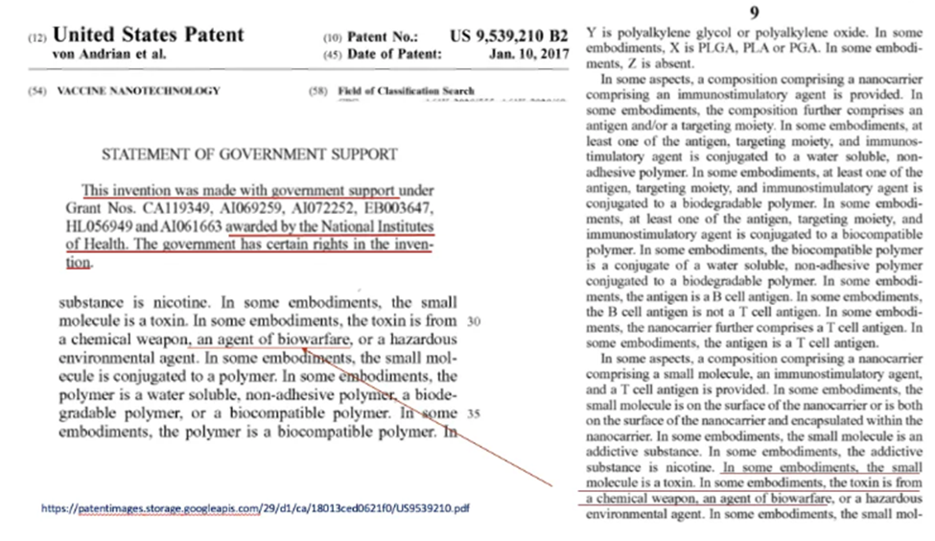
HOPEGIRLBLOG.COM
FTWPROJECT.COM

Slide 9
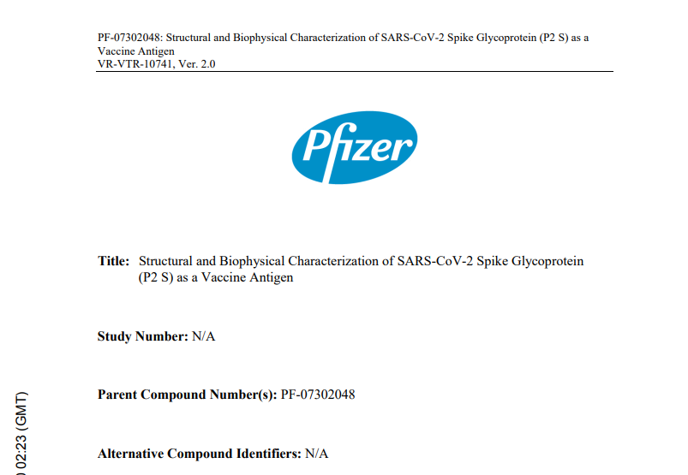
HOPEGIRLBLOG.COM
FTWPROJECT.COM

Slide 10
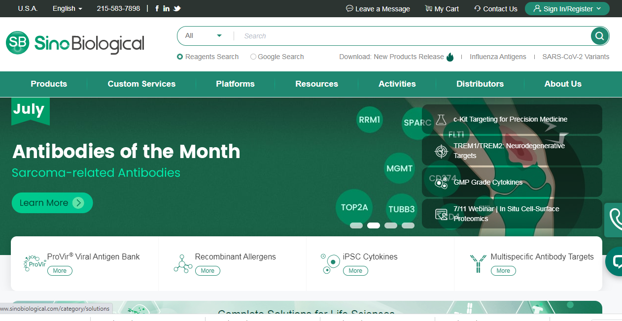
HOPEGIRLBLOG.COM
FTWPROJECT.COM

Slide 11
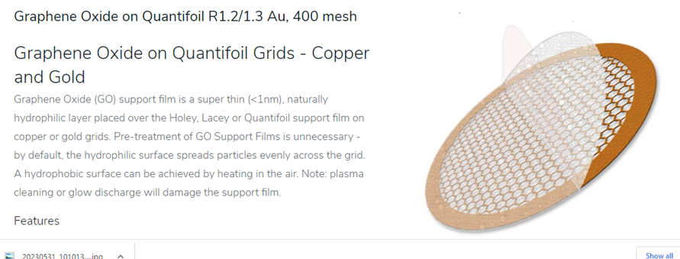
HOPEGIRLBLOG.COM
FTWPROJECT.COM

Slide 12
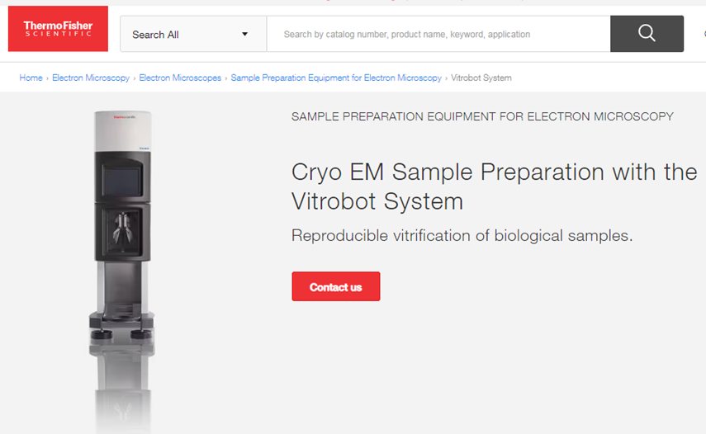
HOPEGIRLBLOG.COM
FTWPROJECT.COM

Slide 13
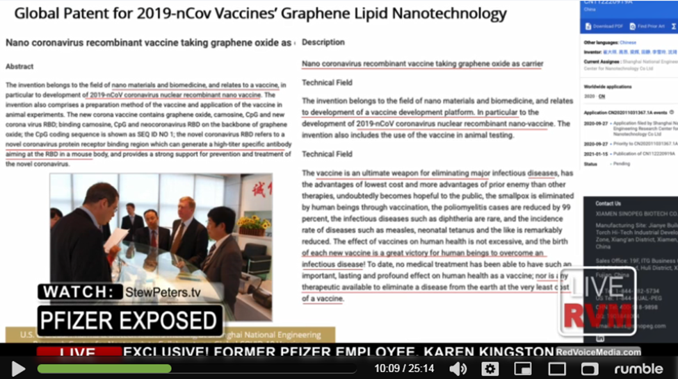
HOPEGIRLBLOG.COM
FTWPROJECT.COM

Slide 14
The production of almost everything, especially advanced technology products, especially vaccine excipients, is OUTSOURCED to China. This is because China is one of the few places in the world that has the high tech infrastructure, manufacturing capabilities and workforce to produce certain kinds of products on a mass scale. A global patent for an invention is given to the manufacturers in china who mass produce the invention. Then independent companies have the manufacturer put their own label on it so they can sell it as their brand.
ALL THE COVID INJECTIONS CAME FROM THE SAME BASE EXCIPIENT FORMULA WITH PERHAPS A SMALL CUSTOMIZATION FOR EACH DIFFERENT BRAND. (PFIZER, MODERNA, ASTRAZENECA,SINOPHARM, SPUTNIK, ETC)
HOPEGIRLBLOG.COM
FTWPROJECT.COM

Slide 15
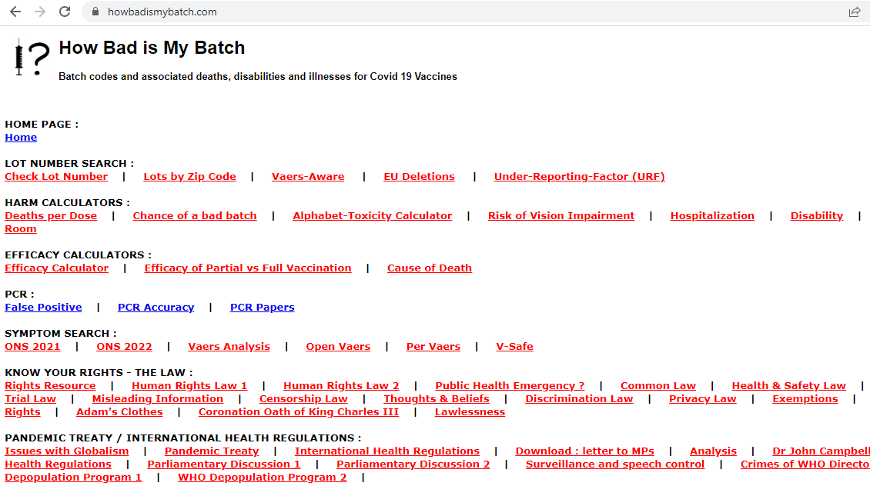
HOPEGIRLBLOG.COM
FTWPROJECT.COM

Slide 16
PEOPLE ARE BECOMING HOSTS TO ELECTROMAGENTIC FIELDS
Graphene oxide is a great conductor of electromagnetic fields. When it is merged with the bio synthetic spike proteins it creates new synthetic agents called transducers.
A transducer is a device that converts energy from one form to another. Usually a transducer converts a signal in one form of energy to a signal in another. Transducers are often employed at the boundaries of automation, measurement, and control systems, where electrical signals are converted to and from other physical quantities (energy, force, torque, light, motion, position, etc.).
This is happening inside the bodies of people who have taken these injections. These transducers are changing the electromagnetic field inside the body and now peoples bodies are becoming hosts to different kinds of un-natural electromagnetic fields. This is why people are becoming magnetic and are able to emit blue tooth codes.
HOPEGIRLBLOG.COM
FTWPROJECT.COM

Slide 17

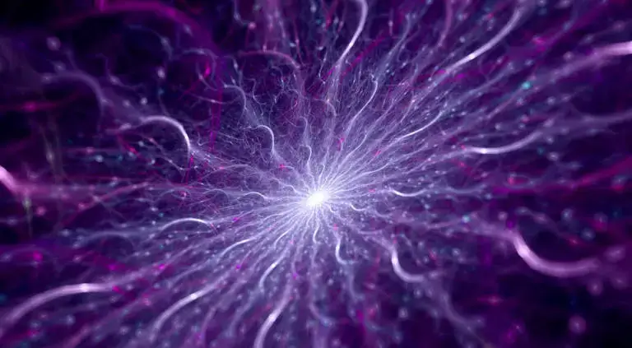
THIS NANOTECHNOLOGY IS PROGRAMMED TO MANIPULATE THE ELECTRICAL BALANCE IN YOUR BODY
The term “cationic” is an ion or group of ions that have a positive charge that migrates towards the negative electrodes.
HOPEGIRLBLOG.COM
FTWPROJECT.COM

Slide 18
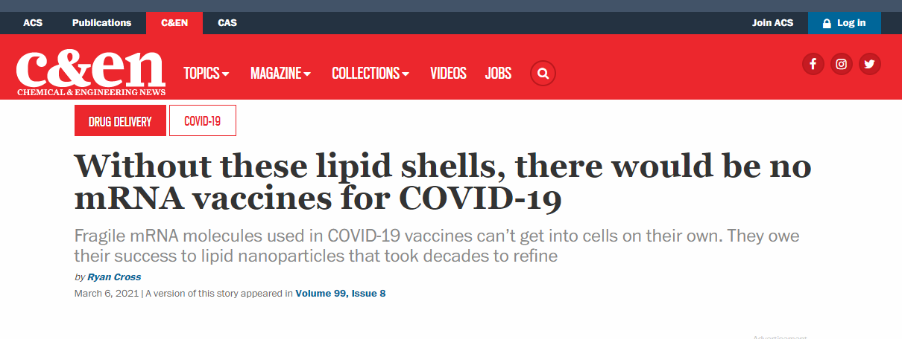
HOPEGIRLBLOG.COM
FTWPROJECT.COM

Slide 19
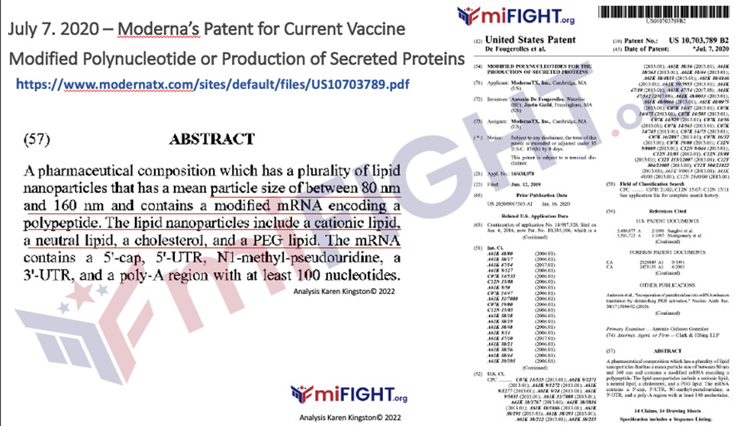
HOPEGIRLBLOG.COM
FTWPROJECT.COM

Slide 20
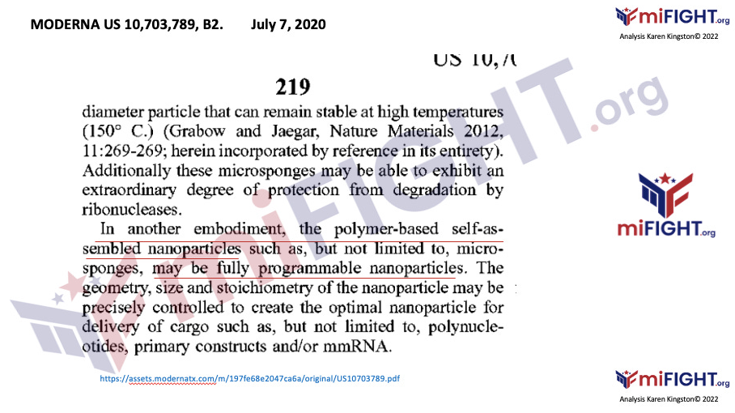
HOPEGIRLBLOG.COM
FTWPROJECT.COM

Slide 21
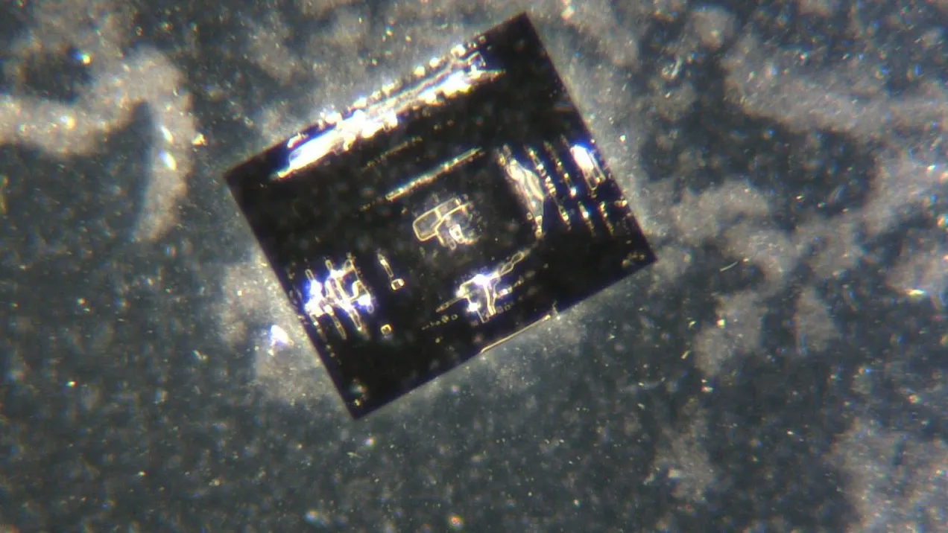
TREATING THE BODY FOR THE ILLNESS CAUSED BY THIS NANOTECHNOLOGY
THE WORK OF DR. ANA MARIA MIHALCEA
Scientists around the globe are starting to take a look at what's under the microscope. Pioneered by Dr. Ana Maria Mihalcea, MD PhD Vaccine Microscopy. Her and her colleagues have found electromagnetic devices under the microscope and they have seen the technology self-assemble. Engineers have brought in cell phones to see if there is a reaction. What they found is that when the fluid that is in the vials is near electromagnetic frequencies from smart phones, wifi etc, it activates this technology.
Dr. Ana’s substack: https://substack.com/@anamihalceamdphd
Dr. David Nixon Nanotech Found in Pfizer Vials
HOPEGIRLBLOG.COM
FTWPROJECT.COM

Slide 22
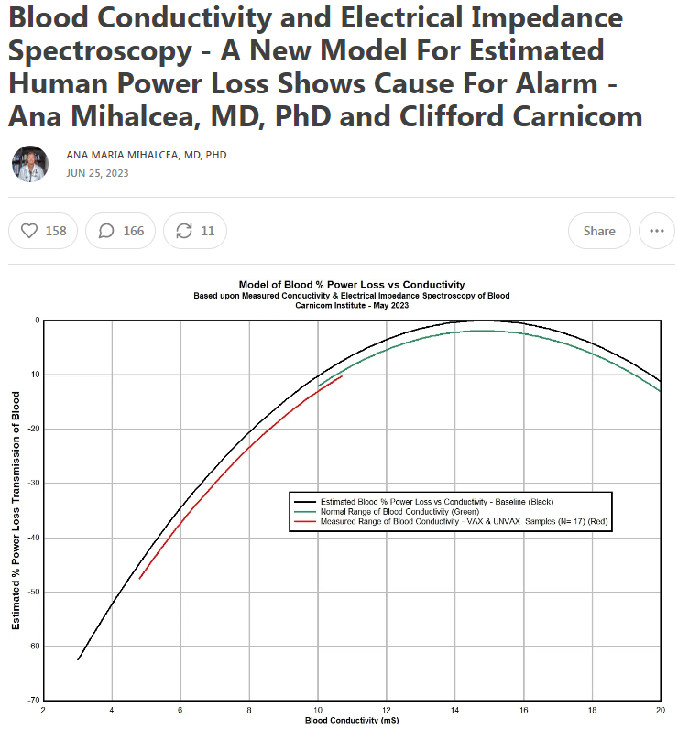
The Covid Injections contain “cationic lipids” which are synthetic components that do not exist in nature. These cationic lipids host a positive charge (bad for your health) that migrates towards negative electrons (good for your health).
What this means is that this nanotech is literally sucking the life force out of you. And the creation of this electromagnetic field is probably effecting other people around you even if they are not injected. This explains the “shedding” or transmission of symptoms to the unvaccinated.
Furthermore, these cationic lipid nanoparticles are self assembling and fully programmable from an outside source.
Dr. Ana Mihalcea and Clifford Carnicom have done electrical impedance spectroscopy testing to show the loss of human power caused by the nanotech in these shots.
They found that the power loss is commonly estimated on the order of 25-40%, and is as low as 47%.
Almost 50% of your life force energy is taken from you by this nanotech!
WWW.FTWPROJECT.COM

Slide 23
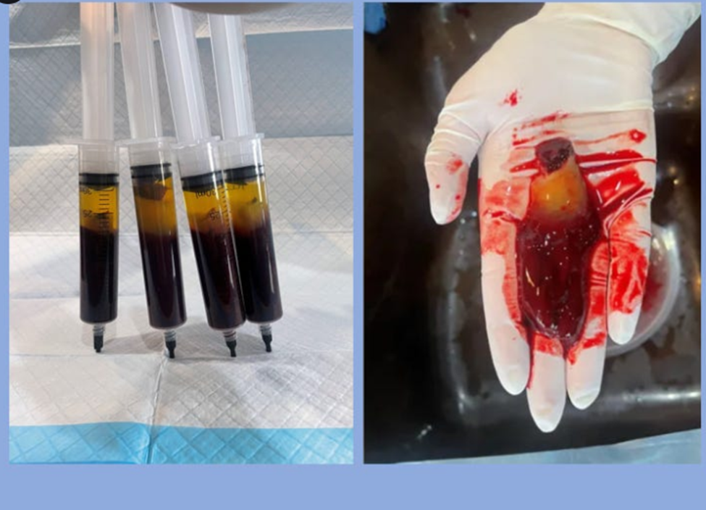
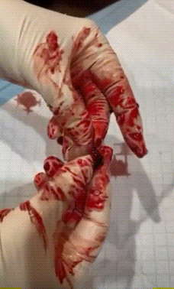
Hydrogel seen in the blood Tests run by Dr. Ana Mihalcea
Peoples blood looks like sludge or jello and cannot transport oxygen, it is filled with nanotech. Dr. Ana took blood from three vaccinated patients and let it sit in a tube for 4 hours. The blood separated on its own and a rubbery yellow hydrogel plastic formed on the top. Dr. Ana calls the hydrogel programmable plastics, because that’s what hydrogel essentially is. The hydrogel plastics in the blood cannot be dissolved by conventional blood thinners.
EDTA Chelation is the only thing so far that has been shown to break down the hydrogels to remove them from the body.
Video shows stretchy rubber band like texture of the hydrogel in blood.
WWW.FTWPROJECT.COM

Slide 24
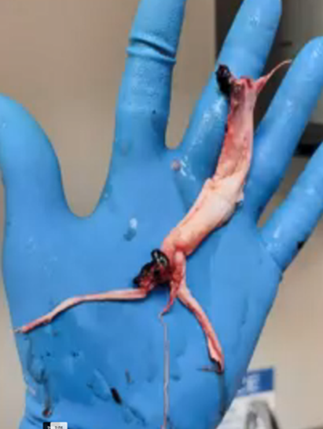
In addition to this, the hydrogels in the shots are also creating biosynthetic structures in the body that take the form of veins and arteries. Many of these structures that have never been seen before in nature have been pulled out of the bodies of vaccinated deceased by embalmers. We’ve done a separate video that walks you through how these structures were formed by the shots.
HOPEGIRLBLOG.COM
FTWPROJECT.COM

Slide 25
QUANTUM DOT TECHNOLOGY IN THE INJECTIONS IS WHAT ENABLES HIGHER FREQUENCY (EMF) COMMUNICATION FROM INJECTED HUMAN BODIES. BLUETOOTH AND QUANTUM FIELD FREQUENCIES
Under the same Intellectual property of this patent, is another patent for water dispersible- semi-conductive metallic nanoparticles, this is also called quantum dot technology.
You may have heard of Luciferase being used in the injections, Quantum dot technology and Luciferase are basically the same thing. Here we will expand more on what quantum dot technology is and what it can do.
HOPEGIRLBLOG.COM
FTWPROJECT.COM

Slide 26
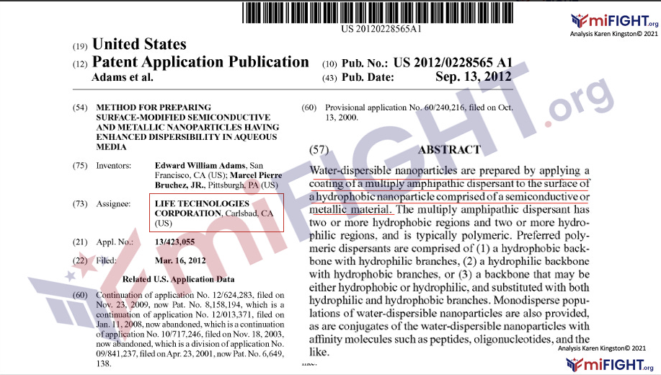
HOPEGIRLBLOG.COM
FTWPROJECT.COM

Slide 27
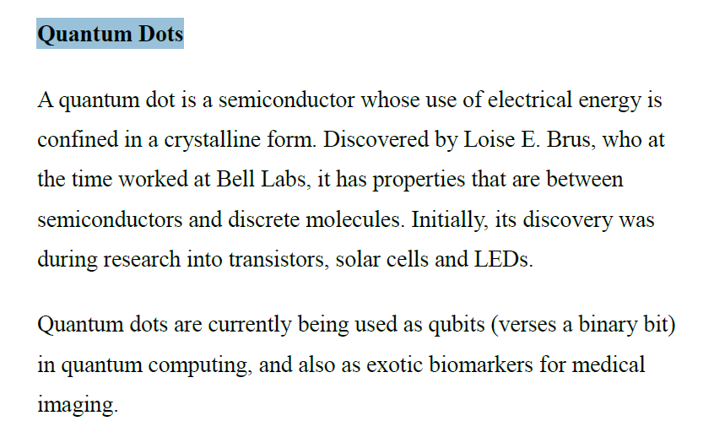
From Forbidden Tech
HOPEGIRLBLOG.COM
FTWPROJECT.COM

Slide 28
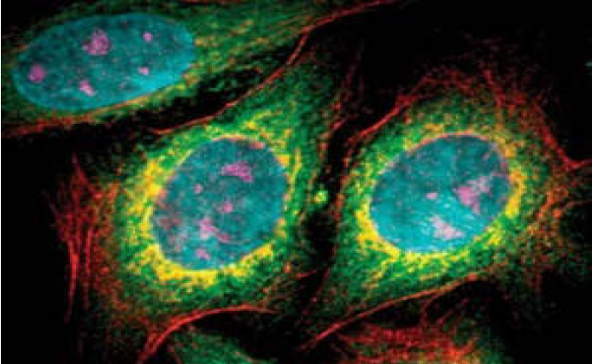
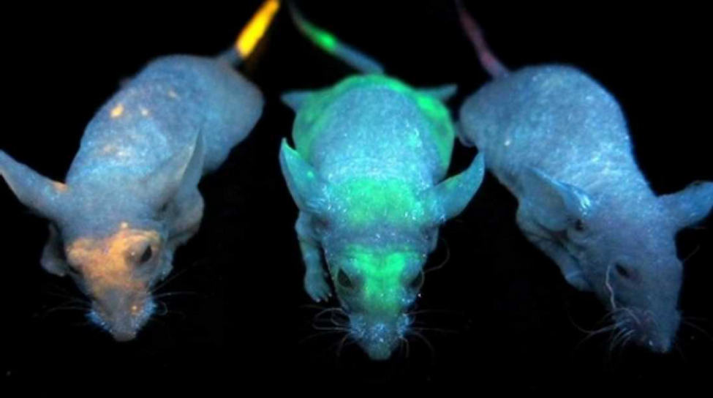
Lab mice injected with quantum dots in University of Toronto Experiment.
Noted: the quantum dots can be programmed to accumulate in specific areas of the body- such as your right hand or your forehead Mark of the beast
Fabricated Quantum dots in laboratory
HOPEGIRLBLOG.COM
FTWPROJECT.COM

Slide 29
What are quantum dots?
Quantum dots (QDs) are man-made nanoscale crystals that exhibit unique optical and electronic properties, including the ability to transport electrons and emit light of various colors when exposed to UV light. These artificially synthesized semiconductor nanoparticles have a wide range of potential applications, including use in composites, solar cells, fluorescent biological labeling, displays, lighting, and medical imaging.
https://www.nanowerk.com/what_are_quantum_dots.php
HOPEGIRLBLOG.COM
FTWPROJECT.COM

Slide 30
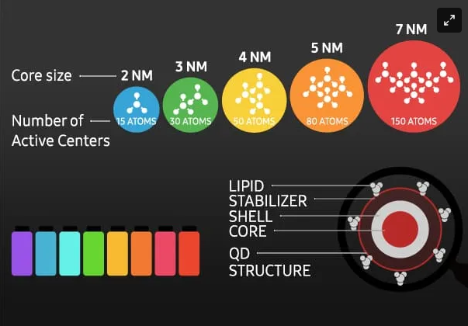
QUANTUM DOT TECHNOLOGY IN THE INJECTIONS IS WHAT ENABLES HIGHER FREQUENCY (EMF) COMMUNICATION FROM INJECTED HUMAN BODIES. BLUETOOTH AND QUANTUM FIELD FREQUENCIES
The electromagnetic fields and frequencies emitted by quantum dots can cause emotional, psychological, and physical disease and dysfunction in our bodies. Quantum dots can be used as neuroweapons and can cause severe disruptions to your emotions, energy, physical abilities and your ability to think straight (brain fog).
From the patents: quantum dot’s functionality is based on the quantum mechanics of the Bohr particle. Due to quantum mechanics, quantum dots that have been injected into humans by means of the COVID-19 bioweapons and can quite literally appear within the human body based on specific electromagnetic frequencies (EMF) or disappear based on specific frequencies.
Quantum dots respond to high- and short- frequencies that emit blue light. At these higher frequencies, the quantum dots reduce in size enabling them to connect with, receive, and emit frequencies from the quantum field.
Per the 2011 book publication, Quantum Confinement Effect, quantum dots are able to produce electromagnetic labels (i.e. Bluetooth addresses) inside the body and tag organs.
Use of quantum dot technology in humans is regulated by the Centers of Devices & Radiological Health (CDHR) of the FDA because they are electronic devices that emit radiation.
WWW.FTWPROJECT.COM

Slide 31
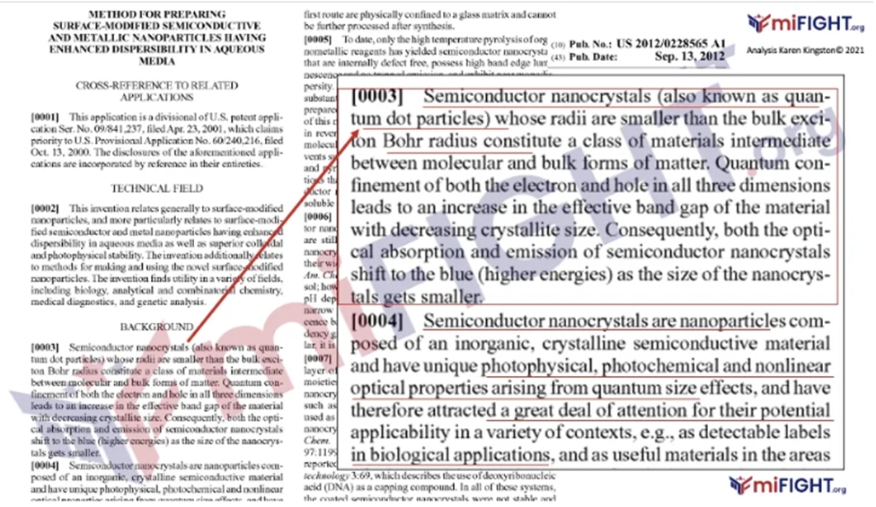
HOPEGIRLBLOG.COM
FTWPROJECT.COM

Slide 32
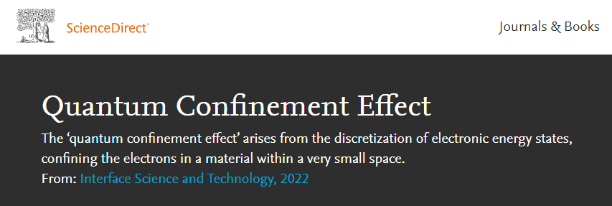
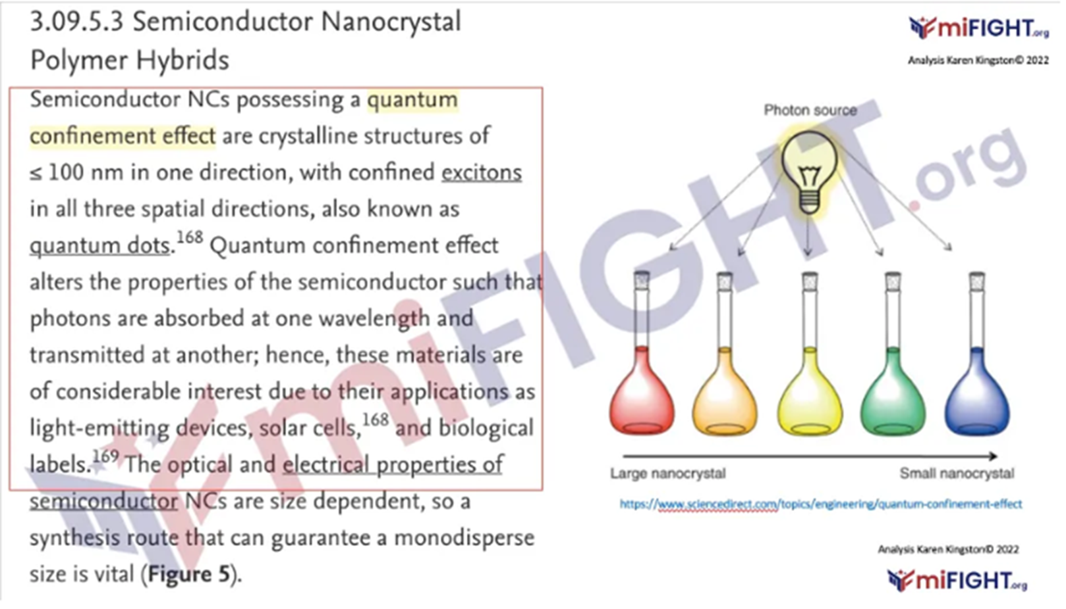
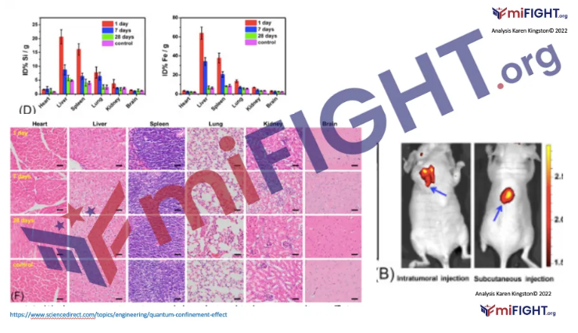
Quantum dots produce electromagnetic fields (Blue Tooth addresses)
Quantum dots tag organs
HOPEGIRLBLOG.COM
FTWPROJECT.COM

Slide 33
HOPEGIRLBLOG.COM
FTWPROJECT.COM

Slide 34
SATANS DEVICES:
ELECTROMAGNETIC DEVICES IN THE COVID INJECTIONS
¹¹ Lest Satan should get an advantage of us: for we are not ignorant of his devices.
-2 Corinthians 2
HOPEGIRLBLOG.COM
FTWPROJECT.COM

Slide 35
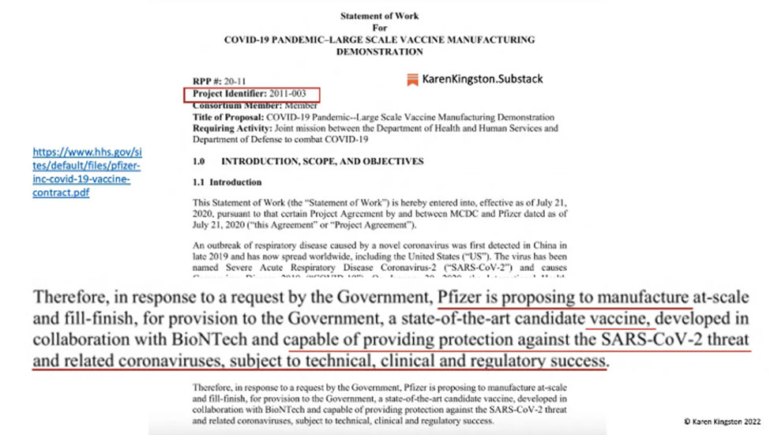
HOPEGIRLBLOG.COM
FTWPROJECT.COM

Slide 36
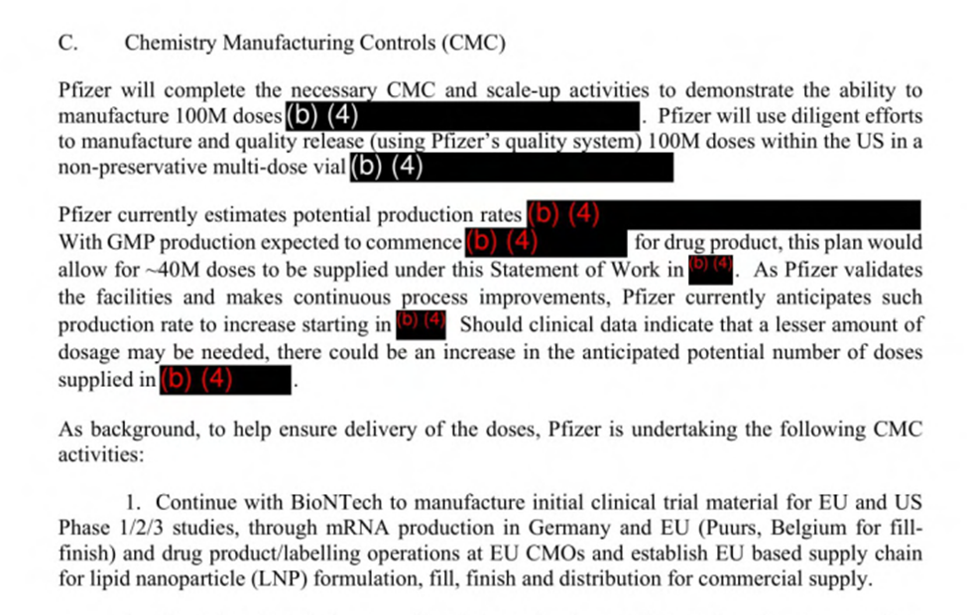
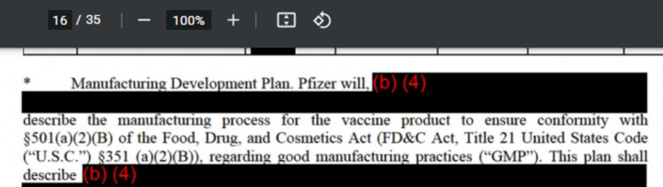
HOPEGIRLBLOG.COM
FTWPROJECT.COM

Slide 37
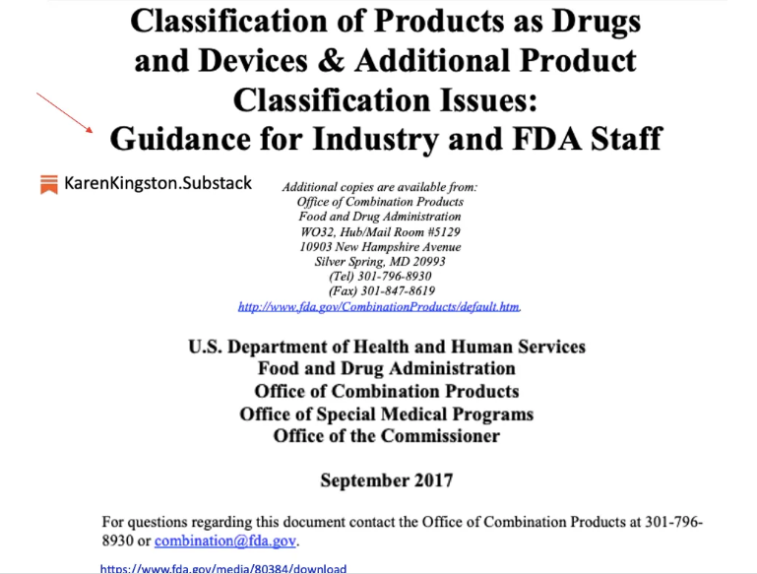
HOPEGIRLBLOG.COM
FTWPROJECT.COM

Slide 38
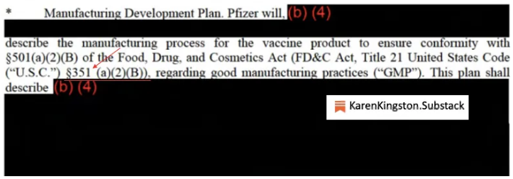
HOPEGIRLBLOG.COM
FTWPROJECT.COM

Slide 39
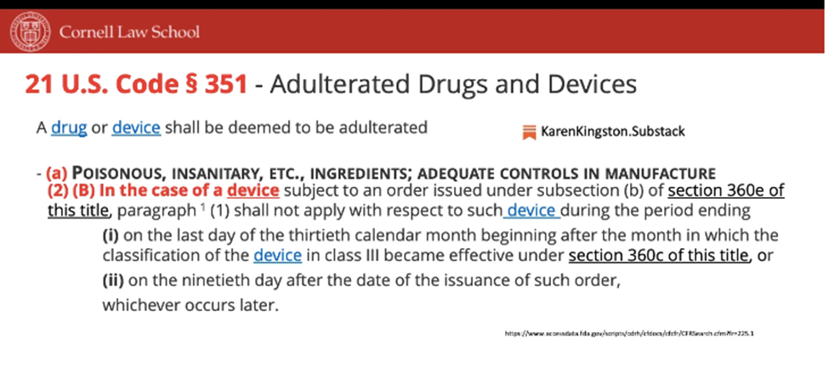
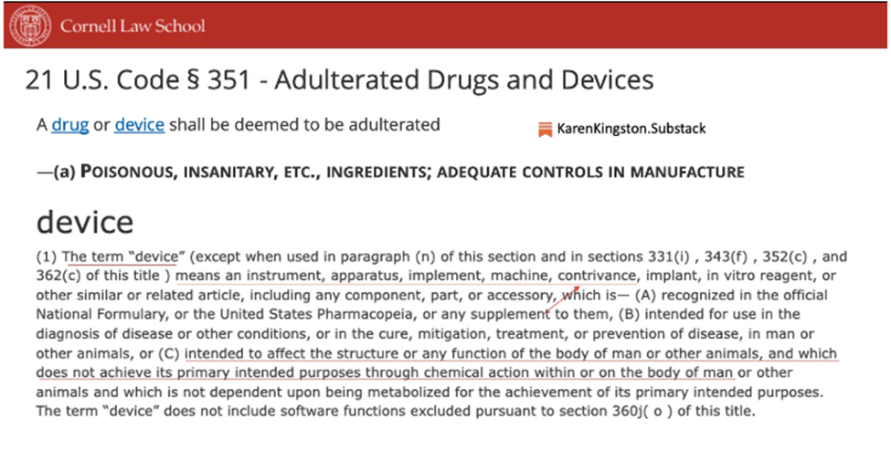
HOPEGIRLBLOG.COM
FTWPROJECT.COM

Slide 40
WHEN INJECTED NANOPARTICLES IN THE BODY ARE STIMULATED BY EMF THEY KILL YOUR CELLS
Going back to the FDA Document, not only are nanoparticles categorized as devices, but the mechanism of action of the nanoparticles described in this FDA document should be alarming.
HOPEGIRLBLOG.COM
FTWPROJECT.COM

Slide 41
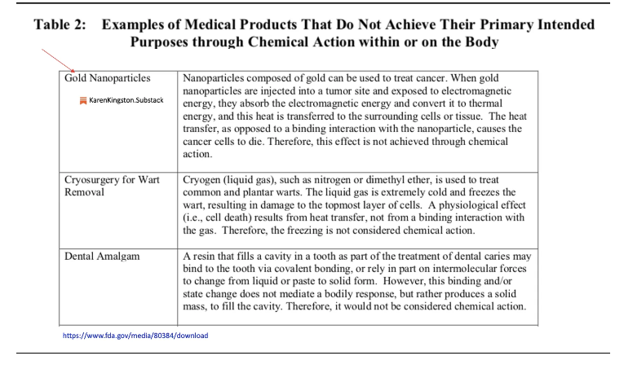
HOPEGIRLBLOG.COM
FTWPROJECT.COM

Slide 42
No one was told that they were being injected with electromagnetic devices.
No one agreed to be injected with nanoparticle technology that would kill surrounding cells and tissue when exposed to electromagnetic energy.
Per the Operation Warp Speed DOD contract, the COVID Injections are categorized as electromagnetic devices. Let that sink in.
These are not medicines. These are not vaccines. They are electromagnetic devices and bioweapons.
Furthermore, Nomenclature has been used to change words and meanings to deceive and fool the public.
HOPEGIRLBLOG.COM
FTWPROJECT.COM

Slide 43
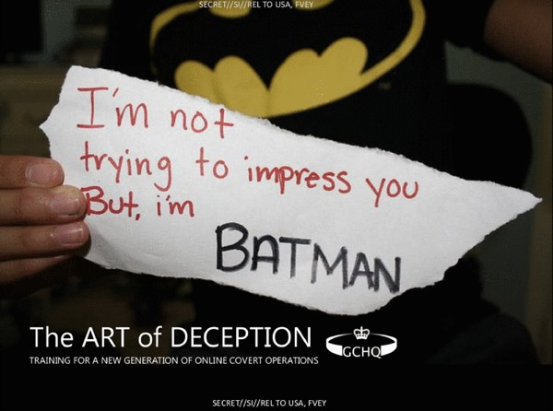
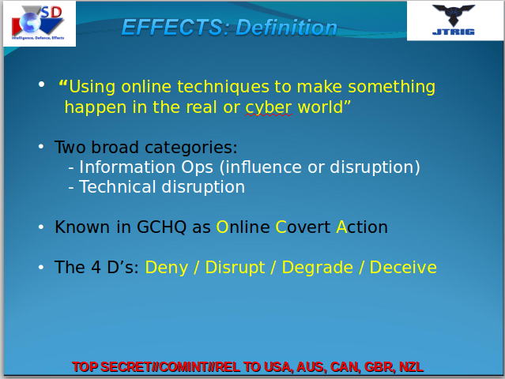
HOPEGIRLBLOG.COM
FTWPROJECT.COM

Slide 44
When a person takes one of the COVID injections, THEY BECOME A DEVICE according to the legal structure as outlined in the FDA guidelines and DOD contracts.
Furthermore, anyone who gets these injections legally turns them into a new organism, a genetically modified person, which makes them a host to the synthetic bio-technology that is fused into their bodies. This bio-technology is Intellectual property that is owned by the Big Pharma companies. And since its inside of you, the Big Pharma companies can now claim they have a patent on and own your body because their technology is inside of you.
Todd Callendar Interview with Stew Peters
https://stewpeters.com/video/2022/10/vaxxed-are-non-human-big-pharma-slaves-u-s-law-mrna-technology-makes-you-the-cyborg-property-of-patent-holders/
HOPEGIRLBLOG.COM
FTWPROJECT.COM

Slide 45
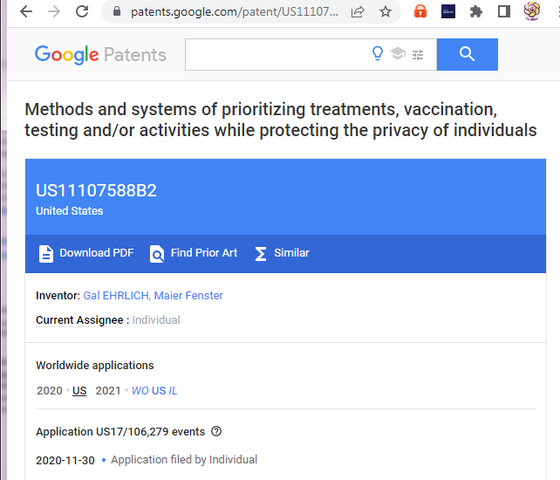
“DEVICES” ARE COVID19 “VACCINE” INJECTED PEOPLE THESE PATENTS SHOW THEIR PLANS FOR THESE “DEVICES”
Abstract
System and methods for anonymously selecting subjects for treatment against an infectious disease caused by a pathogen. The system comprises a plurality of electronic devices comprising instructions to generate an ID and, when in proximity of another such electronic device, one or both electronic devices transmit/receive the ID to/from the other electronic device. Then, a score is generated based on a plurality of such received IDs. Additionally, based on information received from a server, relevant treatment instructions are displayed to the subjects based on the received information and the score. The server comprises instructions for sending to the plurality of electronic devices the information to be displayed with the relevant treatment instructions, additionally the server and/or the electronic devices comprise instructions to generate a prediction of likelihood of a subject transmitting the pathogen, based on the score of the subject.
HOPEGIRLBLOG.COM
FTWPROJECT.COM

Slide 46
The purpose of this Patent is to remotely contact trace all vaccinated humans worldwide who will be or are now connected to the internet of things by a quantum link high Terahertz frequencies only found in 5G, 6G, 7G that come from cell towers and satellites directly to the graphene oxide nano-antennae’s.
More information on this can be found in "COVID MRNAS ARE NOTHING MORE THAN SMALL SCALE BIO-NANO MACHINES" - Lecture by Professor Ian Akyildiz From Georgia Institute Of Technology
https://anamihalceamdphd.substack.com/p/covid-mrnas-are-nothing-more-than
HOPEGIRLBLOG.COM
FTWPROJECT.COM

Slide 47
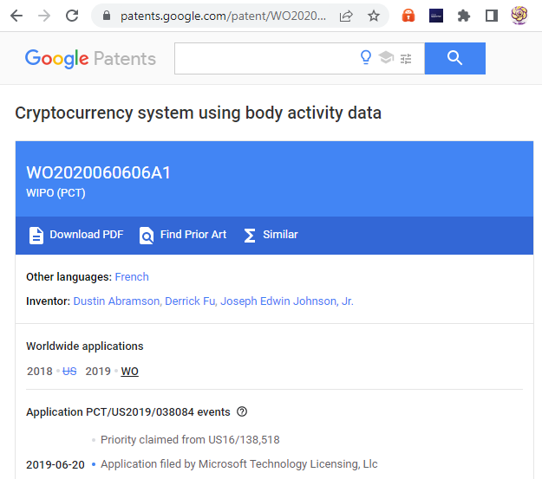
Abstract
Human body activity associated with a task provided to a user may be used in a mining process of a cryptocurrency system. A server may provide a task to a device of a user which is communicatively coupled to the server. A sensor communicatively coupled to or comprised in the device of the user may sense body activity of the user. Body activity data may be generated based on the sensed body activity of the user. The cryptocurrency system communicatively coupled to the device of the user may verify if the body activity data satisfies one or more conditions set by the cryptocurrency system, and award cryptocurrency to the user whose body activity data is verified.
HOPEGIRLBLOG.COM
FTWPROJECT.COM

Slide 48
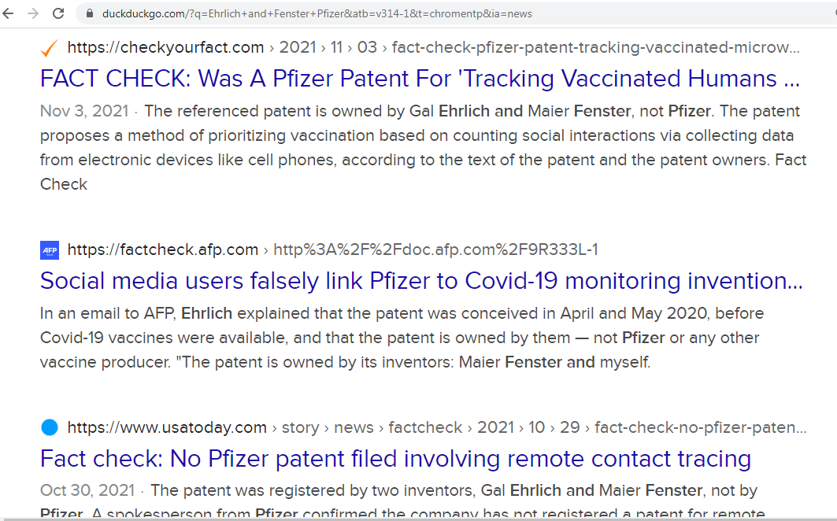
HOPEGIRLBLOG.COM
FTWPROJECT.COM

Slide 49
COVID TRUTH EDUCATIONAL SERIES
HOPEGIRLBLOG.COM
FTWPROJECT.COM

Slide 50

HOW ITS MADE: SATANS DEVICES.
THE WITCHES BREW THEY INJECTED INTO EVERYONE.
From Pfizer Documents: This is How They Made this Nanotechnology in the Covid Injections.
Pfizer was forced to release many of their documents under a FOIA request. This document is one of the documents Pfizer wanted to hide from the public for 75 years. This internal document is evidence that Pfizer’s mRNA ‘vaccines’ are programmable electronic nanotech devices that are made with graphene oxide. (even though a huge smear campaign was launched denying that there was graphene oxide in the shots)
HOPEGIRLBLOG.COM
FTWPROJECT.COM

Slide 51

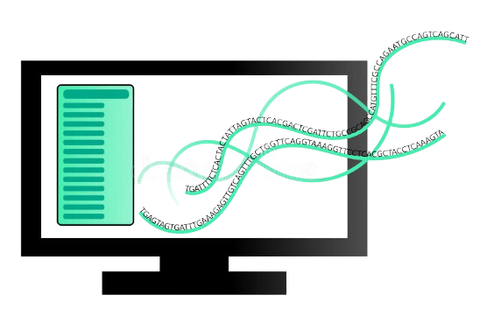
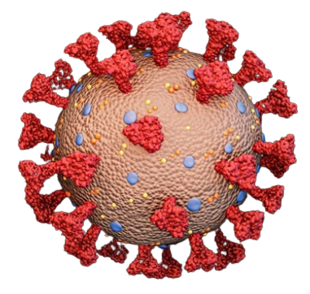
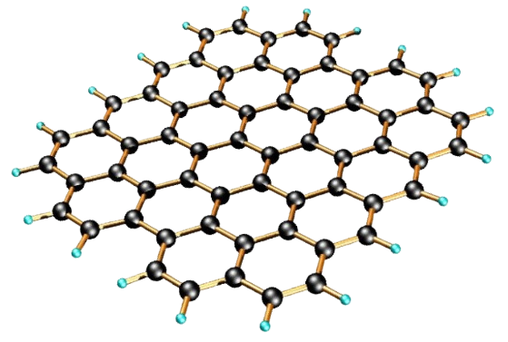
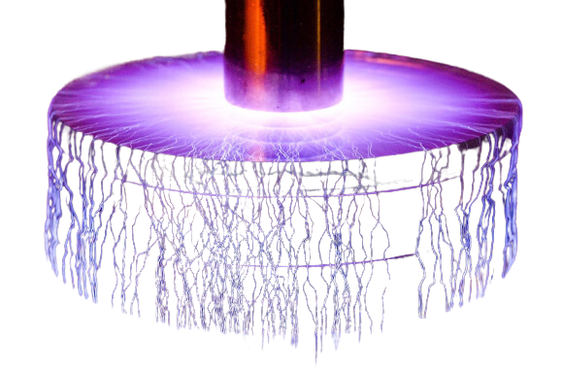
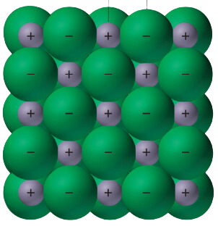
HOW ITS MADE: SATANS DEVICES.
THE WITCHES BREW THEY INJECTED INTO EVERYONE.
+
+
+
+
=
ABORTED
FETAL
CELLS
GRAPHENE
OXIDE
POISON
ELECTROMAGNETIC
FIELDS
(EMF)
BREAKING AND
REASSEMBLING
IONIC BONDS
“SPIKE PROTEIN”
REPLICATING
BIOWEAPON
COMPUTER SEQUENCE
Computer sequences from China are used to infect human embryotic kidney cells (aborted fetus), then these kidney cells produce new multi-species proteins that have genetic sequences from non human DNA in a fluid form. They then have this liquid soup from this that they pour over a gold quanta foil mesh grid that is layered with graphene oxide. They then create electromagnetic fields that then disrupt the electrons of all of these materials both organic and inorganic and new ionic bonds are created. Those new ionic bonds then create millions of what they are calling “spike proteins” which are new artificial pathogens. Then the proteins are frozen cryogenically and during the freezing, the gold nanoparticles and graphene oxide integrates with the mRNA spike proteins. This integration of the gold nanoparticles and graphene oxide with the mRNA is critical to ensure that the spike proteins are then “tagged” with quantum dot technology that can host electromagnetic fields and penetrate cells for the purposes of gene editing.
HOPEGIRLBLOG.COM
FTWPROJECT.COM

