Slide 1
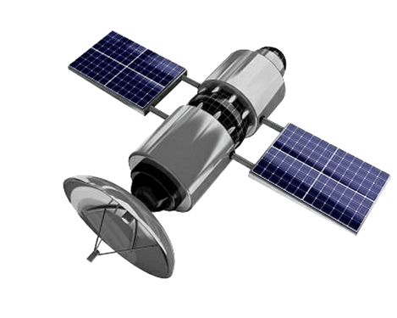
USING 5G,6G,7G, SATELLITES AND NANOTECH COVID INJECTIONS
COVID TRUTH EDUCATIONAL SERIES
HOPEGIRLBLOG.COM
FTWPROJECT.COM

Slide 2
COVID TRUTH EDUCATIONAL SERIES
This video is one of several videos we are calling the COVID Truth Educational Series. It has been put together in a step by step educational format. The purpose of these videos is to help clear up the confusion of the lies that have been told to the public through the COVID agenda. We believe that educating people about the truth of what was done to the human population through COVID is the best defense humanity has against this ever happening again, and those who planned COVID are definitely planning to do something again in the near future.
This video is meant to be free and uninterrupted. It is put together as a public service by FTWProject.com We are Engineers, Scientists and Researchers that run a handmade EMF protection products business. We are also Authors of the Book “Forbidden Tech The Complete Guide To Energy, Social, And Biological Technologies That They Did Not Want You To Know About” We Hope You Benefit From this Presentation and Share it / Mirror It To Help Spread The Word.
HOPEGIRLBLOG.COM
FTWPROJECT.COM

Slide 3
The network that hooks up human bodies to the internet has just been established.
This is what the most recent conferences and papers coming out of the UN and the WEF are focusing on right now. We have recently discovered a body of work that has been made public that discloses what the technology is, how it works, and what the plans are for rolling it out. While this technology is not really something new (its been worked on since at least the 1990’s) it was kept hidden and implemented covertly for years and then recently launched in full force right before COVID. Perhaps it is the reason why Covid happened. The network consists of a global grid that runs on 6G and 7G frequencies that connects all surfaces of the planet through satellites in space to the nano machine technology that has been injected into 5.55 billion people through the Covid-19 Injections.
HOPEGIRLBLOG.COM
FTWPROJECT.COM

Slide 4
DISCLOSURE GUIDELINES
HOPEGIRLBLOG.COM
FTWPROJECT.COM

Slide 5
Professor Ian Alkyildiz (last name pronounced I-kill-deez) from the Georgia Institute of Technology has been developing terahertz communication systems for the internet of everything for at least the last 15 years. He’s worked with the US Army and DARPA and is currently running webinars for the United Nations. He’s set up technology research centers in Spain, South Africa, Finland, Saudi Arabia, Germany, Russi, India and Cyprus. This is just the beginning of his insanely impressive resume. His current areas of expertise and research includes:
6G, 7G wireless communication systems
Hologram communication
Terahertz communication
Internet of Bio-Nano Things
Intelligent surfaces
Molecular Communications
HOPEGIRLBLOG.COM
FTWPROJECT.COM

Slide 6
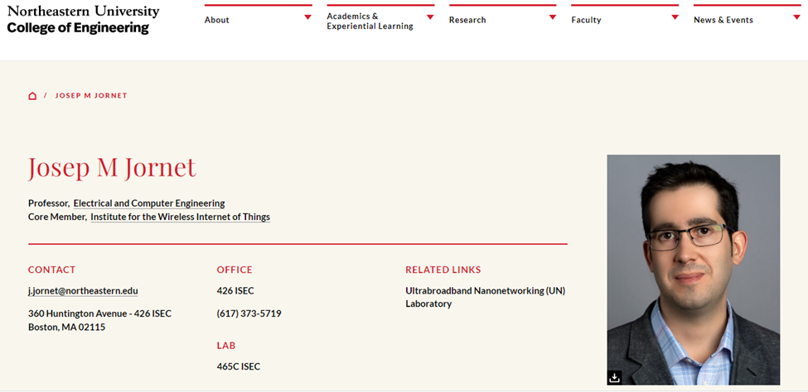
Josep Miquel Jornet is a Professor in the Department of Electrical and Computer Engineering, the director of the Ultrabroadband Nanonetworking (UN) Laboratory, and a member of the Institute for the Wireless Internet of Things and the SMART Center at Northeastern University (NU).
He is a leading expert in terahertz communications, in addition to wireless nano-bio-communication networks and the Internet of Nano-Things. He is serving as the lead PI (Principle Investigator) on multiple grants from U.S. federal agencies including the National Science Foundation, the Air Force Office of Scientific Research and the Air Force Research Laboratory as well as industry.
Josep Jornet was a student of Ian Alkyildiz and they worked together for many years writing IEEE papers and creating patents for terahertz communications wireless nano-bio-communication networks and the Internet of Nano-Things. Recently they gave a joint presentation for the UN in a webinar that explained the technology that is being used today to connect peoples bodies to the internet of things.
HOPEGIRLBLOG.COM
FTWPROJECT.COM

Slide 7
HOPEGIRLBLOG.COM
FTWPROJECT.COM

Slide 8
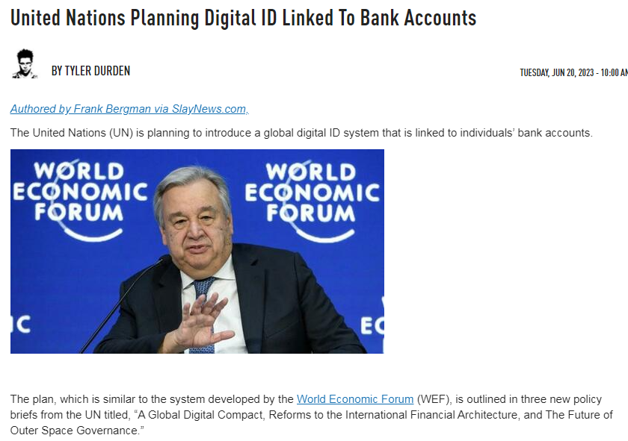
HOPEGIRLBLOG.COM
FTWPROJECT.COM

Slide 9
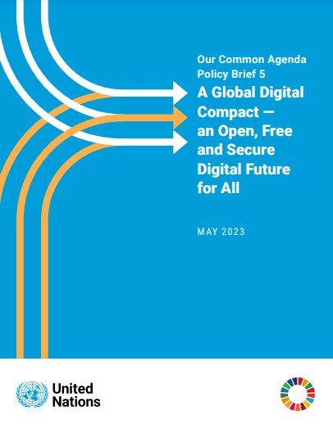
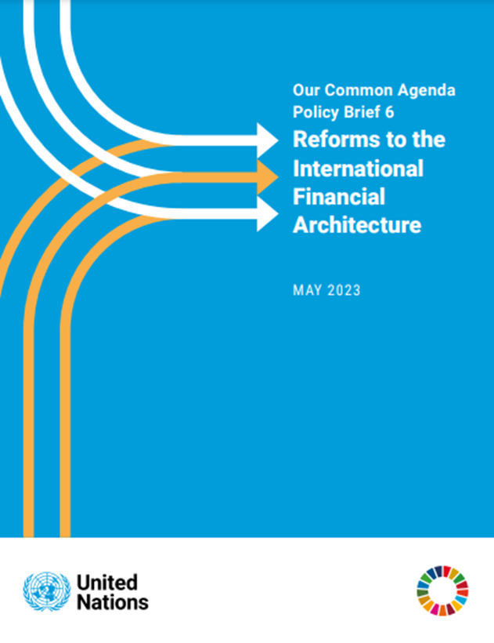
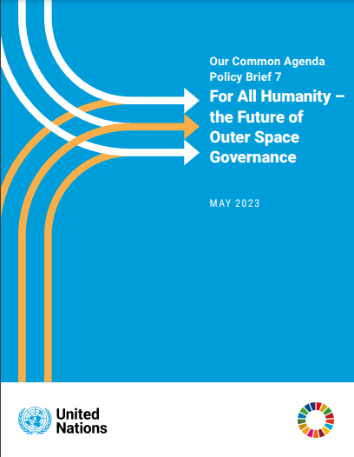
United Nations Planning Digital ID Linked to Bank Accounts
The plan, which is similar to the system developed by the World Economic Forum (WEF), is outlined in three new policy briefs from the UN titled, “A Global Digital Compact, Reforms to the International Financial Architecture, and The Future of Outer Space Governance.” Essentially, the objective is to have people, devices, and entities, all tied up in a connected network that could apparently be centrally administered, seemingly by unelected bureaucrats. These came out in May 2023
WWW.FTWPROJECT.COM

Slide 10
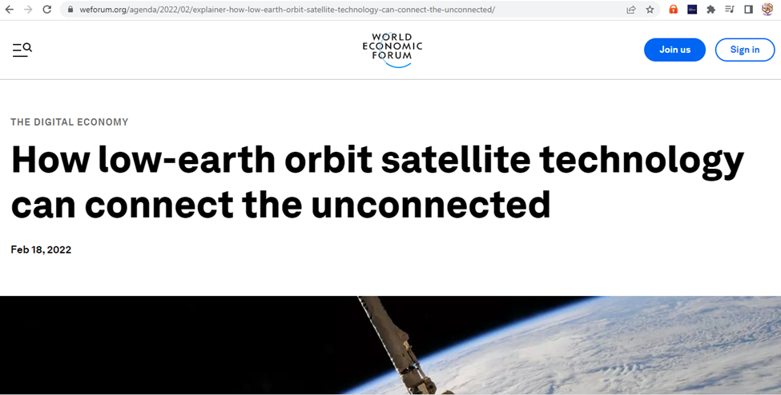
What does Outer Space Have to do with Digital ID and Bank Accounts?
This UN document is all about who gets to control the satellites, which is what they are using to track human beings through their bodies and control your data.
From the WEF website under “Digital Economy”
Nomenclature –changing of words to make it more appealing to the masses. Digital Inclusivity Reduce Digital Inequality Bridge the Digital Divide 2.9 Billion People Still Don’t Use Internet Barriers to Connectivity Closing Connectivity gaps Peaceful Uses of Outer Space access to space based assets universal Internet connectivity
WWW.FTWPROJECT.COM

Slide 11
WEF says that LOW EARTH ORBIT SATELLITES ARE THE ONLY OPTION THAT WOULD CONNECT THE 2.9 BILLION PEOPLE IN THE WORLD THAT ARE STILL NOT CONNECTED TO THE INTERNET.
The European Union recently announced plans for an LEO satellite system worth €6 billion. The EU is entering a space internet race where technology giants are spending billions of dollars on LEO satellite technology to close the global connectivity gaps. Space X’s Starlink, Elon Musk’s satellite internet venture, has deployed nearly 2,000 satellites in orbit and has applied for licences to fly more than 40,000 satellites. Bill Gates backs a $1 billion plan to cover Earth in 'Big Brother' satellites capable of streaming 'live and unfiltered' HD footage of the planet 500 Low earth orbit satellites that have cameras pointed onto the earth that will create real time imagery that people an view on their cell phones.
WWW.FTWPROJECT.COM

Slide 12
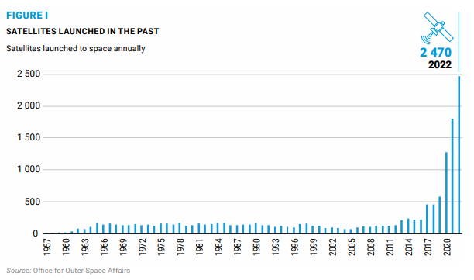
Look how many LEO satellites they launched into space DURING THE PANDEMIC
Its getting very congested up there in Low Earth Orbit. Check out this chart from the UN Paper on how many LEO satellites were launched into space. Look at the timing…during the pandemic is when they launched the most. Almost makes you think that the LEO satellites and the nanochips in the vaccines were connected somehow? Perhaps they had to get 5.55 billion people injected with nanotech sensors to complete their LEO control grid? Perhaps that’s the reason they did Covid, to convince a large part of the worlds population to inject themselves with nanotech sensors?
WWW.FTWPROJECT.COM

Slide 13
HOPEGIRLBLOG.COM
FTWPROJECT.COM

Slide 14
HOPEGIRLBLOG.COM
FTWPROJECT.COM

Slide 15
HOPEGIRLBLOG.COM
FTWPROJECT.COM

Slide 16
HOPEGIRLBLOG.COM
FTWPROJECT.COM

Slide 17
HOPEGIRLBLOG.COM
FTWPROJECT.COM

Slide 18
HOPEGIRLBLOG.COM
FTWPROJECT.COM

Slide 19
HOPEGIRLBLOG.COM
FTWPROJECT.COM

Slide 20
HOPEGIRLBLOG.COM
FTWPROJECT.COM

Slide 21
Plasmonics
Also called nanoplasmonics refers to the generation, detection, and manipulation of signals at optical frequencies along metal-dielectric interfaces in the nanometer scale. It is what they use for “sensing”. The plasmas they are creating in this technology relay information about the target (person) in real time. This plasma can also be used to manipulate signals in the body can trigger lethal actions in the body.
“Sensing”
the acquiring of information from a distance. For example satellites are remote sensors acquiring information about the atmosphere, and plasmonic nano antennae’s and transceivers are also sensors of information on a small scale, such as acquiring information from a room or inside of your body.
HOPEGIRLBLOG.COM
FTWPROJECT.COM

Slide 22
Graphene Based Plasmonic Nano-Antennas
A nano sized antennae made out of graphene. They stimulate the graphene with Electromagnetic waves which create plasma waves across the surface that allow for the communication needed.
BLOCKED BY CIA
HOPEGIRLBLOG.COM
FTWPROJECT.COM

Slide 23
HOPEGIRLBLOG.COM
FTWPROJECT.COM

Slide 24
Reconfigurable Intelligent Surfaces
They arrange these graphene plasmonic nano antennas and transceivers in an array (line up a bunch of them side by side) and use them to create surfaces of all kinds that can be used to track things like high speed vehicles in real time and more.
HOPEGIRLBLOG.COM
FTWPROJECT.COM

Slide 25
Examples of Intelligent Surfaces
HOPEGIRLBLOG.COM
FTWPROJECT.COM

Slide 26
Examples of Intelligent Surfaces
HOPEGIRLBLOG.COM
FTWPROJECT.COM

Slide 27
HOPEGIRLBLOG.COM
FTWPROJECT.COM

Slide 28
HOPEGIRLBLOG.COM
FTWPROJECT.COM

Slide 29
HOPEGIRLBLOG.COM
FTWPROJECT.COM

Slide 30
HOPEGIRLBLOG.COM
FTWPROJECT.COM

Slide 31
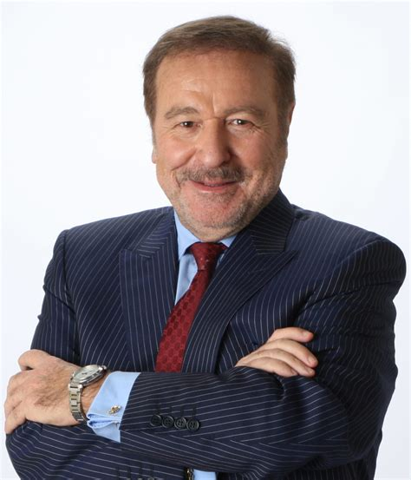
Ian Akyildiz slipped up and made the following statement at 13:40 in this presentation: https://www.youtube.com/watch?v=YAtQFkEg5-w
“I did a lot of research on the Internet of Bio-Nano Things in the last 15 years, this is bio nano machines that are injected into the body for monitoring of health problems. This is going really well. These Covid vaccines, these mRNAs are nothing more than small scale nano machines that are programmed and injected.”
Well he would know wouldn’t he?
Ian Alkyildiz Nanotech terahertz communications expert 6G,7G wireless communications Internet of Bio-Nano Things Internet of Space Nano Things Worked for US Army and DARPA and UN
WWW.FTWPROJECT.COM

Slide 32
We learned from Josep Jornets presentation to the UN that terahertz frequencies have the unique ability to interact with molecules in the body. This is how they can target an individual. Josep shows a chart that says they have figured out at exactly what terahertz frequency specific molecules or materials can get excited, or where the frequency is absorbed.
To a person who has been on the receiving end of energy weapon frequency technology that governments have been covertly using on citizens, this chart reads a whole different way. The chart shows at exactly what terahertz frequencies you need to beam at a person to target different parts of their body. The first peak could be the frequency to target the heart for a heart attack, the second peak could be the skin, maybe the third peak is the frequency to penetrate the brain and cause strokes and so on.
HOPEGIRLBLOG.COM
FTWPROJECT.COM

Slide 33
Synchronizing the timing in the network so that it works
How clocks work: Clocks work by counting a periodic event with a known frequency. Grandfather clocks count the pendulum swings Quartz clocks count the frequency vibration of the quartz Atomic clocks count the changes in the energy levels of atoms when they are exposed to very specific frequencies. Atomic clocks use Cesium because the changes in the energy levels of cesium atoms can be synchronized within nanoseconds of each other. Older networks (since 1967) use cesium to synchronize equipment, this includes GPS satellites.
HOPEGIRLBLOG.COM
FTWPROJECT.COM

Slide 34
Synchronizing the timing in the network so that it works
HOPEGIRLBLOG.COM
FTWPROJECT.COM

Slide 35
HOPEGIRLBLOG.COM
FTWPROJECT.COM

Slide 36
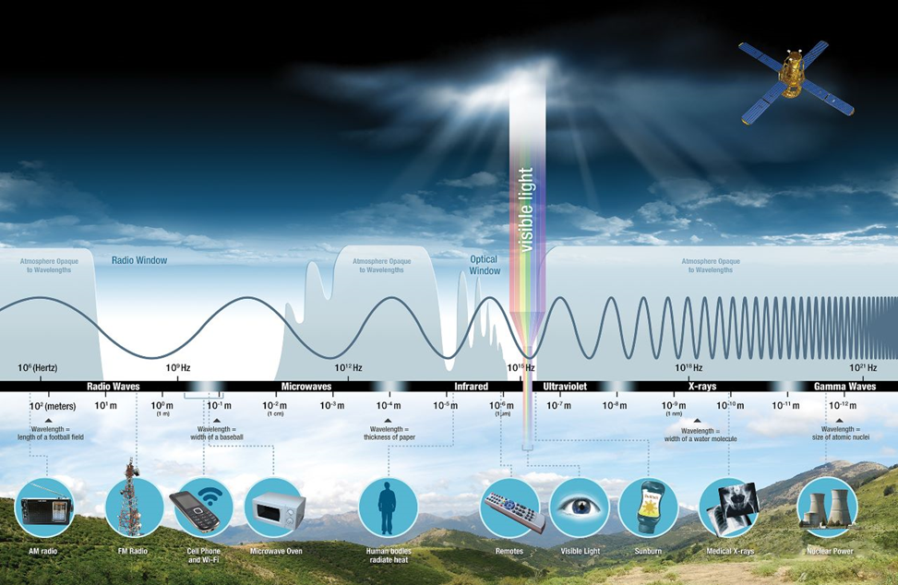
Geoengineering lays the foundation for the reset and helps clear the air for satellite to ground communications.
Nanomaterials from chemtrails can have the ability to break up existing clouds (moisture in the air).
Geoengineering lays the foundation for the reset. You can set forests of fire with it, you can induce droughts, you can even target livestock and individuals. It can also clear the air, very literally for satellite to ground communications. The higher frequency bands (terahertz) that operators wish to use can be disrupted by the moisture in the atmosphere. Geoengineering allows for better surveillance and better control over the internet of things.
Equipment that operates at higher frequencies (5G,6G,7G) has issues with water particles in the atmosphere disrupting the signals. That is why these satellites that operate in higher frequencies are way above the atmosphere (but still in low earth orbit) so they can operate where there is no water particles in the air to disrupt the signal. In order for signals to reach down to the surface from the satellites in space they need to be converted into lower frequencies which are not disrupted by water particles in the air. The following chart shows that communication from space to ground you get a clearer signal when you are communicating on a lower frequency.
HOPEGIRLBLOG.COM
FTWPROJECT.COM

Slide 37
HOPEGIRLBLOG.COM
FTWPROJECT.COM

Slide 38
In the next slide Josep Jornet shows how this network operates in space and explains that miniature satellites in low earth orbit are already operating on terahertz frequencies and they are all up there just watching everything or “sensing”, they are just collecting data from the atmosphere.
WWW.FTWPROJECT.COM

Slide 39
In this slide Prof. Akyildiz is explaining how all the different technologies using all the different frequencies can link together and can switch over to different frequencies without getting out of sync.
HOPEGIRLBLOG.COM
FTWPROJECT.COM

Slide 40
This is What this technology can do: track and trace you control your body read your reactions to stimuli mind control crowd control target parts of your body death and illness population control
HOPEGIRLBLOG.COM
FTWPROJECT.COM

Slide 41
HOPEGIRLBLOG.COM
FTWPROJECT.COM

Slide 42
HOPEGIRLBLOG.COM
FTWPROJECT.COM

