Slide 1
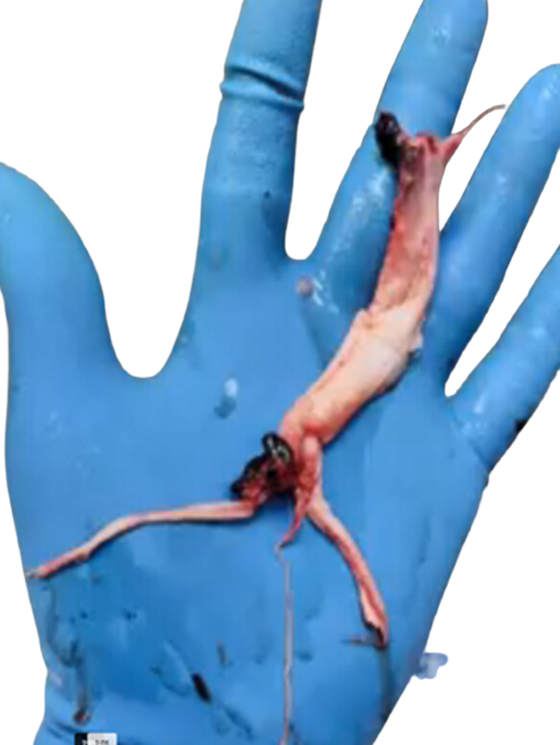
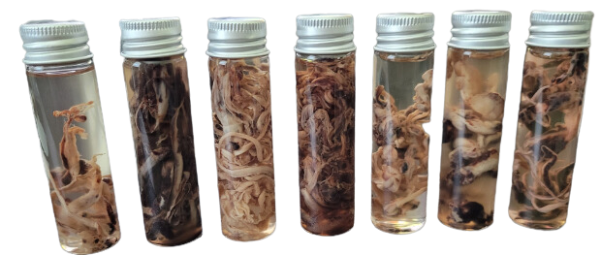
Pulled From Vaccinated Deceased
HOPEGIRLBLOG.COM
FTWPROJECT.COM

Slide 2
COVID TRUTH EDUCATIONAL SERIES
This video is one of several videos we are calling the COVID Truth Educational Series. It has been put together in a step by step educational format. The purpose of these videos is to help clear up the confusion of the lies that have been told to the public through the COVID agenda. We believe that educating people about the truth of what was done to the human population through COVID is the best defense humanity has against this ever happening again, and those who planned COVID are definitely planning to do something again in the near future.
This video is meant to be free and uninterrupted. It is put together as a public service by FTWProject.com We are Engineers, Scientists and Researchers that run a handmade EMF protection products business. We are also Authors of the Book “Forbidden Tech The Complete Guide To Energy, Social, And Biological Technologies That They Did Not Want You To Know About” We Hope You Benefit From this Presentation and Share it / Mirror It To Help Spread The Word.
HOPEGIRLBLOG.COM
FTWPROJECT.COM

Slide 3
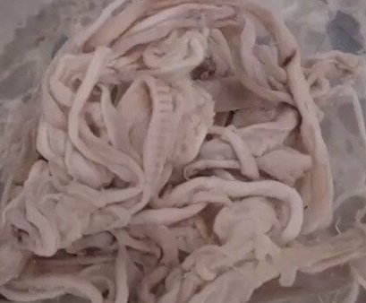
EMBALMERS WERE FINDING WHITE FIBROUS STRUCTURES IN THE BODIES OF THE VACCINATED DECEASED, MANY PEOPLE HAD A LOT OF QUESTIONS.
Just after the Covid 19 Vaccines were rolled out in 2021. Embalmers across the world experienced a phenomenon most of them had never seen in their life long careers. When they were beginning the process of embalming a body, they were not able to run the embalming fluid through the veins of the body because there was something inside of the veins and arteries that was blocking the fluid. Embalmers started pulling these long white fibrous structures that took the shape and form of veins and arteries. These structures are not natural and had never been seen before. They were coming from the bodies of those who had received the Covid 19 vaccine.
HOPEGIRLBLOG.COM
FTWPROJECT.COM

Slide 4
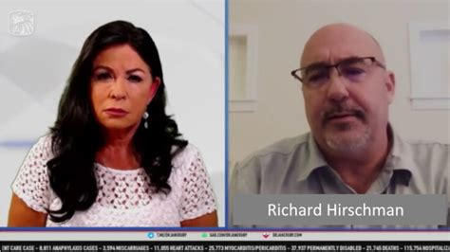
Embalmers were threatened by their governing associations and told not to disclose what they were pulling out of people. The story was covered by Dr. Jane Ruby who was able to get one of the embalmers Dr. Richard Hirschman to come forward.
These white fibrous structure were very alarming to many people and many were trying to figure out what these structures were, what they made out of, how they formed in the body, why they were forming in the body, if they were an intentional side effect of the vaccines, and if so, what they were intended to do. Furthermore there were more questions like, how long did these structures take to form? Can you be walking around with these things inside of you and not feel it or know it? If you have these in you, can you get rid of them and how can you get rid of them?
HOPEGIRLBLOG.COM
FTWPROJECT.COM

Slide 5
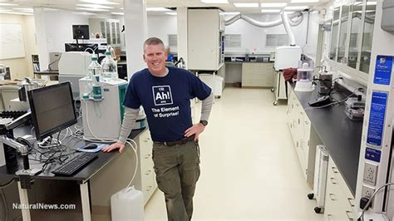
AN ANALYSIS WAS DONE TO FIND OUT WHAT THESE STRUCTURES WERE MADE OF
There is only one person that we know of that has the proper equipment to test these structures was able to do so and that is Mike Adams. He did an elemental analysis using his very sophisticated lab equipment on some of these white structures that he received from the embalmer Dr. Richard Hirschman.
An elemental analysis is where you run tests to find out exactly what components make up something. From Mikes analysis, the structures were made up of trace amounts of iron 5%, potassium, magnesium and chlorine, but more potassium. (this means they are not blood) The structures contained high amounts of sodium, tin (588%) and aluminum. (these are electrical conductive elements). These structures are self assembling and get bigger over time inside of peoples blood vessels. These structures are “harvesting” conductive elements from the persons body (blood) to increase its size and grow. The structure takes the shape of the artery or vein it resides in.
Mike Adams in His Lab Where He Tested the White Structures
HOPEGIRLBLOG.COM
FTWPROJECT.COM

Slide 6
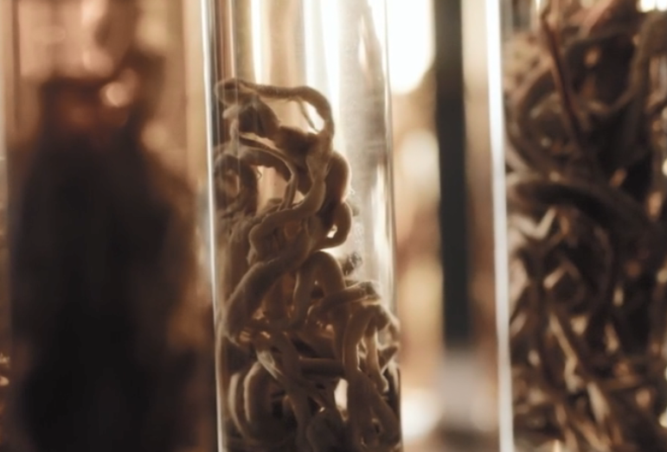
MICROSCOPE ARMY LATEST RESEARCH
Question arises. What connection do these constructs have with the clotting structures extracted from the embalmers?
Are the white fibrous structures made by and from the technology in the shots?
-Dr. Jane Ruby and Mike Adams (‘The Health Ranger’) Reveal Post-Covid Clot Mysteries
“These rubber structures are NOT blood clots” Summary of Laboratory Analysis Findings that were published from the elemental analysis:
- self assembling biostructures that get bigger over time inside peoples’ blood vessels
- unlike blood, contains only trace amounts of iron (5%), potassium, magnesium and chlorine, but more potassium
- Sodium, Tin (588%), and Aluminum were in much higher amounts in the structures than human blood
- This structure is ‘harvesting’ conductive elements from the blood to increase its size (grow). The structure take the shape of the artery (or vein) it resides in.
- These elements make these structures electromagnetically conductive in the RF range . For what purpose?
- It is unknown the exact mechanism by which these things are forming, although there are ideas. Lookup Dr. Charles Lieber Patents (arrested and convicted for selling ‘bio-circuitry’ secrets to China)
HOPEGIRLBLOG.COM
WWW.FTWPROJECT.COM

Slide 7
WERE THESE STRUCTURES WORKING WITH EMF TO TURN A HUMAN BODY INTO A WALKING ANTENNAE?
There have been many independent scientists around the world that have been analyzing the vaccines and the blood of the vaccinated under microscopes and using other instrumentation. They have found that components in the vaccines are activated and self-assemble inside of the blood when they are exposed to certain electromagnetic frequencies. (EMF from routers and cell phones etc). With our background working with electrical engineering and EMF’s effects on the human body we had some educated theories of what might be causing these white fibrous structures to form.
HOPEGIRLBLOG.COM
FTWPROJECT.COM

Slide 8
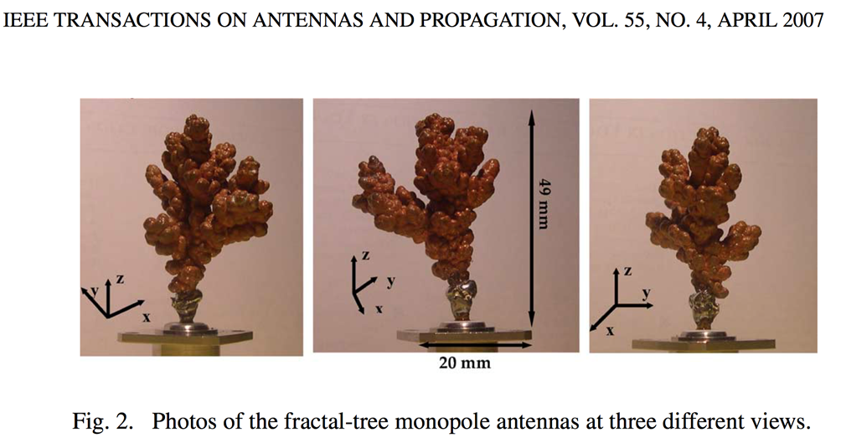
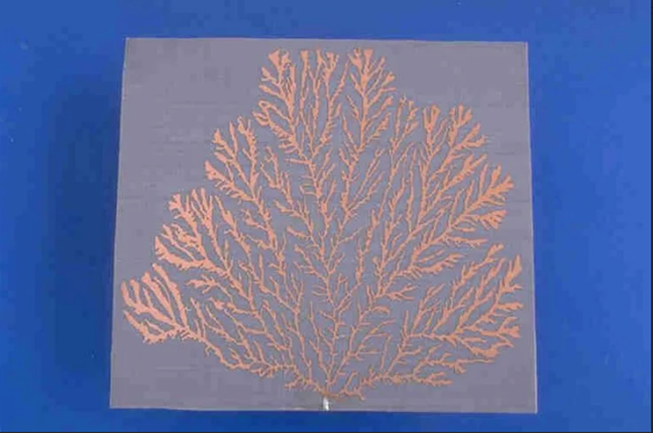
MICROSCOPE ARMY LATEST RESEARCH
Can they behave like fractal antennas?
Suggested Tests on Rubbery Fibrous ‘Clots’
- Do these fibrous clots change dimension when stimulated by EMF pulse(s)?
- Is there instantaneous thermal heating associated with these ‘clots/structures’ when stimulated by EMFs?
- Do these structures have resonant frequencies in the mega (and gigahertz) range (with low loss)?
WWW.FTWPROJECT.COM

Slide 9
THE COVID INJECTION PATENTS AND OTHER DOCUMENTATION EXPLAIN WHAT THESE STRUCTURES ARE, HOW THEY ARE FORMED, HOW THEY ARE CONTROLLED BY EMF, AND WHAT THEY ARE PROGRAMMED TO DO IN THE HUMAN BODY
The Covid Injection patents explain that hydrogels are used in the injections for the purposes of forming a biosynthetic material inside the body that is similar to natural tissue. Biosynthetic means it is part natural and part artificial. Hydrogels can be programmed to send and receive signals from a wide range of electromagnetic frequencies that can then tell the hydrogel to carry out a command or action inside of the body. These hydrogels are also merged with another form of nanotechnology called quantum dots. Quantum dots are semiconductors with unique electrical properties and they operate in extremely high frequencies (5G,6G,7G) in the quantum field. They can be programmed to produce electromagnetic labels in the body such as blue tooth codes and they can tag organs in side the body.
You may have heard the term luciferase being used in the shots, luciferase and quantum dots are virtually the same thing.
Kingston Report Hydrogels in Covid Injections
HOPEGIRLBLOG.COM
FTWPROJECT.COM

Slide 10
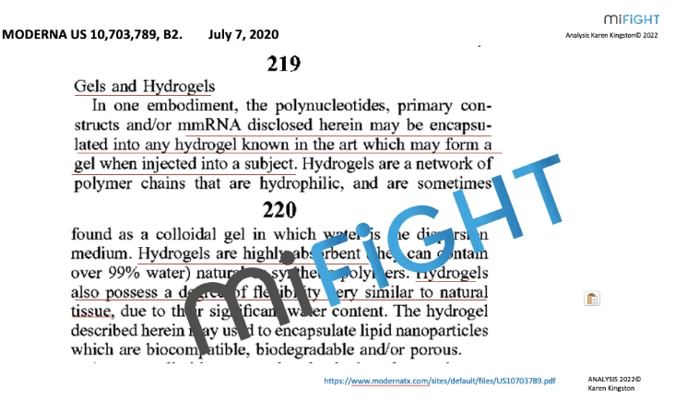
Covid Injection Patents Explain Hydrogels
HOPEGIRLBLOG.COM
FTWPROJECT.COM

Slide 11
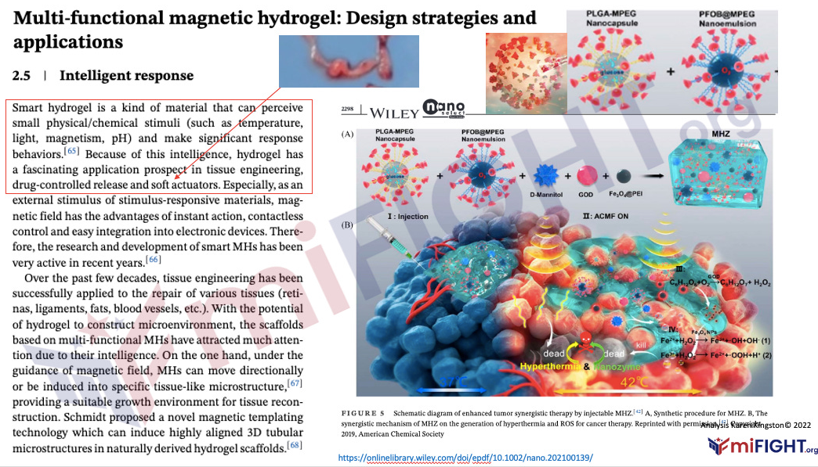
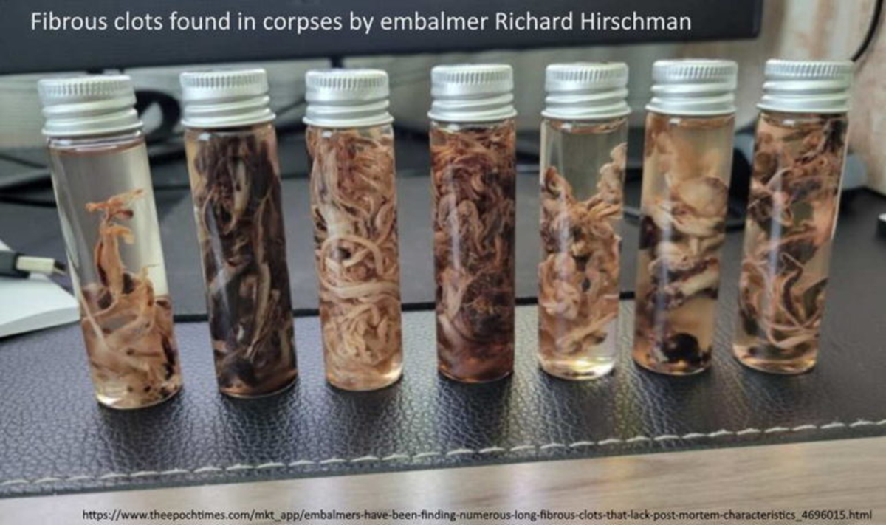
White Fibrous Structures are Soft Actuators
These structures which are bioengineered and mimic tissues and organs in the body are called soft actuators. Although these soft actuators look like structures of tissues and organs, such as veins and arteries, they are far more than just structures. They can perform more diverse functions beyond those of human cells, tissues, or organs. The hydrogel that was programmed to produce these soft actuators has been programmed to have “intelligence” that can direct their movement, self-heal and be multi responsive to the internal environment of the person that they are inside of. This same programming also enables them to respond to external stimuli including light, sound, temperature and electromagnetic signals or optics.
These white fibrous structures are soft actuators that were grown by the programmable hydrogel inside of the COVID injections.
HOPEGIRLBLOG.COM
FTWPROJECT.COM

Slide 12
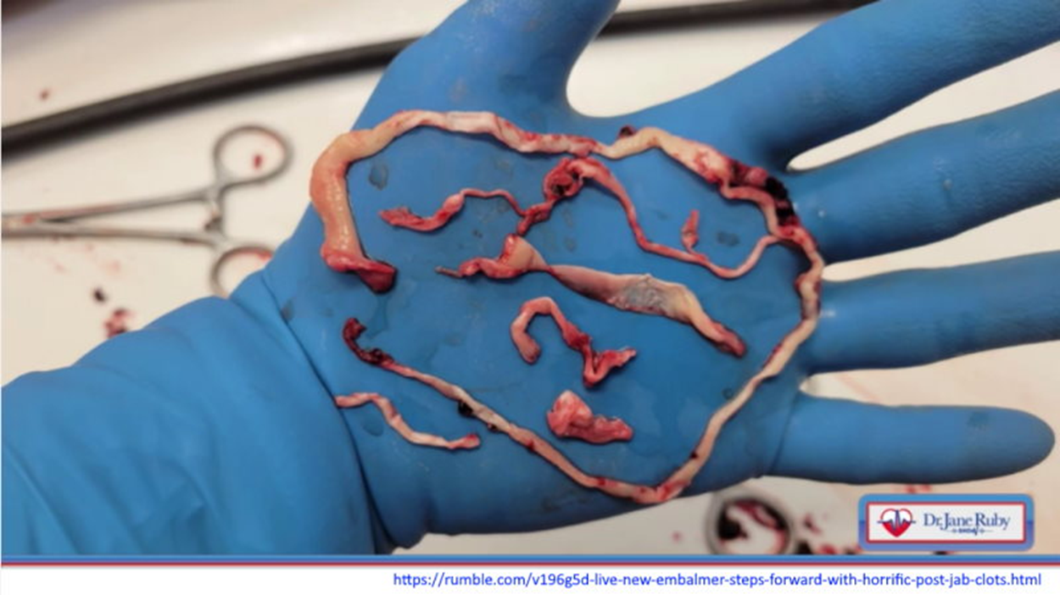
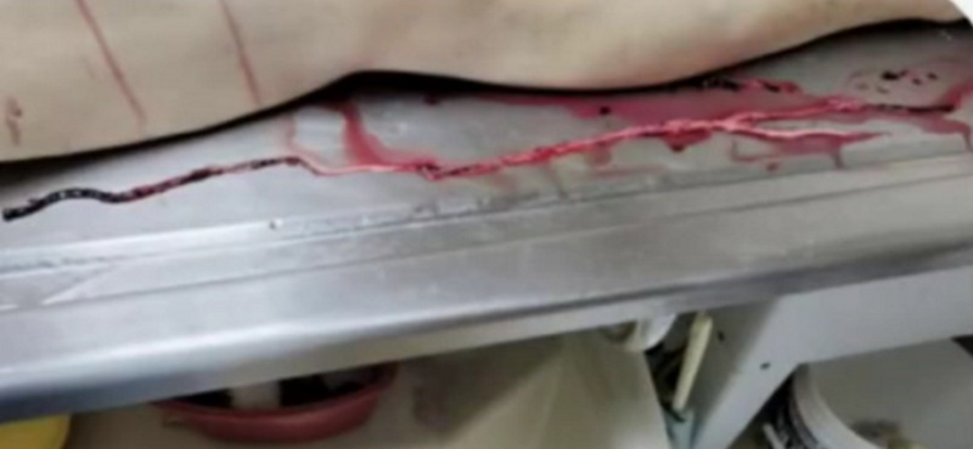
Actuators are Controlling Mechanisms
actuators are a component of a machine that is responsible for moving and controlling a mechanism or system, for example opening a valve. Actuators require a control device that is controlled by a signal and a source of energy. When an actuator receives a signal (such as external EMF) it converts the systems energy (taken from the human body) into a mechanical motion. It is a form of automation or automatic control.
HOPEGIRLBLOG.COM
FTWPROJECT.COM

Slide 13
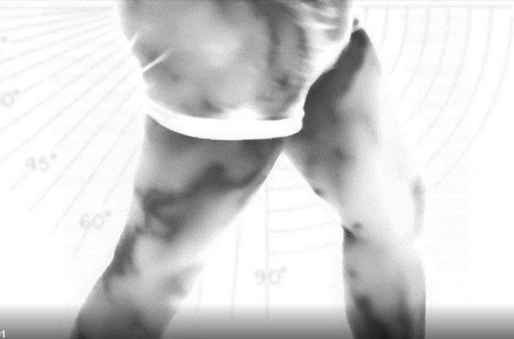
You Cant Feel These White Structures Inside You
The location of these structures is in the veins and arteries where there are no nerves, so you cannot feel this growing inside of you. You could be walking around with this in you and you wont even know it. They have found these structures in the veins and arteries of living vaccinated people that do not have any symptoms. These structures have been found during the course of surgeries performed on living vaccinated people.
Large white clot structure found under thermography in living vaccinated person with no symptoms
HOPEGIRLBLOG.COM
FTWPROJECT.COM

