Slide 1
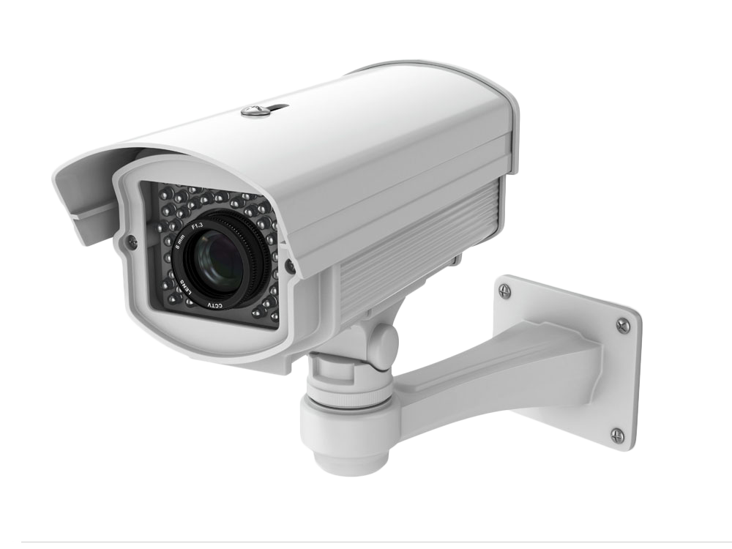
WWW.FTWPROJECT.COM

Slide 2
SUMMARY
1. The Microscope Army Latest Research 2. Mental and Spiritual Effects of the Jabs Latest Research 3. The Plan of the Enemy A Paper Tiger. Vaxx Passports, G20 Meetings, Surveillance and more 4. Critical Mass and the Resistance: Protests, Sudden Deaths, Airlines, Governments confronted 5. CointelPro Tactics Being used to delay critical mass: lawsuits and scandals 6. Special surprise video we made just for SGT Report.
Blog Post with Links to everything referenced in the description.
WWW.FTWPROJECT.COM

Slide 3
MICROSCOPE ARMY LATEST RESEARCH
WHAT IS THE MICROSCOPE ARMY? The microscope army is a term given to the organic, global movement of independent, scientific, professional researchers that are using modern analytical tools and techniques (primarily microscopic analysis) to investigate the contents of current and post-COVID injections, and the abnormalities arising from the those that are suffering from its effects. Collaborations between the members of the groups are happening to quickly experiment, replicate and verify findings in the hope of bringing forward solutions for the general population
EXAMPLES OF PUBLIC GROUPS THAT SHARE FINDINGS IN VIDEO FORMAT SO YOU CAN SEE THEIR PROGRESS:
IT IS ILLEGAL TO HAVE POSSESSION OF ANY VACCINE VIAL FOR INDEPENDENT STUDY IN MANY JURISDICTIONS Remember, the ‘experts’ did not want to look through Galileo’s telescope in his day, nor do they want to like through the microscopes now!
WWW.FTWPROJECT.COM

Slide 4
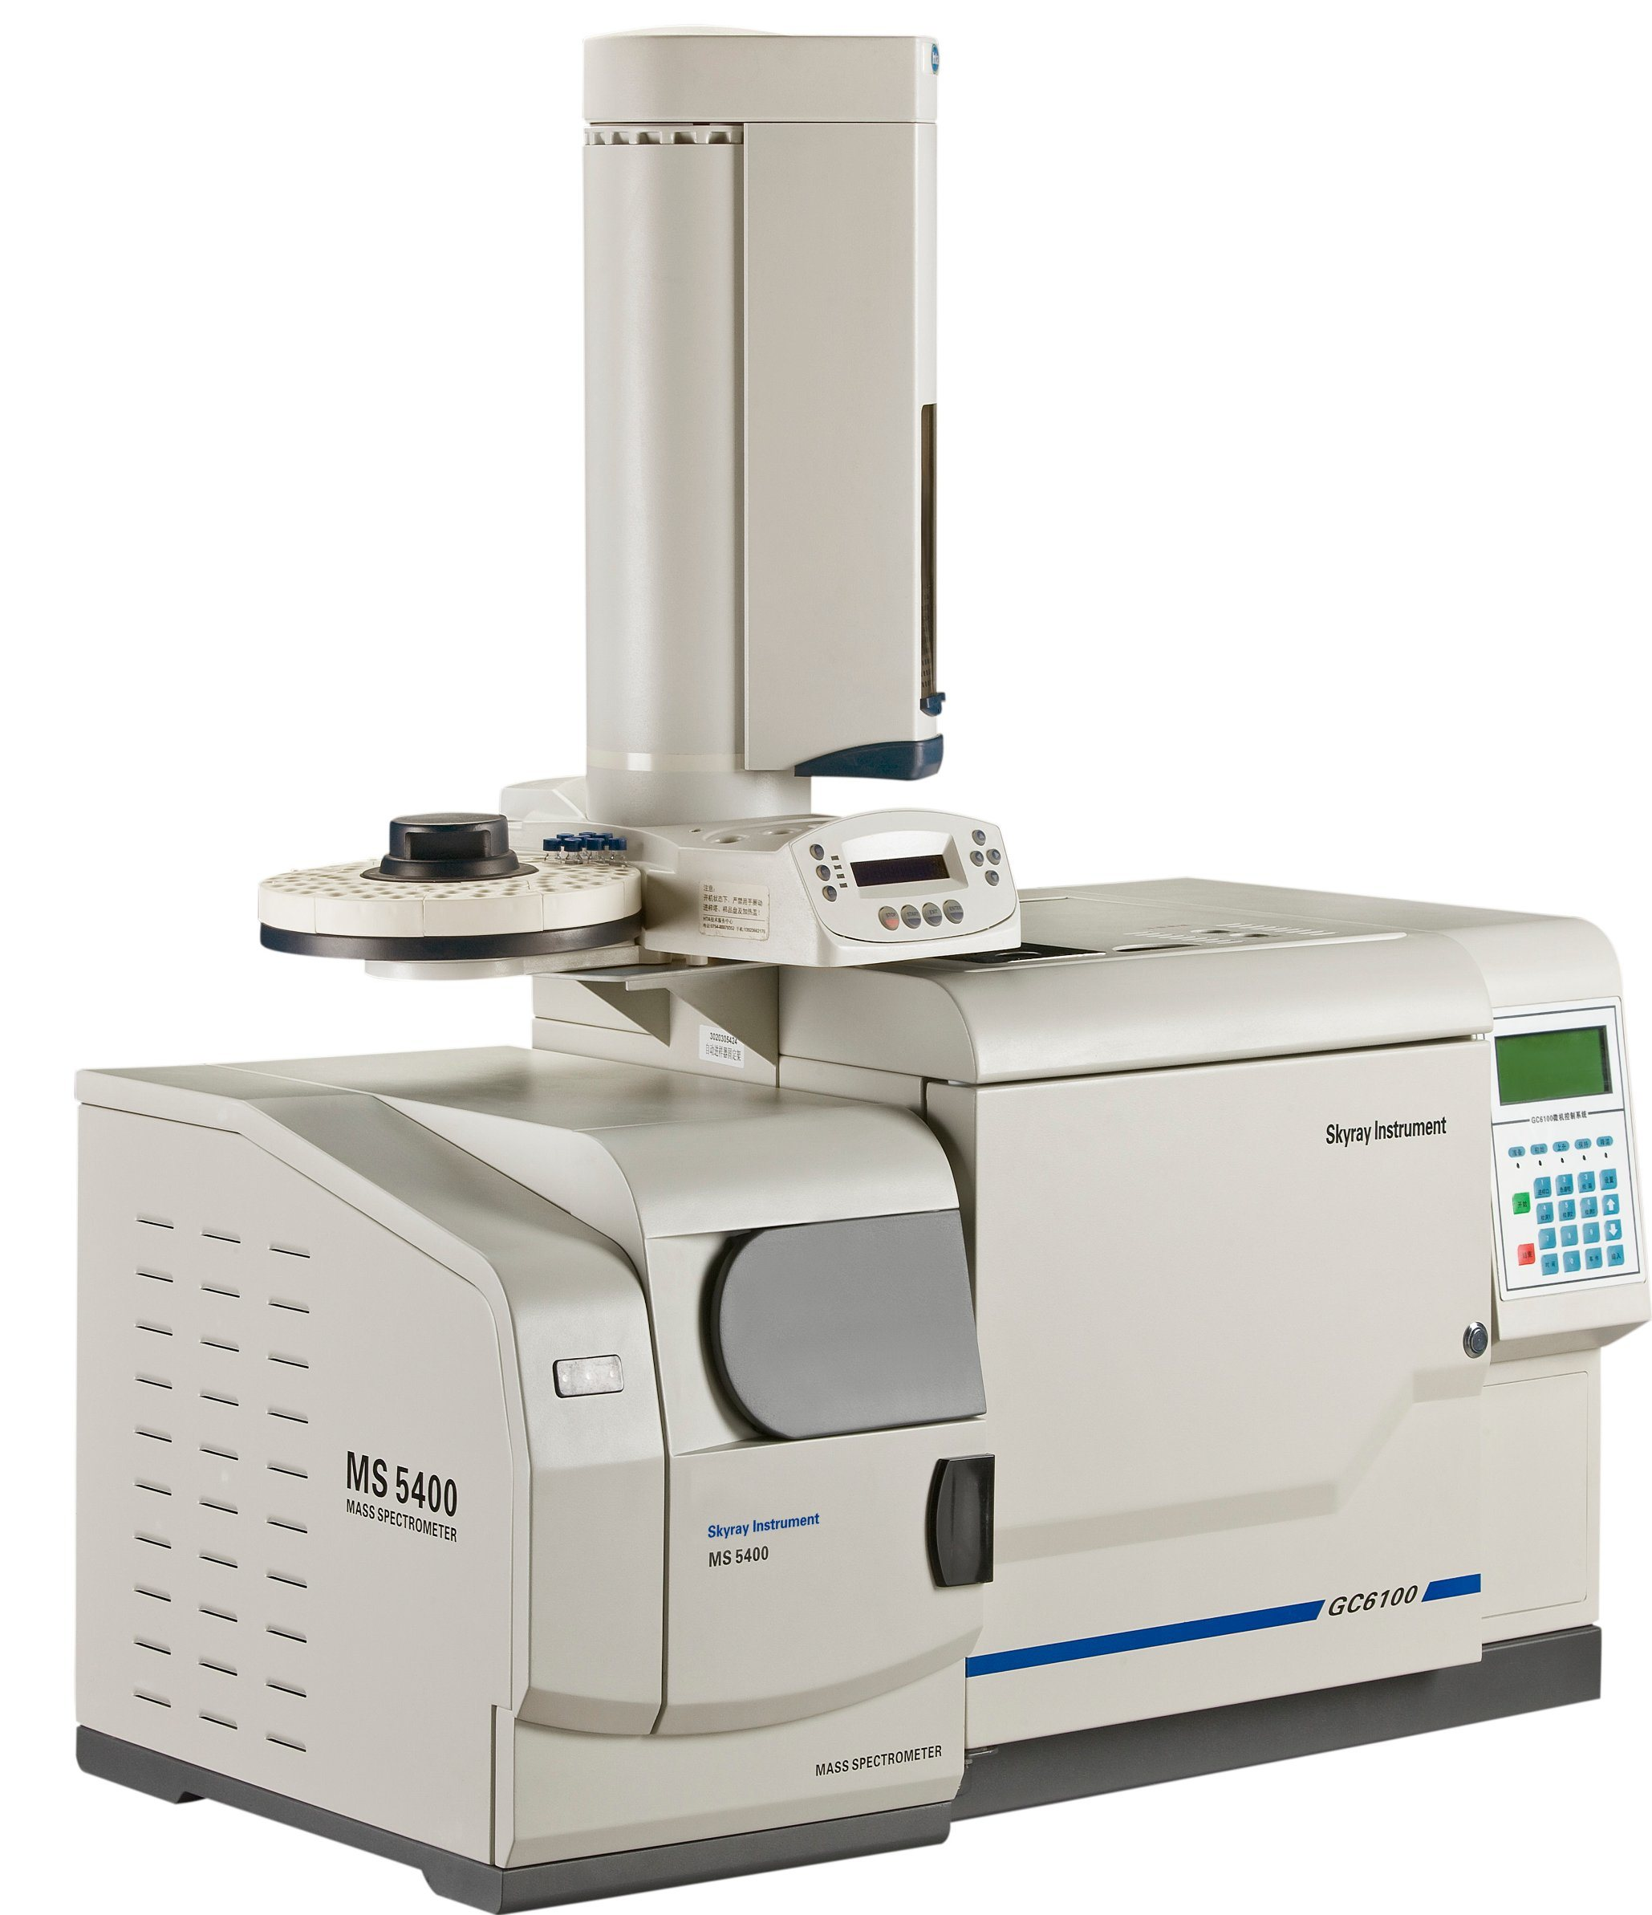
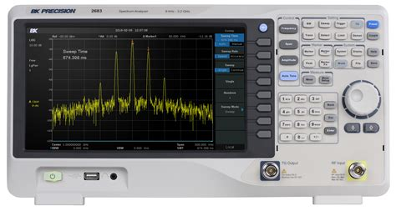
MICROSCOPE ARMY LATEST RESEARCH
Equipment requires training to operate and a budget:
- 12,000 USD for a good dark/light field microscope w/ digital display output
- 2K-3K USD for laptop, video display and HD editing
- 7K USD for lab hardware, supplies, accessories, etc.
(Note: this is only to do microscopic study.)
- Mass Spectrometer (2k – 200k)
- Electromagnetic Detection Hardware (spectrum analyzer, etc.)
- Faraday Cage
- Oscilloscope / Signal Generator
Equipment to run experiments (Faraday Cage, hardware R&D, etc.)
Conclusion: You need time, money and technical competency
WWW.FTWPROJECT.COM

Slide 5
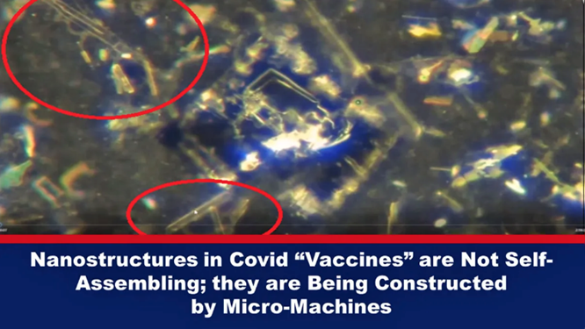
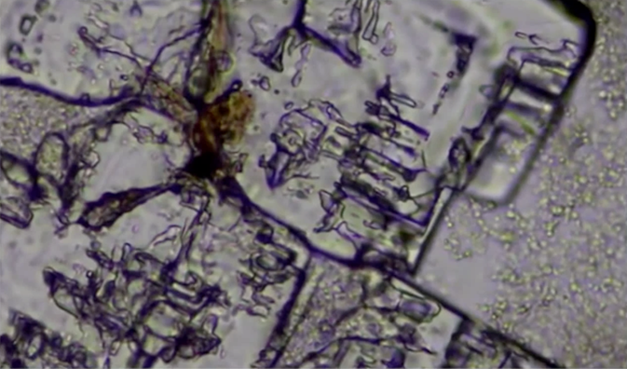
MICROSCOPE ARMY LATEST RESEARCH
Dr. Dave Nixon – Was able to demonstrate from samples taken from injections vials contain intelligent assembly and disassembly of synthetic structures in high resolution light/dark field microscopy over a large interval of time using time-lapse techniques. In closer inspection, it was observed micro-machines are building the larger structures (micro-circuits, etc.)
Matt Taylor, Electrical Engineer – Discovered that components of vial samples formed structures when the samples were near his active 4G wireless router. Only when he turned off the router, did these structures ‘dissolve’ back into the sample solution. He was able to repeat this process repeatedly with the same sample. He has continued to do numerous tests with other samples and experiments since his initial discovery.
UPDATE! Matt Taylor and Dave Nixon are both currently working on testing blue tooth code activations with the right equipment. Their findings so far: they can grow the chips outside of the body and get them to emit. They are also able to “harvest” chips at will. This means that we can start testing tools to eliminate these from the body without running human risk. More COMING soon.
WWW.FTWPROJECT.COM

Slide 6
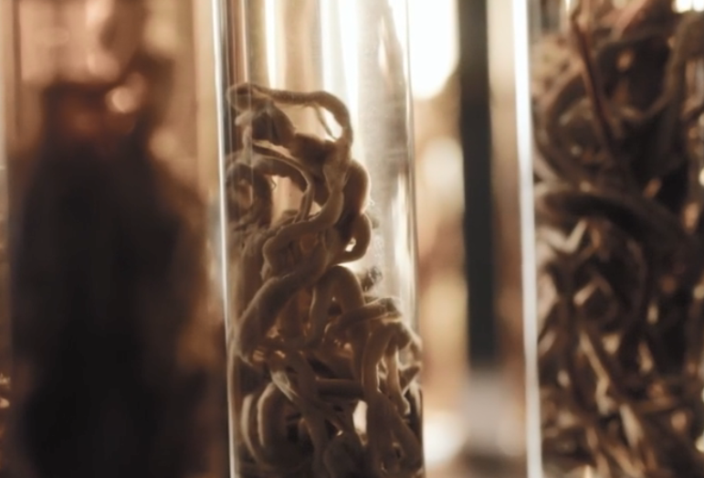
MICROSCOPE ARMY LATEST RESEARCH
Question arises. What connection do these constructs have with the clotting structures extracted from the embalmers?
Are the white fibrous structures made by and from the technology in the shots?
-Dr. Jane Ruby and Mike Adams (‘The Health Ranger’) Reveal Post-Covid Clot Mysteries
“These rubber structures are NOT blood clots” Summary of Laboratory Analysis Findings that were published from the elemental analysis:
- self assembling biostructures that get bigger over time inside peoples’ blood vessels
- unlike blood, contains only trace amounts of iron (5%), potassium, magnesium and chlorine, but more potassium
- Sodium, Tin (588%), and Aluminum were in much higher amounts in the structures than human blood
- This structure is ‘harvesting’ conductive elements from the blood to increase its size (grow). The structure take the shape of the artery (or vein) it resides in.
- These elements make these structures electromagnetically conductive in the RF range . For what purpose?
- It is unknown the exact mechanism by which these things are forming, although there are ideas. Lookup Dr. Charles Lieber Patents (arrested and convicted for selling ‘bio-circuitry’ secrets to China)
COMING SOON: HOPE AND TIVON WILL BE INTERVIEWING JANE RUBY TO DISCUSS THE TECHNOLOGICAL ASPECTS OF THE FINDINGS BY HER AND MIKE ADAMS AND MORE. SPECIAL REPORT WILL BE ON OUR RUMBLE CHANNEL.
WWW.FTWPROJECT.COM

Slide 7
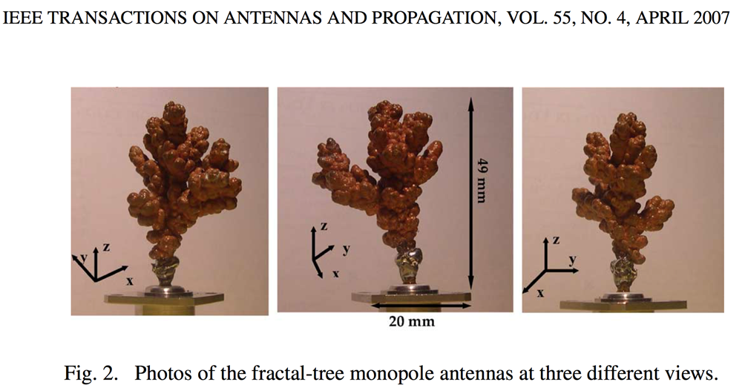
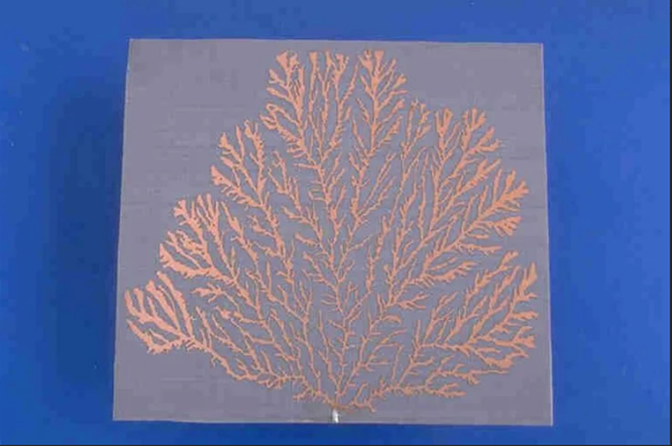
MICROSCOPE ARMY LATEST RESEARCH
Can they behave like fractal antennas?
Suggested Tests on Rubbery Fibrous ‘Clots’
- Do these fibrous clots change dimension when stimulated by EMF pulse(s)?
- Is there instantaneous thermal heating associated with these ‘clots/structures’ when stimulated by EMFs?
- Do these structures have resonant frequencies in the mega (and gigahertz) range (with low loss)?
WWW.FTWPROJECT.COM

Slide 8
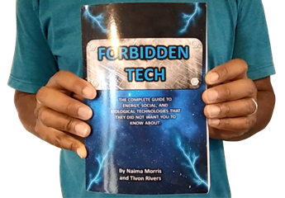
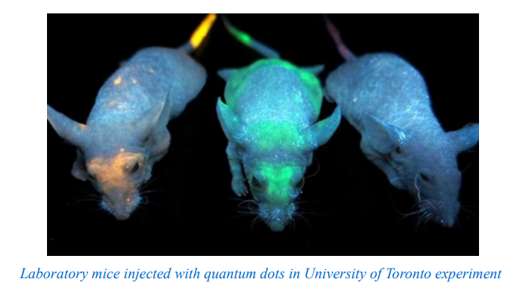
MENTAL SPIRITUAL EFFECTS OF JABS LATEST RESEARCH
We wrote about Quantum Dots in 2017. Now quantum dot technology is found to be in the COVID vaccines.
FROM OUR BOOK “FORBIDDEN TECH” 2017
WWW.FTWPROJECT.COM

Slide 9
MENTAL SPIRITUAL EFFECTS OF JABS LATEST RESEARCH
Karen Kingston recently did a presentation with Maria Zeee and connected the patented trans-humanist bio-technology, the creation of an AI-driven tyranny, and gateway to the demonic realm with the help of the quantum computing-based infrastructure. She also concluded that the plan set by these authors for humanity would be physically and mentally merged with artificial intelligence as the only means to advance further and losing one’s soul and spirituality in the process.
This is inline with Elon Musk’s warning about the responsible use of AI to avoid ‘...with AI we are summoning a demon’ (Elon,2014),
‘D-Wave’ Geordie Rose of Kindred AI in response to Elon’s quote says “these words..demons, does not capture the essence of what’s happening here.” Then later explains at a tech conference in Vancouver, that the entities summoned are more like ones in an HP Lovecraft (1890-1937) science/horror fiction book, super-intelligent and indifferent to humanity.
WWW.FTWPROJECT.COM

Slide 10
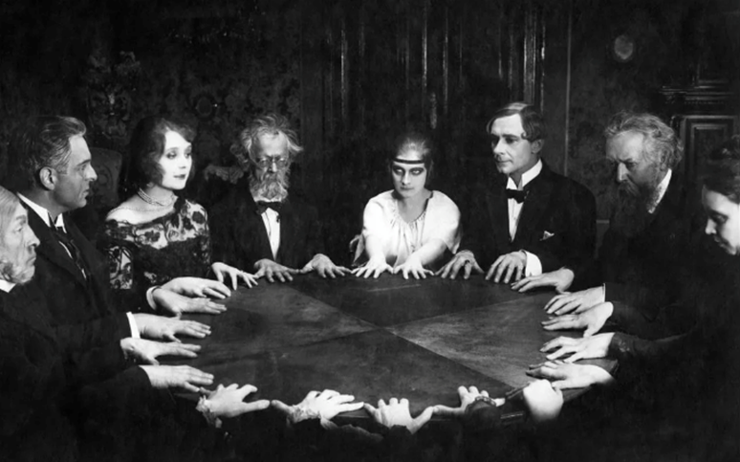
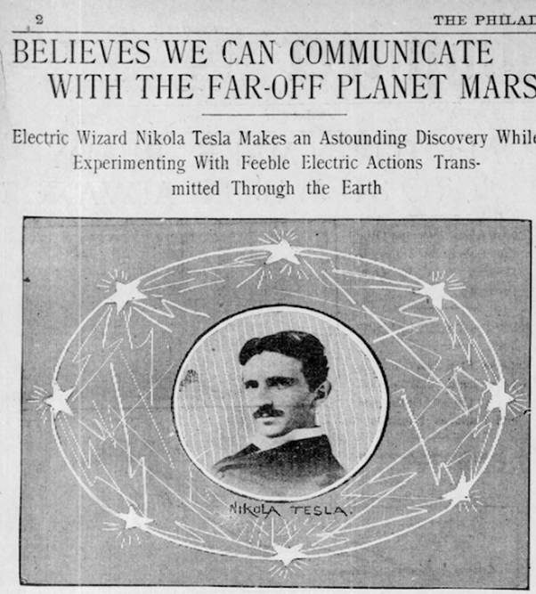
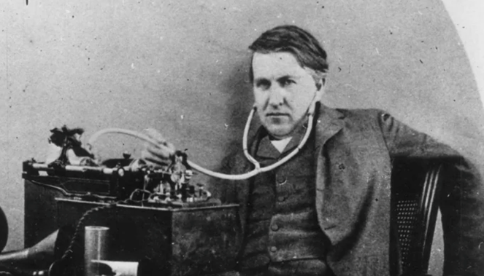
"Today they call them angels and demons, tomorrow they will call them something else" (ref extraterrestrial aliens, entities, etc.). -Aleister Crowley
Ghost summoning parties were the rage of the late 19th and early 20th century among the elites of Western society defining the Spiritualism Movement. There were also great strides innovation in human flight, telecommunication, motion pictures, photography and the application of both DC and AC currents. In fact, let us not forget that both prolific inventors Edison and Tesla had interest in communication with the heavenly realms.
Technology has always been used as a primary tool to connect to the divine among elite circles. The illusion of division between science and spirituality is only given to the masses
Edison’s Spirit Phone
“And the light of a candle shall shine no more at all in thee; and the voice of the bridegroom and of the bride shall be heard no more at all in thee: for thy merchants were the great men of the earth; for by thy sorceries were all nations deceived.” (Revelation 18:23, KJV)
WWW.FTWPROJECT.COM

Slide 11
Solution Mindset: It is easy to fall into hopelessness when listening to the advertised plans of the enemy. “If you are looking at this issue as a victim, you’re not thinking of a solution”GOD LAUGHS AT ENEMIES’ PLANSPsalm 37:13 (KJV) “The Lord shall laugh at him: for he seeth that his day is coming”“The wicked have drawn out the sword, and have bent their bow, to cast down the poor and needy, ant to slay such as be of upright conversation.Their sword shall enter into their own heart, and their bow shall be broken.”
WWW.FTWPROJECT.COM

Slide 12
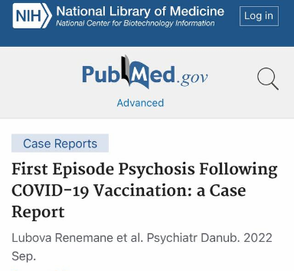
MENTAL SPIRITUAL EFFECTS OF JABS LATEST RESEARCH
TimTruth reported on vaccine events in the VAERs database related to the search terms ‘dream OR Nightmare OR Night Terror’. Many of the accounts describe dreams events related to; vivid night terrors on a nightly basis, sleep paralysis, sleep walking, an evil presence in the room, dreams of space, dark visual and/or auditory hallucinations while awake, time is longer in the dream than in reality, sensation of something grabbing at their feet in the bed, etc. There appears to be a steady increase of Night Terror cases since the initial injection roll-out.
Search term ‘vaccine vivid dream side effect’ in Google News search gives many hits of accounts of ‘crazy dreams’ as a side effect of the vaccine. Many sufferers claim that this never happened before the injection.
NEW STUDY: COVID INJECTIONS CAUSE PSYCHOSIS
WWW.FTWPROJECT.COM

Slide 13
SPINNING VAXXED COLLAPSING PHENOMENON
We did a video back in October discussing the phenomenon of people who were spinning while seeing something that terrified them just before collapsing on the ground in what appeared to be having a brain aneurism. We Found Predictive programming in an Episode of Stargate Atlantis that aired in 2004. It is about 20 years old. We believe these are scripts written by the CIA foretelling future plans.
In this episode members of the crew had nanotechnology infecting their brain, specifically their visual cortex, which caused them to hallucinate and see things in the demonic realm just before they collapsed and died from a brain aneurism.
WWW.FTWPROJECT.COM

Slide 14
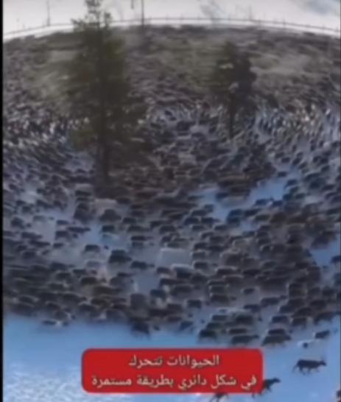
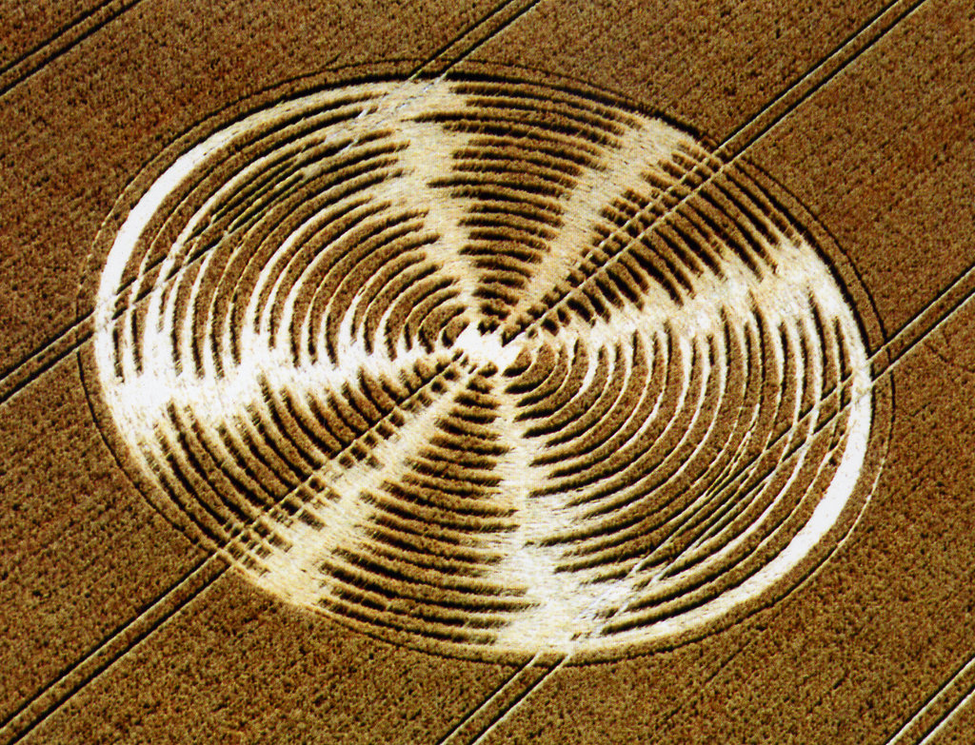
ANIMALS WALKING IN CIRCLES PHENOMENON
We have been asked by a lot of people what we think this is. We think this is caused by electromagnetic fields. It could be combination technology. Microwave weapons from satellite combined with nanotechnology injected into larger mammals. In the case of insects, they are usually extra sensitive to EMF.
Iron rich microspheres found in crop circles. Shows circles were formed in a magnetic field. Are they testing equipment for human control?
WWW.FTWPROJECT.COM

Slide 15
THE PLAN OF THE ENEMY- A PAPER TIGER
New G20 Agenda 2030 Document calls for Global Vaccine Passports G-20 leaders have adopted a joint declaration calling for the establishment of “global digital health networks” that build on existing digital COVID-19 vaccine passports. November 18
WHO Plans to Vaccinate Everyone with 500 New Vaccines by 2030 Dr. Rima Laibow Interview with Maria Zee COVID State of emergency extended to April 2023 msn.com “The public health emergency, which was set to expire on Jan. 11, will remain in place through the first quarter of 2022 to allow the government more time to offload responsibility for COVID-19 vaccines, tests, antiviral treatment, and other COVID-19 pharmaceuticals to the private sector” FEMA WHISTLEBLOWER: PLANDEMIC 2 COMING SOON SGT Report “The FEMA strategic planning calendar shows that the plan for this quarter and the next 4 quarters of 2023, we are under a pandemic exercise”
The Final Lockdown: digital currency / vaccine passports / surveillance / CBDC / weaponized street lights
G20 Sadikin on Global vaccine Passports
WWW.FTWPROJECT.COM

Slide 16
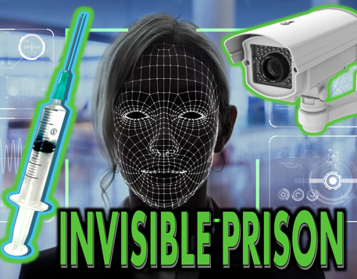
THE PLAN OF THE ENEMY- THE FINAL LOCKDOWN
Interview with Maria Zeee and Computer Scientist Aman Jabbi
A digital control system is being formed globally that includes: an international vaccine passport, a social credit system, a central bank digital currency (CBDC).
There are 1 billion data collecting surveillance cameras in the world all connected to the internet and using facial recognition. A lot of the hardware for these camera’s has been weaponized with drone charging stations and LED microwave weapons that can be used on crowds of people. Cell phones, automobiles, smart appliances also collect and share data.
Data on your activities is collected and fed to an AI control system that then establishes your credit score. Your digital identity will be your invisible prison.
WWW.FTWPROJECT.COM

Slide 17
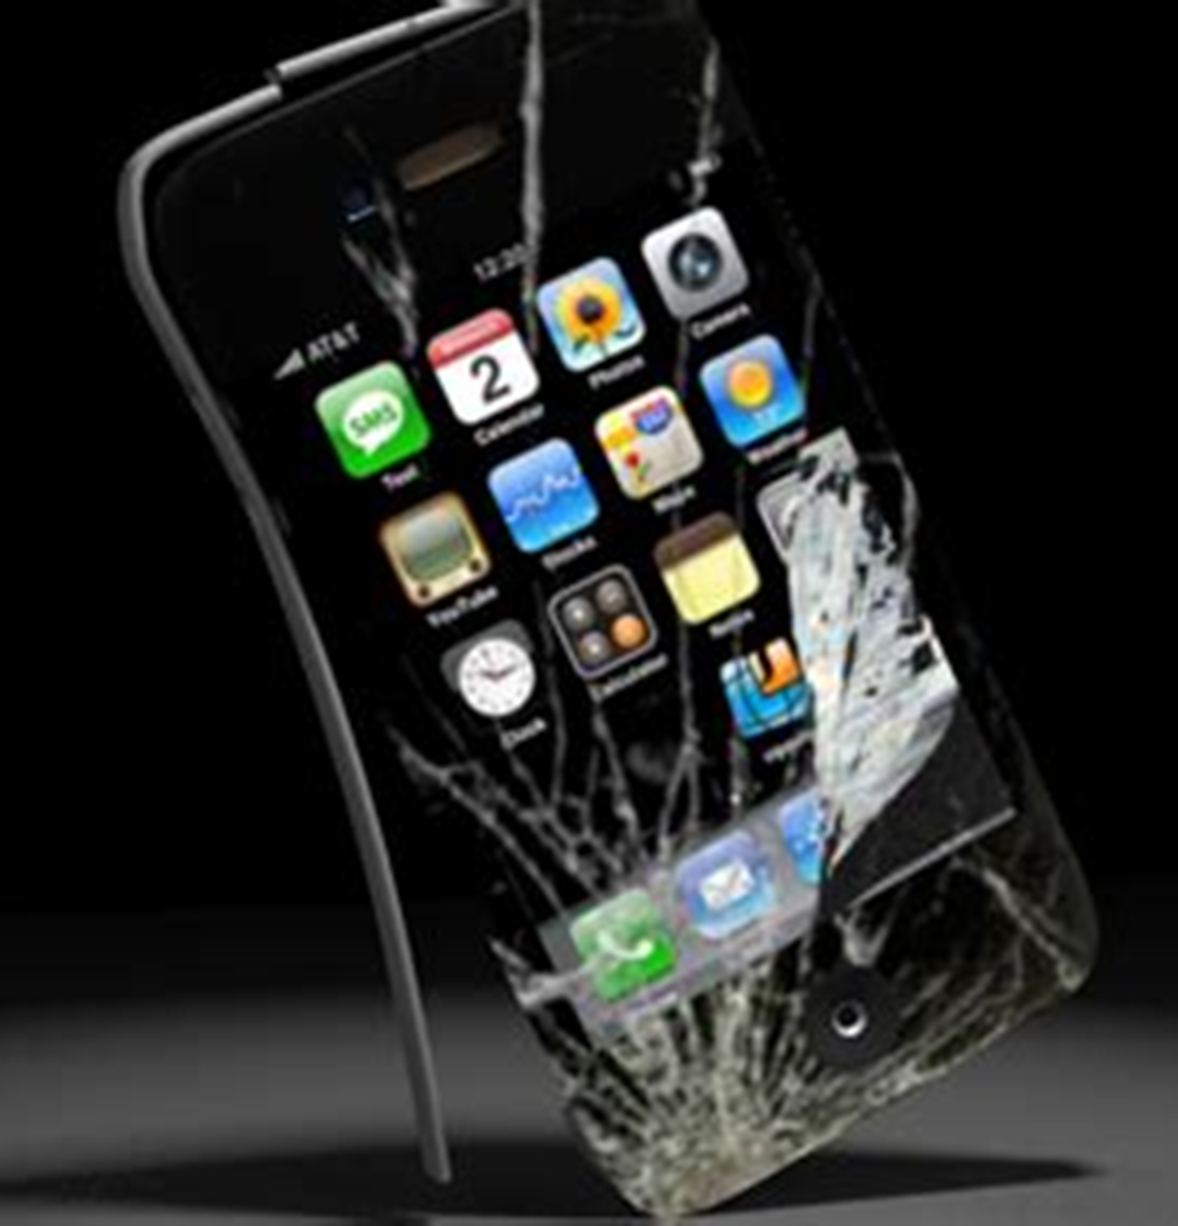
A PAPER TIGER. POKING HOLES IN THE EVIL PLAN
While we do believe the global powers will do their best to implement their plans, and we think that they may succeed with some aspects of their plans in a limited capacity, we see many flaws in their plans and we think most of their plans will fail for the following reasons: Vaccine Passports Did Not Work – True story of what really happened Most people are rejecting the boosters and they think they’ll get another 500 vaccines into the population? Americans still have guns – they will shoot before getting hauled off to a Fema camp Technology fails – camera maintenance? cell phones that work all the time? Power source and EMP? Many places in the world do not have the infrastructure to host this system which goes for surveillance, the tracking and tracing, and any form of digital currency.
WWW.FTWPROJECT.COM

Slide 18
IF ONLY PEOPLE WOULD HAVE WAITED A LITTLE BIT LONGER
We have seen it for ourselves while living in another country, their plans fell apart during COVID. The infrastructure wasn’t there to support the technology. The enforcement couldn’t control the people. The rules were enforced for a short period of time, and then ignored by the entire population.
Events we witnessed with people we know in our own life and community:
Morocco was only able to coerce its population into getting the vaccine for 4 months. After 4 months, all COVID regulations were completely eliminated. Anyone that was able to hold out for those 4 months and not get a vaccine is now allowed to do everything you were told you were required to get a vaccine to do. Our friend who did not want to get the vaccine, felt he had to get it in order to travel back to his business in the UK as the UK required a vaccine in order to enter the country. He had waited 12 months to get back into the UK. One month after he got the shots to go, the UK dropped all vaccine and testing requirements to enter the country. If he only would have waited… now he’s stuck with that poison in his body for the rest of his life.
Friends wanted to travel from the US into Morocco. They had gone 2 years without ever getting a PCR test or a vaccine. Morocco required a PCR test to enter the country. They waited till the vaccine mandate was dropped but there was still a PCR test requirement. They got their first PCR test to fly into the country. THREE DAYS AFTER THEY ARRIVED Morocco dropped the PCR test requirement. If only they would have waited…
WWW.FTWPROJECT.COM

Slide 19
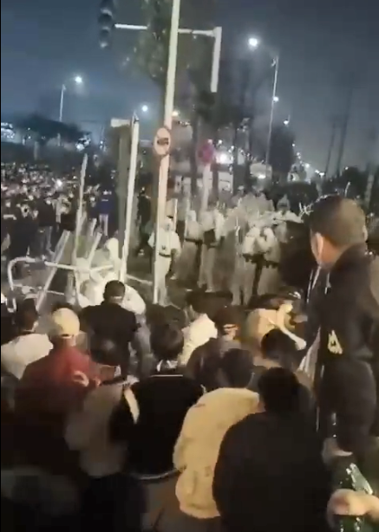
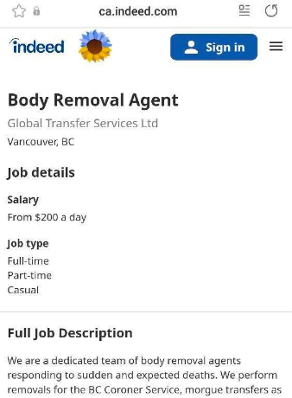
CRITICAL MASS AND THE RESISTANCE
DR PUT TO DEATH IN MALAYSIA Dr. Betsy Eads reports that a doctor in Malaysia has been put to death using the Nuremburg code for giving out COVID injections that killed people.
RIOTS IN CHINA Fire Kills dozens of residents trapped inside of a building thanks to lock down.
During world cup, Chinese see stadiums of free mask less people around the world and lose it. Worse than seen in 30 years.
BODY REMOVAL AGENT JOB LISTINGS FOR ALL THE SUDDEN DEATHS. In Canada paying $200 a day “a dedicated team of body removal agents responding to sudden and expected deaths”
WWW.FTWPROJECT.COM

Slide 20
MAYHEM IN THE SKIES
Number of pilots passing out or dying while flying has increased worldwide. Pilots are dying during take off and landing and co-pilots are taking over. In one incident both pilots fell asleep and missed their landing. One of the air traffic controllers that works in management in Madrid Spain anonymously reported that there were 28 unscheduled emergency landings in one month due to medical issues associated with people losing consciousness. Airline colleagues fearing they will lose their job have been discretely discussing the total number of unscheduled emergency landings due to medical issues that involve un-consciousness. It used to be 1-2 per YEAR across all Spanish airports. Now its about 30 a month, every month since the beginning of 2022.
WWW.FTWPROJECT.COM

Slide 21
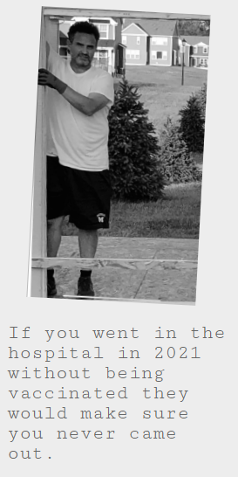
CRITICAL MASS HOSPITAL KILLING FIELDS ARCHIVE
The COVID-19 Humanity Betrayal Memory Project A living archive of COVID crimes against humanity. Testimonials of people who have been killed by the hospitals and more.
“THEY MURDERED MY MOTHER” “MURDERED BY MANDATE” “MURDERED BY FDA DEATH PROTOCOL” “I WATCHED THEM MURDER MY HUSBAND”
WWW.FTWPROJECT.COM

Slide 22
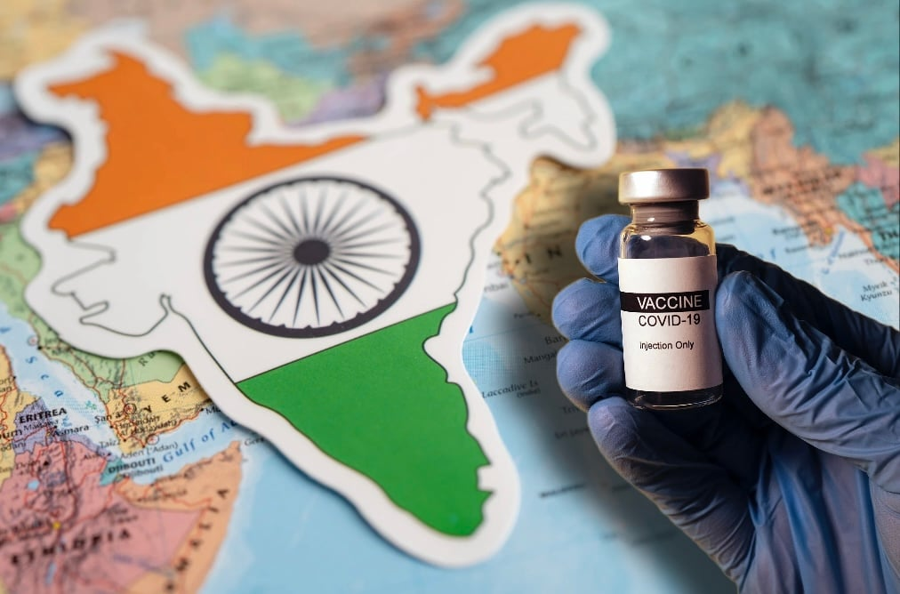
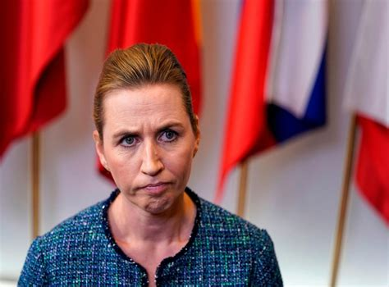
CRITICAL MASS AND THE RESISTANCE
INDIAN GOVERNMENT BLAMES PUBLIC FOR GETTING VACCINES DESPITE BEING AWARE OF ITS SIDE EFFECTS – CLAIMS IT CANNOT BE HELD LIABLE FOR INJURIES India government states vaccines were voluntary. They were administered by the government and all advertisement done by the government falsely informed the public that the vaccines were safe.
DANISH PRIME MINISTER FLEES WHEN CONFRONTED WITH VACCINE MASS MURDER
Prime Minister Mette Frederiksen, was confronted by the leader of a new Danish political party called the Freedom List, a new party formed during the COVID scandal. She fled like a criminal.
AUSTRALIA REVERSING 45,000 COVID FINES Two Australians won their case with the Supreme court over Covid Fines and as many as 45,000 penalties could be struck down as a result .
WWW.FTWPROJECT.COM

Slide 23
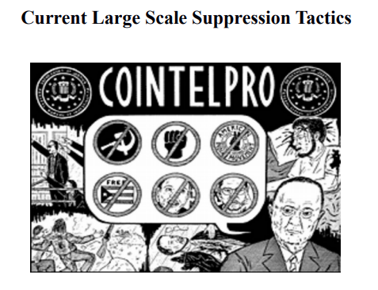
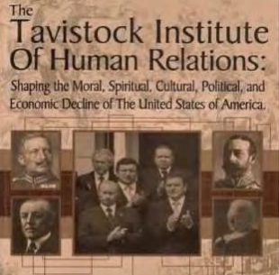
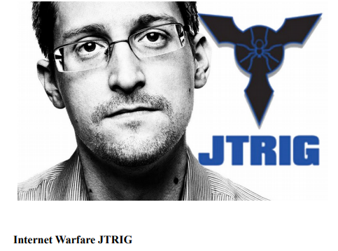
COINTELPRO TACTICS USED TO DELAY CRITICAL MASS
FROM OUR BOOK “FORBIDDEN TECH” 2017
The COINTELPRO program started in the 1950’s as an obscure branch of the CIA's MKULTRA mind control project group during the Cold War, a time when the United States and its allies were in conflict with Russia. COINTELPRO was a counter intelligence program. It was a series of covert (and at times) illegal projects conducted by the United States Federal Bureau of Investigation (FBI) which was aimed at surveilling, infiltrating, discrediting and disrupting domestic political organizations.
The Joint Threat Research Intelligence Group
The Joint Threat Research Intelligence Group (JTRIG) is a unit of the Government Communications Headquarters (GCHQ), the British intelligence agency. The existence of JTRIG was revealed as part of the global surveillance disclosures by NBC News in documents leaked by the former National Security Agency contractor Edward Snowden.
Tavistock is a propaganda creating and dissemination organization that studies human psychology and predicable behaviors known as “Social Science Scientists””. Tavistock is responsible for the US involvement in all world wars, the Bolshevik Revolution, CIA programs like MKUltra and much more.
By John Coleman
WWW.FTWPROJECT.COM

Slide 24
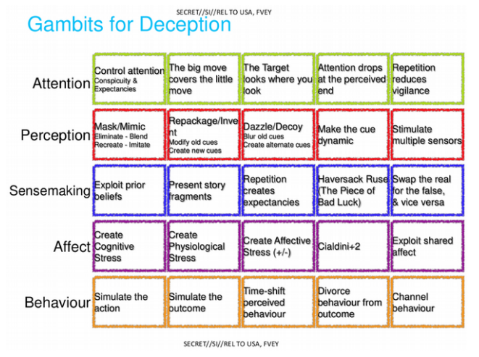
COINTELPRO TACTICS USED TO DELAY CRITICAL MASS
ONLY SOME OF THE TACTICS USED: FROM THE LEAKED JTRIG TRAINING DOCUMENTS
WWW.FTWPROJECT.COM

Slide 25
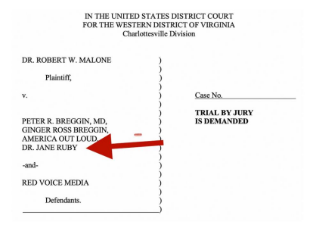
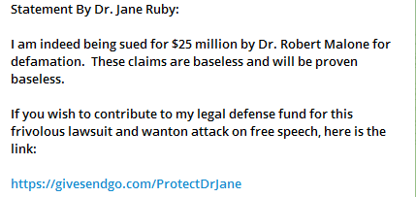
COINTELPRO TACTICS USED TO DELAY CRITICAL MASS
Recent examples happening NOW in the sphere of the “truth movement”. -Internet rumors of infighting amongst colleagues -Endless debates about trivial matters -Massive distractions -Discrediting leaders of the resistance -Scandals -Creating “Legal Vortices” (tied up in legal battles)
Dr. Robert Malone is suing 4 of the leaders of truth and resistance against the global genocide for “defamation” for 25 MILLION DOLLARS. Dr. Peter and Ginger Breggin’s: Dr. Peter McCullough American Out Loud Dr. Jane Ruby Stew Peters Red Voice Media
DESIRED END RESULT IS TO KEEP THE MASSES FROM UNITING TO FIGHT AGAINST THE GOVERNMENT THAT IS ENGAGED IN AN ACTIVE WORLDWIDE GENOCIDE OF HUMANITY
WWW.FTWPROJECT.COM

Slide 26
COINTELPRO TACTICS USED TO DELAY CRITICAL MASS
AFLDS Whistleblower SPEAKS OUT: Give me the GOLD! Top Front Line Doctor Simone Gold Accused Of Buying Mansion, Luxury Cars With Front Line Money Dr. Simone Gold is the founder of America’s Frontline Doctors (AFLDS). One of the leading defenses against the Covid Tyranny. AFLDRS raised money in donations that was meant to help victims of the Covid Tyranny. While spending 60 days in jail for participating in Jan 6 at the capital, an audit was performed on Simone Golds personal finances. There is now a lawsuit underway, the lawsuit states she embezzled the money from the organization and spent it on a 3.6 million dollar mansion which she lives in rent free with her boyfriend who is an underwear model that is 20 years younger than her. She bought three cars with the groups money, spent $12,000 a month on personal security, $5,600 a month on a personal housekeeper, she uses the groups money to fly around on private jets and her boyfriend uses $10,000 a month on himself with the groups credit cards.
The other members of the AFLDS staff is now in an uproar against what they have discovered. A whistleblower came forward on the Stew Peters show to discuss what was happening.
WWW.FTWPROJECT.COM

Slide 27
SPECIAL VIDEO WE MADE JUST FOR SGT REPORT
FROM ALL OF US HERE AT FIX THE WORLD MOROCCO
WWW.FTWPROJECT.COM

Slide 28
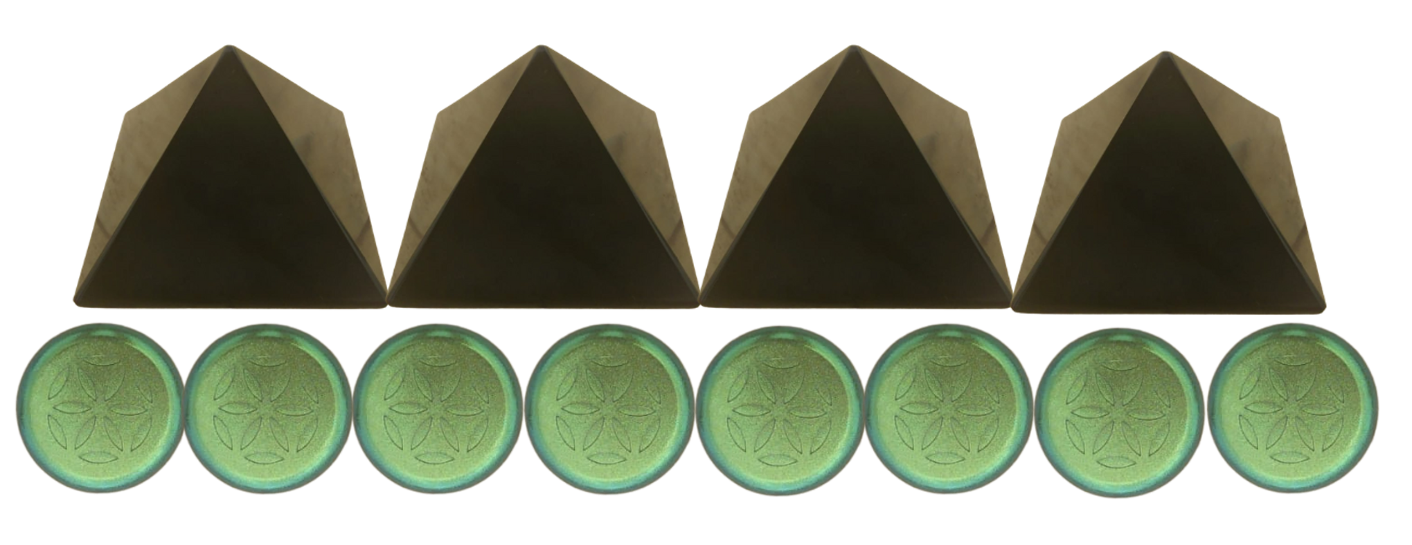
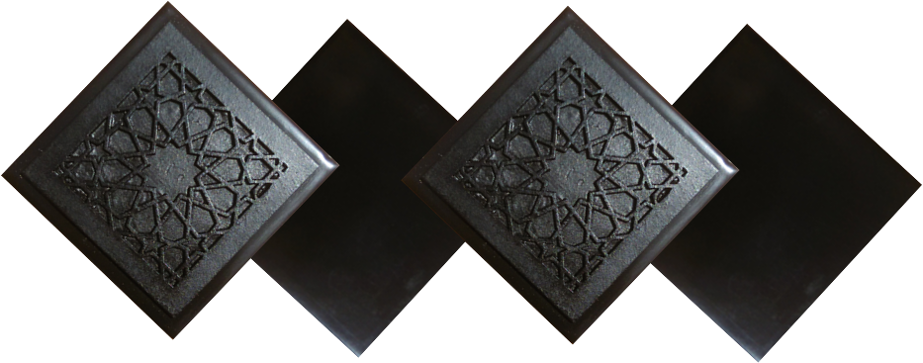
ABOUT OUR EMF PROTECTION PRODUCTS
HELP SUPPORT SGT REPORT BY SHOPPING FROM THIS LINK: https://www.ftwproject.com/ref/6/
SLEEPING PODS For a good nights sleep
CHARGE PLATES for use around the home, to preserve food and more
“We just can't believe our eyes! We have placed the garden pucks from our first order around our property, and the plants/trees with the pucks are BLOOMING within days! This is happening with every single place the pucks have been rested. Just incredible.” -Australia
PHONE SHIELDS to put on your cell phone, laptop and routers
PENDANTS for personal emf protection on your body
PYRAMIDS and garden sets for gridding your home / property / garden for emf protection on a large scale
SCIENTIFIC STUDIES AND DOCUMENTATION DESCRIBING HOW OUR PRODUCTS WORK AVAILABLE ON OUR WEBSITE.
TILES for incorporating emf protection into construction projects
WWW.FTWPROJECT.COM

