Slide 1
TITLE SLIDE
WWW.FTWPROJECT.COM

Slide 2
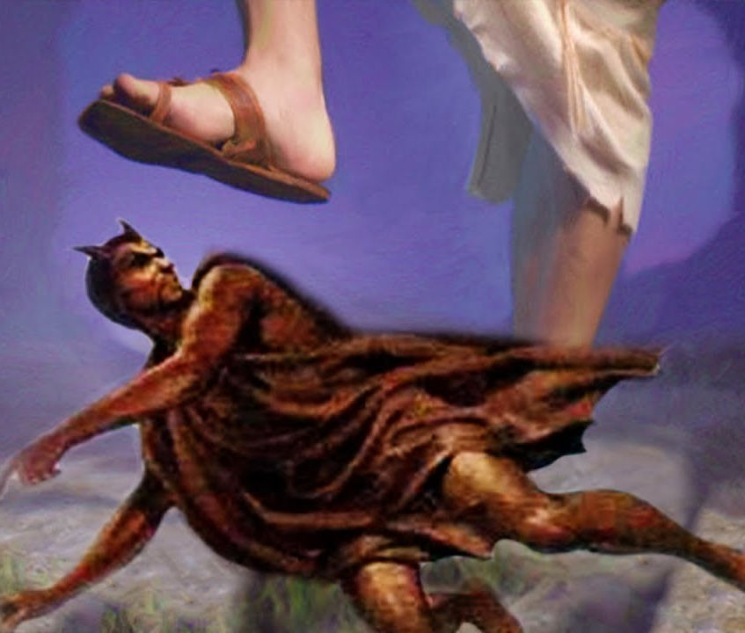
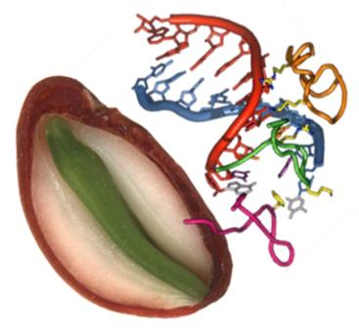
HOW DID WE GET HERE? HISTORICAL BACKDROP
The Seed War This goes back to the beginning, in the garden of Eden when the serpent told Adam and Eve: “For God doth know that in the day ye eat thereof, then your eyes shall be opened, and ye shall be as gods, knowing good and evil” When God found they had eaten of the fruit he said to the serpent “I will put enmity (extreme hatred) between you and the woman, and between your seed (Satan) and her seed (Jesus). He will crush your head, and you will strike his heel.”
We are made in Gods image. GOD has written HIS NAME in Every Strand of Human DNA https://www.drrobertyoung.com/post/god-has-written-his-name-in-every-strand-of-your-dna
Satan despises everything that is made in Gods image, and has been striving for thousands of years to take Gods creation and corrupt it so that it is no longer part of God’s kingdom.
SEED = DNA
WWW.FTWPROJECT.COM

Slide 3
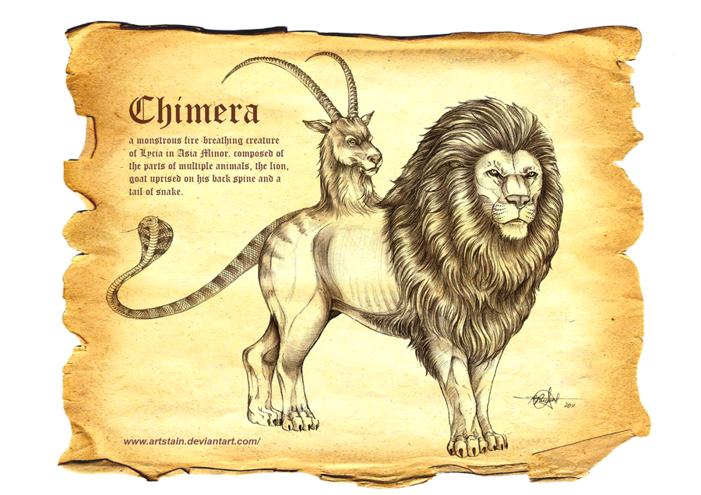
HOW DID WE GET HERE? THE DAYS OF NOAH
Jesus said “As it was in the days of Noah, so will it be at the coming of the Son of Man”
The “Book of Giants” was one of the many manuscripts found in the caves of Qumran in 1947 now known as the “Dead Sea Scrolls” The book of giants describes in detail how the fallen angels insidiously corrupted the genetics of all flesh on the earth.
“ And God saw that the wickedness of man was great in the earth, and that every imagination of the thoughts of his heart was only evil continually.
And it repented the Lord that he had made man (and every creature) on the earth, and it grieved his heart.” Genesis 6:6
HAPPENING DURING DAYS OF NOAH -Genetic Modification -Transhumanism -Beastiality
Miscegenation refers to the mixing of races or species.
This was extreme cross species genetics involving the seed of the fallen angels themselves.
WWW.FTWPROJECT.COM

Slide 4
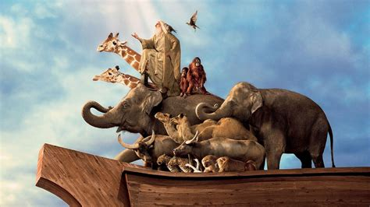
HOW DID WE GET HERE? NOAH’S ARK
God put animals onto the Ark, each ACCORDING TO ITS KIND. (not genetically modified) Noah was “righteous in his generation” (not genetically modified)
God only wanted pure genetic material that he created on the Ark.
WWW.FTWPROJECT.COM

Slide 5
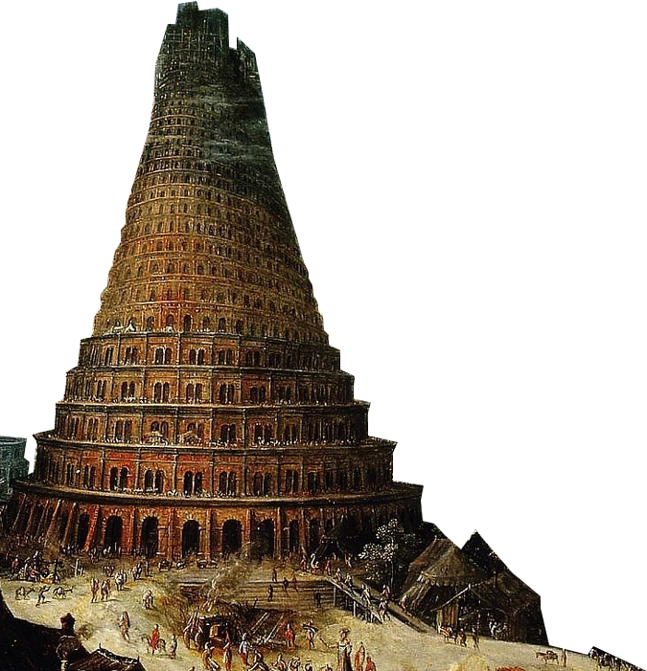
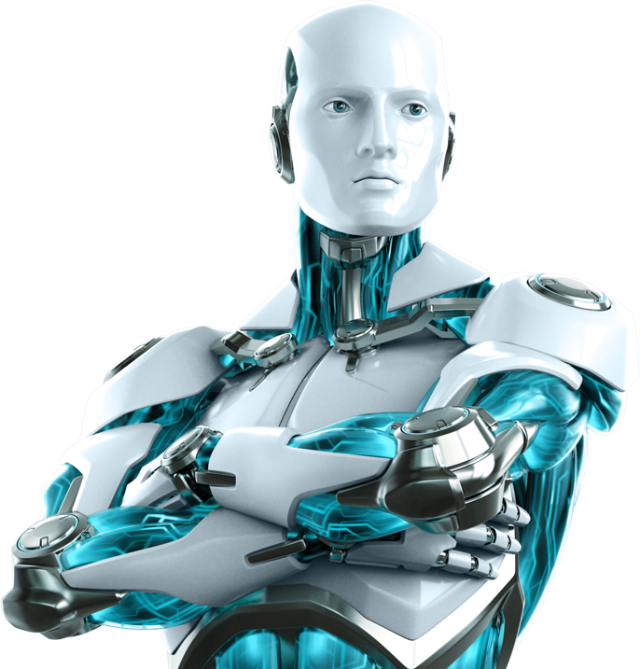
HOW DID WE GET HERE? NIMROD, TRANSHUMANISM, TOWER OF BABEL AND ARTIFICIAL INTELLIGENCE
Noah cursed his son Ham, who later on had a son called Cush, who then became Nimrod who was the first transhuman on the earth after Noah. Nimrod became the founder of the Babylonian mystery schools and the tower of babel. Noah also cursed all of the Canaanites the land of the giants who were also transhuman hybrids, not of pure genetic material. This was rooted in the Babylonian mystery schools which led to the tower of babel, which was the intellectual equivalent of the artificial intelligence, transhumanist movement that is happening today. The Babylonian mystery schools also founded what we know today as the beast system, members of whom are the “Children of Darkness”
WWW.FTWPROJECT.COM

Slide 6
THE INTENTIONAL DESTRUCTION OF THE TEMPLE (HUMAN DNA)
“Do you not know that your body is a temple of the Holy Spirit who is in you, whom you have received from God? You are not your own; you were bought at a price. Therefore glorify God with your body” 1 Corinthians 6:19
GOD CAN SEE HIS DNA. THE LORD KNOWS WHO IS HIS.
We are made in his image. “Before I formed you in the womb I knew you, And before you were born I consecrated you;” Nevertheless, the firm foundation of God stands, having this seal, “The Lord knows those who are His,” and, “Everyone who names the name of the Lord is to abstain from wickedness.” Timothy 2:19 Notice the word “seal” which is similar to the seal or the mark God puts on his people, Satan has a mark too, this is the mark of the beast. It could be referring to genetics. God can see those who have altered their DNA…
“The Covid “Vaccine” is a Genetic modification technology designed change your God given DNA and permanently weaken your immune system. They want us dead. Those that survive will be chronically sick for life. Those that have multiple boosters will be moved into the transhumanism movement.” Dr. Sherry Tenpenny
“…depart from me for I never knew you”
WWW.FTWPROJECT.COM

Slide 7
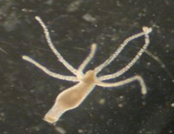
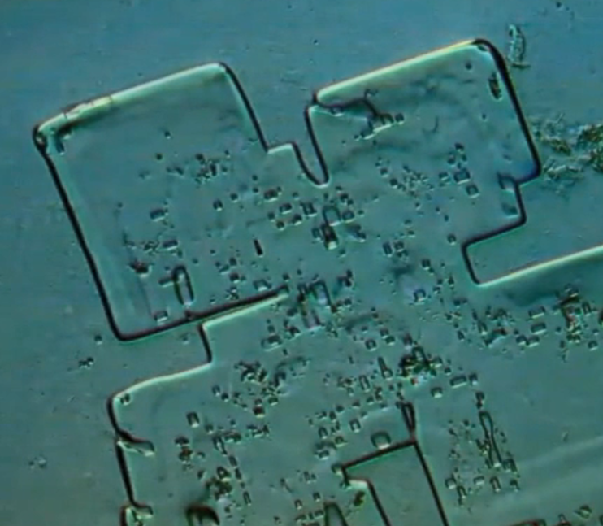
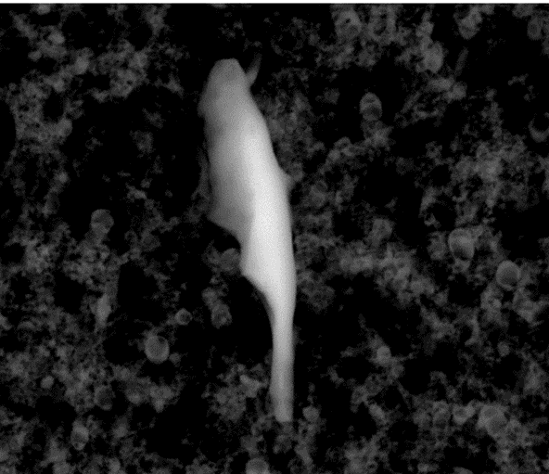
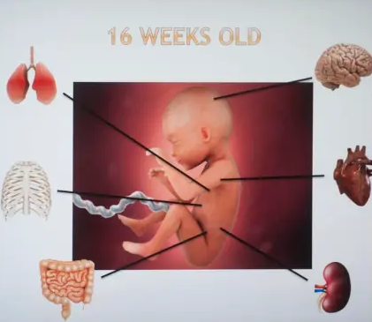
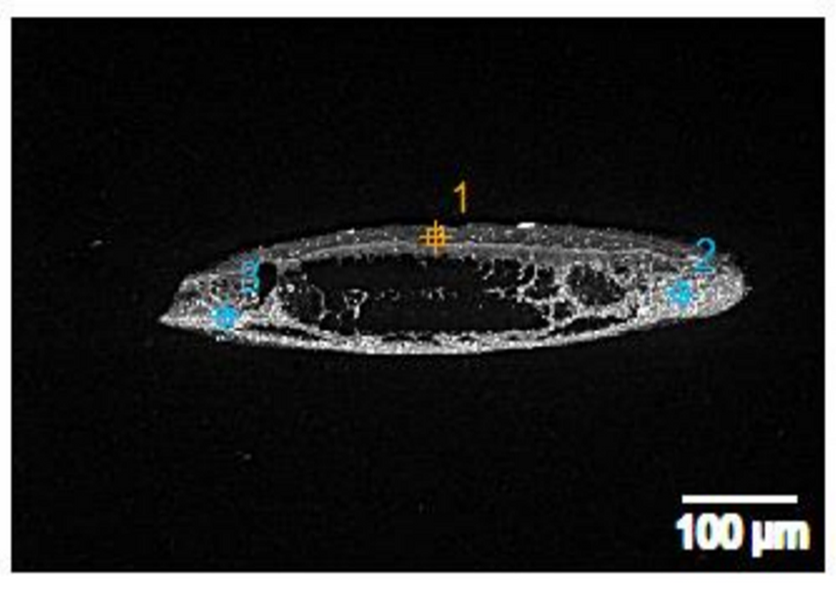
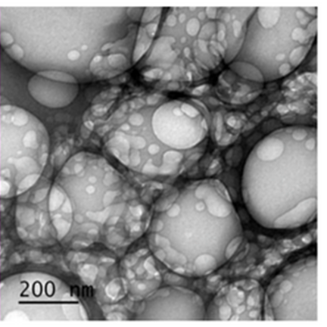
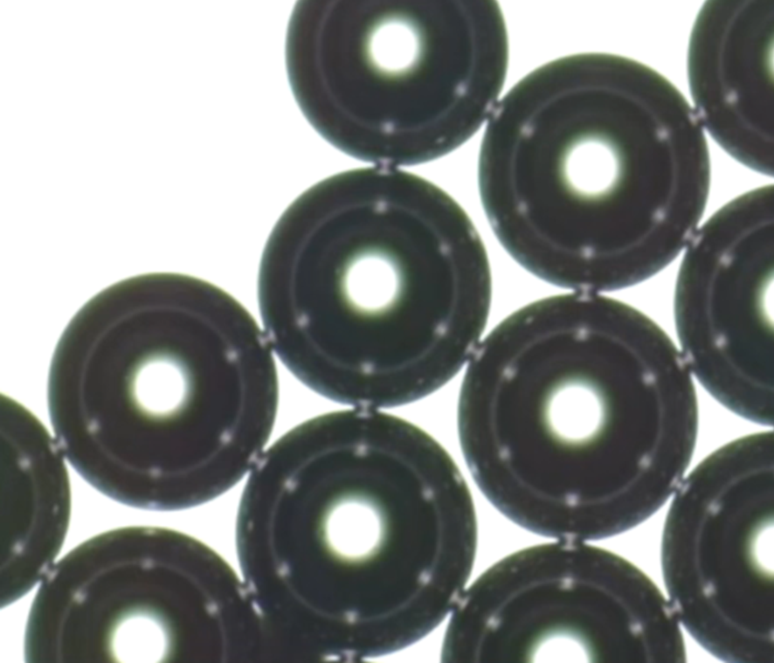
THIS IS WHAT WE KNOW IS IN THE COVID INJECTIONS (SO FAR):
“… receiving in themselves that recompence of their error” (Injections?) Romans 1
HYDRA VULGARIS ORGANISMS (GMO)
MICROCHIPS
PARASITES
ABORTED HUMAN FETAL TISSUE
STEEL AND ALUMINUM METALS
MICROBUBBLE TECHNOLOGY
GRAPHENE OXIDE
WWW.FTWPROJECT.COM

Slide 8
Found in Covid Injections: (compared to scientific papers) Nano Routers that emit MAC addresses via Bluetooth Nano antennas and plasmonic antennas to amplify signal Nano rectennas as rectifier bridge of alternating and direct current Codecs- devices that perform transformations on a data stream or signal Logic gates- small digital electronic devices that compute binary functions like “and”, “or” ,“not” ,“true”, “false” ,“less than” ,“greater than” , etc. Used for the encryption of these network communications from vaccinated individuals to a remote network server.
PATENTS THAT DESCRIBE HOW THEY WILL HOOK UP HUMAN BEINGS TO THE “INTERNET OF THINGS” VIA 5G. (Now we know that they need the nanotech in the Covid shots in order to accomplish this) Routing policies for biological hosts (AT&T) US10163055B2 Devices and Methods for Transferring Data through a Human Body (AT&T) No. 20130142363 Cryptocurrency system Using Body Activity Data (Microsoft) W02020060606
Text
EXCELLENT REPORT! MUST READ! LINK IN BLOG POST TO REPORT IN ENGLISH “INTRABODY NANO NETWORK BRIEF SUMMARY” –MIK ANDERSON THROUGH LA QUINTA COLUMNA
WWW.FTWPROJECT.COM

Slide 9
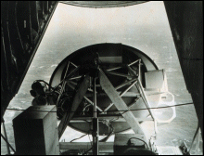
Operation Crimson Mist: Electronic Slaughter in Rwanda American forces flew a plane with a microwave dish and beamed the Hutu's with rage inducing low frequencies causing them to slaughter the Tutsis.
Dr. Pierre Gilbert: Magnetic Vaccines to Control People “In the biological destruction there are the organized tempests on the magnetic fields. What will follow is a contamination of the bloodstreams of mankind, creating intentional infections. This will be enforced via laws that will make vaccination mandatory. And these vaccines will make possible to control people. The vaccines will have liquid crystals that will become hosted in the brain cells, which will become micro-receivers of electromagnetic fields where waves of very low frequencies will be sent. And through these low frequency waves people will be unable to think, you’ll be turned into a zombie. Don’t think of this as a hypothesis. This has been done. Think of Rwanda”
WWW.FTWPROJECT.COM

Slide 10
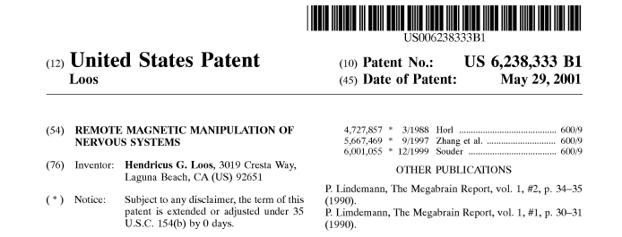
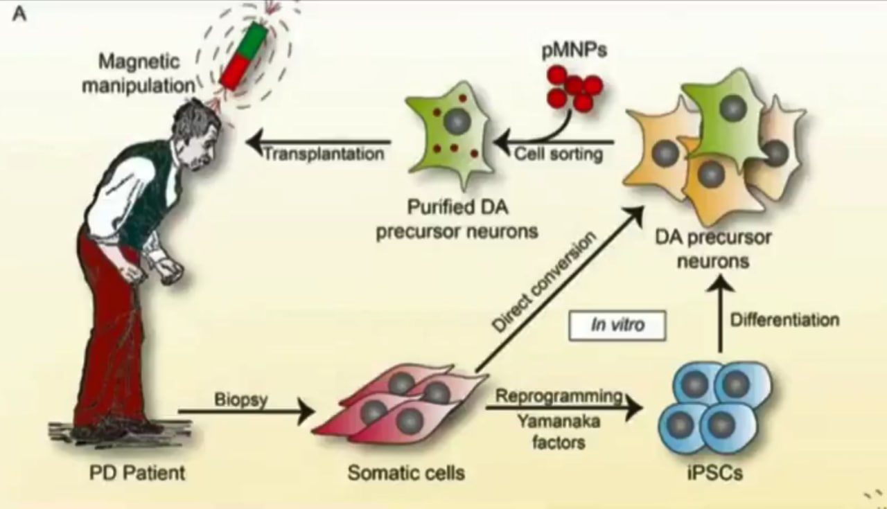
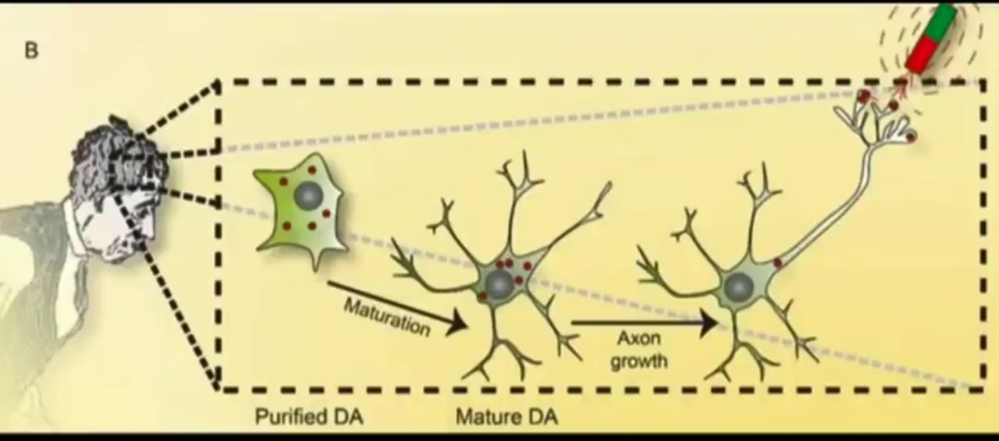
PATENT EXAMPLES MENTAL MANIPULATION
WWW.FTWPROJECT.COM

Slide 11
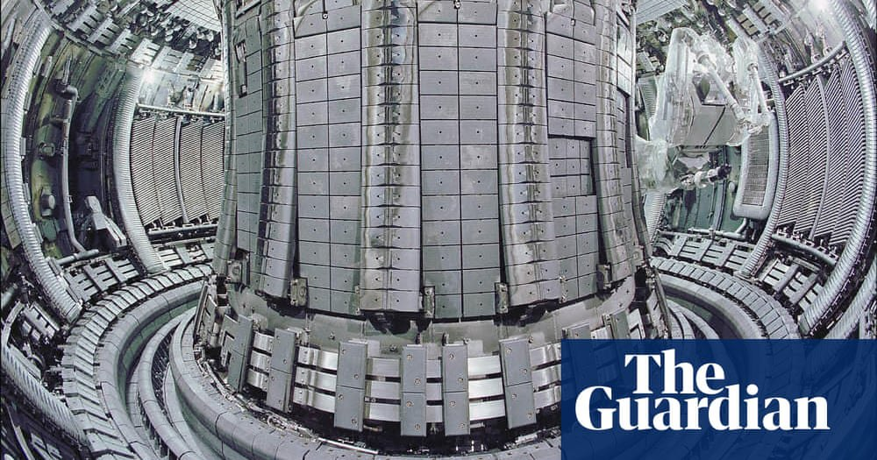
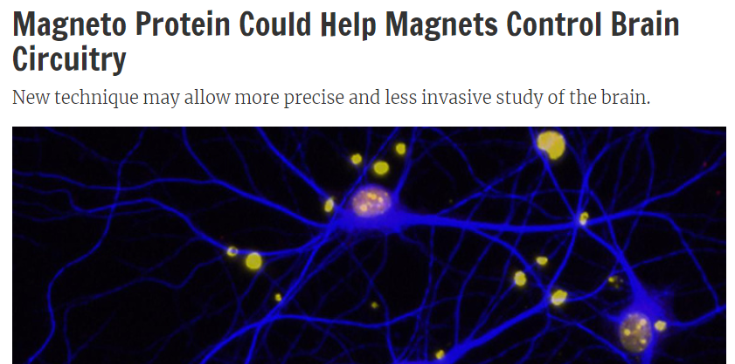
MAGNETO PROTEIN TO CONTROL BRAIN AND BEHAVIOR
Researchers in the United States have developed a new method for controlling the brain circuits associated with complex animal behaviours, using genetic engineering to create a magnetised protein that activates specific groups of nerve cells from a distance.
(Inside Science) -- Genetic engineering can now help researchers use magnets to control nervous systems. Scientists have successfully controlled the behavior of zebrafish and mice with this research, and suggest that one day it might help treat brain disorders in people.
WWW.FTWPROJECT.COM

Slide 12
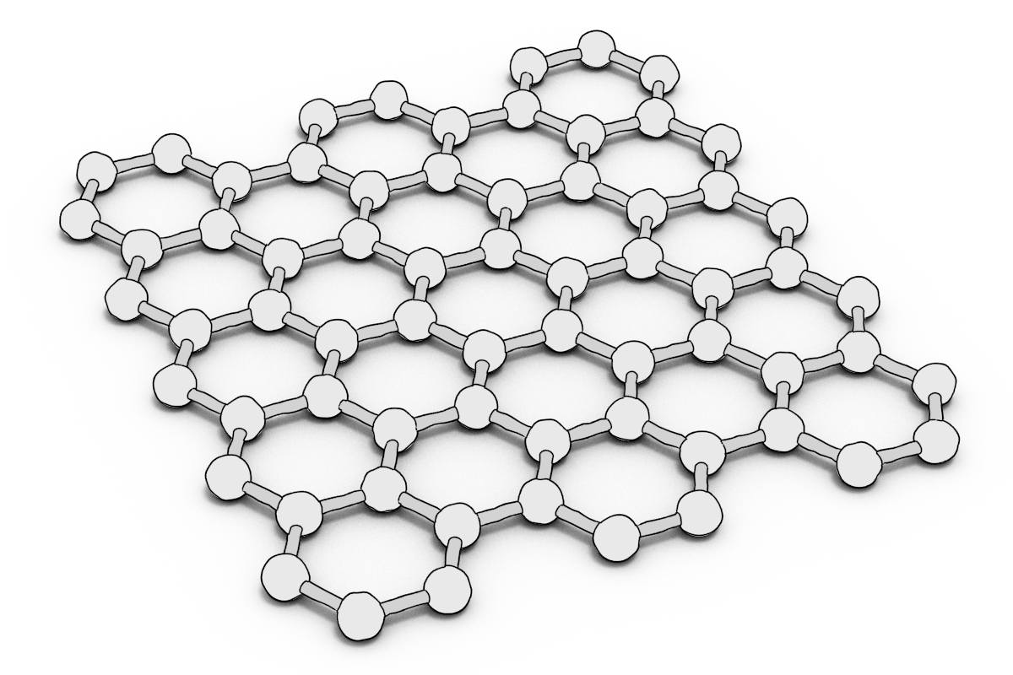
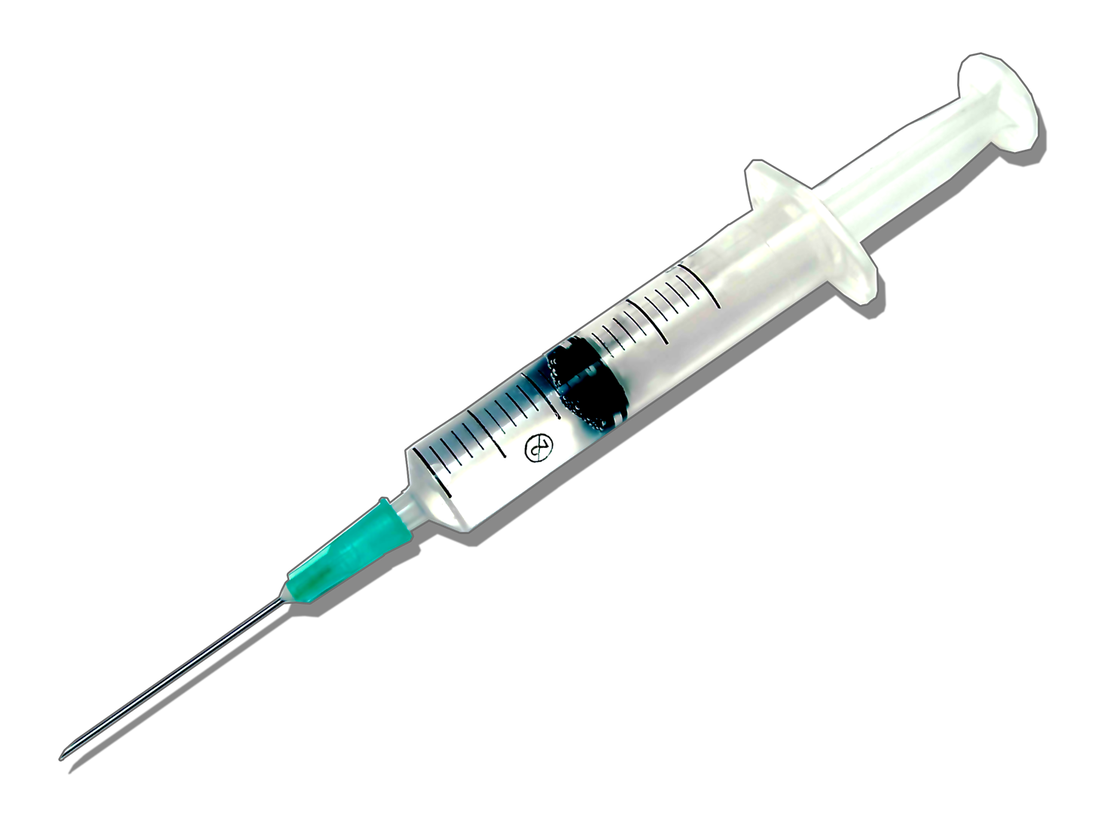
Graphene oxide is activated by electromagnetic frequencies (EMF), specifically the frequencies that are part of the 5G spectrum. All materials have what is known as an electronic absorption band. An absorption band is a range of wavelengths, frequencies or energies in the electromagnetic spectrum which are characteristic of a particular transition from initial to final state in a substance. This is a specific frequency above which a substance is excited and oxidizes very quickly. Frequencies beamed at human beings that have a build up of graphene oxide in their body can cause the graphene oxide to multiply very rapidly, breaking the balance of glutathione and causing a cytokine storm in a matter of hours.
Graphene Oxide is the main ingredient in DARPA patented hydrogels. It is these hydrogels that are in the Covid Jabs, the PCR test swabs and the masks. A conductive hydrogel is a polymer like material that has substantial qualities and applications. They are developing different kinds of conductive hydrogels that are being used in many things, in our food, our water, and injected into our bodies in vaccines. Conductive hydrogels contain nanotech that locks on to your DNA and can be controlled by 5G sensors. They allow for DNA collection and manipulation. Conductive hydrogels allow for tracking tracing and biological and mental control of human beings.
Notes:
If time permits we’d like to play this 4 minute clip https://www.youtube.com/watch?v=aVj7_0A5-Ew

Slide 13
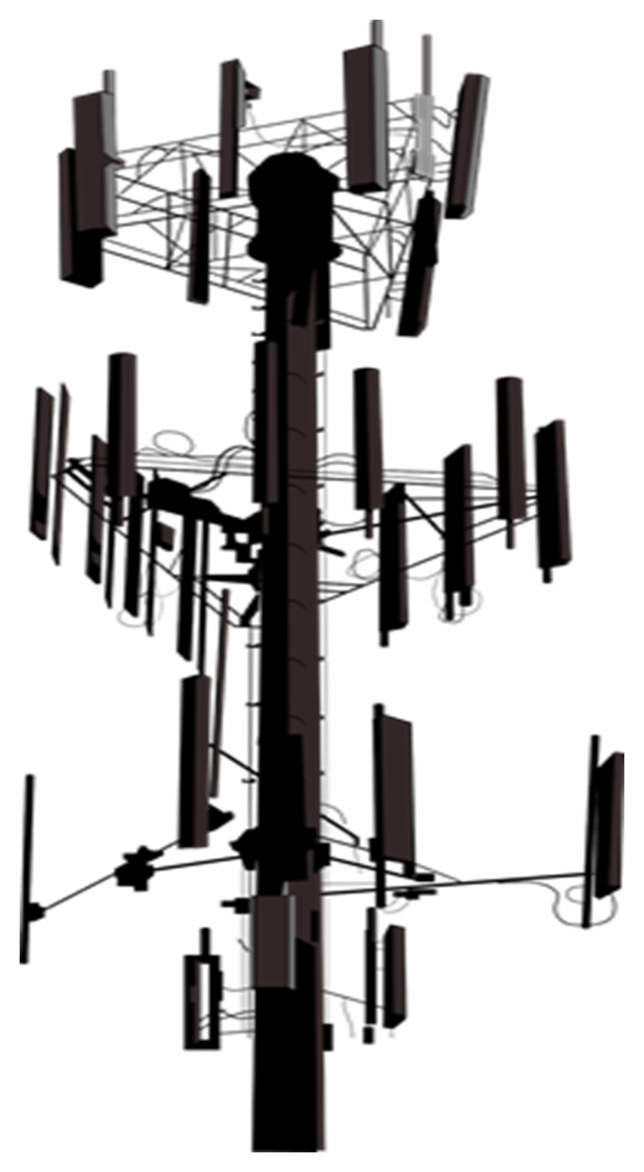
STOP THE BEAST SYSTEM
SOLUTIONS: Protect yourself from shedding by limiting your exposure to freshly vaccinated crowds whenever possible and with a full immune system protocol, include supplements that block spike protein transmission and remove graphene oxide from the body.
Mitigate EMF in your environment to stop the transmission of frequencies that are being put out by the 4G and 5G weapon system that have been shown to control our physical and mental health. (as documented in our previous presentations)
How our products work to Mitigate EMF. Our handmade products are a composite of shungite, steel, iron oxide and brass powders all encased in an epoxy resin. When the resin cures it creates a piezoelectric effect that emits a field of healthy life preserving energy called orgone. This energy field was discovered and studied by late scientist Dr. Wilhelm Reich and there are fascinating studies around orgone energy that we’ve included in our research documentation section. When used in your environment, these devices transform the harmful energy given off by electromagnetic frequencies or EMF’s that come from 5G, your cell phones, Wi-Fi, and electronic devices, into healthy life preserving energy. Benefits are: better sleep, pain relief, better growth in plants, food preservation, better mental clarity and an overall calming effect.
Notes:
If time permits we’d like to play this 4 minute clip https://www.youtube.com/watch?v=aVj7_0A5-Ew

Slide 14
Science Behind EMF Protection and Frequencies
Notes:
If time permits we’d like to play this 4 minute clip https://www.youtube.com/watch?v=aVj7_0A5-Ew

Slide 15
Science Behind EMF Protection and Frequencies
Shungite is a natural mineral found only in Karelia. It is 98% carbon-based and is naturally abundant in nested carbon fullerenes.
-Transforms local EMF radiation thus reducing the toxic impact on the body
-boosts the bodies metabolism
-cleanser for nuclear radiation
-natural water détoxifiera and decontamination agent
-reverse beehive collapse
Notes:
If time permits we’d like to play this 4 minute clip https://www.youtube.com/watch?v=aVj7_0A5-Ew

Slide 16
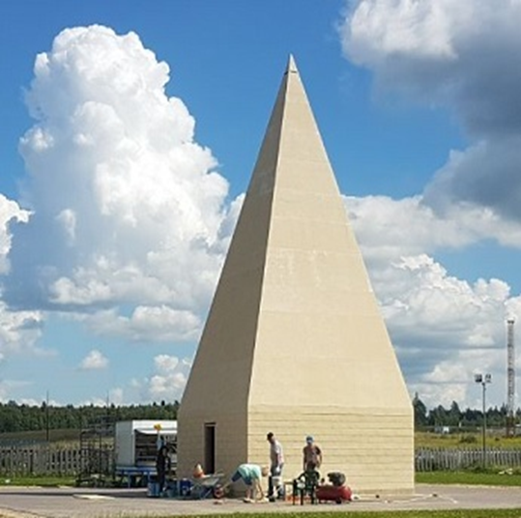
Science Behind EMF Protection and Frequencies
Some of the scientific results of previous studies with Pyramids built by Alexander Golod show:
· The Immune system of organisms increased upon exposure in the pyramid (Scientific Research Institute named by Mechnikov, Russian Academy of Medical Sciences);
· Specific properties of medicines increase with decreasing side effects after exposure in the Pyramid (SRI of Virology named by Ivanovskiy, Russian Academy of Medical Sciences);
· Agricultural seeds placed in the pyramid showed a 30-100% increase in yield;
· Russian military radar detected an energy column above the Pyramids built by Alexander Golod which is thought to have repaired the Ozone layer in Russia (the same can be done for example in Australia);
· The pathogenic strength of different viruses and bacteria becomes less with exposure in the pyramid;
· The amount of radioactivity becomes less after exposure in the pyramid.
· Improved oil viscosity in deposits below a pyramid array. Easier to pump crude (world patent)
Notes:
If time permits we’d like to play this 4 minute clip https://www.youtube.com/watch?v=aVj7_0A5-Ew

Slide 17
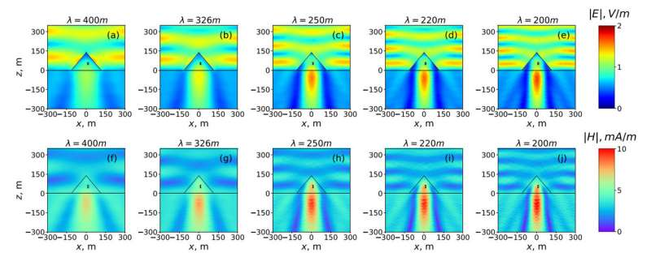
Science Behind EMF Protection and Frequencies
Great Pyramid Can Focus Electromagnetic Energy https://phys.org/news/2018-07-reveals-great-pyramid-giza-focus.html
Study reveals the Great Pyramid of Giza can focus electromagnetic energy
An international research group has applied methods of theoretical physics to investigate the electromagnetic response of the Great Pyramid to radio waves. Scientists predicted that under resonance conditions, the pyramid can concentrate electromagnetic energy in its internal chambers and under the base. The research group plans to use these theoretical results to design nanoparticles capable of reproducing similar effects in the optical range. Such nanoparticles may be used, for example, to develop sensors and highly efficient solar cells. The study was published in the Journal of Applied Physics.
Propagation of electromagnetic waves inside the pyramids of Cheops at different lengths of radio waves (from 200 to 400 meters). The black rectangular position of the so-called King's Chamber. Credit: ITMO University, Laser Zentrum Hannover
Notes:
If time permits we’d like to play this 4 minute clip https://www.youtube.com/watch?v=aVj7_0A5-Ew

Slide 18
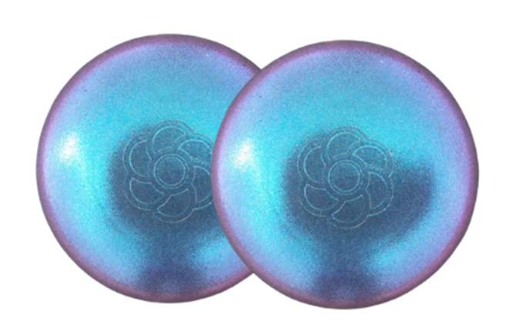
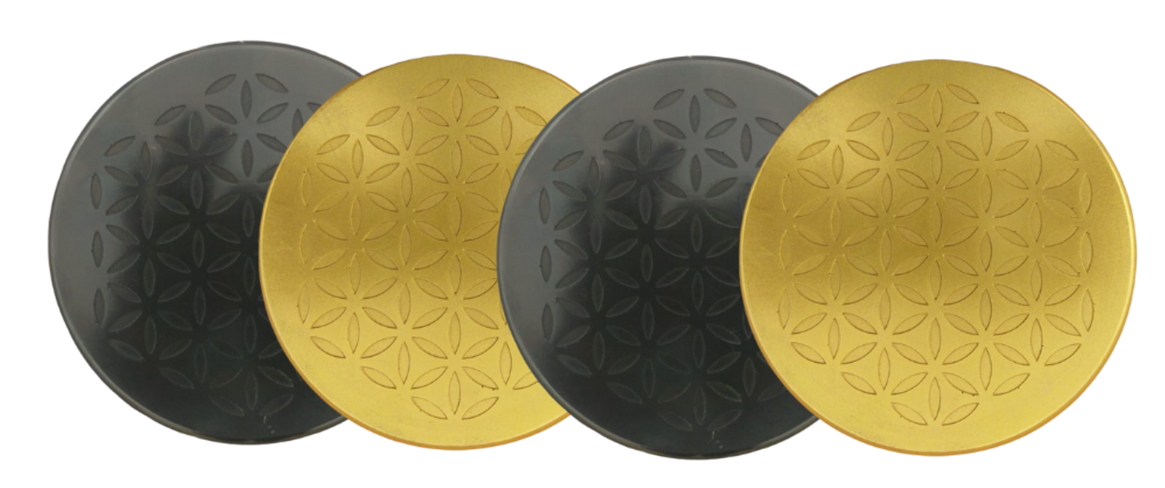
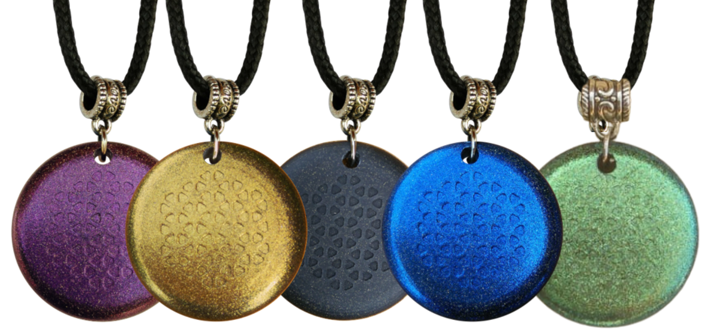
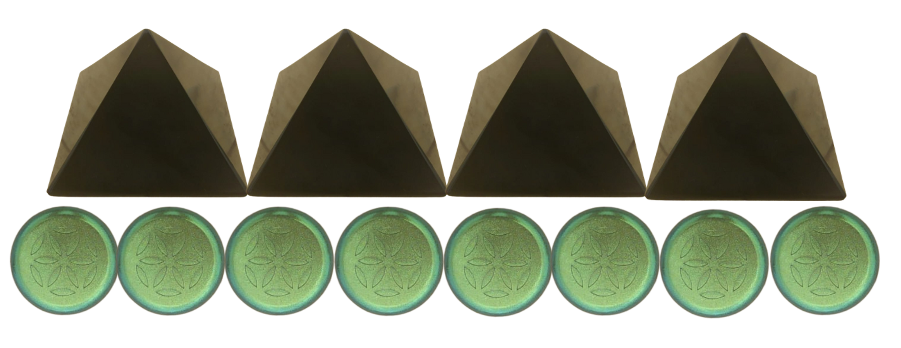
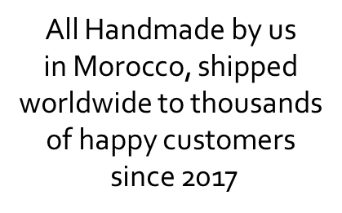
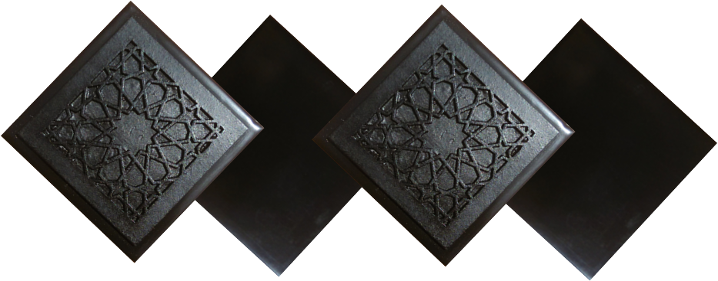
ABOUT OUR EMF PROTECTION PRODUCTS
HELP SUPPORT SGT REPORT BY SHOPPING FROM THIS LINK: https://www.ftwproject.com/ref/6/
SLEEPING PODS For a good nights sleep
CHARGE PLATES for use around the home, to preserve food and more
“We just can't believe our eyes! We have placed the garden pucks from our first order around our property, and the plants/trees with the pucks are BLOOMING within days! This is happening with every single place the pucks have been rested. Just incredible.” -Australia
PHONE SHIELDS to put on your cell phone, laptop and routers
PENDANTS for personal emf protection on your body
PYRAMIDS and garden sets for gridding your home / property / garden for emf protection on a large scale
SCIENTIFIC STUDIES AND DOCUMENTATION DESCRIBING HOW OUR PRODUCTS WORK AVAILABLE ON OUR WEBSITE.
TILES for incorporating emf protection into construction projects
WWW.FTWPROJECT.COM

