Slide 1
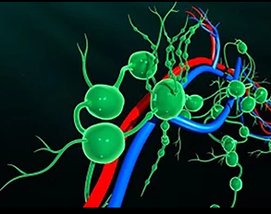
The Lymphatic
&
Glymphatic
Systems
The Ultimate Indicators Of Health
Valerie Robitaille, PhD
Holistic Nutritionist/Herbalist
www.holistichealthonline.info

Slide 2
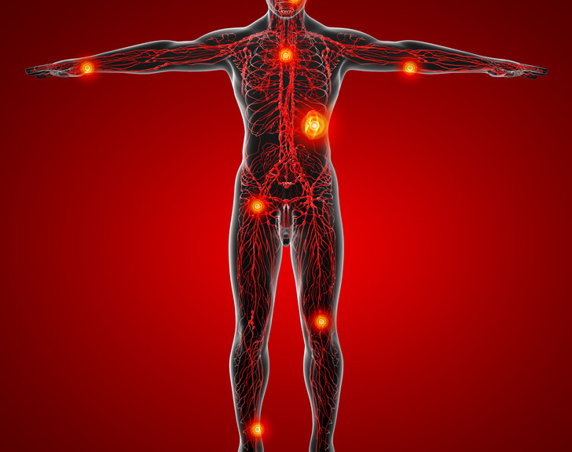
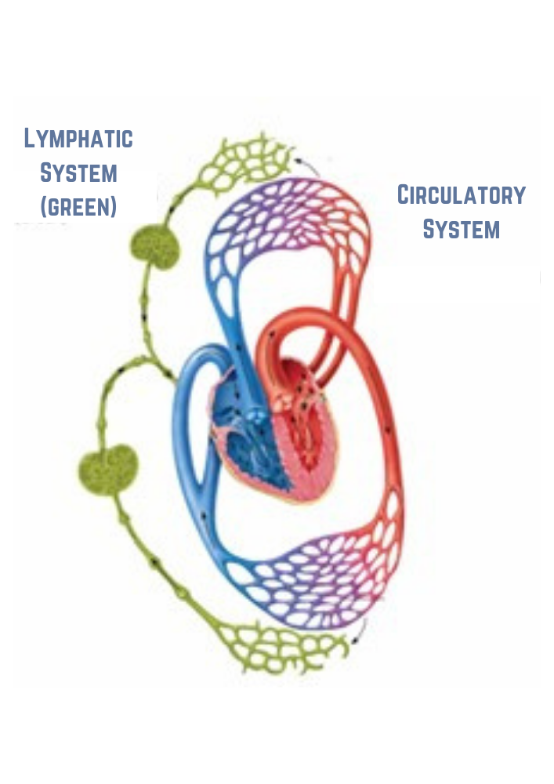
The Lymphatic System: Your Best Immunity Weapon
The lymphatic system is made up of a network of lymphatic vessels, nodes and fluid that are in every part of the body. The vessels run alongside the circulatory system where it picks up the waste from the blood at the capillaries.
There’s 3 times more lymph fluid than blood because we include the interstitial fluid between the cells part of this system.
It’s a detox or purification system - its job is to carry away waste, toxins and various kinds of cellular debris so the cells can function properly. But it’s also an integral part of the immune system because it transports lymphocytes that are used by the body to attack invaders.
The lymphatic system is our most powerful weapon against almost any harmful thing that can enter or that goes on in the body. It carry toxins out through one of the detox organs of the body to be eliminated, primarily via the kidneys, intestines, skin and lungs, and delivers immune cells to attack any foreign invaders in the body.
The lymphatic system is susceptible to clogging when there is a heavy toxic load coming from the blood and other areas of the body. Lymph fluid becomes sludgy and gets stuck in the nodes. It’s in the lymph nodes that the fluid is processed to remove harmful substances. The processed lymph gets dumped back into the blood stream.

Slide 3
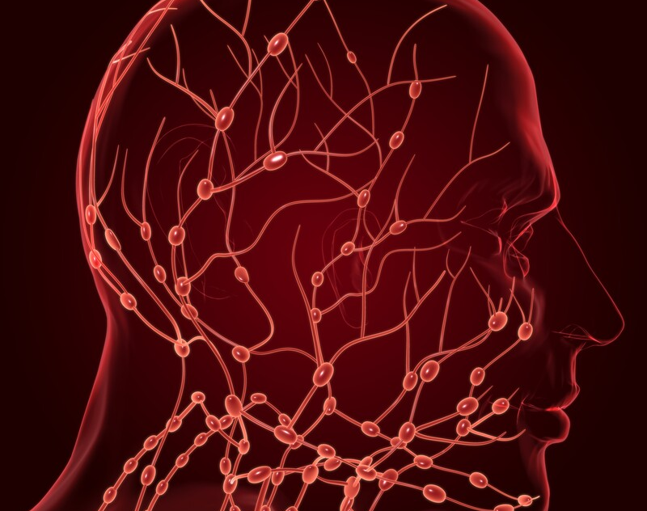
Movement of the lymph is critical to health and the ability to fight off pathogens and disease because the immune system will be able to do its job, the blood stays clear, and toxins are removed from the body.
The lymphatic system in the brain is called the glymphatic system. What happens here is our brains shrink to about 60% their normal size when we are sleeping to make room for an ocean of lymph fluid that will bring nutrients to, and carry away wastes from, the brain. The brain returns to normal size by the time we wake up.
When lymph fluid gets stuck in the nodes of the neck we say we have “swollen glands.” When it gets stuck in the nodes of the brain we say we have “brain fog.”
Lymph must flow or we get sick.
Lymph gets thick because:
it is overloaded with what it’s picking up from the blood, which may be toxic
metabolic wastes are being re-circulated within the body
the effects of harmful electrical signals coming from the environment (causing a cytokine storm). For example, electromagnetic fields or EMFs. Studies have shown that 18 GHz EMF exposures caused cell membranes to be permeable, deformed them and resulted in an enhanced degree of membrane trafficking – all kinds of stuff going in and out of the cell! Cytokine storm might be an understatement!

Slide 4
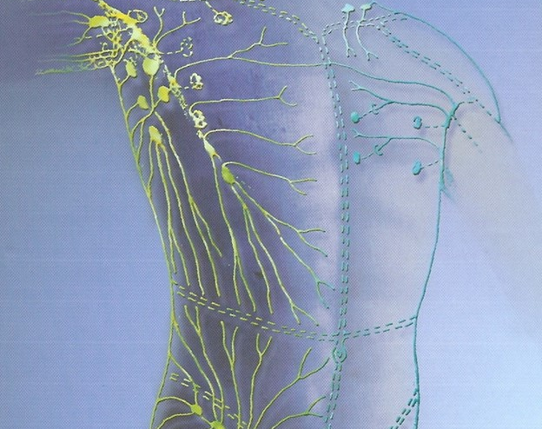
Since we are surrounded by different types of electromagnetic frequencies we should constantly be thinking of ways to keep the lymph flowing so it can clean up these technological mishaps of modern society which is only going to get more intense with the activation of 5G.
We must be prepared. We can imagine what’s happening in the blood if cells are being permeated, deformed and broken open. We can imagine the job the lymphatic system has to do to clean up the debris and keep bringing immune cells to the battle zones.
The number one way to get the lymph flowing is movement of your skeletal muscles. This is because the lymphatic system doesn’t have a pump for getting the fluid around like the heart does for the blood. Instead, lymph fluid flows in 1 direction and that’s toward the heart, as a result of the muscles impinging on lymph vessels during movement… like exercise.
When the lymph fluid reaches the area above the heart it dumps into the lungs and toxins get breathed out. You detoxify more through the lungs than any other eliminative organ!
You can get lymphatic drainage massage and you can do lymph self-massage. There’s lots of instructional videos on the internet for this.

Slide 5
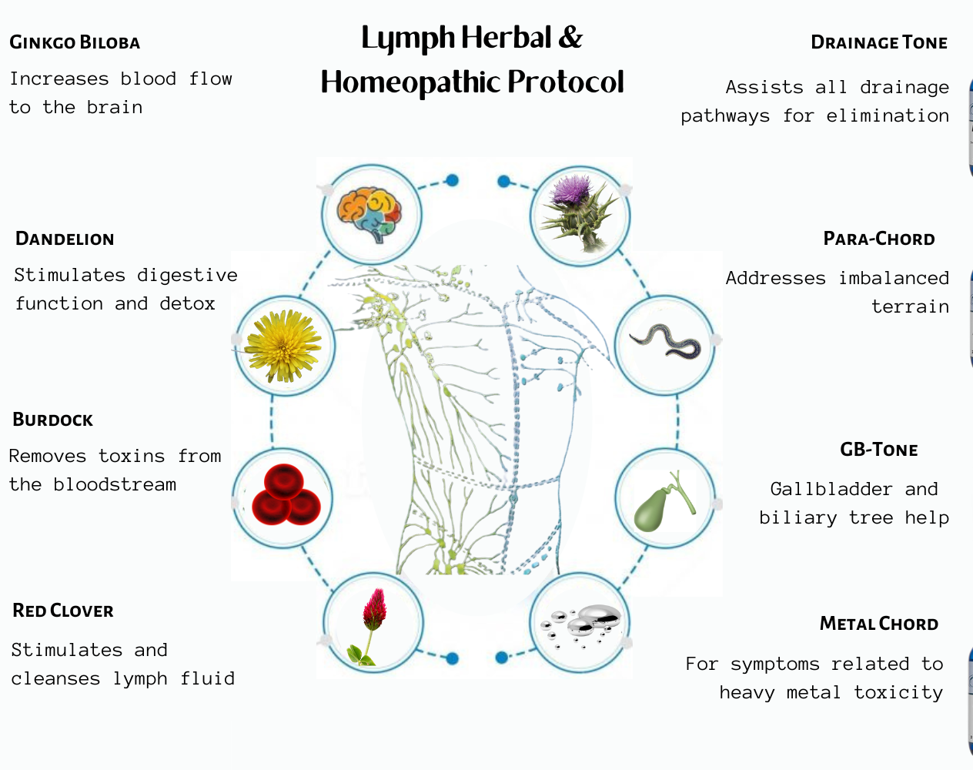
To avoid ending up in the hands of hospital personnel should
you fall ill, take action now to steel up your health and immunity. This is especially true if you’ve taken any covid shots, boosters or tests.
Research the doctors who aren’t on the WHO, FDA and CDC payroll and what they are saying. Get knowledgeable about the immune system. I have several protocols with detailed explanations, articles and videos available on my website – information that I have been researching and putting out since the beginning of this scamdemic.
There are 2 protocols in particular I recommend:
1) The Graphene Oxide Detox (GOD) Protocol – this formulation was inspired by the presentation given by Ricardo DelGado of the La Quinta Columna Scientists – one of the first groups to discover the graphene oxide in the shots, and to discover the amazing effects of antioxidants such as glutathione and NAC. It’s imperative to work at detoxing any graphene you think you may have absorbed (whether through the shots, the tests, the masks, chemtrails, etc.)
2) The Lymph Protocol was designed with foundational immune improvement in mind and which also treats symptoms. The combinations support every major cellular system in the body; the plant remedies because they are easily recognized and instantly absorbed by human cells, and the homeopathics to recognize the energetics involved in healing the whole human.

