Slide 1
How covert agents infiltrate the internet to manipulate, deceive and destroy reputations.
Top secret documents leaked by Edward Snowden that expose the training programs for these covert agents that come from a branch of GCHQ known as the Joint Threat Research Intelligence group or JTRIG.
These tactics are being used in full force all over the internet and also in controlled social manipulation operations such as protests, various forms of activism and control over main stream media propaganda.
Presentation by Tivon Rivers and Naima Feagin
www.forbiddentech.website / www.FTWproject.com / www.hopegirlblog.com / www.cleanenergyacademy.com

Slide 2
How covert agents infiltrate the internet to manipulate, deceive and destroy reputations.
this presentation is a public service to help others understand the tactics that are being used against common people and businesses on the internet
This is deep psychological warfare at its core.
Presentation by Tivon Rivers and Naima Feagin
www.forbiddentech.website / www.FTWproject.com / www.hopegirlblog.com / www.cleanenergyacademy.com

Slide 3
How covert agents infiltrate the internet to manipulate, deceive and destroy reputations.
Part 1 (this presentation) Outline and review of training documents tactics of the GCHQ / JTRIG that were leaked by Edward Snowden.
Part 2 (future presentations) Using our own personal targeting as evidence and examples of these tactics as they have been played out on us in real life.
Presentation by Tivon Rivers and Naima Feagin
www.forbiddentech.website / www.FTWproject.com / www.hopegirlblog.com / www.cleanenergyacademy.com

Slide 4
About Us:
Tivon Rivers-Engineer and Inventor with a background as a trained technician in the US Navy with over 16 years experience working in IT
Naima Feagin- also known by the Pen Name “HopeGirl”
Holds a Masters Degree in Business Administration, with over 10 years experience in Project Management and Government and Corporate Finance
Husband and wife team and co-founders of the Fix The World Organization based out of Morocco where we have spent the last few years developing technology solutions around energy and health and wellness.
Our family has been working on an energy invention which is a Tesla inspired electrical generator for off grid living called the QEG or Quantum Energy Generator. This project is what has made our whole family a target for these covert programs.
Presentation by Tivon Rivers and Naima Feagin
www.forbiddentech.website / www.FTWproject.com / www.hopegirlblog.com / www.cleanenergyacademy.com

Slide 5
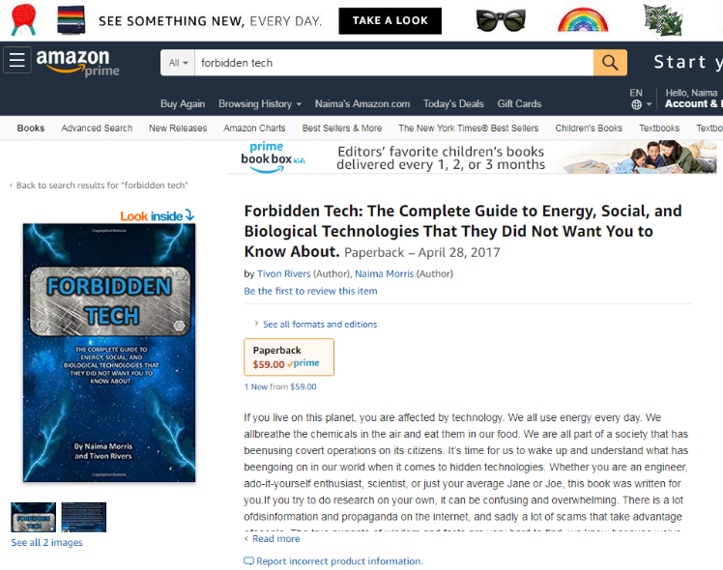
About Our Book Forbidden Tech:
This book is the culmination of experiences and research in the field of technology and all the politics that go with it. We cover a wide array of inventions in this book that are considered “disruptive” to the energy industry, but we’ve also included sections on taboo or controversial topics such as gangstalking, electronic harassment, V2K, Cointelpro, JTRIG and GCHQ, chemtrails and geoengineering, 9/11, technology such as 5G and energy weapons, just to name a few.
Presentation by Tivon Rivers and Naima Feagin
www.forbiddentech.website / www.FTWproject.com / www.hopegirlblog.com / www.cleanenergyacademy.com

Slide 6
What Are these Slides?
These slides are the actual slides leaked by Edward Snowden in 2014. They were put together for a presentation put together by the NSA for a top secret cyber spy conference that was NOT open to the public.
Presentation by Tivon Rivers and Naima Feagin
www.forbiddentech.website / www.FTWproject.com / www.hopegirlblog.com / www.cleanenergyacademy.com

Slide 7
Definitions
GCHQ- Government Communications Headquarters (GCHQ) is an intelligence and security organization responsible for providing signals intelligence (SIGINT) and information assurance to the government and armed forces of the United Kingdom.
JTRIG- The Joint Threat Research Intelligence Group (JTRIG) is a unit of the Government Communications Headquarters (GCHQ), the British intelligence agency.[1] The existence of JTRIG was revealed as part of the global surveillance disclosures in documents leaked by the former National Security Agency contractor Edward Snowden.
Mission of JTRIG
The scope of the JTRIG’s Mission Statement includes using "dirty tricks" to “destroy, deny, degrade [and] disrupt” enemies by “discrediting” them, planting misinformation and shutting down their communications. Known as "Effects" operations, the work of JTRIG had become a "major part" of GCHQ's operations by 2010.
Presentation by Tivon Rivers and Naima Feagin
www.forbiddentech.website / www.FTWproject.com / www.hopegirlblog.com / www.cleanenergyacademy.com

Slide 8
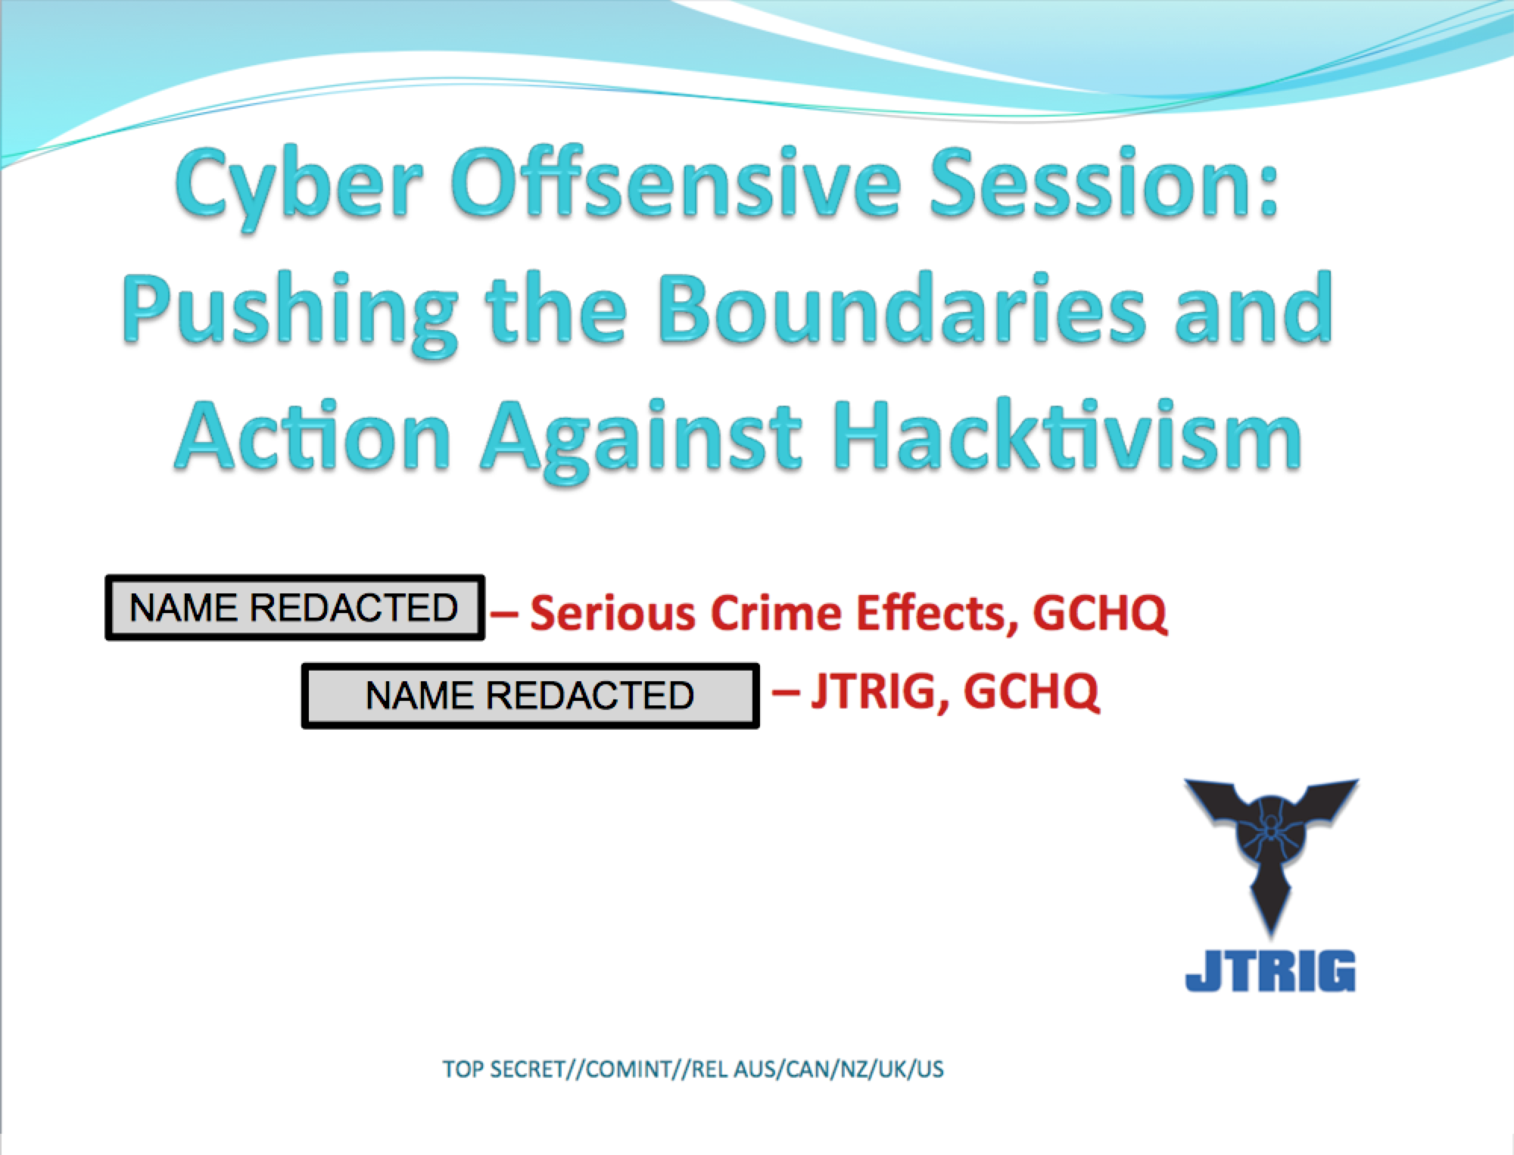

Slide 9
Definitions
Hacktivism Definition:
In Internet activism, hacktivism or hactivism (a portmanteau of hack and activism) is the subversive use of computers and computer networks to promote a political agenda or a social change.
From Techopedia
Presentation by Tivon Rivers and Naima Feagin
www.forbiddentech.website / www.FTWproject.com / www.hopegirlblog.com / www.cleanenergyacademy.com

Slide 10
What does Hacktivism mean?
Hacktivism is the act of hacking a website or computer network in an effort to convey a social or political message. The person who carries out the act of hacktivism is known as a hacktivist.
In contrast to a malicious hacker who hacks a computer with the intent to steal private information or cause other harm, hacktivists engage in similar forms of disruptive activities to highlight political or social causes. For the hacktivist, hacktivism is an Internet-enabled strategy to exercise civil disobedience. Acts of hacktivism may include website defacement, denial-of-service attacks (DoS), redirects, website parodies, information theft, virtual sabotage and virtual sit-ins.
Presentation by Tivon Rivers and Naima Feagin
www.forbiddentech.website / www.FTWproject.com / www.hopegirlblog.com / www.cleanenergyacademy.com

Slide 11
Definitions
Website Parodies – spoof websites
A spoof website is a site that uses dishonest designs to trick users into thinking that it represents some other uninvolved party. ... This term can refer to a site that is a parody or satire, although this use is less common.
Virtual sit in-
A virtual sit-in is a form of electronic civil disobedience deriving its name from the sit-ins popular during the civil rights movement of the 1960s. The virtual sit-in attempts to recreate that same action digitally using a distributed denial-of-service attack (DDOS). During a virtual sit-in, hundreds of activists attempt to access a target website simultaneously and repetitively. If performed correctly, this will cause the target website to run slowly or even collapse entirely, preventing anyone from accessing it
Presentation by Tivon Rivers and Naima Feagin
www.forbiddentech.website / www.FTWproject.com / www.hopegirlblog.com / www.cleanenergyacademy.com

Slide 12
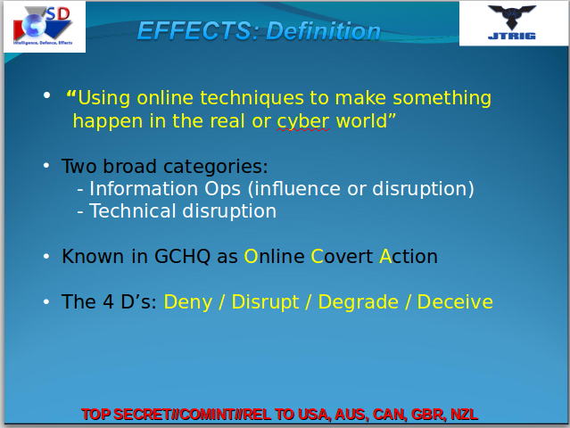

Slide 13
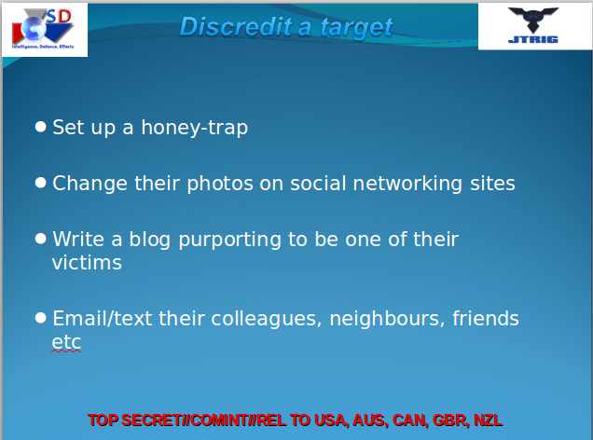

Slide 14
Definitions
Honey Trap Definition
In a "honey trap" an identified target is lured “to go somewhere on the Internet, or a physical location” to be met by “a friendly face”, with the aim to discredit them. A “honey trap” is described as "very successful when it works” by the slides. The disclosures also revealed the technique of “credential harvesting”, in which journalists could be used to disseminate information and identify non-British journalists who, once manipulated, could give information to the intended target of a secret campaign, perhaps providing access during an interview. It is unknown whether the journalists would be aware that they were being manipulated.
Credential Harvesting
The term credential harvesting also called account harvesting refers to the attacking technique or activities of grabbing legitimate user ID and even passwords to gain access to target systems for illegal or malicious purposes. Can also happen outside of a computer system.
Presentation by Tivon Rivers and Naima Feagin
www.forbiddentech.website / www.FTWproject.com / www.hopegirlblog.com / www.cleanenergyacademy.com

Slide 16
Definitions
Honey Trap Definition
In a "honey trap" an identified target is lured “to go somewhere on the Internet, or a physical location” to be met by “a friendly face”, with the aim to discredit them. A “honey trap” is described as "very successful when it works” by the slides. The disclosures also revealed the technique of “credential harvesting”, in which journalists could be used to disseminate information and identify non-British journalists who, once manipulated, could give information to the intended target of a secret campaign, perhaps providing access during an interview. It is unknown whether the journalists would be aware that they were being manipulated.
Credential Harvesting
The term credential harvesting also called account harvesting refers to the attacking technique or activities of grabbing legitimate user ID and even passwords to gain access to target systems for illegal or malicious purposes. Can also happen outside of a computer system.
Presentation by Tivon Rivers and Naima Feagin
www.forbiddentech.website / www.FTWproject.com / www.hopegirlblog.com / www.cleanenergyacademy.com

Slide 18
Definitions
Sock Puppet Accounts
A sockpuppet is an online identity used for purposes of deception. The term, a reference to the manipulation of a simple hand puppet made from a sock, originally referred to a false identity assumed by a member of an Internet community who spoke to, or about, themselves while pretending to be another person.
Presentation by Tivon Rivers and Naima Feagin
www.forbiddentech.website / www.FTWproject.com / www.hopegirlblog.com / www.cleanenergyacademy.com

Slide 20
Definitions
Fake victims - blogs / posts / crisis actors
Pretending to be a victim of a target in order to disseminate false information and influence people in a negative way to act against the target.
Presentation by Tivon Rivers and Naima Feagin
www.forbiddentech.website / www.FTWproject.com / www.hopegirlblog.com / www.cleanenergyacademy.com

Slide 22
Definitions
Poison pen letter
A poison pen letter is a letter or note containing unpleasant, abusive, or malicious statements or accusations about the recipient or a third party. It is usually sent anonymously. In the term "poison pen", the word poison is used figuratively, rather than literally. Poison pen letters are usually composed and sent to upset the recipient. They differ from blackmail, which is intended to obtain something from the recipient. In contrast, poison pen letters are purely malicious.
In the United Kingdom, Section 1 of the Malicious Communications Act 1988 covers most cases of poison pen letters.
Presentation by Tivon Rivers and Naima Feagin
www.forbiddentech.website / www.FTWproject.com / www.hopegirlblog.com / www.cleanenergyacademy.com

Slide 23
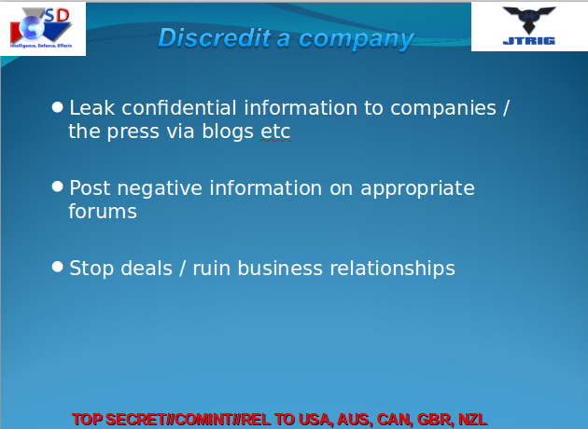

Slide 26
Definitions
human science
a branch of study which deals with people or their actions, including the social sciences and the humanities, as contrasted with the natural sciences or physical sciences.
Presentation by Tivon Rivers and Naima Feagin
www.forbiddentech.website / www.FTWproject.com / www.hopegirlblog.com / www.cleanenergyacademy.com

Slide 27
Definitions
Magic
the power of apparently influencing events by using mysterious or supernatural forces.
Illusion
an instance of a wrong or misinterpreted perception of a sensory experience.
Conjurer
one that practices magic arts : WIZARD
one that performs feats of sleight of hand and illusion : MAGICIAN, JUGGLER
Presentation by Tivon Rivers and Naima Feagin
www.forbiddentech.website / www.FTWproject.com / www.hopegirlblog.com / www.cleanenergyacademy.com

Slide 28
GCHQ USES THE OCCULT
The concepts of magic, illusion, masking, mimicking, and conjuring used throughout these slides are the same tactics used by the occult. In part two of this presentation using real examples we will show the links between these tactics and how GCHQ is using or hiring members of the dark occult to carry out its operations.
Presentation by Tivon Rivers and Naima Feagin
www.forbiddentech.website / www.FTWproject.com / www.hopegirlblog.com / www.cleanenergyacademy.com

Slide 30
Definitions
HUMINT
Stands for Human Intelligence
definition= covert intelligence-gathering by agents or others.
Other technical intelligence gathering
Signals intelligence or SIGINT
Signals intelligence (SIGINT) is intelligence-gathering by interception of signals, whether communications between people (communications intelligence—abbreviated to COMINT) or from electronic signals not directly used in communication (electronic intelligence—abbreviated to ELINT). Signals intelligence is a subset of intelligence collection management.
Examples of this are Menwith hill which is a part of Echelon
IMINT- imagery intelligence
Presentation by Tivon Rivers and Naima Feagin
www.forbiddentech.website / www.FTWproject.com / www.hopegirlblog.com / www.cleanenergyacademy.com

Slide 31
COINTEL PRO
AND GANGSTALKING
FROM OUR BOOK : “FORBIDDEN TECH”
Presentation by Tivon Rivers and Naima Feagin
www.forbiddentech.website / www.FTWproject.com / www.hopegirlblog.com / www.cleanenergyacademy.com

Slide 33
John Mulholland (magician)
John Mulholland (9 June 1898 in Chicago, Illinois – 25 February 1970 in New York City) was an American magician, author, publisher and intelligence agent.
During the Cold War, Mulholland was paid by the CIA to write a manual on deception and misdirection. Copies of the document were believed to have been destroyed in 1973, however, copies later resurfaced and were published as "The Official CIA Manual of Trickery and Deception".[6]
Mulholland was part of the MKUltra program
Presentation by Tivon Rivers and Naima Feagin
www.forbiddentech.website / www.FTWproject.com / www.hopegirlblog.com / www.cleanenergyacademy.com

Slide 34
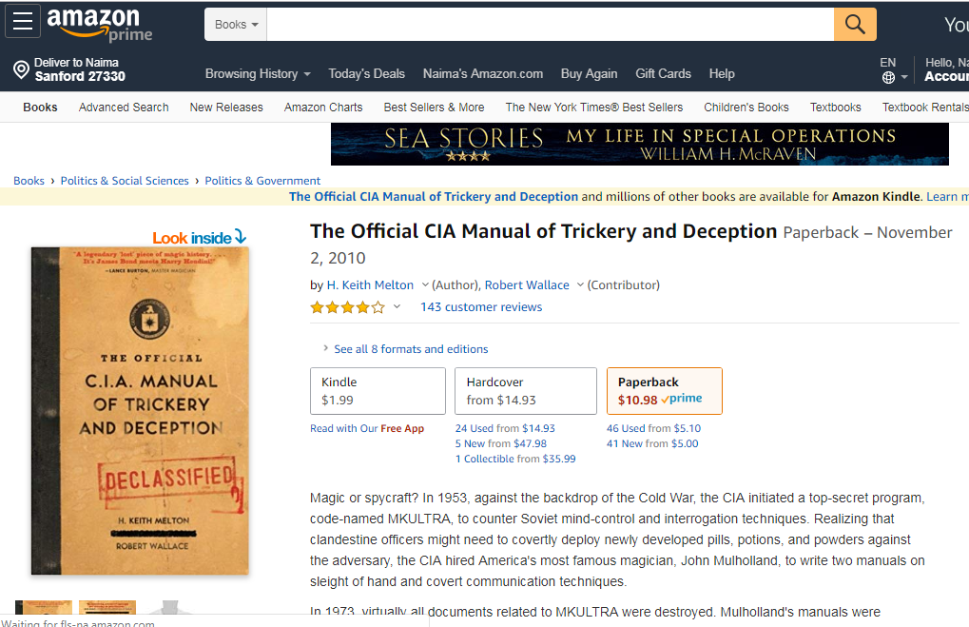
CIA Manual of Trickery and Deception
Presentation by Tivon Rivers and Naima Feagin
www.forbiddentech.website / www.FTWproject.com / www.hopegirlblog.com / www.cleanenergyacademy.com

Slide 35
CIA Manual of Trickery and Deception
“From the earliest days of MKULTRA, Dr. Sidney Gottlieb recognized that CIA’s drugs and chemicals, regardless of their ultimate purpose, would be operationally useless unless field officers and agents could covertly administer them. During the same month MKULTRA was authorized, April 1953, Gottlieb contacted John Mulholland, then fiftyfive years old and one of America’s most respected magicians.
Mulholland was an expert in sleight of hand or “close-up” magic, a style of conjuring that appealed to Gottlieb because it was performed only a few feet from the audience.38 Further, sleight-of-hand illusions required no elaborate props for support. If Mulholland could deceive a suspecting audience who was studying his every move in close proximity, it should be possible to use similar tricks for secretly administering a pill or potion to an unsuspecting target. To do so, CIA field officers would need to be taught to perform their own tricks and John Mulholland, the author of several books about performing magic, appeared to be the ideal instructor.39 When approached, Mulholland soon agreed to develop a “spy manual” for Gottlieb describing “the various aspects of the magician’s art,” which might be useful in covert operations.
The instructions would provide information enabling a field case officer “to develop the skills to surreptitiously place a pill or other substance in drink or food to be consumed by a target.”40 Mulholland accepted $3,000 to write the manual and the CIA approved the expense as MKULTRA Subproject Number 4 on May 4, 1953.41”
Presentation by Tivon Rivers and Naima Feagin
www.forbiddentech.website / www.FTWproject.com / www.hopegirlblog.com / www.cleanenergyacademy.com

Slide 38
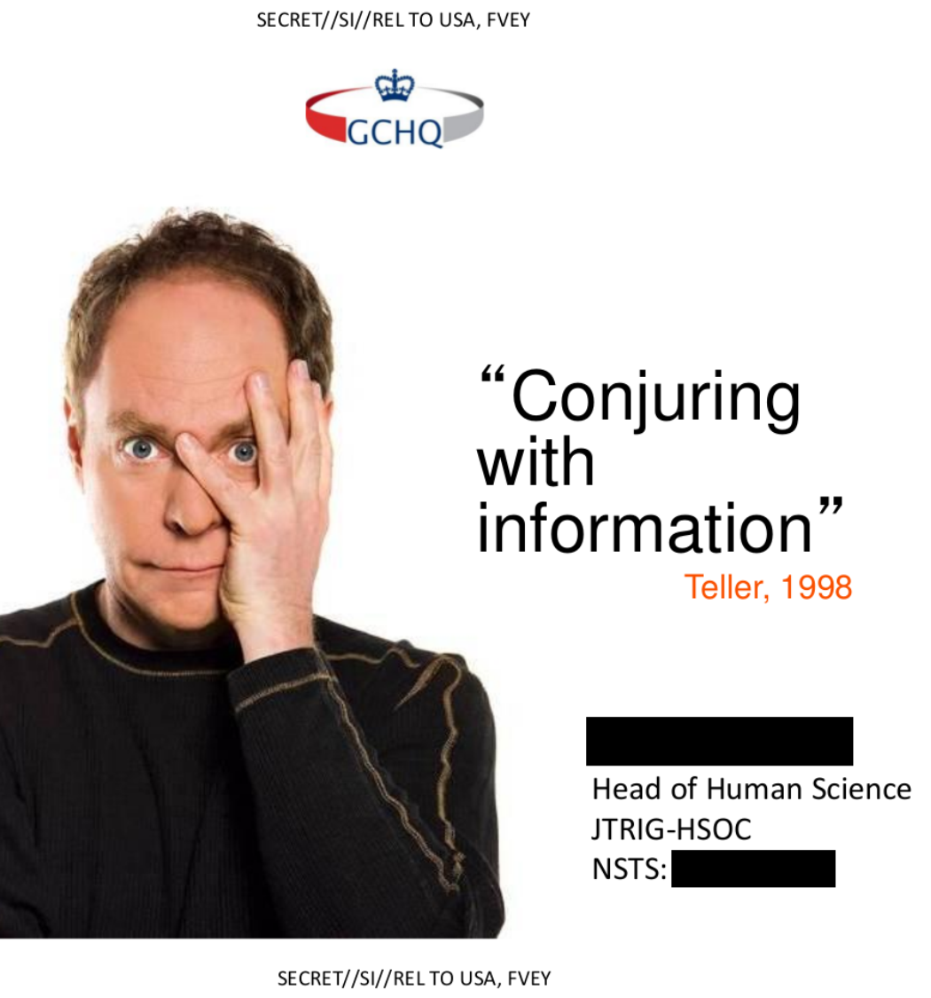
Teller (magician)
Teller (born Raymond Joseph Teller; February 14, 1948) is an American magician, illusionist, writer, actor, painter, and film director. He is best known as half of the comedy magic duo Penn & Teller, along with Penn Jillette. Teller usually does not speak during performances. He is an atheist, debunker, skeptic, and a fellow of the Cato Institute (a free market libertarian think tank that also lists Jillette as a fellow)
Presentation by Tivon Rivers and Naima Feagin
www.forbiddentech.website / www.FTWproject.com / www.hopegirlblog.com / www.cleanenergyacademy.com

Slide 46
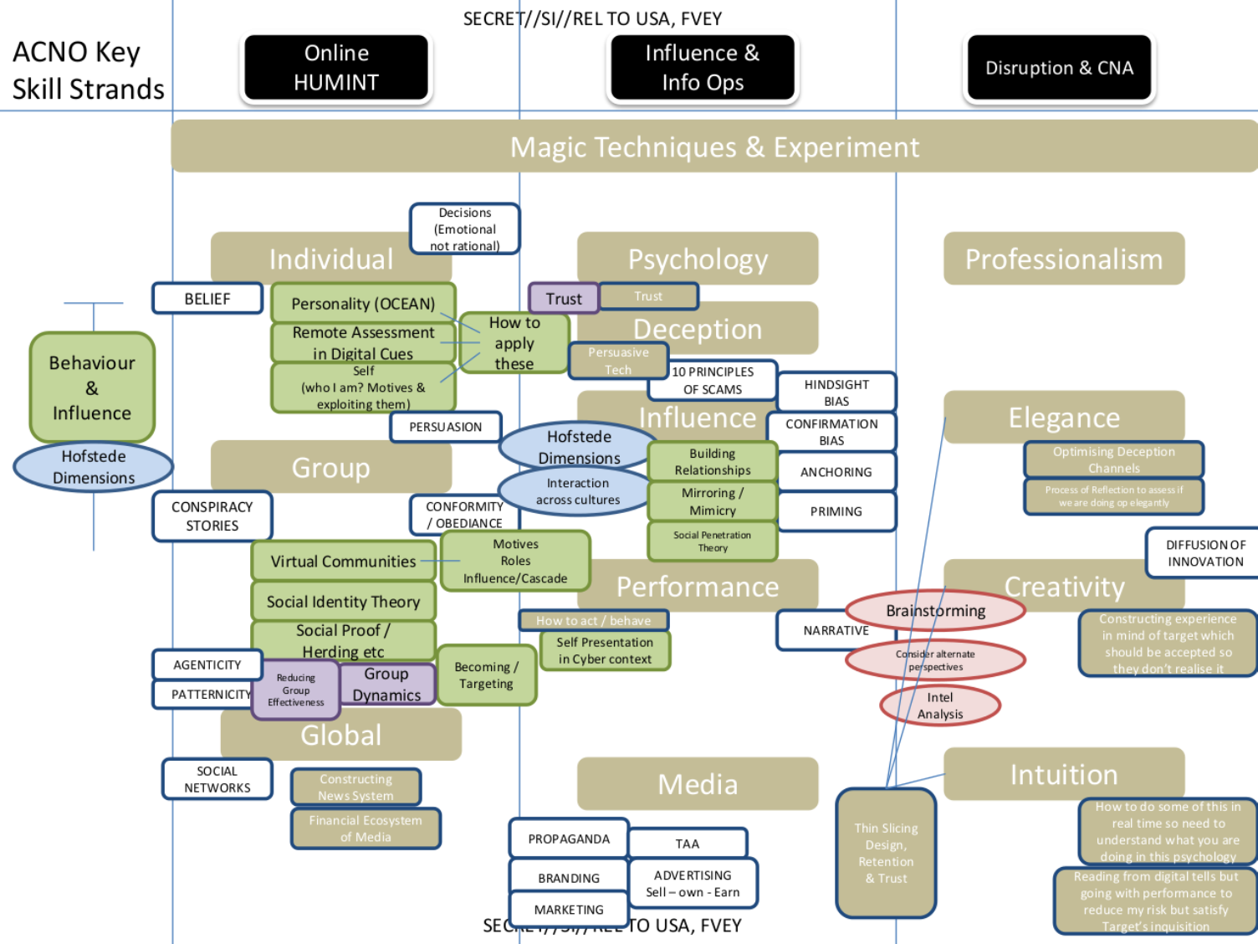

Slide 47
Definitions
Hofstede dimensions
Hofstede's cultural dimensions theory is a framework for cross-cultural communication, developed by Geert Hofstede. It describes the effects of a society's culture on the values of its members, and how these values relate to behavior, using a structure derived from factor analysis
Herding- herd mentality
Herd mentality, mob mentality and pack mentality, also lesser known as gang mentality, describes how people can be influenced by their peers to adopt certain behaviors on a largely emotional, rather than rational, basis. When individuals are affected by mob mentality, they may make different decisions than they would have individually.
Social proof
a term coined by Robert Cialdini in his 1984 book, Influence, is also known as informational social influence. It describes a psychological and social phenomenon wherein people copy the actions of others in an attempt to undertake behavior in a given situation.
Presentation by Tivon Rivers and Naima Feagin
www.forbiddentech.website / www.FTWproject.com / www.hopegirlblog.com / www.cleanenergyacademy.com

Slide 49
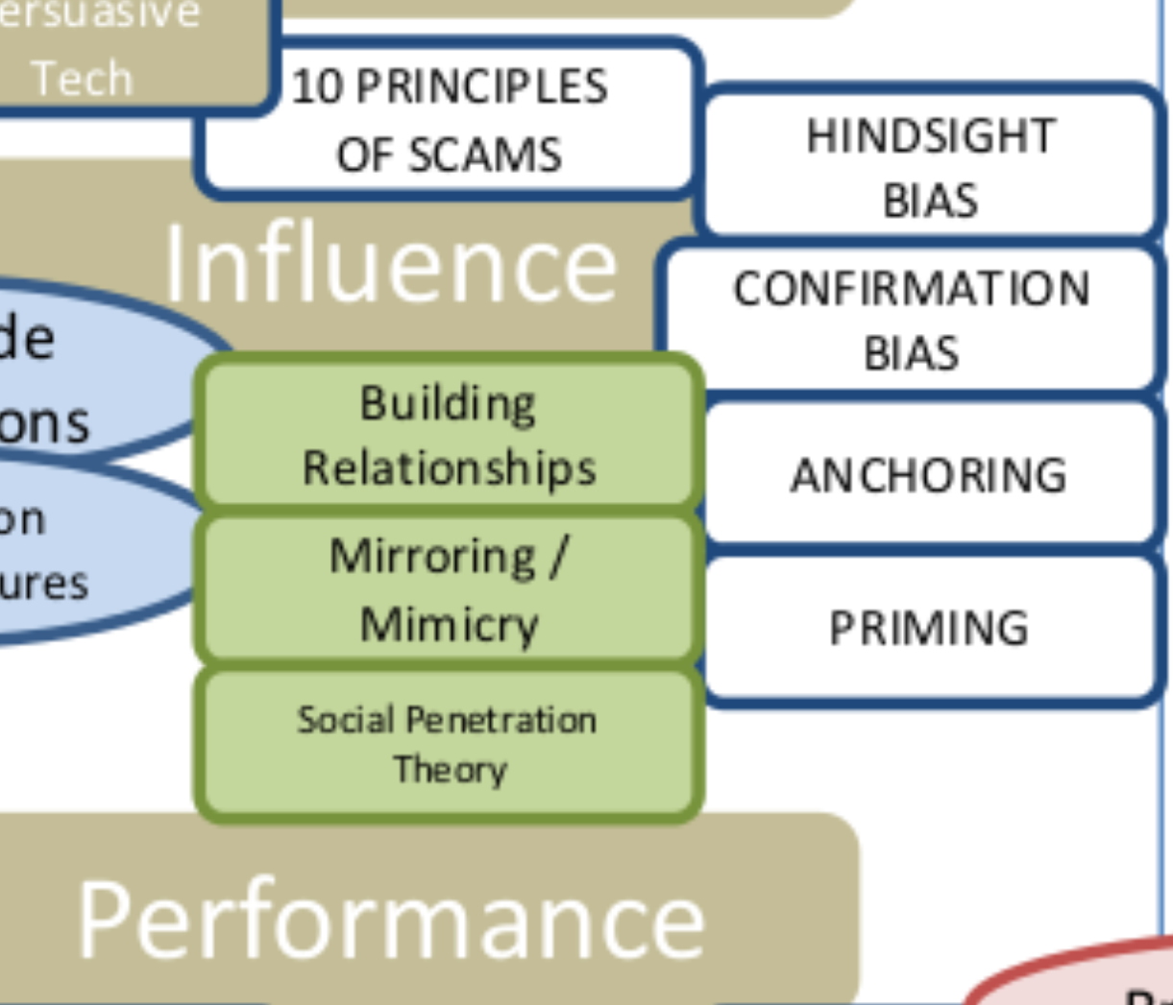

Slide 53
Definitions
Hindsight bias
Hindsight bias is a term used in psychology to explain the tendency of people to overestimate their ability to have predicted an outcome that could not possibly have been predicted.
Confirmation bias
Confirmation bias, also called confirmatory bias or myside bias,[Note 1] is the tendency to search for, interpret, favor, and recall information in a way that confirms one's preexisting beliefs or hypotheses.[1] It is a type of cognitive bias and a systematic error of inductive reasoning. People display this bias when they gather or remember information selectively, or when they interpret it in a biased way. The effect is stronger for emotionally charged issues and for deeply entrenched beliefs.
Presentation by Tivon Rivers and Naima Feagin
www.forbiddentech.website / www.FTWproject.com / www.hopegirlblog.com / www.cleanenergyacademy.com

Slide 54
Definitions
Anchoring
Anchoring or focalism is a cognitive bias for an individual to rely too heavily on an initial piece of information offered (known as the "anchor") when making decisions.
Priming
Priming is a technique whereby exposure to one stimulus influences a response to a subsequent stimulus, without conscious guidance or intention.[1][2] For example, the word NURSE is recognized more quickly following the word DOCTOR than following the word BREAD. Priming can be perceptual, semantic, or conceptual. Research, however, has yet to firmly establish the duration (a day? a week?) of priming effects, [3][4] yet their onset can be almost instantaneous. [5]
Priming works best when the two stimuli are in the same modality. For example, visual priming works best with visual cues and verbal priming works best with verbal cues. But priming also occurs between modalities,[6] or between semantically related words such as "doctor" and "nurse".[7][8]
Presentation by Tivon Rivers and Naima Feagin
www.forbiddentech.website / www.FTWproject.com / www.hopegirlblog.com / www.cleanenergyacademy.com

Slide 56
Self presentation in cyber context Presenting a false projection of yourself online
Anchoring
Anchoring or focalism is a cognitive bias for an individual to rely too heavily on an initial piece of information offered (known as the "anchor") when making decisions.
Priming
Priming is a technique whereby exposure to one stimulus influences a response to a subsequent stimulus, without conscious guidance or intention.[1][2] For example, the word NURSE is recognized more quickly following the word DOCTOR than following the word BREAD. Priming can be perceptual, semantic, or conceptual. Research, however, has yet to firmly establish the duration (a day? a week?) of priming effects, [3][4] yet their onset can be almost instantaneous. [5]
Priming works best when the two stimuli are in the same modality. For example, visual priming works best with visual cues and verbal priming works best with verbal cues. But priming also occurs between modalities,[6] or between semantically related words such as "doctor" and "nurse".[7][8]
Presentation by Tivon Rivers and Naima Feagin
www.forbiddentech.website / www.FTWproject.com / www.hopegirlblog.com / www.cleanenergyacademy.com

Slide 95
Paid Trolls
Trolls lie. They get paid. Don’t be deceived. Normal people don’t do this.
Look at the amount of labor that is put into the trolling
Presentation by Tivon Rivers and Naima Feagin
www.forbiddentech.website / www.FTWproject.com / www.hopegirlblog.com / www.cleanenergyacademy.com

Slide 96
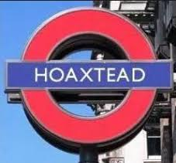
Paid Trolls Example: Hoaxtead
More details coming soon in future presentations
Presentation by Tivon Rivers and Naima Feagin
www.forbiddentech.website / www.FTWproject.com / www.hopegirlblog.com / www.cleanenergyacademy.com

Slide 97
Paid Trolls
Trolls get gigs on Fiverr, Craigslist, Freelance writing
“Virtual Assistants” in different countries (outsourced trolls)
Presentation by Tivon Rivers and Naima Feagin
www.forbiddentech.website / www.FTWproject.com / www.hopegirlblog.com / www.cleanenergyacademy.com

Slide 98
Disclaimer:
The following websites are legitimate businesses with good track records that offer valuable services to online businesses and clients. This is by no means a negative review of these companies, this is only a demonstration to show that there are services out there that will perform any number of content management tasks for a set price and it is relatively easy to hire someone to do this sort of work online all while maintaining your anonymity.

Slide 99
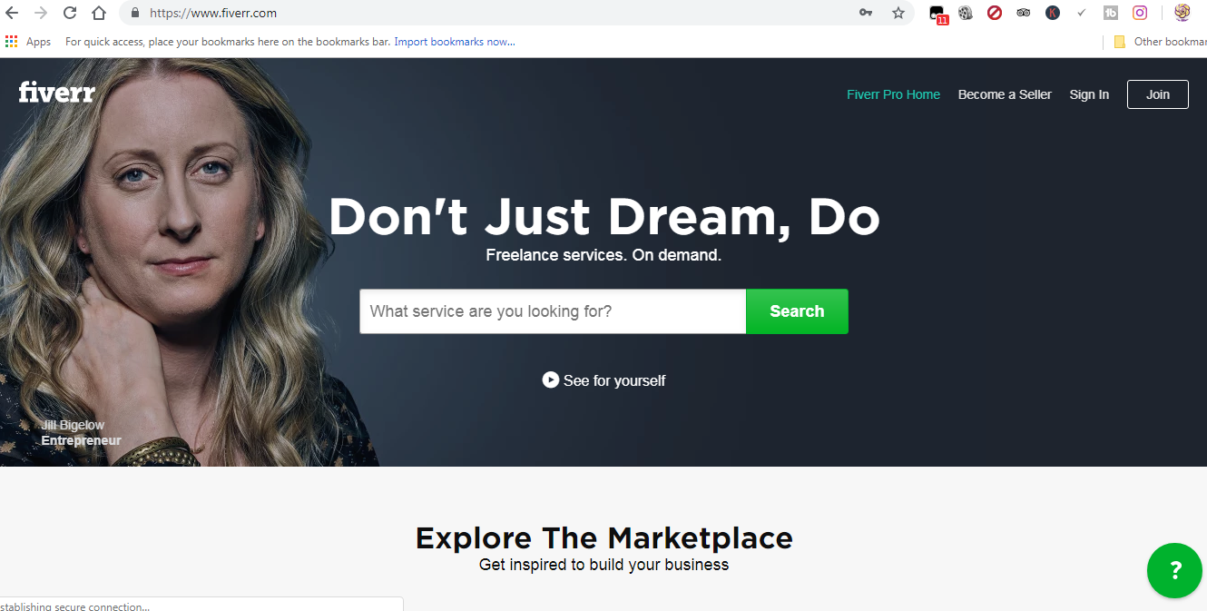

Slide 100
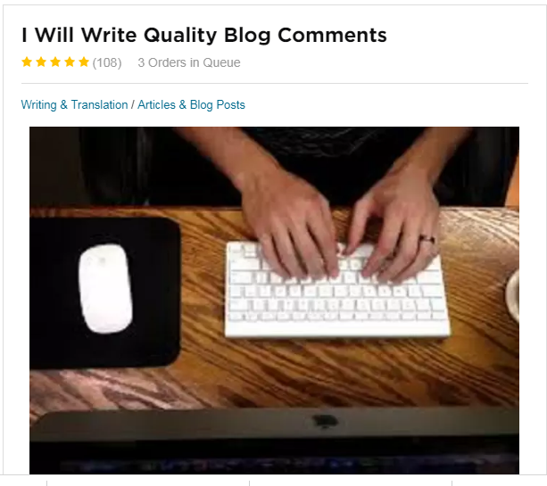


Slide 101
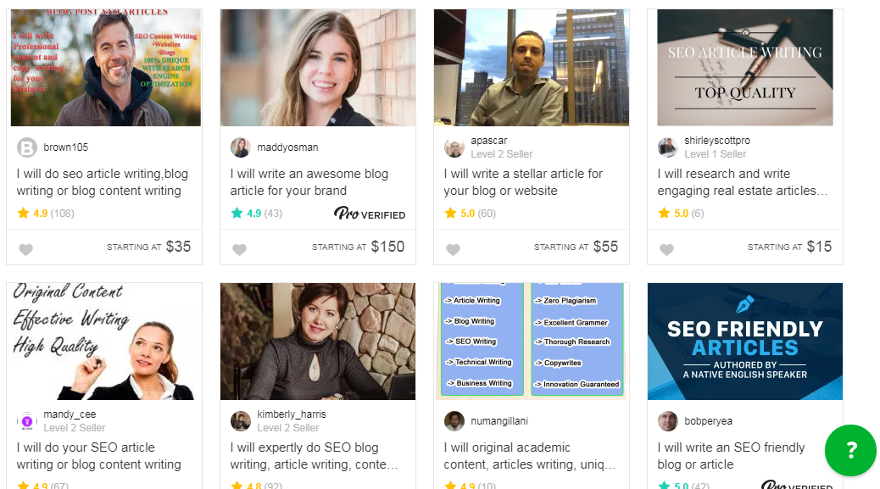

Slide 102
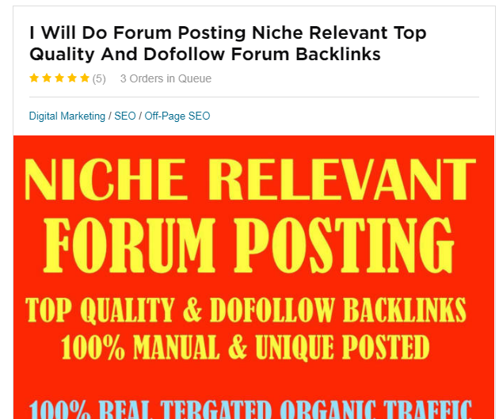
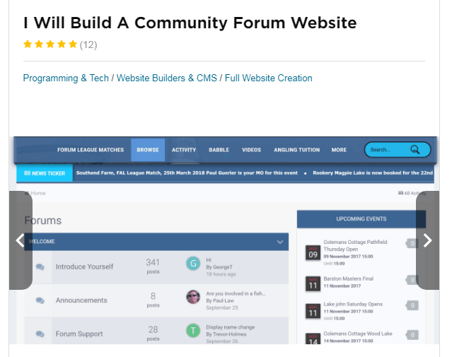
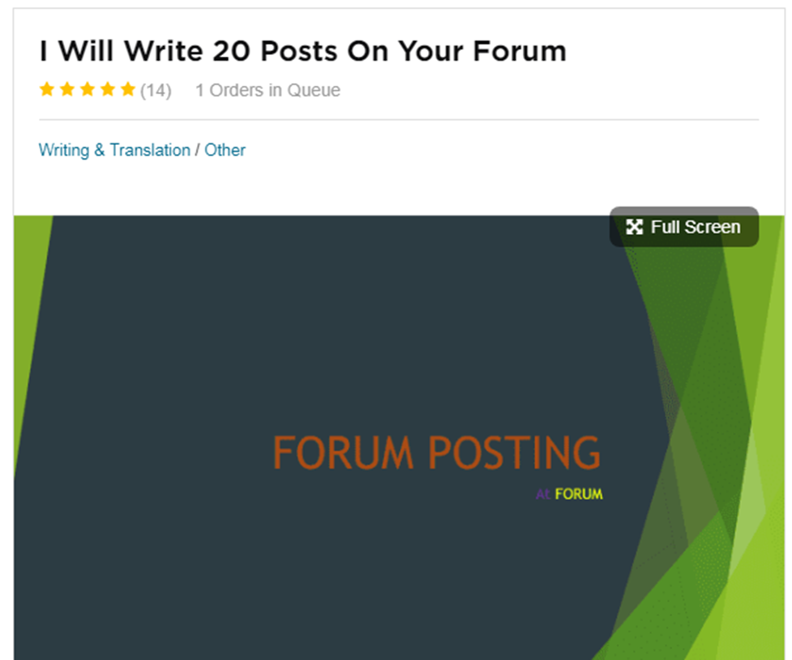

Slide 103
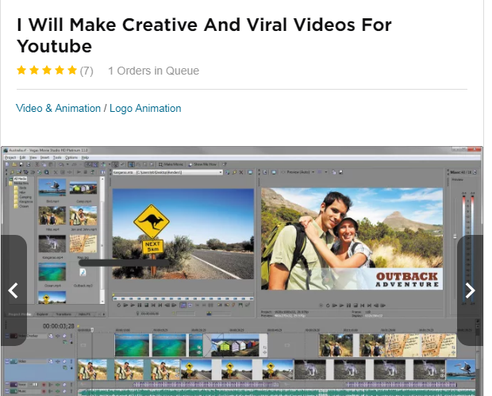
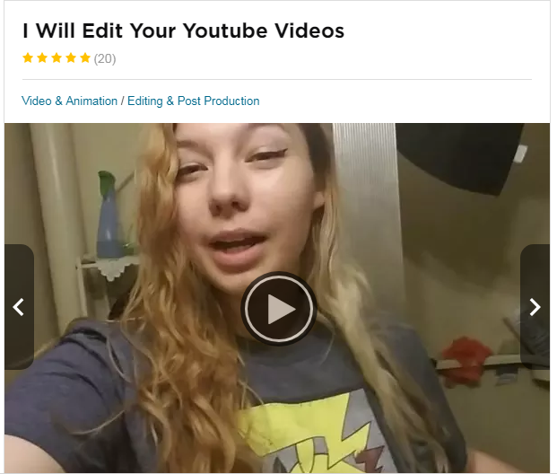

Slide 104
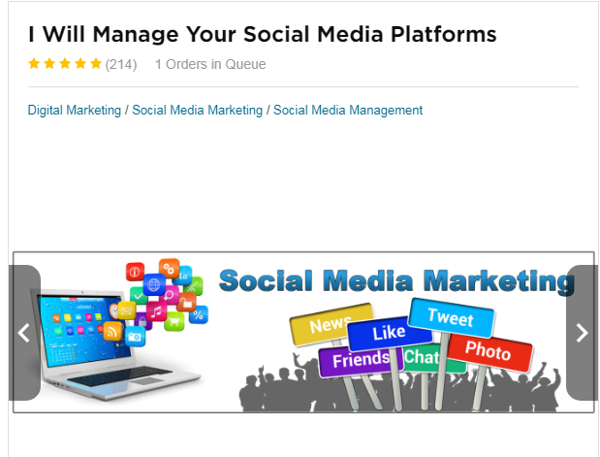
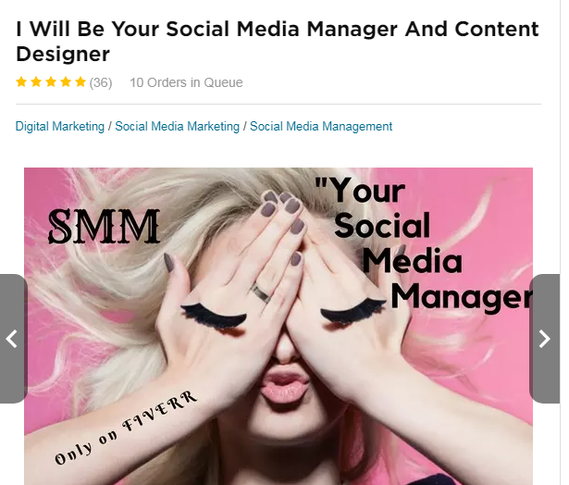

Slide 105
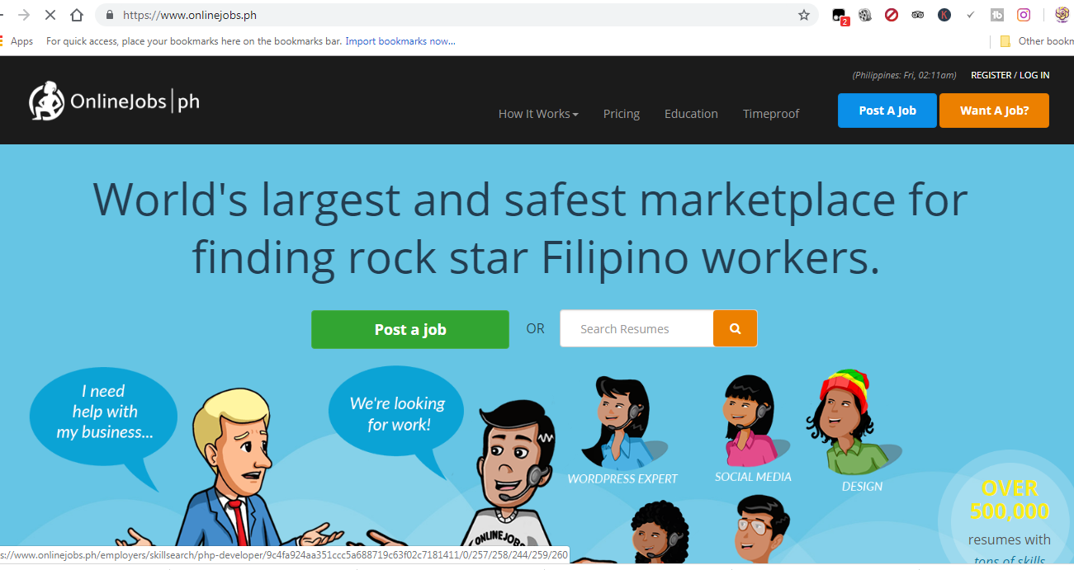

Slide 106


Slide 107
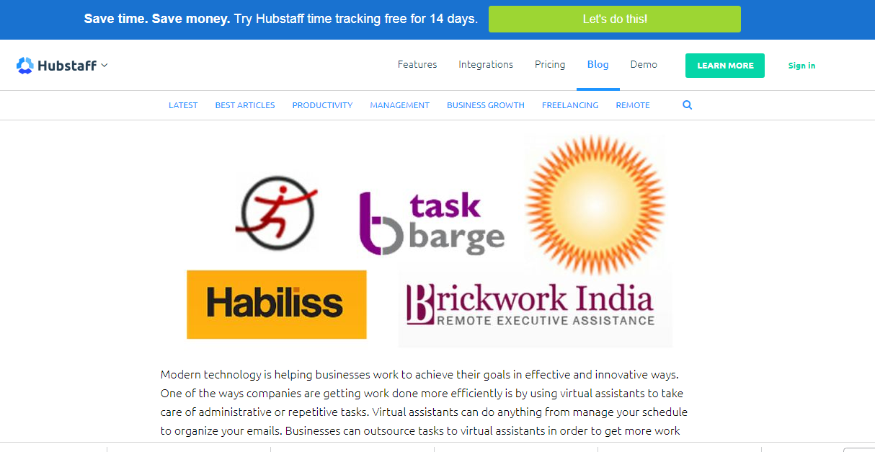

Slide 108
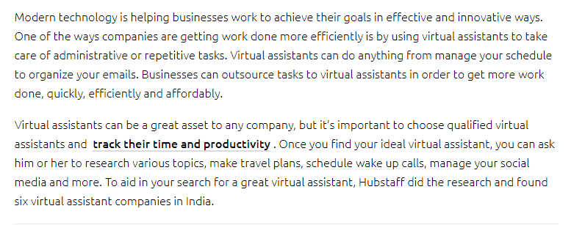

Slide 109
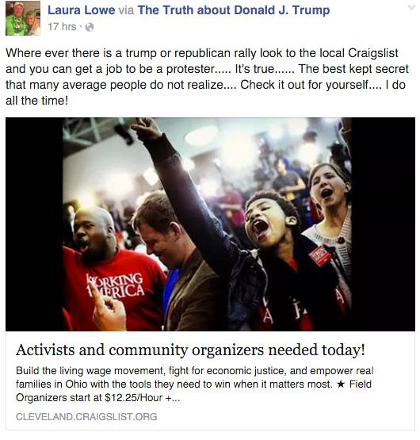

Slide 110
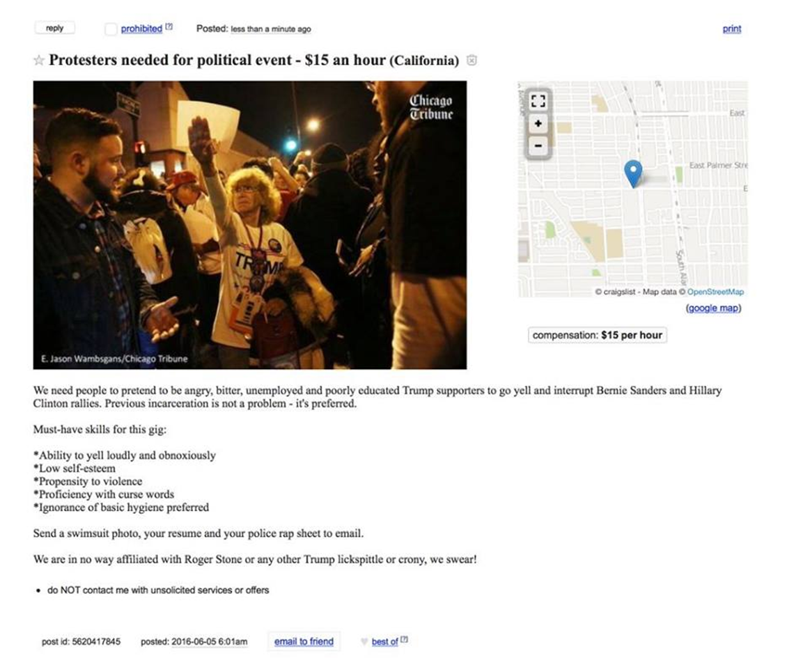

Slide 111
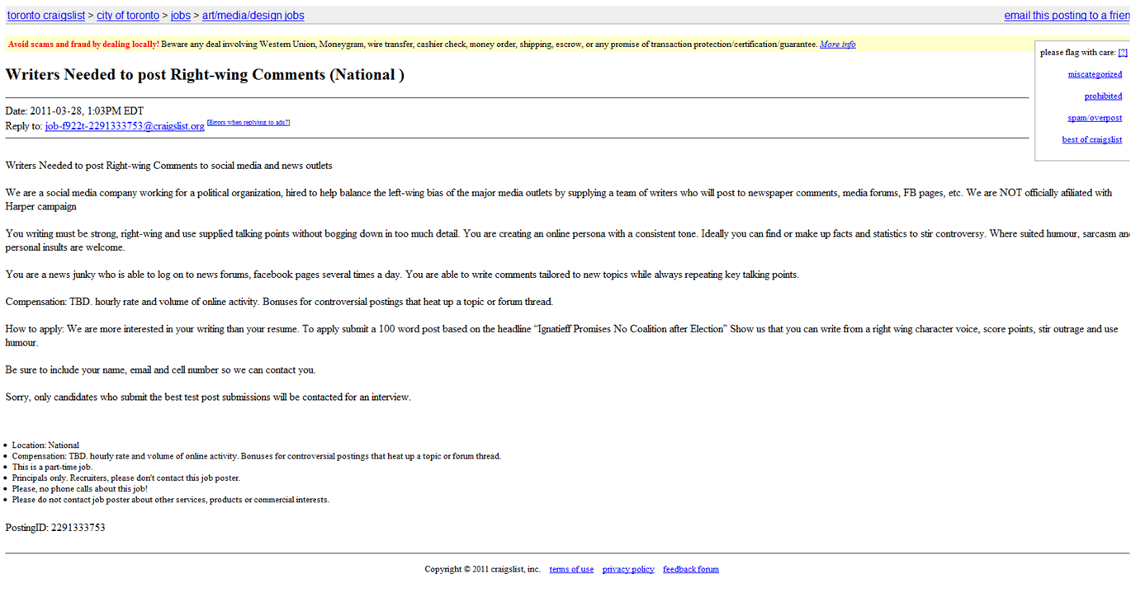

Slide 112


Slide 113
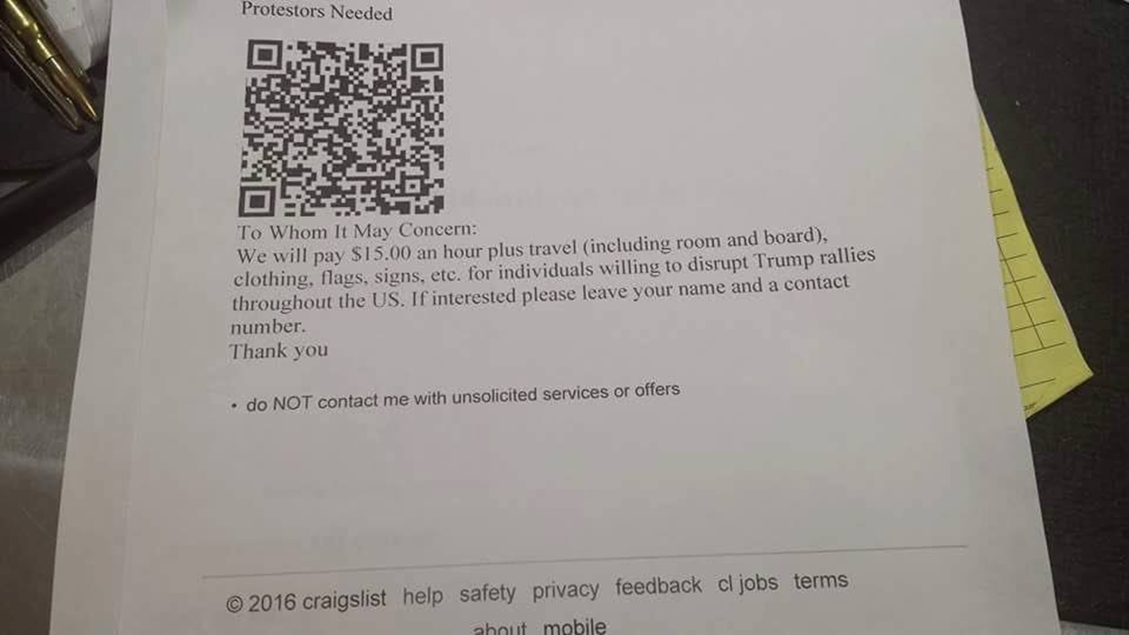

Slide 114
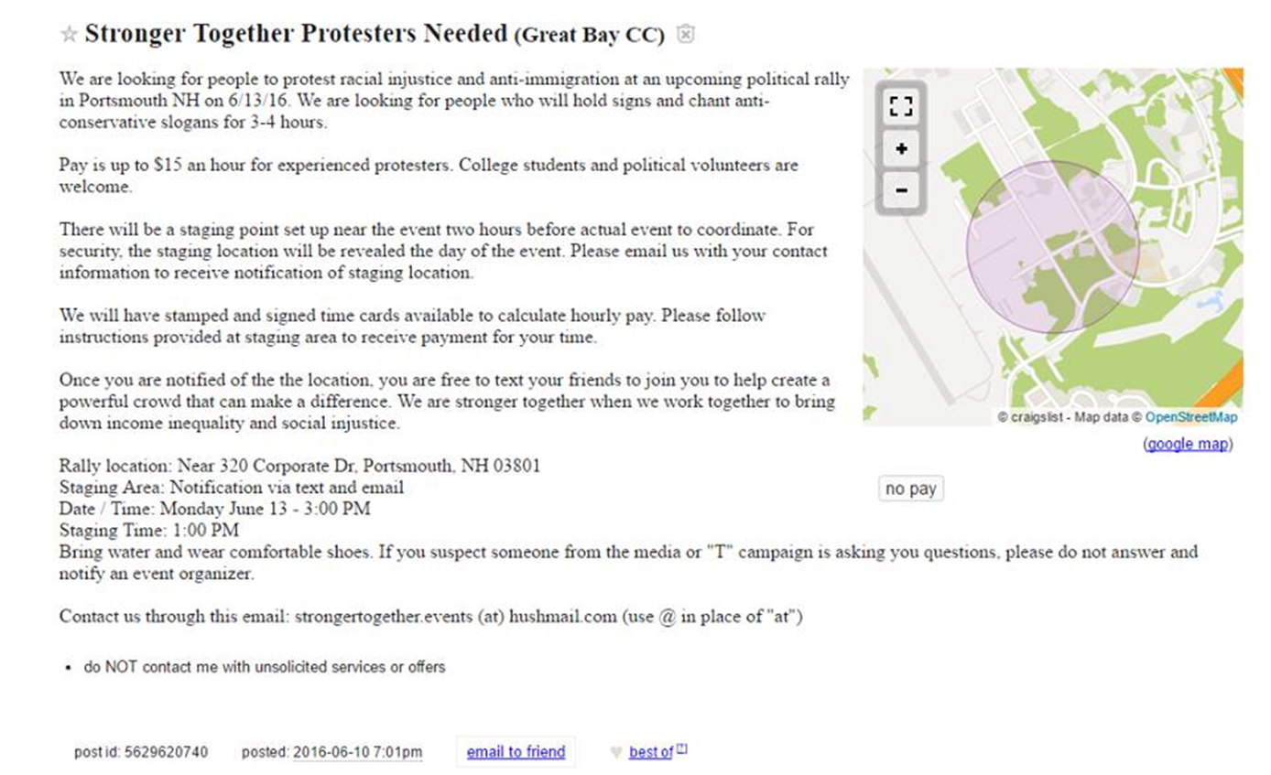

Slide 115


Slide 116
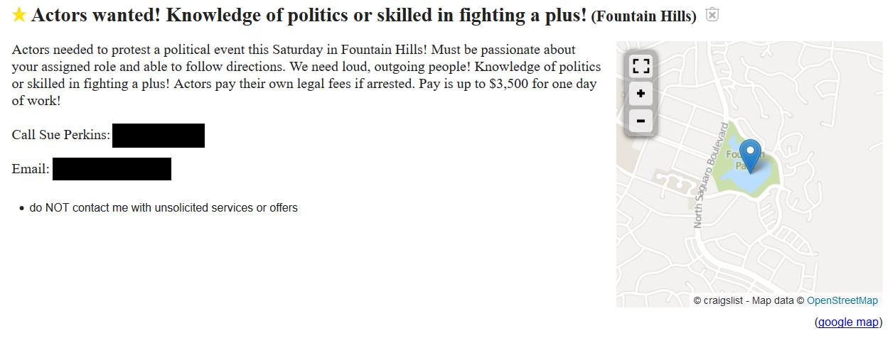
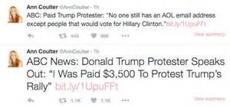

Slide 117
Where is the Funding Coming From
For these Programs?
In the American 2016 elections, it was discovered that billionaire George Soros was funding hundreds of organizations aimed at social manipulation tactics. This is just the organizations based in America. Soros’s network reaches all over the world and also has connections with GCHQ. There is plenty of money provided by dark agenda’s to fund these tactics covertly and on a grand scale.
This is one example of where covert funding
for such programs comes from. Of course there
are others.

Slide 118
Conclusion of Part 1
Thanks for watching, we hope you learned something. Stay tuned to the Hopegirl blog for more updates on this topic and for future related segments.
Be sure to check out our book Forbidden Tech at www.forbiddentech.website
Contact us via the contact form on the hopegirl blog or
at our company email address:
fixtheworldproject@gmail.com

