Slide 1
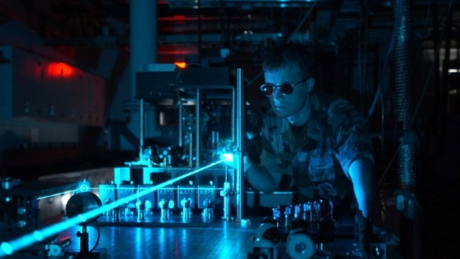
ELECTRONIC HARASSMENT
TARGETED INDIVIDUALS

Slide 2
FREE ENERGY VOCABULARY
Radiant Energy
- noun
The energy of electromagnetic and gravitational radiation. It is a form of energy that can travel through space.The SI unit of radiant energy is the joule (J).
Orgone Energy
- noun
The universal life force energy defined by scientist Wilhelm Reich in the 1930s. Also defined as: aetheric energy, prana, chi, biophotons , soft electron and scalar field.
Notes:
2

Slide 3
FREE ENERGY VOCABULARY
Orgonite
- noun
Simply metal shavings and quartz crystal encased in Epoxy or fiberglass resin. Concept invented by Karl Hans Welz using metal powders in resin. Used to clear the environment from the harmful effects of electro-smog.
EM Field
- noun
An electromagnetic field (also EM field) is a physical field produced by electrically charged objects. It is comprised of electrical and magnetic potentials, and affects the behavior of charged objects in the vicinity of the field. The electromagnetic field extends indefinitely throughout space and describes the electromagnetic interaction.
Notes:
3

Slide 4
FREE ENERGY VOCABULARY
Psychotronics
- noun
A particular branch of parapsychology developed by the Soviet era Eastern Bloc that supposes an energy or force to emanate from living organisms and affect matter. Coined in 1967 by Zdenek Rejdak, the research led to numerous conferences into the field during the 1970s and 80s and sparked Cold War fears of mind control and directed energy weaponry.
Notes:
4

Slide 5
MIND CONTROL AND TARGETED INDIVIDUAL REFERENCE MATERIAL
http://targetedindividualscanada.com/
http://www.peoplecooker.com/
https://targetedindividualseurope.wordpress.com
http://www.kurzweilai.net/wireless-brain-stimulation-with-magnetic-nanoparticles
https://youarenotmybigbrother.wordpress.com/
http://www.aspbs.com/sam/samv6n7.htm
http://nypost.com/2013/12/28/the-soviet-union-spent-1-billion-on-mind-control-programs/
http://www.mindjustice.org/2003_survey.htm
http://www.bibliotecapleyades.net/scalar_tech/esp_scalartech12.htm
http://mkultra1.blogspot.com/
http://lissakr11humane.com/2013/04/23/the-international-ban-investigation-and-prosecution-of-psychotronic-weapons-crimes-2/
http://www.specialsol.com/electronicharassment.htm
Notes:
5

Slide 6
GANGSTALKING
From - ORGANIZED GANG STALKING WHAT YOU NEED TO KNOW
Gangstalking is also known as Cause Stalking, Organized Vigilante Stalking, Stalking by Proxy, Community-Based Harassment and Covert War. These are basically, harassment and discrediting campaigns waged against a targeted individual. Neighbors are often recruited to participate. Other recruits tend to come from extremist groups, witch covens, secret societies, public servants, Satanic cults, and also co-workers. It is an operation comprised of rogue factions within society (Private Security Firms and /or Organized Criminal Mafias) that have access to both private and government resources. The purpose of such a program is to frame, isolate and destroy a target financially, socially and professionally via slander, framing for non-existent criminal activities, online harassment and following the target everywhere, he/she goes. Targets are; whistle-blowers, good Samaritans, minorities, artists, activists and any others from different groups of people who have been labeled as a domestic threat.
They are followed and harassed by civilian groups who have been hired by Private Security Companies, who either directly or under contract have classified security access within Law Enforcement / Intelligence or ex-military intelligence. In addition, covert federal agencies are granted large budgets with unknown agendas.
Notes:
6

Slide 7
GANGSTALKING
Gang-stalking is also called COINTELPRO 2.0 . Started in the 1950s as an obscure branch of the CIA's MKULTRA project group during the Cold War. Modern COINTELPRO style harassment consists of unique, carefully engineered-unprovable events in addition to mental torture to produce psychological stress in the victim as just cause for their force removal from society. The intended outcome is one or more of the following:
Create a violent reaction within the target, leading to a criminal offense, thus perpetuate the need for a police state in reaction to growing 'domestic terrorism'. aka. making a (Manchurian Candidate)
Repeat incarceration of the victim due to a minor offenses. Most likely the victim was 'triggered' to act out. Some police within local law enforcement may be involved.
Either forced or induced detention in a psych ward. A V2K target/victim is encouraged to seek 'professional help' if they tell acquaintances, friends or family that they hear voices.
Induced suicide. Depression and financial ruin compels victim to commit suicide (prime motive of the operation). If the victim dies, this form of assassination is also called soft kill. Directed Energy may also be used to brute force trigger the heart muscle to beat irregularly. Is the target wearing a pace maker?
Notes:
7

Slide 8
GANGSTALKING
Initially, someone with access to the COINTELPRO program (database) blacklists the target.
A covert investigation is then performed on the target. This process may take years.
Through covert and overt surveillance ALL INFORMATION ABOUT YOUR LIFE IS BLACKHOLED. Online and Social activity, sexual habits, employment, friendships, family ties and finances are monitored. A CORRUPT psychological profile (aka black record) is then created. .This black record is what is used to fabricate a script, and hire perpetrators use this to create a smear campaign about you to your neighbors, friends, coworkers, your ex etc.
The end result is a virtual isolation control grid is created around the targeted individual (TI). Finally, for the electronic harassment to activate, your EEG and biorhythms must be captured to be uploaded to platforms the perps use to permanently track and electronically harass you 24 / 7.
In every series of stress event type; ONE introductory event of very high energy/effect is staged. The obvious purpose is to be certain the victim KNOWS this is external harassment.
There are no events which do not fit that apparent purpose.
Evidence of Gangstalking (ABC News)
https://www.youtube.com/watch?v=jzLpd9U9wYg
Notes:
8
Evidence of Gangstalking (ABC News) https://www.youtube.com/watch?v=jzLpd9U9wYg

Slide 9
ELECTRONIC HARASSMENT
Electronic harassment is the use of electromagnetic devices to harass or kill another human being. The devices are also known as 'soft kill' weapons.
Electronic harassment uses directed energy weapons to torment, agitate, cause illness and slowly cook the victim over a long period of time.
You cannot see the beam and the effects are silent. The ultimate active denial killing weapon.
Such use is a violation of rights of the human being under the Nuremburg Treaty.
Used in mind control programs to do:
Real time mind reading; erasing thoughts and memories; short term memory loss
Employ voice-to-skull microwave technology to disrupt the human psyche. Dark Neural Linguistic programming uses threatening abusive phrases to control thought patterns and behaviour. Transmitted phrases can be looped via a recorder with a live operator directly to the skull as a form of noise torture, disrupt sleep patterns, hypnotize the subject. Occult practices are used.
In recent years the number of gang-stalking harassment claims has risen such that there are many support groups for 'Targeted Individuals' in communities and online.
Notes:
9

Slide 10
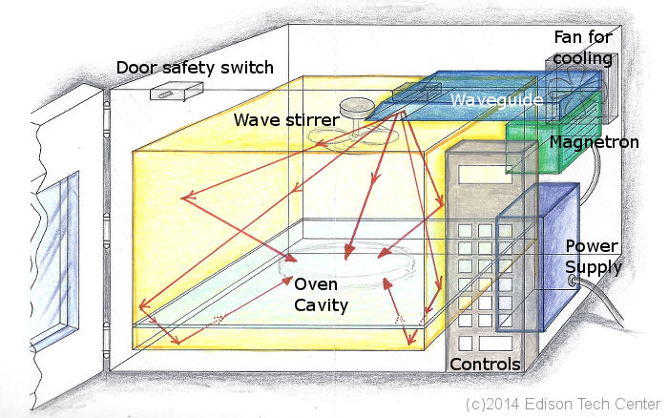
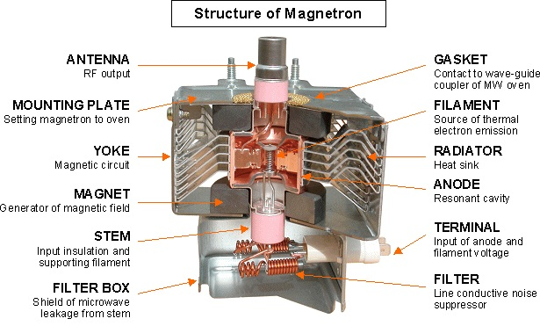
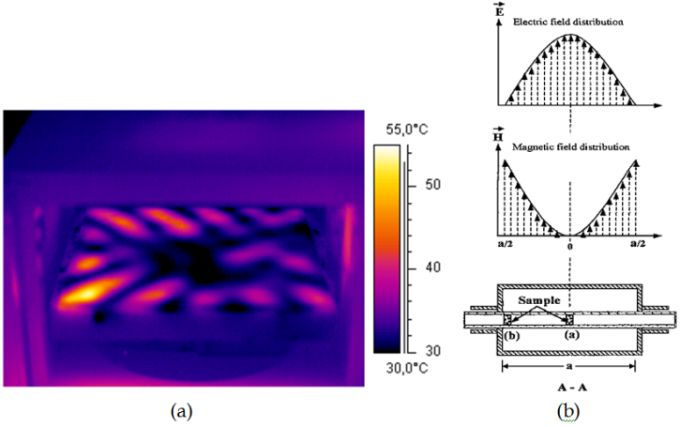
ELECTRONIC HARASSMENT
WEAPONS
Notes:
10

Slide 11
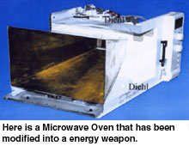
ELECTRONIC HARASSMENT
WEAPONS
Notes:
11

Slide 12
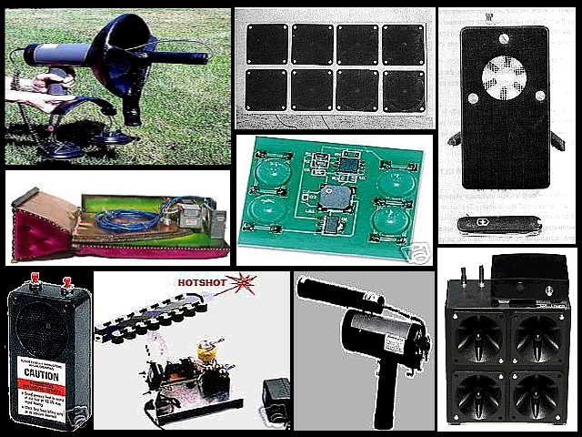
ELECTRONIC HARASSMENT
WEAPONS
Notes:
12

Slide 13
ELECTRONIC HARASSMENT
WEAPONS
OSEH - voice to skull https://www.youtube.com/watch?v=nbhT-o_UDxQ
Paranormal State Billboard Makes You hear Voices
https://www.youtube.com/watch?v=f0Z1QLVTBoI
Notes:
13
OSEH - voice to skull https://www.youtube.com/watch?v=nbhT-o_UDxQ
Paranormal State Billboard Makes You hear Voices https://www.youtube.com/watch?v=f0Z1QLVTBoI

Slide 14
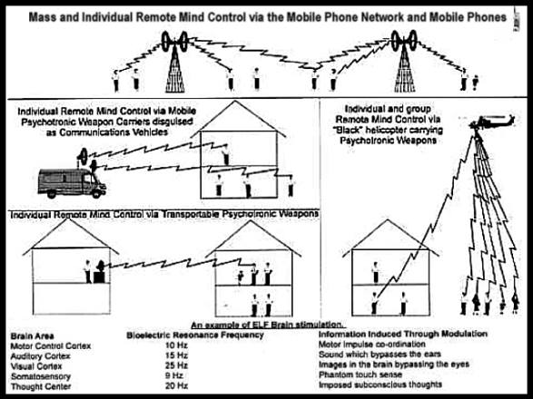
ELECTRONIC HARASSMENT
MODES OF ATTACK
Notes:
14

Slide 15
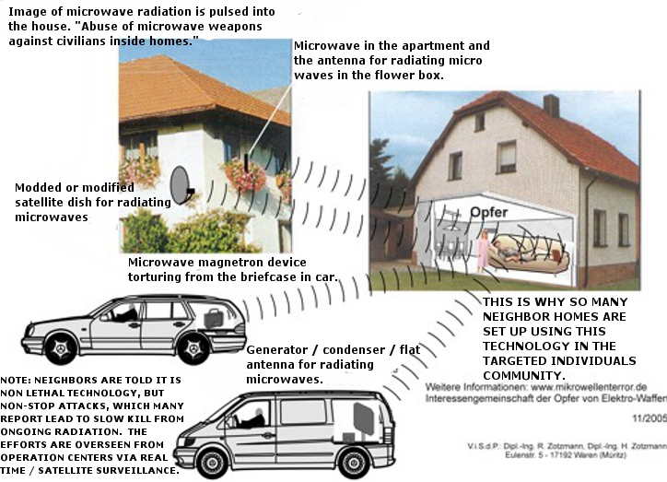
ELECTRONIC HARASSMENT
MODES OF ATTACK
Notes:
15

Slide 16
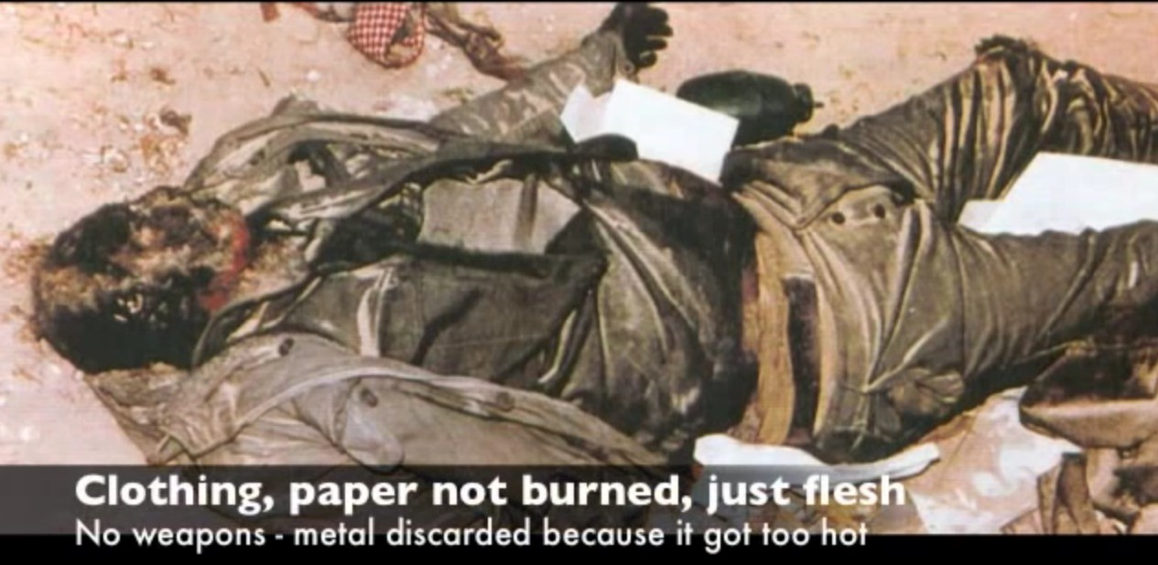
ELECTRONIC HARASSMENT
EFFECTS
Heated body, feeling sick like having the flu
Headaches that come and suddenly disappear
Sting sensations like a fly or mosquito
Blurred vision
Irresistible coughing
Very serious diarrhea
Heart attack/cramps
Kidney pain
Excessive burping
Excessive farting
Stomach pain
Stomach bubbling
Intestinals cramps
Pain in the legs
Pain in ankles
Heel muscle
Reduced strength in hands
Aging the body
Microwave Warfare - Barrie Trower https://www.youtube.com/watch?v=kvn-8ITy0oc
Notes:
16
Microwave Warfare - Barrie Trower https://www.youtube.com/watch?v=kvn-8ITy0oc

Slide 17
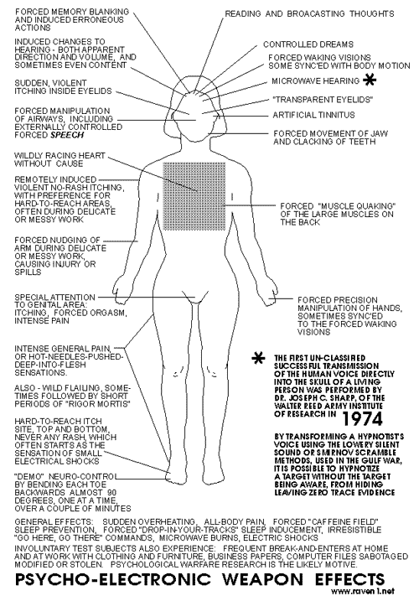
ELECTRONIC HARASSMENT
EFFECTS
BY VARYING THE PULSE WIDTH OF THE MICROWAVE BEAM DIFFERENT BODILY FUNCTIONS AND BEHAVIOURS CAN BE TRIGGERED. ILLNESSES CAN EVEN BE INDUCED.
THESE WEAPONS HAVE BEEN DEVELOPED BUT WE WERE'NT TOLD. METHODS TO DETECT THESE KINDS OF HARASSMENT WERE NOT DEVELOPED. THERE IS DENIAL OF THIS ABUSIVE APPLICATION OF TECH IN THE MEDIA AND LAW ENFORCEMENT.
SEE WINNING TI COURT CASE: KATHLEEN WATTERSON
Notes:
17

Slide 18
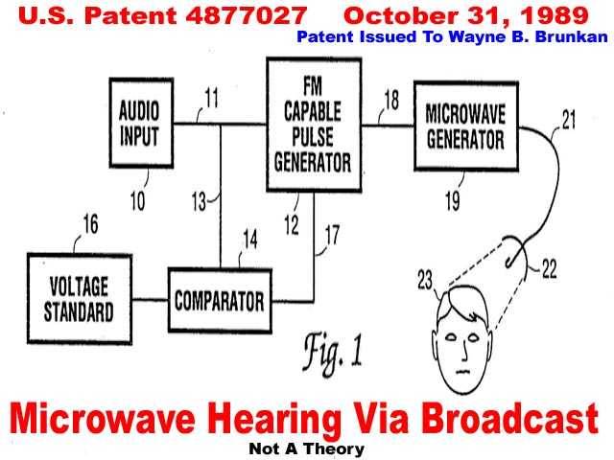
MIND CONTROL
VOICE TO SKULL (V2K)
Notes:
18

Slide 19
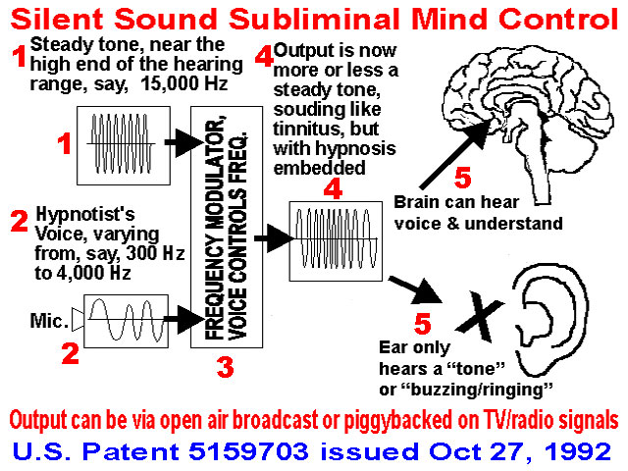
MIND CONTROL
VOICE TO SKULL (V2K)
Notes:
19

Slide 20
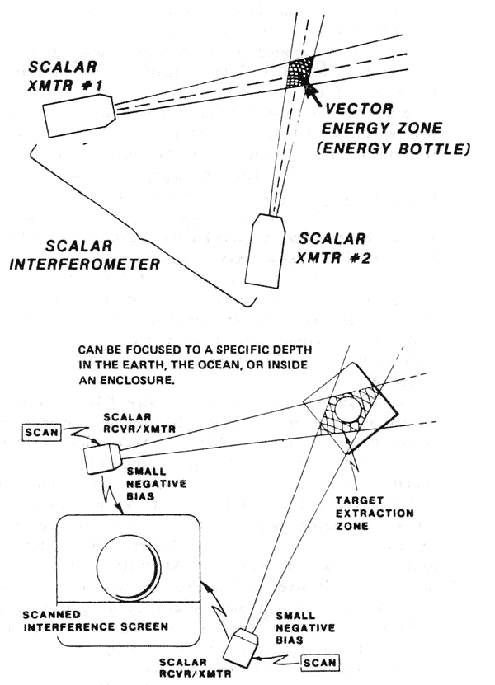
MIND CONTROL
TOM BEARDEN SCALAR AND (V2K)
Notes:
20

Slide 21
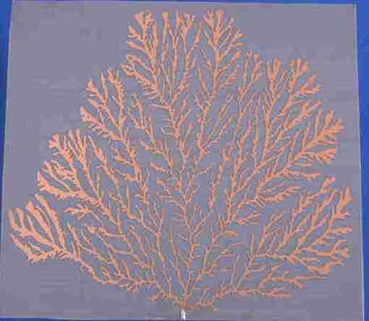
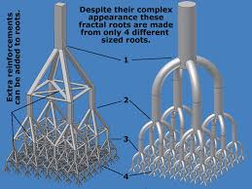
TRACKING TECHNOLOGIES
A fractal antenna is an antenna that uses a fractal, self-similar design to maximize the length, or increase the perimeter (on inside sections or the outer structure), of material that can receive or transmit electromagnetic radiation within a given total surface area or volume.
Notes:
21

Slide 22
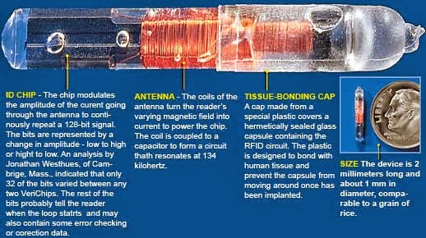
TRACKING TECHNOLOGIES
Notes:
22

Slide 23
TRACKING TECHNOLOGIES
Notes:
23

Slide 24
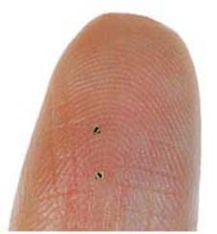
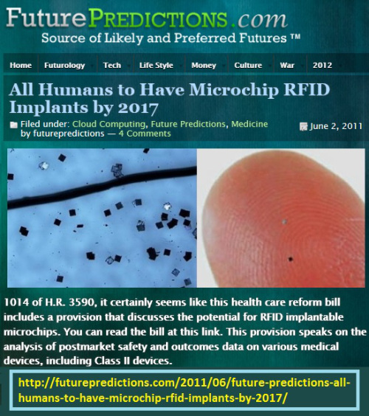
TRACKING TECHNOLOGIES
Notes:
24

Slide 25
TRACKING TECHNOLOGIES
Notes:
25

Slide 26
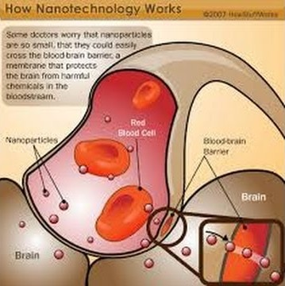
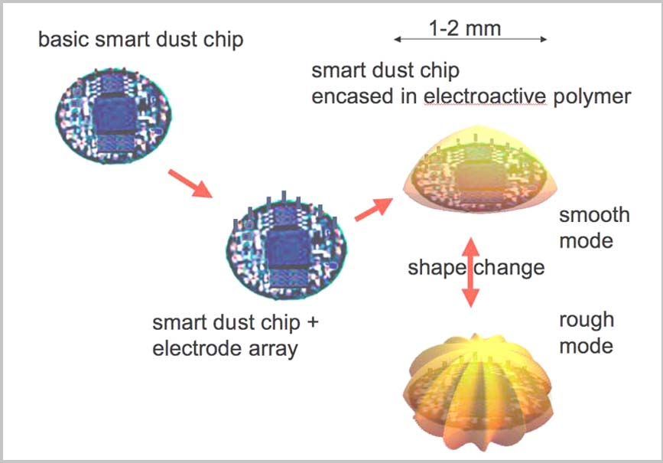
TRACKING TECHNOLOGIES
TECHNOLOGIES ARE NOW USING NANOSCALE AS AN EFFICIENT DELIVERY METHOD PAST THE BLOOD/BRAIN AND NERVOUS SYSTEM BARRIERS
Notes:
26

Slide 27
“GANS” FROM KESHE TECH
The GANS from Keshe technology is a form of untested contaminated ormus which contains electrically conductive nano-particles. This can turn you into a walking antennae
These nano-particles go into your skin and can turn you into an antennae
Also it can lead to heavy metal poisoning.

Slide 28
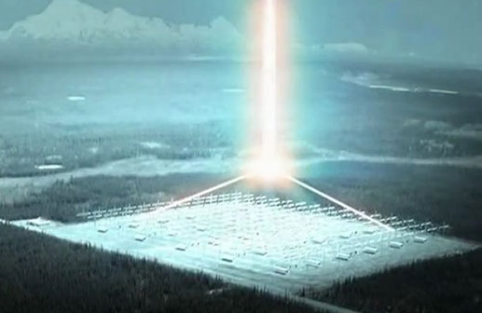
Chemtrails
Chemtrails covertly microchip us all in order to create antennas inside of us via nanotechnology so as to make us totally controllable via a "psychocivilized" (electronically mind controlled) society.
Using HAARP microwave antennas, the National Security Agency (NSA) can establish a seamless computer link direct to our brains, but first they're using chemtrails to get the nanoparticles into us which are reassembling in our bodies to form the antennas.
Chemtrails contain a nasty mix of parasites, pathogens, toxic heavy metals including barium and aluminum, and worst of all- high tech nano engineered particles designed in a lab to assemble themselves inside our bodies into nano-machines which will microchip us from the inside unless we do cleanses to remove the particles to keep them from assembling inside our bodies.
The Intelligence of Geoengineering
https://www.youtube.com/watch?v=ivp7dbGu9TI
Chemtrails on Main Stream TV!
KLAS Navada TV Reports Chemtrails https://vimeo.com/119141933
Notes:
The Intelligence of Geoengineering
https://www.youtube.com/watch?v=ivp7dbGu9TI
Chemtrails on Main Stream TV!
KLAS Navada TV Reports Chemtrails https://vimeo.com/119141933

Slide 29
TRACKING TECHNOLOGIES
Microchips are mostly composed of aluminum, barium titanium oxide, graphene and silicon
Nanoparticulates from chemtrails are mostly aluminum, barium and strontium
METALS LODGED IN THE BODY CAN TURN YOU INTO AN ANTENNAE
=
Notes:
29

Slide 30
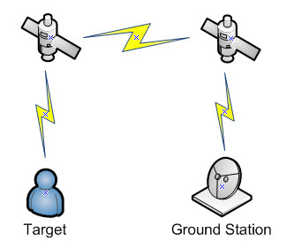
TRACKING TECHNOLOGIES
Toxic with various metals you are now a walking fractal antenna, making it easy to be tracked and managed by would be dictators and despots with the push of a button.
WELCOME TO THE OPEN AIR CONCENTRATION CAMP
Notes:
30

Slide 31
TRACKING PATENTS
US 6239705B1 – INTRA ORAL ELECTRONIC TRACKING DEVICE PATENT
US 2009/0237236A1 – TOOTH LOCATED GPS PERSON TRACKING & LOCATION METHOD
US 8072337B2 – MICRO RF TRANSPONDERS (SMARTDUST PATENT)
US 4877027 – VOICE TO SKULL BY MICROWAVE INDUCTION PATENT
US 6011991 – REMOTE NEURAL NETWORK MONITORING PATENT
Notes:
31

Slide 32
OTHER TRACKING METHODS
Presentations online by German Scientist and Journalist Harold Kautz Vella
www.youtube.com/watch?v=qHQeEnBZiFo
www.youtube.com/watch?v=QiGwN9F6aNw
Fast forward to 16 minutes for modern V2K application via resonating nano particles.
MODULATION OF SCALAR FIELDS BY MICROWAVE TRANSMISSION
MUST READ NASA DOCUMENT:
FUTURE STRATEGIC ISSUES / FUTURE WARFARE [CIRCA 2025]
THE FUTURE IS NOW!
Nano-Bot and Swarms – Chemtrail delivery system
Explosive smart dust
Notes:
32

Slide 33
SOLUTIONS
IGNORE / DISMISS 'INSERTED' THREATS, FEARS AND NEGATIVE THOUGHTS.
NEVER GIVE UP! ASSERT YOUR WILL! STAY CONFIDENT
THE POWER OF PRAYER
JOIN A TI SUPPORT GROUP AND HAVE AN UNDERSTANDING CLOSE FRIEND OR PARTNER
LEARN TO MAKE ORGONITE AND SHARE. WEAR EM PROTECTION
STAY HEALTHY, PERFORM HEAVY METAL DETOX!
LIVE YOUR LIFE AS NORMAL. REMEMBER, THESE DEMONS ARE THE SICK PSYCOPATHIC PERVS AND SADISTS.
Notes:
33

Slide 34
FURTHER DIRECT ACTIONS
HAVE AN ACTION CAM OR RECORDING DEVICE WITH YOU AT ALL TIMES. TAKE PHOTOS OF ANY SUSPICIOUS ACTIVITIES. BUILD A CASE FILE
CONTINUE TO RESEARCH WAYS OF GATHERING MORE EVIDENCE OF VOICE-TO-SKULL TECHNOLOGY AND WAYS TO ATTENUATE THE EFFECTS UPON YOURSELF, AND SHARE WITH ONLINE AND LOCAL TI COMMUNITY
HIRE YOUR OWN INVESTIGATOR
Notes:
34

Slide 35
HOW TO GET HEAVY METALS OUT OF YOUR BODY
How to Rid Your Body of Heavy Metals: A 3-Step Detoxification Plan
http://drhyman.com/blog/2010/05/19/how-to-rid-your-body-of-mercury-and-other-heavy-metals-a-3-step-plan-to-recover-your-health/
Cilantro and Chlorella can Remove 80% of Heavy Metals from the Body within 42 Days Read more: http://naturalsociety.com/proper-heavy-metal-chelation-cilantro-chlorella/#ixzz42Fbcxen8 Follow us: @naturalsociety on Twitter | NaturalSociety on Facebook

Slide 36
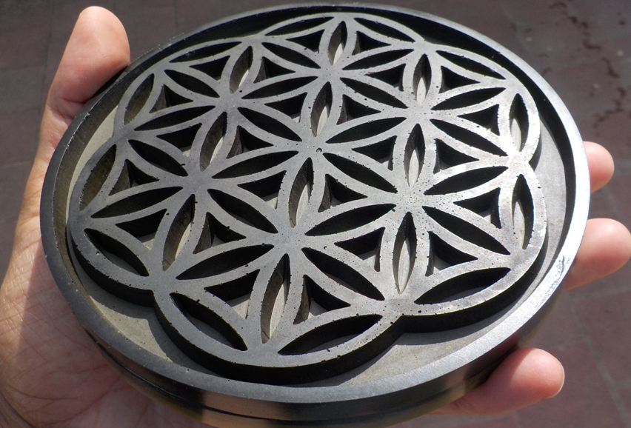
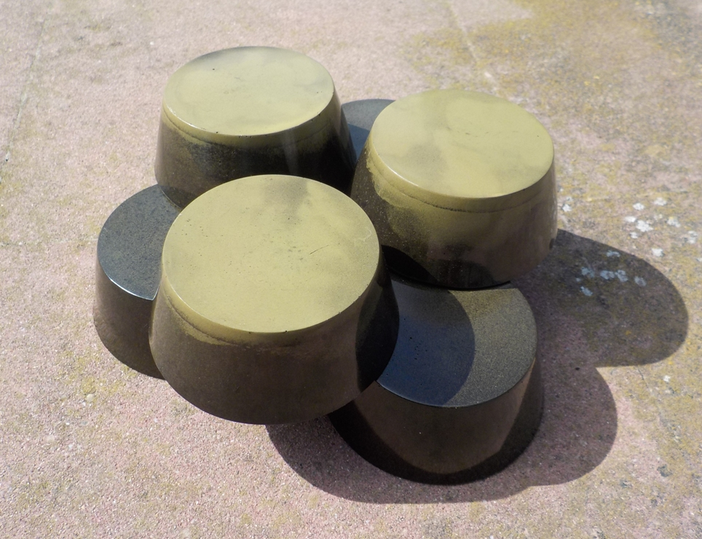
ORGONITE
Orgonite was invented by Karl Hans Welz (Austrian) Orgonite is a mixture of catalyzed epoxy resin with metal shavings, particles or powders, poured into molds. It attracts orgone energy similarly to Reich's accumulators. Some people also add quartz crystals to the mixture to enhance the performance of the orgonite. Thus orgonite basically is a substance which functions as a self-driven, continuously-operating, highly efficient energy transmutation device, drawing in negative energy and transmuting it into positive energy.

Slide 37
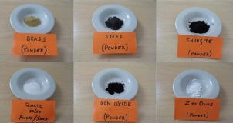
ORGONITE CONVERTS HARMFUL EM !
Orgonite emits soft electrons that can be detected with an ion counter. A chargeplate (a flat dish-like disc) made from this substance is able to change the pH of drinks sitting ontop of it. When freezing water above orgonite a tornado pattern is frozen in the ice, giving the water a crystalline structure when it thaws.
The resin in orgonite shrinks during the curing process, permanently squeezing the quartz crystal inside which creates a well-known piezoelectric effect inside the crystal, meaning its end-points become polarized electrically, this apparently causes it to function more effectively as a positive energy generator. Although crystals improve the function of orgonite, they are not necessary for the orgonite to work.

Slide 38
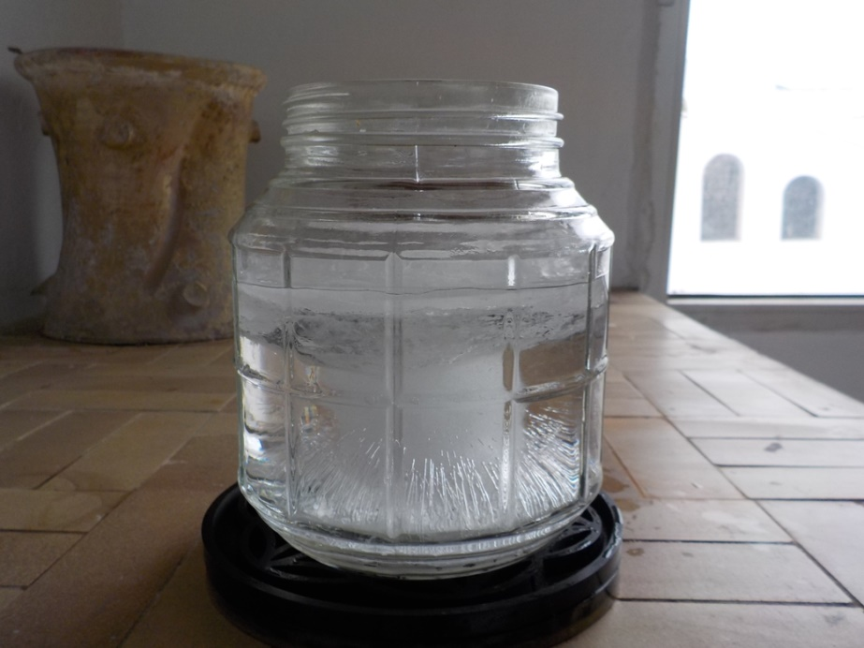
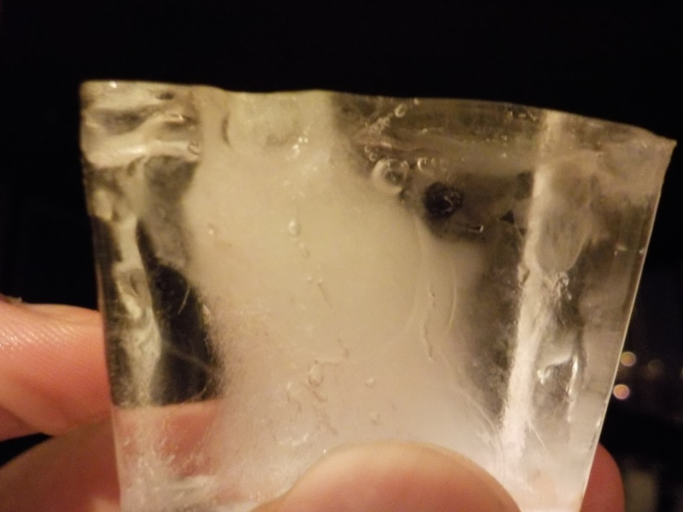
ORGONITE CONVERTS HARMFUL EM !
Anyone can build these devices with easy to find materials. Orgonite is simply a mix of metal and resin (polyester, urethane or epoxy). It can be poured into all kinds of shapes: pyramids, cones, disks, cylinders and pendants, to name a few. Some people use it to combat pollution and cell tower radiation. Others use it for clearing or purifying energies in their houses, or to enhance the growth of plants in their garden. It seems to work also really well in various kinds of spiritual healing work. We have received positive feedback on the orgonite given to our friends. I have personally found it very effective in combating chemtrails over head and improve my overall health against electronic harassment when worn as pendants.

Slide 39
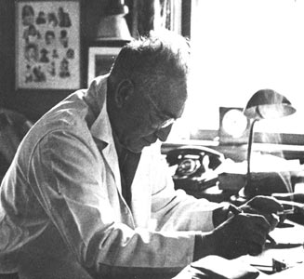
WILHELM REICH (1897 - 1957)
Wilhelm Reich was an Austrian psychoanalyst. Author of several influential books – most notably Character Analysis, The Mass Psychology of Fascism and The Sexual Revolution – Reich became known as one of the most radical practitioners of psychiatry.
Reich's discovery also revealed the role of emotional-sexual energy in the psychosomatic process. What at first appeared to be only "bioelectricity" was later clarified by Reich as a much more powerful bioenergetic force -- a form of life-energy at work within living organisms, expressing itself as emotion and sexuality, but also directly observable in the microscope as a bluish-glowing field around living blood cells and other substances. This bluish-glowing energy, which he eventually called orgone energy (to preserve its relationship with living processes), is a physical phenomenon similar to the older ideas of "vital force" and "cosmic ether" combined.

Slide 40
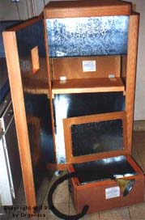
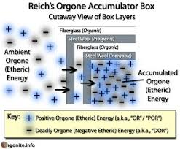
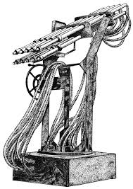
During the course of Reich's investigations, he developed a special metal-lined enclosure which attracted a high charge of orgone energy inside itself, directly from the atmosphere: the orgone energy accumulator. The orgone accumulator was proven to charge seeds and increase garden plant growth, speed the healing of burns and cuts, and there are a number of physical experiments which demonstrate anomalous phenomena inside the accumulator. Reich observed that certain kinds of low-energy illness, such as cancer, would symptomatically yield to careful application of the orgone accumulator.

Slide 41
Reich's experiments in these directions led to even more controversy: new methods for ending drought and greening deserts (leading to the development of the cloudbuster), and new approaches to the problem of nuclear waste detoxification.
Reference: http://www.orgonelab.org/wrhistory.htm
Questions from the Audience

