Slide 1








The Peoples Free Energy Show
Episode 2
Dirty Games

Slide 2











Free Energy Mafia Organization Chart
Banks
Secret Societies
Oil Companies
Governments
Agencies
Associates

Slide 3
FREE ENERGY VOCABULARY
Cold Fusion
- noun
(unbiased definitions)
a hypothetical form of nuclear fusion postulated to occur at relatively low temperatures and pressures, as at room temperature and at one atmosphere.
a hypothetical method for achieving nuclear fusion at low temperature (such as room temperature) – Merriam-Webster Dictionary
(biased definition)
nuclear fusion occurring at or close to room temperature. Claims for its discovery in 1989 are generally held to have been mistaken.

Slide 4
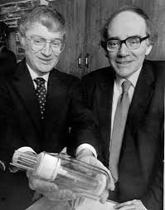
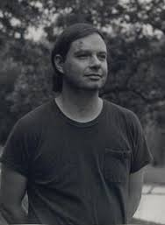
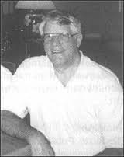
FREE ENERGY INVENTORS
BRUCE
DE PALMA
STANLEY
MEYER
STANLEY PONS &
MARTIN FLEISCHMANN

Slide 5
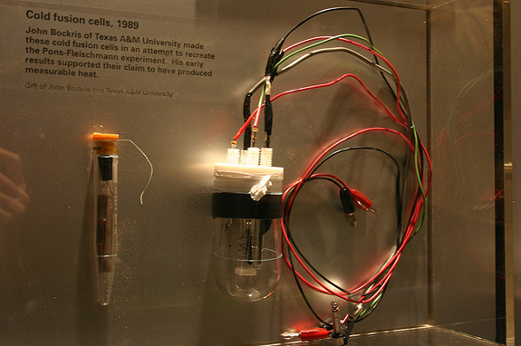

PONS & FLEISCHMANN & 'COLD FUSION'
They were well-regarded Chemists at the University of Utah.
They had worked for 5 years to develop a process which seem to yield too much energy to be a simple chemical reaction.
They stated they had observed evidence of nuclear reactions – such as neutron emission, transmutation and “excess heat”
In 1989 they announced their findings at a press conference.
They were criticised for this as they would normally have “announced” their research in a paper which would be peer reviewed – in a scientific journal.
Cold Fusion should more correctly Low Energy Nuclear Reactions (LENR)
The somewhat inaccurate description “Cold Fusion” appears to have been coined by Dr Steven E “Thermite” Jones – yes, the very same….
Pons and Fleishman and Stephen Jones 1 minute clip
Notes:
Thank you to Andrew Johnson for permission to use this information.
www.checktheevidence.com

Slide 6
STEVE JONES & 'COLD FUSION'
There is quite a bit about Steve Jones in (the late) Dr. Eugene Mallove’s book about the Cold Fusion Cover Up 'Fire From Ice'.
A year 2000 documentary called “Heavy Watergate” (available on Google Video) has this about Steve Jones, however…
Steven E Jones, it appears, coined the term Cold Fusion.
His “job” seems to have been to claim that it was not possible to use.
Notes:
Thank you to Andrew Johnson for permission to use this information.
www.checktheevidence.com

Slide 7
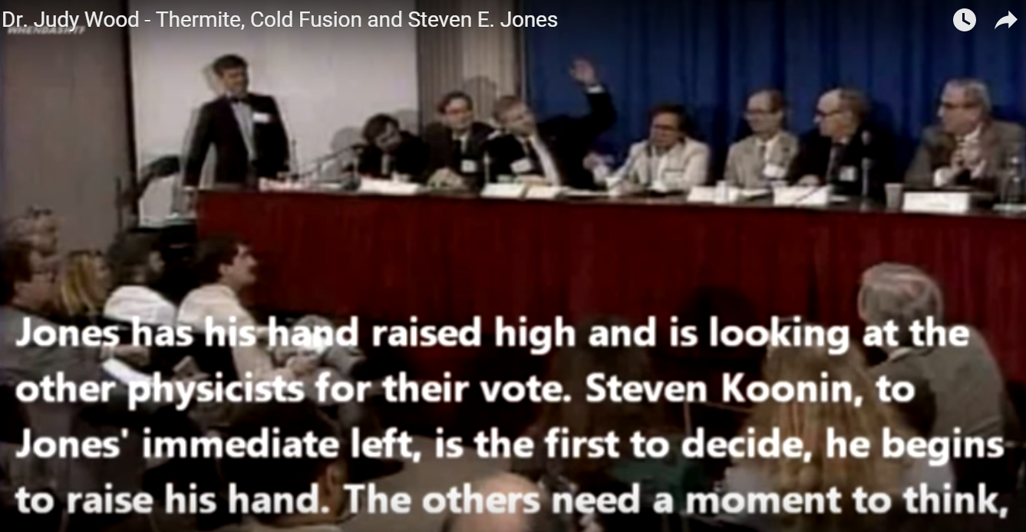
STEVE JONES & 'COLD FUSION'
Judy Wood Science By Vote
Notes:
Thank you to Andrew Johnson for permission to use this information.
www.checktheevidence.com

Slide 8
COLD FUSION SUMMARY
It seems the whole affair was managed from start to finish.
The goal was to trash and debunk the science and it seems a whole array of sceptics and debunkers were “wheeled out” to “stomp out the fire”
It was the first time the phrase “pathological science” was brought into general use.
People I speak to today say things like “their results have never been reproduced!” (which is wholly untrue).
Basically, in many cases, it is difficult to reliably reproduce the conditions under which the reaction will take place.
Different reproductions have different results in terms of seeing
Excess Heat
Evidence of a nuclear process (neutrons and or tritium)
Transmutation of elements

Slide 9

SUPPORT OUR CAMPAIGN !
Open Sourced Co-Development Tesla Technology
Flywheel
Hairpin Circuit
Tesla Coil & Nunez Coil
Lenzless Transformers:
Bi-Toroid Transformer
Markov Transformer
Rodin Coils
Leal & Barbosa Transformer
Phases of This Project:
1) Research phase
2) Design and Development phase
3) Cost of Production phase
4) Fabrication and Assembly phase
5) Build and Test to Resonance
6) Final Phase: Improve efficiency
The TeslaGen V1 mini QEG is a new open sourced co-development project intended on building a portable reluctance generator that can power loads between 700w-900w or more. This project is based around building, teaching and open sourcing instructions. This can help a wider array of DIY engineers learn formerly suppressed engineering skills based on the creation of electrical power through the phenomenon Nikola Tesla discovered, known as resonance and radiant energy. Some of the exciting key features of the TeslaGen v1 mini QEG are; lower price, smaller and lighter weight, CAD files made available, easier core winding, hot-swap rotor, easy experimentation with other popular “free energy” techniques.

Slide 10
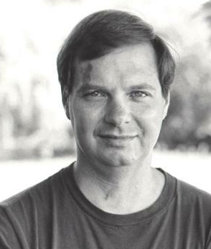
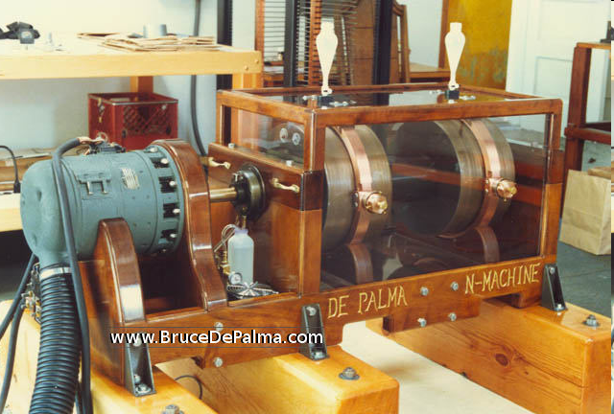
BRUCE DE PALMA'S N-MACHINE
De Palma studied electrical engineering at Harvard (1958) and taught physics at MIT for 15 years, working under Harold Eugene Edgerton. He was also employed by Edwin H. Land of Polaroid.
He is the brother of the Hollywood film director “Brian De Palma”
In his study of inertia, he developed a kind of “Rotating Magnetized Gyroscope” – the N Machine and here he discusses this. PATENT WO 95/08210
http://depalma.pair.com/patent/patent.html
WWW.BRUCEDEPALMA.COM
Notes:
Thank you to Andrew Johnson for permission to use this information.
www.checktheevidence.com

Slide 11
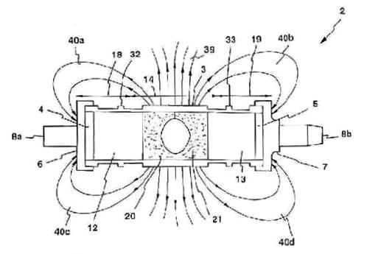

BRUCE DE PALMA'S N-MACHINE
The N-Machine is essentially a low voltage, very high amperage dynamo that has two repelling disc magnets co-rotating with the conductive rotor in between them. This configuration does not suffer from back emf.
Depalma quoted, “The perpetual motioN-Machine is only supposed to run itself. It could never put out five times more power than is put into it. Perpetual motion schemes used conventional energy sources, whereas the N-Machine is a new way of extracting energy from space.”
In India, engineer Paramahamsa Tewari has since tested a derivation of DePalma's device, called the Space Power Generator (SPG). With 5 kilowatts total power input, the SPG is reportedly yielding 30 kilowatts of electrical power output. (correspondence to B. DePalma 8/13/90).
Bruce De Palma N Machine 3 minutes
Notes:
Thank you to Andrew Johnson for permission to use this information.
www.checktheevidence.com

Slide 12
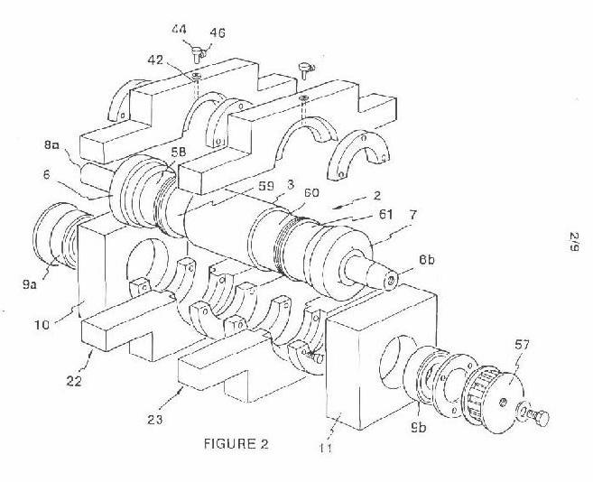
DEATH OF BRUCE DE PALMA
http://www.padrak.com/ine/DEPALMA2.html
“This was not a surprise considering the condition that I had seen Bruce in when I visited him in December of 1993. Bruce began each day upon arising, some time before noon, with fine wine mixed with sparkling water. Years of alcohol and substance abuse finally took its toll.”
“The mystique and enigma that encircled the life of Bruce dePalma was due in part to the fact that he was never able to prove his theories with a working over unity device.”
Notes:
Thank you to Andrew Johnson for permission to use this information.
www.checktheevidence.com

Slide 13


Death of Bruce De Palma
De Palma's death in New Zealand in October 1997 put an end to his most ambitious free energy project, and occurred only weeks prior to the official testing of a device constructed during 6 months in an Auckland workshop. The test was attended by, among others, the project's financial backer, Bruce Bornholdt, a prominent Wellington barrister, as well as the pioneering developer of the Adams motor, Robert Adams (now deceased), who observed the operation of, and measured electrical output from, the N-machine. The test demonstrated no over-unity potential of the N-machine - most of the output energy was lost as heat - and the project was abandoned.
Notes:
Thank you to Andrew Johnson at checktheevidence.com for these slides

Slide 14
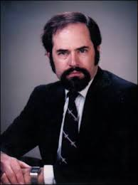



DR. EUGENE MALLOVE
Eugene Franklin Mallove was an American scientist, science writer, editor, and publisher of Infinite Energy magazine, and founder of the non-profit organization New Energy Foundation
Since 1991 he worked as a consultant to U.S. corporations and investment firms doing and planning R & D in new energy.
He was also the author of three science books and wrote several science and technology articles for magazines and newspapers.
Mallove became very critical of the scientific establishment – what he termed the “Academic Government Complex”.
Here he describes how he was told by his superior what was “knowable” in science and what was not.
Dr Mallove was murdered on 17th May 2004.
Interview here: https://www.youtube.com/watch?v=uipT-me_e1s
Eugene Mallove Academic Government Complex (6 minutes)
Notes:
Thank you to Andrew Johnson for permission to use this information.
www.checktheevidence.com

Slide 15
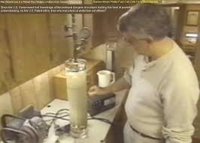
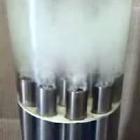

STAN MEYER'S CELL
High frequency pulse circuit
Seems to have some kind of feedback mechanism so that it will work with various types of water – either tap water or salt water.
This process yields hydrogen
The hydrogen can be burned to produce energy
The energy released in the burning of the hydrogen seems to be greater than that used to produce it
The hydrogen can be produced on demand and does not need to be stored.
Interestingly, Bob Lazar has developed a hydrogen generation system where the hydrogen can be stored in a metal hydride.
Here is a clip from “It Runs on Water” from 1997
Stanley Meyers It Runs on Water (6 minutes)
Notes:
Thank you to Andrew Johnson for permission to use this information.
www.checktheevidence.com

Slide 16
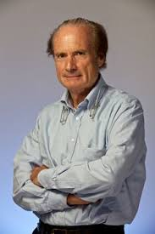

ANDREA ROSSI E-CAT
Born June 3rd, 1950 in Milan, Italy
The CEO of Leonardo Corporation
Founder of Petroldragon in the 1970s, that processed organic waste into oil. Legal battles with government ensued after claims of mismanagement of waist, forced closure of Petroldragon
Inventor of the E-CAT and “The Rossi Effect”
Effect based on Thermal energy production reactions based on Lithium Nickel Hydrogen.
Based on research working with Sergio Focardi to build
a Low Energy Nuclear Reactions (LENR) device.
First semi-public disclosure in 2011
Several independent replications including from a team in Switzerland in October 2014:
“This amount of energy is far more than can be obtained from any known chemical sources in the small reactor volume.”
He's now is working on the E-CAT in Florida for a commercial customer do to be finished by the end of February 2016

Slide 17
E-CAT, COLD FUSION & LENR
The E-CAT and the Pons & Fleischmann Palladium cell are examples a new class of energy production from hydrogen by Low Energy Nuclear Reactions (LENR). They are characterized as a small metallic, glass or ceramic vessel that contains semi-precious nano powders that absorb hyrdogen, and a thermal resistor to initiate the self-sustain anomalous catalytic reaction. The excess thermal energy is then taken off by steam cycle. The term 'cold fusion' was first coined by the media in 1989 but has since been stigmatized as a pathological science by skeptics IN OPPOSITION TO COMPELLING EVIDENCE!
over 3,500 journal papers, news articles and books show excess heat in LENR processes around the world
governmental organizations and companies, such as NASA, Toyota and Boeing, are currently working on this disruptive technology.
American company Industrial Heat had acquired the licensing rights to his technology in the US, Russia and China.

Slide 18
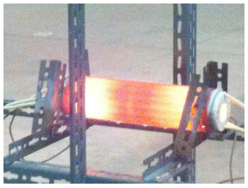
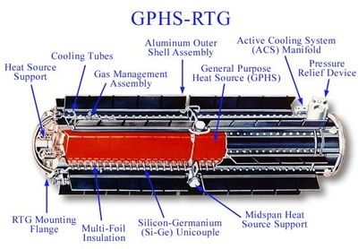
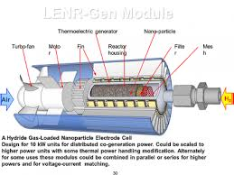
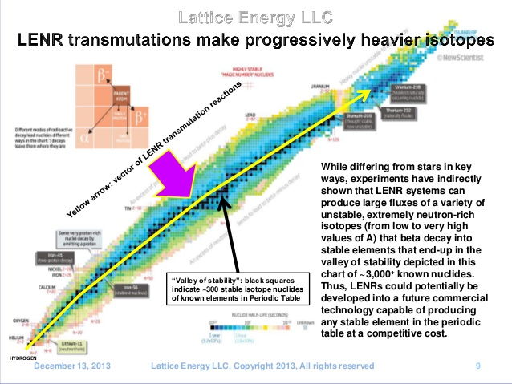
E-CAT, COLD FUSION & LENR
Examples of Successful replications and designs

Slide 19
E-CAT, COLD FUSION & LENR
References:
http://newenergytimes.com/v2/news/2010/35/SR35902coldfusionisneither.shtml
http://lenr-canr.org/
http://ecat.com/inventor-andrea-rossi
http://www.forbes.com/sites/markgibbs/2013/05/20/finally-independent-testing-of-rossis-e-cat-cold-fusion-device-maybe-the-world-will-change-after-all/#48e6da0a57e4
http://fortune.com/2015/09/27/ceo-cherokee-investment-partners-low-energy-nuclear-reaction/

Slide 20
Deaths Related to Free Energy Research
Wilhelm Reich – Nov 3rd 1957 – Found hanged in his Prison Cell
Bruce De Palma – 1997 (more later)
Stan Meyer - March 21, 1998 (more later)
Dr Eugene Mallove - Murdered 17th May 2004 – apparently in a “burglary which got discovered”.
James Black - On August 1, 2003 - 1988 Nobel Laureate for Medicine). He attempted to sue US/Canadian Govt’s over their actions against John Hutchison’s research - was found on his bed in his apartment. The autopsy described it as a natural death, a "possible heart attack". At the time of his death, he was 51 years old (born November 25, 1951), in perfect health, and had never had any heart problems.
Arie M. DeGeus - Nov. 11, 2007 - inventor of a revolutionary, “self powering battery”, of AMDG Scientific Corp was found slumped in his car, totally unresponsive, in the long-term parking lot of the Charlotte
Michael Zebuhr – March 19, 2006 – nephew of William Zebuhr who worked with Mallove.
Notes:
http://pesn.com/2007/12/05/9500463_self-powered_battery_inventor_dead/
http://web.archive.org/web/20071022035743/http://www.psiapplications.com/topjamesblack1.html
Thank you to Andrew Johnson at checktheevidence.com for these slides

Slide 21

Stan Meyers’ Death
After more than 20 years of research and tinkering, Stanley Allen Meyer, his brother and two Belgian investors raised glasses in the Grove City Cracker Barrel on March 20, 1998. Stephen Meyer recalls the events of that evening.
"Stanley took a sip of cranberry juice. Then he grabbed his neck, bolted out the door, dropped to his knees and vomited violently."
"I ran outside and asked him, 'What's wrong?' " Stephen recalled.
"He said, 'They poisoned me.' That was his dying declaration."
People who knew him say his work drew worldwide attention: mysterious visitors from overseas, government spying and lucrative buyout offers.
Sparked a three-month investigation that consumed and fascinated Grove City police, but in the end, the coroner's report listed the cause of death as a brain aneurysm.
"Meyer's death was laced with all sorts of stories of conspiracy, cloak-and-dagger stories," said Grove City Police Lt. Steve Robinette, lead detective on the case.
If Stephen Meyer was shocked at his twin brother's collapse and death, he was equally amazed at the Belgians' response the next day. "I told them that Stan had died and they never said a word," he recalled, "absolutely nothing, no condolences, no questions. I never, ever had a trust of those two men ever again."
Notes:
http://www.top-alternative-energy-sources.com/stanley-meyer.html
Thank you to Andrew Johnson at checktheevidence.com for these slides

Slide 22
How do we get access to Free Energy Devices?
This YouTube posting describes what happens:
Stanley Meyer and many others. Always the same story. The Pentagon wants to see your idea and tell you how they would like to use your invention. You demonstrate your device proving to them that it works, then they block all of your efforts and end up killing you. The only way to get a free energy device out to the public is to forget about patents, distribute underground, sell it to EV enthusiasts with the plans and encourage them to travel around and do as you are, you then have created a non interlinked underground distribution system that will spread to the general populous and it will spread like wild fire, it will be un-stoppable.
Notes:
http://www.youtube.com/watch?v=uGRsQZx6zWA
Thank you to Andrew Johnson at checktheevidence.com for these slides

Slide 23
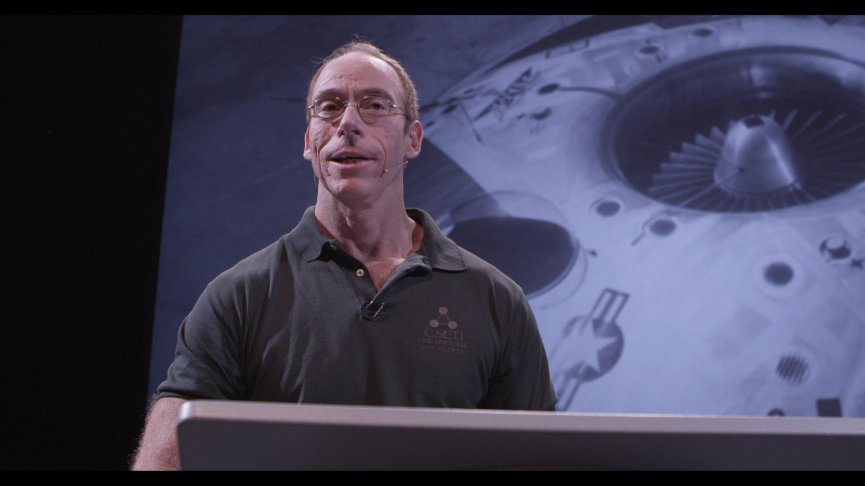
Dr. Steven Greer and the
$100,000 STAR Challenge
Notes:
Stephen Greer and the $100,000 Star Challenge
Steven M. Greer, MD is Founder of The Disclosure Project, The Center for the Study of Extraterrestrial Intelligence (CSETI), The Orion Project and Sirius Technology Advanced Research, LLC.
In 2001 he presided over the National Press Club Disclosure Event where over 20 military, government, intelligence and corporate witnesses presented compelling testimony regarding the existence of extraterrestrial life forms visiting the planet, and the reverse engineering of the energy and propulsion systems of these craft.
Dr. Greer has now retired as an emergency physician to work on ET disclosure and free energy related projects.
He is the author of four insightful books and multiple DVDs on the UFO/ET subject. He teaches groups throughout the world how to make peaceful contact with extraterrestrial civilizations, and continues to research bringing truly alternative energy sources out to the public.
Dr. Greer has been seen and heard by millions world-wide on CBS, the BBC, The Discovery Channel, the History channel, The Ancient Aliens series, Thrive and through many news outlets worldwide. He made a documentary movie called “Sirius” which disclosed extraterrestrial coverup and the suppression of free energy devices.
He has worked for 17 years to bring together the scientists, inventors and leaders in society to advance new clean technology energy systems.
See more at: http://www.siriusdisclosure.com/about-us/#sthash.trQdgRfH.dpuf

Slide 24
So what’s required of the inventor in order to claim the $100K?
Device must be open sourced
Device must be mass producible
You have to get it verified and tested by independent 3rd party testing
You have to bring the device to them in Charlottesville Virginia USA
You have to leave the device with them
If you want a copy of your device you’ll have to make two
You have to cover all your expenses up front
The $100K will only be released to you after they have finished reproducing your device.
Notes:
The 100,000 Star Challenge
Steven Green spent several years and $900,000 traveling the world trying to find a free energy device without much luck. So he has put up a $100,000 prize for anyone who brings a working Free Energy Device to him. This award has been available for a few years now, and no one has yet claimed it that we know of.
Greer does not have enough funding to create his own high energy lab that can be streamed to the world on the internet, plus he is not a technician and states he couldn’t assemble a toaster with a set of plans. However he does claim:
“We have an amazing network of people all over the world who can help get such a device secured, funded and launched to the public- If the technology is legitimate and can be properly vetted. Many powerful people, while justifiably skeptical, will come forward to support us if we can put in front of them something that is real.”
So what’s required of the inventor in order to claim the $100K?
Device must be open sourced
Device must be Mass Producible
You have to get it verified and tested by independent 3rd party testing
You have to bring the device to them in Charlottesville Virginia USA
You have to leave the device with them
If you want a copy of your device you’ll have to make two
You have to cover all your expenses up front
The $100K will only be released to you after they have finished reproducing your device.
http://www.siriusdisclosure.com/100000-star-challenge-and-award/
http://siriusdisclosure.com/wp-content/uploads/2014/04/Criteria-for-Device.pdf
http://siriusdisclosure.com/wp-content/uploads/2014/04/TEF.pdf

Slide 25
How much would it cost us to get the QEG to Steven Greer?
$16K build 2 QEG’s
$50K purchase equipment for required verification and testing
$2K international shipping and import taxes
$8K round trip international Airfare for family of 4
$8K additional expenses for 4 people for about a month
$85K Total
Notes:
We’ve gotten countless letters from QEG followers asking us why we don’t go for Steven Greers prize. I’d like to take this opportunity to break this down for everyone from a project managers perspective. While everyone is different, lets use the QEG as a hypothetical.
How much would it cost us to get the QEG to Stephen Greer?
$16K Build 2 QEG’s
$50K purchase equipment for required verification and testing
$2K International shipping and import taxes (if we even get it past customs!)
$8K Round trip international Airfare for family of 4
$ 8K Traveling, lodging and food expenses for 4 people for about a month
$85K Total
We would have to put out $85K in expenses just to eventually receive $100K for a net total of $15K profit.

Slide 26
Additional Concerns about $100K STAR Challenge from the Inventors Perspective
How can I protect myself, my family and my device while bringing it to Steven Greer? (Post 9/11 TSA in a high security country like America is not the ideal place to bring a free energy device)
The headquarters of the CIA is a two hour drive away from where they want you to bring your free energy device.
How do I know that my device won’t be confiscated as a national security threat once I bring it to you?
How do I know you’ll do the right thing with the device after I give it to you?
Is it really worth risking so much and going through so much trouble?
Notes:
Additional concerns:
How can I protect myself, my family and my device while bringing it to Steven Greer?
(Post 9/11 TSA Security in a high security country like America is not the ideal place to bring a free energy device)
The headquarters of the CIA is a two hour drive away from where they want you to bring your free energy device.
How do I know that my device won’t be confiscated as a national security threat once I bring it to you?
How do I know you’ll do the right thing with the device after I give it to you?
Is it really worth risking so much and going through so much trouble?
Our Conclusion:
We feel it makes more sense for Greer to build a QEG on his own using our free plans for a fraction of what he would give away as a prize. For all we know, he might very well be doing just that and not telling anyone about it! We like Dr. Greer, we’ve learned a lot from his videos and welcome the chance to be able to speak with him one day.
However, it should be noted. None of these semi-famous people have ever done ANYTHING to help this project move forward. It has always been people like YOU that have supported this work, and that’s why it is THE PEOPLE that we chose to spend most of our time focusing on. We do this work for YOU.

Slide 27


JTRIG
Joint Threat Research Intelligence Group
Video “Proof of Government Paid Internet Trolls and Free Energy” Young Turks (11 minutes)
Notes:
JTRIG
The Joint Threat Research Intelligence Group (JTRIG) is a unit of the Government Communications Headquarters (GCHQ), the British intelligence agency . The existence of JTRIG was revealed as part of the global surveillance disclosures by NBC News in documents leaked by the former National Security Agency contractor Edward Snowden.
JTRIG TACTICS ARE USED FOR A NUMBER OF AREAS THAT ARE DISRUPTIVE TO THE AGENDA OF THE RULING INTERESTS. INCLUDING: VACCINES AWARENESS, MONSANTO OPPOSITION, NATURAL CURES FOR CANCER, AND FREE ENERGY.
The core self-identified purposes of JTRIG are to:
1. To inject all sorts of false material onto the internet in order to destroy the reputation of its targets.
2. To use social sciences and other techniques to manipulate online discourse and activism to generate outcomes it considers desirable.
The Intercept, a website organized by Glenn Greenwald, Laura Poitras, and Jeremy Scahill that reports on documents leaked by NSA whistleblower, Edward Snowden, has published some of these documents – including instructions on how to be an Internet troll for corporate purposes.
These techniques have not only been highly researched, but manuals have been created to teach them. This article entitled “How Covert Agents Infiltrate the Internet to Manipulate, Deceive, and Destroy Reputations” shows detailed directions from manuals on how to discredit a person or company, and includes even more destructive practices, like leaking information, emailing colleagues, neighbors and friends, and changing photos on the target’s social media.
Please watch this short video for an overview of these documents from the Joint Threat Intelligence Research trainings.
Play video
Links:
Links to original Intercept Article and Links to JTRIG documentshttps://theintercept.com/2014/02/24/jtrig-manipulation/
Clean Energy Suppression Article with more Links
http://www.fixtheworldproject.net/clean-energy-suppression.html
Video Link Proof of Government Paid Internet Trolls
https://youtu.be/vddULW_7CcM

Slide 28
Strategies Used to Destroy Free Energy Online
Label it a scam or conspiracy theory
-JTRIG Art of Deception Online Covert Operations Training Manual pg. 11 “Magic Techniques and Experiment Online HUMINT”
Spread false information
-JTRIG Art of Deception Online Covert Operations Training Manual pg. 17 “Dissimulation Hide the Real Simulation Show the False”
Create false accounts
-JTRIG Art of Deception Online Covert Operations Training Manual pg. 42 “Mirroring, Accommodation and Mimicry”
Creating multiple user profiles
- JTRIG Art of Deception Online Covert Operations Training Manual pg. 48 “Identifying and Exploiting Fracture Points”
Organized, timed attacks
-JTRIG Art of Deception Online Covert Operations Training Manual pg. 45 “Disruption and Computer Network Attack”
Posting comments that claim “I am a victim!”
-JTRIG Top Secret Conference Slides Leaked by Snowden titled “Discredit a Target”
Create Baiting Websites
-JTRIG Top Secret Conference Slides Leaked by Snowden titled “Discredit a Company”
Controlled Opposition
-JTRIG Art of Deception Online Covert Operations Training Manual pg. 42 “Mirroring, Accommodation and Mimicry”
Notes:
Strategies Used to Destroy Free Energy Online
The most common strategy is labeling all free energy research and devices as a “scam”, and all evidence supporting free energy as a “conspiracy theory”.
JTRIG Art of Deception Online Covert Operations Training Manual pg. 11 “Magic Techniques and Experiment Online HUMINT”
Spreading false or skewed information in online conversations, including social media and blog comments. Lies of omission are another popular technique here as well.
JTRIG Art of Deception Online Covert Operations Training Manual pg. 17 “Dissimulation Hide the Real Simulation Show the False”
Creating false accounts that appear to follow and support free energy devices and inventions and then generally acting unhinged (acts crazy) as a follower of the author, in order to scare new followers away. This involves agreeing with the article while displaying unstable or outrageous behavior in the comments so that real readers and commenters are scared away from following him or her. JTRIG Art of Deception Online Covert Operations Training Manual pg. 42 “Mirroring, Accommodation and Mimicry”
Creating multiple user profiles to make it look like there are more dissenters than there actually are. Usually, the same person or group creates them all. Someone who is very skilled will vary the “voice” of the commenters so that they sound like different people who coincidentally just met and all agree. JTRIG Art of Deception Online Covert Operations Training Manual pg. 48 “Identifying and Exploiting Fracture Points”
Organized, timed attacks to ruin a person’s livelihood or reputation. These can be timed with the victim’s own successes: such as a new breakthrough, a big announcement, release of new important information or schematics, a successful campaign, etc. JTRIG Art of Deception Online Covert Operations Training Manual pg. 45 “Disruption and Computer Network Attack”
Posting comments that claim “I am a victim!” with details on how the author’s point of view on a topic has destroyed their lives when, in fact, these are just made up stories. Example: “This is a scam, I fell for it and it ruined my life!” Many times, the commenter will look like your average person. JTRIG Top Secret Conference Slides Leaked by Snowden titled “Discredit a Target”
The creation of entire baiting websites / blogs / forums used for data mining and monitoring the threat of free energy progress against the oil industry. Topics appear to start from a neutral point of view but then all forum threads become infiltrated with trolling comments that are not monitored. Mostly “debunking” or “discrediting” every free energy device theory that is presented. JTRIG Top Secret Conference Slides Leaked by Snowden titled “Discredit a Company”
Full time professionals posing as “Experts” both online and at speaking engagements. This is known as “controlled opposition”, the concept being that the best way to control the opposition is to lead it. JTRIG Art of Deception Online Covert Operations Training Manual pg. 42 “Mirroring, Accomodation and Mimicry”

Slide 29
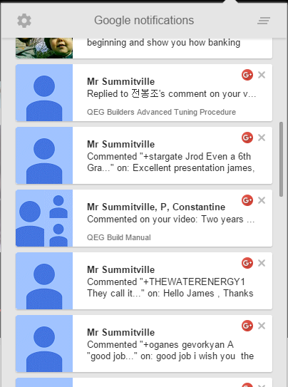



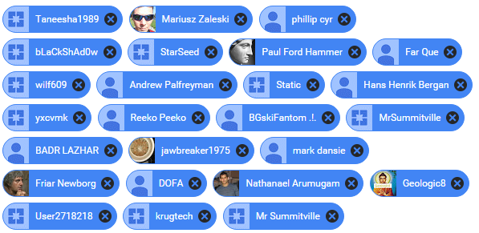
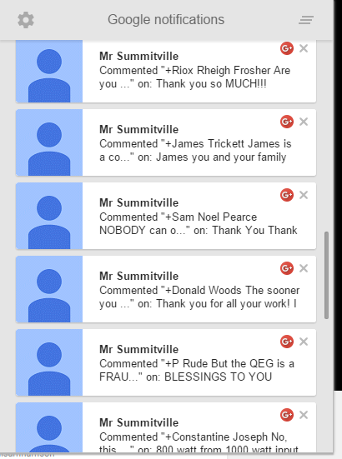



Real Life Examples
Multi-post Spamming
Baiting Websites
Our List of Banned Youtube Trolls
Controlled Opposition
“Creative” Trolls
Notes:
Real Life Examples of Trolling:
Multi-post spamming as evidenced by my Google notifications feed.
Baiting Websites like overunity.com, they act as a trap to data mine new technologies. It would be the equivalent of the IRS starting up a website called “how to not pay your taxes dot com” and look to see who signs up so they can snag them for tax evasion.
Controlled Opposition Websites like Revolution-Green.com. They mix in some truth with their agenda to try to keep traffic going, but mostly they just trash everyone’s devices. We think the oil prices that were displayed on their site for a while are one of the many signs that they are working for the other side and pretending to be advocates of free energy. Like they say, the best way to fight the opposition, is to control it. That looks exactly like what these guys do.
Creative Trolls: These trolls, Doazic and TinselKoala have actually gone through the trouble of producing full youtube videos just to trash projects, complete with the manipulation of their own graphics!
All of these guys know each other, they organize and work together in order to harass a target. We know TinselKoala and Doazic are quite chatty as they comment on and share each others videos. TinselKoala also runs the Overunity.com baiting website, and Mark Dansie gave Tinsel Koala some kind of an award on Revolution Green. Mr. Summitville seems to be one of their lower level cronies as his spamming always seems to pop up around the same time the others do.
And on the right here, we have one of several of our lists of the trolls we’ve had to deal with and ban on our youtube videos.

Slide 30



Trolling is a Serious Problem That Needs to Be Stopped!
Trolls Are narcissists, psychopaths, and sadists who will lie, exaggerate, and offend to get a response.
Trolling skews research
Trolling activities cause children to commit suicide
Trolling destroy innocent lives
¼ of all Americans admit to being Internet trolls
Trolls Create False Flag Events
Trolls are
put in Jail
Notes:
Trolling is a Serious Growing Problem that Needs to be Stopped
A personality study shows that Internet Trolls Are Narcissists, Psychopaths, and Sadists who will lie, exaggerate, and offend to get a response.
*www.psychologytoday.com Internet-trolls-are-narcissists-psychopaths-and-sadists
*www.slate.com Internet_troll_personality_study_machiavellianism_narcissism_psychopathy
Trolling influences research and skews results and public perception: http://www.entrepreneur.com/article/242924
Over one quarter of all Americans admit to being Internet trolls, saying things online that are purposefully offensive in order to upset people.
http://www.huffingtonpost.com/2014/10/20/internet-trolls-survey_n_6014826.html
Trolling activities destroy innocent peoples lives
http://www.businessinsider.com/a-cisco-exec-vanquished-internet-troll-2014-12
Trolling activities cause children to commit suicide
http://www.puresight.com/Real-Life-Stories/real-life-stories.html
Trolling activities are used to influence political outcomes and false flag events
http://www.juancole.com/2014/02/darknesses-manipulated-deceived.html
New laws are being passed that put internet trolls in jail
http://www.bbc.com/news/uk-29678989

Slide 31
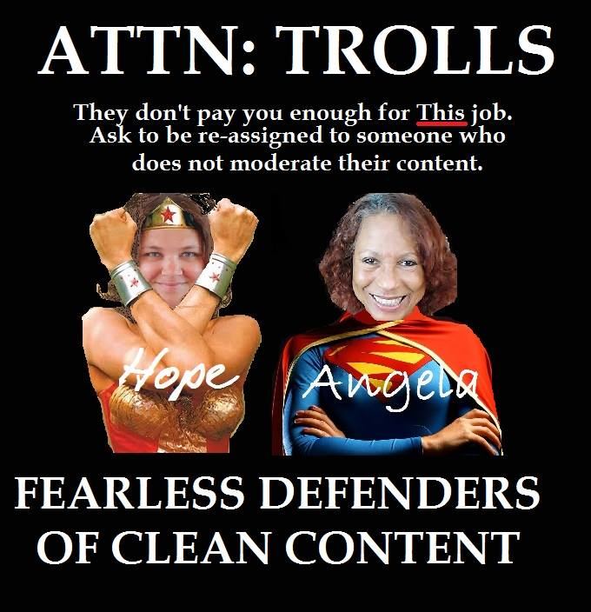
Should we “Just Ignore Trolls?” = NO!!!!
Expose them
Report them
Help shut them down
Moderate your content
People are Fighting Trolls
and Winning!
“Mum turns troll-hunter and forces 500 cyberbullies off the internet”
“Tackling the Trolls how people are fighting back”
Notes:
Should you Just Ignore Trolls? The Answer is NO.
You should expose them, report them, help shut them down, and moderate your own content. People are fighting back trolling and they are winning!
People are fighting back against internet trolling and winning
Check out these two stories here:
“Mum turns troll-hunter and forces 500 cyberbullies off the internet”
-A mom of 5, disgusted by the vile abuse of her children online, turned into a troll hunter and closed down the accounts of more than 500 trolls. Kaitlin spends up to 8 hours a day rooting out the identities of trolls. If she finds out a trolls name, their facebook profile or their website address, she emails the details straight to the people responsible for policing the sites where the abuse appears. She also emails the trolls directly, warning them she is handing their message to police.
“Tackling the Trolls how people are fighting back”
To combat illicit sexual messages, one girl is tracking down the mothers of the offenders and sending screen shots. Another blogger is slamming trolls to get others to come out and share their experiences with the same person. Websites that expose trolling are popping up also, like “Racists Getting Fired”, which tracks down the name and current employer of the people behind racial slurs and reporting them to their employer, thus getting them fired from their jobs.
http://www.mirror.co.uk/news/uk-news/mum-turns-troll-hunter-forces-500-2180859
http://www.thestar.com/life/2014/12/08/tackling_the_trolls_how_people_are_fighting_back_against_online_harassment.html
http://www.buzzfeed.com/emilygould/why-we-need-to-fight-online-trolls-not-just-ignore-them

Slide 32

Confessions of a Paid Shill
Notes:
Confessions of a Paid Shill
http://consciouslifenews.com/paid-internet-shill-shadowy-groups-manipulate-internet-opinion-debate/1147073/
This next part covers a very interesting article that’s been out on the internet for a while called “I Was a Paid Internet Shill”. It’s a confession of an ashamed employee of a seedy company that sets up shop for six months at a time to serve as a base for employing trolling operations. The subject claims to have left his job, disgusted with himself and give a full account of the way things are run in a shill office. He was paid to spread disinformation on the internet around political points of interest as were all those around him. He got “assigned” to specific websites or accounts.
They employ desperate people that are looking for work. They call themselves “consultants” working on “tech support”. The company changes its name monthly giving itself a bland name that doesn’t give a strong impression of what it does.
He goes on to state:
“My task was simple: I would be assigned to four different websites, with the goal of entering certain discussions and promoting a certain view. I learned later that some of the personnel were assigned to internet message boards (like me), while others worked on Facebook or chatrooms. It seems these three types of media each have a different strategy for shilling, and each shill concentrates on one of the three in particular. At first I was on what they call meme-patrol, later on I was trained for more complex arguments.
I was handed two binders with sheets enclosed in limp plastic. The first was labeled simply “Israel” in magic-marker on the cover, and it had two sections .The first section contained basic background info on the topic. I would have to read and memorize some of this, as time went on. It had internet links for further reading, essays and talking points, and excerpts from some history books. The second, and larger, section was called “Strat” (short for “strategy”) with long lists of “dialogue pairs.” These were specific responses to specific postings.
If a poster wrote something close to “X,” we were supposed to respond with something close to “Y.” “You have to mix it up a bit, though, otherwise it gets too obvious. Learn to use a thesaurus.” This section also contained a number of hints for de-railing conversations that went too far away from what we were attempting. These strategies included various forms of personal attacks, complaining to the forum moderators, smearing the characters of our opponents, using images and icons effectively, and even dragging the tone of the conversation down with sexual innuendo, links to pornography, or other such things. “Sometimes we have to fight dirty,” or trainer told us. “Our opponents don’t hesitate to, so we can’t either.”
The site-specific info in the second binder included a brief history of each site, including recent flame-wars, as well as info on what to avoid on each site so as not to get banned. It also had quite detailed info on the moderators and the most popular regged posters on each site: location (if known), personality type, topics of interest, background sketch, and even some notes on how to “push the psychological buttons” of different posters.
Each popular poster was classified as “hostile,” “friendly,” or “indifferent” to my goal. We were supposed to cultivate friendship with the friendly posters as well as the mods (basically, by brownnosing and sucking up), and there were even notes on strategies for dealing with specific hostile posters. The info was pretty detailed, but not perfect in every case. “If you can convert one of the hostile posters from the enemy side to our side, you get a nice bonus. But this doesn’t happen too often, sadly. So mostly you’ll be attacking them and trying to smear them.”
The “complex debate” part of the job involved a fair amount of additional training, including memorizing more specific information about the specific posters (friendly and hostile) I’d be sparring with. Here, too, there were scripts and suggested lines of argument, but we were given more freedom. There were a lot of details to this more advanced stage of the job – everything from how to select the right avatar to how to use “demotivationals” (humorous images with black borders that one finds floating around the web). Even the proper use of images of cats was discussed. Sometimes we used faked or photo-shopped images or doctored news reports (something else that bothered me).
And it goes on from there, he ends with:
This is my confession. I haven’t made up my mind yet about whether I want to talk more about this, so if I don’t respond to this thread, don’t be angry. But I think you should know: Shills exist. They are real. They walk among you, and they pay special attention to your popular content. You should be aware of this. What you choose to do with this awareness is up to you.
Yours,
ExShill
Link: I was a Paid Internet Shill
http://www.thetruthseeker.co.uk/?p=64853

Slide 33
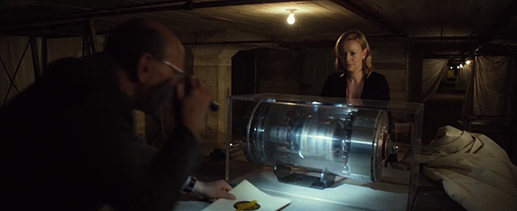
Technology Gaming Trophies
Dagny Taggart acquires a free energy device in Atlas Shrugged
Devices are coveted and hunted like game by wealthy free energy poachers
They are considered trophies of human ingenuity
Many want to confiscate them or display them like a museum piece, but not USE them
They are fiercely protected by their inventors

Slide 34



Free Energy Archetypes
Touchy Feely’s
Unicorn Boys
Blunder Boys
Self appointed experts who want to come to your lab to touch and feel your device. If admission is denied they accuse it as being a scam.
Wide eyed young rookies with an overly unrealistic optimistic attitude and a gift for making speeches about changing the world. They make assumptions that this is somehow easy and that its “already done”.
Clueless businessmen who capitalize on someone else's device, aggressively compete with the original inventor, only to come back to the inventor asking for help when they realize they lack the skills.
Notes:
Touchy Feely’s
Self appointed experts who want to come to your lab to touch and feel your device. If admission is denied they accuse it as being a scam.
Unicorn Boys
Wide eyed young rookies with an overly unrealistic optimistic attitude and a gift for making speeches about changing the world. They make assumptions that this is somehow easy and that its “already done”.
Blunder Boys
Clueless businessmen who capitalize on someone else's device, aggressively compete with the original inventor, only to come back to the inventor asking for help when they realize they lack the skills.

Slide 35



Free Energy Archetypes
Agents of
Omission
Honey Trap
Dust Bunnies
Wealthy people with fully equip labs and lots of devices that they choose to ignore and let collect dust.
Omit known information needed to accurately complete a device to fulfill a personal agenda
Using sexual advances to manipulate the outcome of a free
energy project.
Notes:
Dust Bunnies
Wealthy people with fully equip labs and lots of devices that they choose to ignore and let collect dust.
Agents of Omission
Omit known information needed to accurately complete a device to fulfill a personal agenda
Honey Trap
Using sexual advances to manipulate the outcome of a free energy project

Slide 36
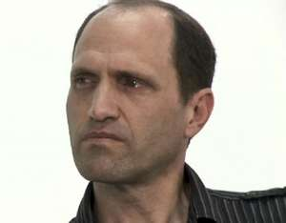


ARCH RIVALS
GOOD COP
BAD COP
Sterling Allan
PESWIKI
Mark Dansie
REVOLUTION-GREEN
Innocent Inventor
Sympathetic Optimist
“I’ll believe anything”
Aggressive Below-the-Belt Pessimist
“Nothing will ever work”
Both Part of PESN
Dansie Banned from PESN
Sterling vs. Dansie Feud
Notes:
Arch Rivals
Next on the list of politics that inventors might get caught in: stuck in the battle field between feuding Arch Rivals. One of the best examples is that of Sterling Allan of Peskwiki.com and Mark Dansie of Revolution-green.com. Sterling and Dansie are both “Free Energy Reporters” that make a career out of “evaluating” other people’s free energy devices. They both claim to be “World Renown Experts and Leaders in Free Energy”, though the number of devices they have invented or built themselves is still unknown. Both write blogs and do internet radio shows and speak at conferences, and have amassed a large amount of internet content. They both play the role of tabloid style reporting. Sterling plays the overly optimistic, sympathetic “good cop” role, and Dansie plays the pessimistic, below-the-belt “bad cop” role. And while some may find their content entertaining, many inventors find their information unreliable.
History:
Both of them used to be a part of PESN Pure Energy Systems Network which conducts what they call “Team Reporting of Alternative Energy Developments”. Of which Sterling Allan is the founder.
In May of 2009 Mark Dansie was banned from PESN and later joined revolution-green.com where he is the primary blogger. Sterling continued on with the formation of Peswiki.com, a huge online encyclopedia of every free energy claim both valid and invalid under the sun.
Dansie well known for his dark skepticism makes dozens of flights each year to go around the world and evaluate devices, all of which he claims will never work. He was banned from PESN after always pointing out only flaws and having an “NSA-level algorithm that alerted him to his postings so he could be the first to comment, setting a negative tone.”
Both Sterling and Dansie seemed to still collaborate, while sitting on different sides of the fence, until 2013 when an online feud started between the two of them. This lasted for quite a while in a written shouting match on their websites and online radio shows. The feud included competing over the latest developments in free energy and who got to “cover the story”. If you were an innocent by standard inventor who happened to bring your device into the public eye during this time, (like the QEG was) your technology would be put through the shredder of the feud.
Links:
Sterling Allan talks about Mark Dansie: http://peswiki.com/index.php/Congress:Member:Mark_Anthony_Dansie
Describing the Feud between Sterling and Dansie
http://freeenergyscams.com/sterling-d-allan-vs-mark-dansie/

Slide 37
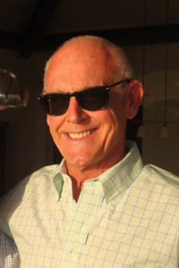
Who’s REALLY Running Some Free Energy Websites?
Tony Craddock is a consultant with forty years experience in the oil industry.
Owns Energetic Productions LLC, which is the company that produced and owns copyright to older videos from Bedini Motors.
He also owns and runs Tom Beardens Website www.cheniere.org
Notes:
Who’s Really Running some Free Energy Websites?
Tony Craddock is a consultant with forty years experience in the oil industry.
Owns Energetic Productions LLC, which is the company that produced and owns copyright to older videos from Bedini Motors.
He also owns and runs Tom Beardens Website www.cheniere.org
Theres a link in the notes here that will bring you to a full discovery of this, and it will also show you how Sterling Allan is supportive of someone from the oil industry owning and running a free energy website.
YouTube, Copyright And Censorship - The Truth About “Free Energy” Technology
http://www.checktheevidence.co.uk/cms/index.php?option=com_content&task=view&id=328&Itemid=55
And Sterling Allan is long time friends with, and lives in an intentional community with Steven E. Jones, the man who voted cold fusion out of existence.
If you recall from the video clip we saw earlier it was Judy woods presentation at the Breakthrough Energy Movement Conference in Holland 2012. Shortly after finishing her presentation, someone stood up in the audience, it was Sterling Allan. In this next clip here you’ll see Sterling Allan stand up explain he’s good friends with Steven E. Jones, and that they both live in an intentional community together. He also goes on to imply that maybe Steven E. Jones’ decision to do science by a vote a small “mental disconnect” and perhaps he could talk reason with him.
After this conversation took place, there was follow up and a whole series of information was uncovered. We don’t have time to go into all of it today but here is a very thorough article with lots of links that details what happened there.
“Chilling Out” about 9/11 With Sterling D Allan and Steven E Jones
http://www.checktheevidence.co.uk/cms/index.php?option=com_content&task=view&id=382&Itemid=60

Slide 38
Our Message to the Trolls
THINK BEFORE YOU ATTACK!
You are NOT anonymous. We have a record of who you are and all of your profiles. We moderate all of our platforms. We keep screen shots of all activity for evidence. We pay attention and we will not forget who you are and what you have written. You will be reported. There are laws against what you are doing and we will defend our content and expose you.
YOUR INTENT TO HARM US HAS BACKFIRED!
Your smear campaign articles send us a ton of traffic, which converts into support for us and awareness about the project. Your attacks on our project only serve to add more validity to our work in the eyes of the people. THANK YOU FOR THE FREE ADVERTISING!

Slide 39
Questions from the Chatroom

