Slide 1
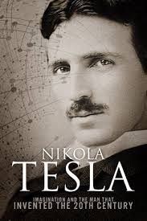
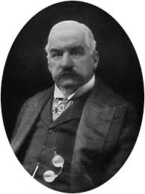
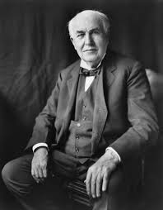
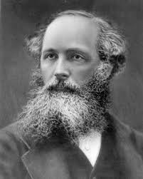
THE PEOPLE’S FREE ENERGY SHOW Season 2 Episode 1 History is Written by the Winners
Tesla JP Morgan Edison Maxwell
1
Notes:
TESLA, EDISON, and JP MORGAN
Nikola Tesla, (1856 -1943) was a trained electrical and mechanical engineer and one of the most
influential inventors of the 20th century. Eventually holding over 700 patents, Tesla worked in a
number of fields, including electricity, robotics, radar, and wireless transmission of energy. Tesla's
discoveries laid the groundwork for many of the 20th century's technological advances. He is also
known as the Father of AC Current, Father of the Radio, and The Man Who Invented the 20th Century.
In 1897 Nikola Tesla was involved in a DC vs. AC current war with Thomas Edison. Tesla was
financially backed by Westinghouse to promote AC current, and Edison was financially backed by J.P.
Morgan to promote DC current. AC current won the war and is still used to this day.
While Tesla’s AC current was only one of his many inventions, his true passion was to bring a source
of energy to the world that would be freely available to everyone. However, J.P. Morgan told Tesla “If
I can’t put a meter on it, it will never happen!” From that day forward, many of Tesla’s inventions,
which were nonpolluting, worked according to the laws of nature and were intended for the benefit of
humanity, would be stolen, suppressed, marginalized and removed from the public eye due to the
financial interests of banking families such as J.P. Morgan and Rockefeller. Many of the inventions we
all use today would not exist if it wasn’t for Tesla’s work. Many, such as Edison and Marconi, have
stolen Tesla’s work and taken the credit.
James Clerk Maxwell FRS FRSE (1831–1879) was a Scottish mathematical physicist. His most
prominent achievement was to formulate a set of equations that describe electricity, magnetism, and
optics as manifestations of the same phenomenon, namely the electromagnetic field. His discoveries
helped usher in the era of modern physics, laying the foundation for such fields as special relativity
and quantum mechanics.

Slide 2
Common Statements - “There's No Such Thing As Free Energy”
“Free Energy” is impossible – there is no such thing as a “free lunch”
“Free Energy” is impossible –it breaks the 1st law of thermodynamics –
“energy can be neither created nor destroyed, heat and mechanical work being mutually convertible”
“If someone had created a free energy device, they’d be a billionaire!”
“Perpetual Motion is impossible!” Followed by the 'programmed' Implicit/Explicit Ad homonym attacks like: IF YOU BELIEVE IN THIS STUFF YOU ARE A....
TIN FOIL HAT WEARING, NUT JOB, WACK JOB, TERRORIST, ANARCHIST, CONSPIRACY THEORIST....BTW YOU'RE ALSO A PSYCHOPATH AND SHOULD BE LOCKED UP!
“No one has demonstrated a device which produces more energy than is fed into it in some form.”

Slide 3
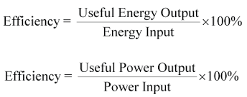
FREE ENERGY VOCABULARY
Efficiency -
Overunity - Simply means you get out more energy than you put in Comes from when you divide the amount of energy output by the amount of energy input and you end up with a figure greater than 1.
In physics (and elsewhere) “unity” is another name for 1
It is confused with perpetual motion because the idea then is that you could connect an over-unity device’s output to its input and then it would run itself.
Perpetual Motion - A hypothetical machine that can do work indefinitely without an energy source (exists in isolation). Often
Confused with overunity.

Slide 4
Coefficient of Performance (COP) - 2
It is normal to express this coefficient as the ratio of energy output to energy input, rather than use temperatures, as shown below.
COP = Q / W
Where;
COP = coefficient of performance
Q = high grade energy output (kWh or kJ).
W = electrical or mechanical energy input (kWh or kJ).
Typically, a heat pump operating from a source temperature of 5°C and designed for heating only would have a COP of about 3.0, whereas a reversible machine for the same conditions would have a COP of about 2.6

Slide 5
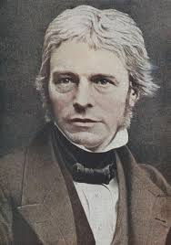
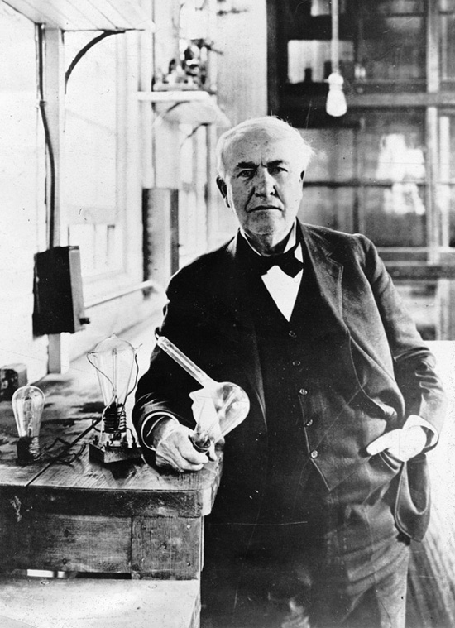
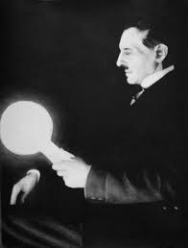
FREE ENERGY INVENTORS
MICHAEL FARADAY
THOMAS EDISON
NIKOLA TESLA

Slide 6
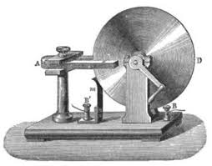
FARADAY HOMOPOLAR GENERATOR
Michael Faraday, FRS (22 Sep 1791–Aug 25 1867) was an English chemist and physicist who studied the magnetic field around a conductor carrying a DC electric current, and established the basis for the magnetic field concept in physics. He discovered electromagnetic induction, diamagnetism, and laws of electrolysis.
Michael Faraday did an experiment on December 26th, 1831, in which he co-rotated a magnet with a copper disk and measured a current output.
Even though he had done that experiment, his own law of induction tended to ignore that fact. [Diagram/photo]
Known for over 150 years, the operation of Faraday homopolar generator whose current generation could not be properly explained
The world later embraced Faraday's two piece induction generator, whose drawbacks include mechanical friction and electrical losses.

Slide 7
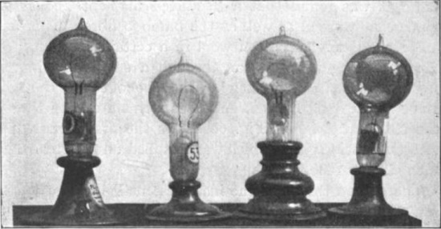
THOMAS EDISON
Thomas Edison was born February 11, 1847 in Milan, Ohio. At age 15, Edison became a “tramp telegrapher”, sending and receiving messages via morse code, an electronically-conveyed alphabet using different clicks for each letter. Eventually, he worked for the Union Army as a telegrapher. Edison often entertained himself by taking things apart to see how they worked. Soon, he decided to become an inventor.
In 1884, after he attained great fame and fortune, and built one of the largest laboratories in the world. He worked extremely hard and registered 1,093 patents. Edison continued to invent or improve products and make significant contributions to x-ray technology, storage batteries and motion pictures (movies). His inventions changed the world forever. They still influence the way we live today.
In the late 1800s, DC could not be easily converted to high voltages. As a result, Edison proposed a system of small, local power plants that would power individual neighborhoods or city sections. By 1887, Edison had constructed 121 DC power stations in the United States.

Slide 8
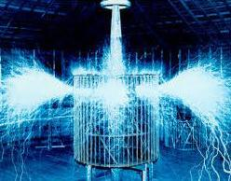
NIKOLA TESLA
"One day man will connect his apparatus to the very wheelwork of the universe... and the very forces that motivate the planets in their orbits and cause them to rotate will rotate his own machinery,“
Inventor Nikola Tesla was born in July of 1856, in what is now Croatia. He came to the United States in 1884 and briefly worked with Thomas Edison before the two parted ways.
In 1887, He was able to find interest in his AC electrical system and funding for his new Tesla Electric Company. By the end of the year, Tesla had successfully filed several patents for AC-based inventions.
Tesla's AC system eventually caught the attention of American engineer and business man George Westinghouse, who was seeking a solution to supplying the nation with long-distance power. Convinced that Tesla's inventions would help him achieve this, in 1888 he purchased his patents for $60,000 in cash and stock in the Westinghouse Corporation. As interest in an alternating-current system grew, Tesla and Westinghouse were put in direct competition with Thomas Edison, who was intent on selling his direct-current system to the nation. A negative-press campaign was soon waged by Edison, in an attempt to undermine interest in AC power. Tesla, for his part, continued in his work and would patent several more inventions during this period, including his 1891 invention, the "Tesla coil," which laid the foundation for wireless technologies and is still used in radio technology today.
Tesla died in New York City on January 7, 1943.
Tesla’s experiments showed that there was a radiant energy field – present everywhere – it just needed the right equipment to extract this energy (and sometimes you needed to put energy in to a system to make the radiant energy “visible”.
Niagara falls famously used generators which were originally designed by Tesla.

Slide 9
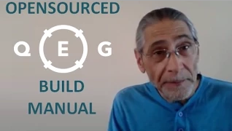
BREAK 5 MINUTE VIDEO: FREE QEG BUILD MANUAL A MESSAGE FROM JAMES
Notes:
QEG Build Manual 4:45 https://www.youtube.com/watch?v=Tp8SPMLxQh4

Slide 10
HISTORY OF FREE ENERGY How Banking Families Robbed You of Your Future
Tesla JP Morgan Edison Maxwell
10
Notes:
TESLA, EDISON, and JP MORGAN
Nikola Tesla, (1856 -1943) was a trained electrical and mechanical engineer and one of the most
influential inventors of the 20th century. Eventually holding over 700 patents, Tesla worked in a
number of fields, including electricity, robotics, radar, and wireless transmission of energy. Tesla's
discoveries laid the groundwork for many of the 20th century's technological advances. He is also
known as the Father of AC Current, Father of the Radio, and The Man Who Invented the 20th Century.
In 1897 Nikola Tesla was involved in a DC vs. AC current war with Thomas Edison. Tesla was
financially backed by Westinghouse to promote AC current, and Edison was financially backed by J.P.
Morgan to promote DC current. AC current won the war and is still used to this day.
While Tesla’s AC current was only one of his many inventions, his true passion was to bring a source
of energy to the world that would be freely available to everyone. However, J.P. Morgan told Tesla “If
I can’t put a meter on it, it will never happen!” From that day forward, many of Tesla’s inventions,
which were nonpolluting, worked according to the laws of nature and were intended for the benefit of
humanity, would be stolen, suppressed, marginalized and removed from the public eye due to the
financial interests of banking families such as J.P. Morgan and Rockefeller. Many of the inventions we
all use today would not exist if it wasn’t for Tesla’s work. Many, such as Edison and Marconi, have
stolen Tesla’s work and taken the credit.
James Clerk Maxwell FRS FRSE (1831–1879) was a Scottish mathematical physicist. His most
prominent achievement was to formulate a set of equations that describe electricity, magnetism, and
optics as manifestations of the same phenomenon, namely the electromagnetic field. His discoveries
helped usher in the era of modern physics, laying the foundation for such fields as special relativity
and quantum mechanics.

Slide 11
THE CURRENT WAR TESLA, EDISON, and JP MORGAN
In 1897 Nikola Tesla was involved in a DC vs. AC current war with Thomas Edison. Tesla was financially backed by Westinghouse to promote AC current, and Edison was financially backed by J.P. Morgan to promote DC current. AC current won the war and is still used to this day. While Tesla’s AC current was only one of his many inventions, his true passion was to bring a source of energy to the world that would be freely available to everyone. However, J.P. Morgan told Tesla “If I can’t put a meter on it, it will never happen!”
From that day forward, many of Tesla’s inventions, which were nonpolluting, worked according to the laws of nature and were intended for the benefit of humanity, would be stolen, suppressed, marginalized and removed from the public eye due to the financial interests of banking families such as J.P. Morgan and Rockefeller. Many of the inventions we all use today would not exist if it wasn’t for Tesla’s work. Many, such as Edison and Marconi, have stolen Tesla’s work and taken the credit.

Slide 13
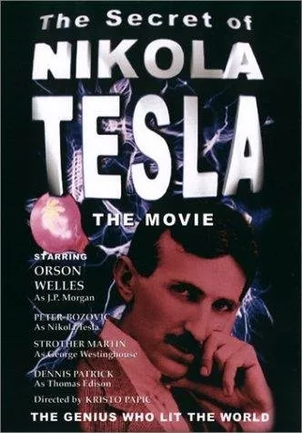
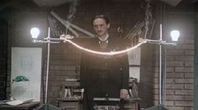
Movie: Secret of Nikola Tesla

Slide 14
MAXWELL, EDISON, JP MORGAN The Laws of Physics
James Clerk Maxwell FRS FRSE (1831–1879) was a Scottish mathematical physicist. His most prominent achievement was to formulate a set of equations that describe electricity, magnetism, and optics as manifestations of the same phenomenon, namely the electromagnetic field. His discoveries helped usher in the era of modern physics, laying the foundation for such fields as special relativity and quantum mechanics.

Slide 15
2 Types of Energy Systems Asymmetrical Symmetrical
In his ORIGINAL work: The Dynamical Theory of the Electromagnetic Field, Maxwell identified two separate systems, both of which were completely different from each other: 1) Asymmetrical system - an ‘open’ system that allows the creation of a series of exchange of energy reaction to our inputs, based on electromagnetic resonance or electromagnetic feedback in every spin (on a motor), or in every pulse of input in a static coil. One of the first asymmetrical motors was Faraday's ‘Unipolar Motor,’ later modified by Nikola Tesla. These systems generate their own energy and do not require fossil fuels. 2) Symmetrical system – a ‘closed’ system that cancels the electromagnetic resonance with every spin, which creates wasted energy in excessive heat and requires an additional energy source to run such as fossil fuels. These are the "symmetrical obsolete systems" we use every day in all of our electrical appliances.
Reference Links in Notes
Notes:
Symmetric Versus Asymmetric Electromagnetic Systems
http://www.energeticforum.com/renewable-energy/11563-symmetric-versus-asymmetric-electromagnetic-systems.html
Solving The World Energy Crisis: Some Ancillary Technical Information and Reference
http://www.theorionproject.org/en/solving_bearden.html

Slide 16
2 Types of Energy Systems Asymmetrical Symmetrical
One year after Maxwell’s death in 1879, scientists Hendrick Lorentz financed by J.P. Morgan and Thomas Edison, mutilated Maxwell’s original work and spent the next two decades deleting all knowledge of asymmetrical systems that would not require the profitable oil industry to operate. They ‘symmetrized’ all of Maxwell’s equations, and labeled these incomplete theories as the “Laws of Physics”. While the laws of physics do indeed apply to symmetrical closed systems of energy, there is another set of laws: The Laws of Nature, which apply to the asymmetrical systems that have been suppressed by the financial interests of the banking families for the last 130 years.
This knowledge was banned from our educational system, and no physics or electrical engineering school on our planet would ever teach about asymmetrical systems. Instead, the first and second laws of thermodynamics, which depend on the consumption of profitable fossil fuels, would conveniently prevail in our public knowledge base.
Reference Links in Notes
Notes:
Symmetric Versus Asymmetric Electromagnetic Systems
http://www.energeticforum.com/renewable-energy/11563-symmetric-versus-asymmetric-electromagnetic-systems.html
Solving The World Energy Crisis: Some Ancillary Technical Information and Reference
http://www.theorionproject.org/en/solving_bearden.html

Slide 17
The Laws of Physics only apply to Symmetrical Systems and are incomplete. 50% of them (those that apply to free energy) were removed from our public teachings by JP Morgan and Edison. This is why you will never learn about this in engineering school.
17
Notes:
1) Asymmetrical system - an ‘open’ system that allows the creation of a series of exchange of
energy reaction to our inputs, based on electromagnetic resonance or electromagnetic feedback in
every spin (on a motor), or in every pulse of input in a static coil. One of the first asymmetrical
motors was Faraday's ‘Unipolar Motor,’ later modified by Nikola Tesla. These systems generate their
own energy and do not require fossil fuels.
2) Symmetrical system – a ‘closed’ system that cancels the electromagnetic resonance with every
spin, which creates wasted energy in excessive heat and requires an additional energy source to run
such as fossil fuels. These are the "symmetrical obsolete systems" we use every day in all of our
electrical appliances.
One year after Maxwell’s death in 1879, scientists Hendrick Lorentz financed by J.P. Morgan
and Thomas Edison, mutilated Maxwell’s original work and spent the next two decades
deleting all knowledge of asymmetrical systems that would not require the profitable oil
industry to operate. They ‘symmetrized’ all of Maxwell’s equations, and labeled these
incomplete theories as the “Laws of Physics”. While the laws of physics do indeed apply to
symmetrical closed systems of energy, there is another set of laws: The Laws of Nature,
which apply to the asymmetrical systems that have been suppressed by the financial
interests of the banking families for the last 130 years.

Slide 18
THE LAWS OF NATURE
The laws of physics tell us that perpetual motion is not possible, yet how does the earth rotate?
The laws of aerodynamics tell us that bumblebees are incapable of flight, yet how do they fly?
Conventional scientists from all over the world will make statements such as: “The claim that this is going to run permanently or indefinitely doesn't seem to hold because the second law of thermodynamics tells us that this is not possible”
Around the turn-of-the-century eminent British scientist Lord Kelvin said “Radio has no future, heavier-than-air flying machines are impossible, and x-rays are a hoax” - so much for conventional science!
The laws of nature contain concepts that focus on frequency, resonation, vibration, magnetics and energy. A perfect example of this can be found in the aerodynamics-law-breaking flight of the bumblebee.

Slide 19
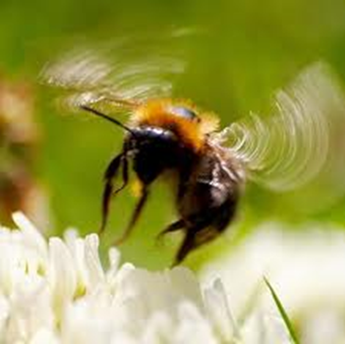
THE FLIGHT OF THE BUMBLEBEE
Ralph Ring is an innovative technician who worked with Otis T. Carr, a direct apprentice of Nikola Tesla. In his presentation at the Breakthrough Energy Movement Conference, Mr. Ring gives an amazing explanation of the flight of the bumblebee:
“Next to the larynx in the bumblebees throat, there is a tiny hollow tube that acts as a resonance cavity that accumulates frequency. When the bee starts beating its wings, it does this to accumulate frequency which bounces back and forth in the resonator cavity until it reaches the same frequency of the earth, known as the Schumann frequency. Once the bee reaches the same frequency as its surroundings it evens out into what is known as zero point. When anything reaches zero point you can then change the energy. The bee is now free from the gravitational influence around it, creates its own little magnetic bubble and hovers around. There are some lizards and hummingbirds that do the same thing.”
Reference Links in Notes
Notes:
Ralph and Marsha Ring : Anti-gravity and Conscious Awareness in Aether Technology
http://www.youtube.com/watch?v=8v3Bsh1E_8Y

Slide 20
LAWS OF NATURE HOW THEY WORK
When you can tune something to vibrate at the same frequency as the earth and reach zero point, you are freed from the frequency influence of your environment and can then change the energy into anything you want including levitation or electrical energy.
This is how devices like the QEG work. Teslas design causes it to resonate so that it matches the frequency of the earth, and in zero point it changes the energy into self-renewing electrical energy.
Reference Links in Notes
Notes:
Ralph and Marsha Ring : Anti-gravity and Conscious Awareness in Aether Technology
http://www.youtube.com/watch?v=8v3Bsh1E_8Y

Slide 21
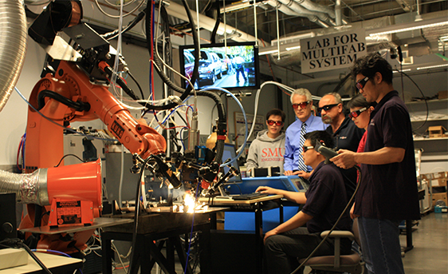
GOVERNMENT FUNDED RESEARCH AND HIGHER EDUCATION
Most of the main stream scientific research and higher education systems today are funded by government grants and corporate interests. Such funding comes with a set of rules and regulations that must be followed in order to continue to receive that funding, even if the rules are unreasonable.
Reference Links in Notes
Notes:
Ralph and Marsha Ring : Anti-gravity and Conscious Awareness in Aether Technology
http://www.youtube.com/watch?v=8v3Bsh1E_8Y

Slide 22
GOVERNMENT FUNDED RESEARCH AND HIGHER EDUCATION
Some examples:
Harold Ashburton has an honors degree in engineering from Cambridge University and is also the retired head of IBM's European patent division. When presented with undeniable proof of a perpetual motion machine designed by John Searl he made the following statement:
“The government doesn't know about this work because the government only knows what their advisers tell them. Their advisers get money from the government and they want to keep getting the grants so they're not giving the advice they should from matters like this.”
Ralph Ring was a laboratory technician in a government-funded research and development laboratory in Costa Mesa, California. His job was to fire an electron through a magnetic field without deflection, and to do it the way they told him to do it. He was employed to repeat this experiment every day, which always failed, at a cost of $10,000 per day paid for by a government grant. He went home and replicated the experiment using the laws of nature and the experiment was successful. The next day he took his results to the head of the Department of Advanced Kinetics, Dr. Weinhart, who gave the following response:
“I see what you're doing there and I do understand, but Ralph what you don't understand is that this is a government-funded lab, and we are paid to look for answers, but not find them. Just go back to work and don't say anything to the engineers. This is not to be talked about at all.” .
MIT graduates cannot power a light bulb with a battery 3:08.
Reference Links in Notes
Notes:
Ralph and Marsha Ring : Anti-gravity and Conscious Awareness in Aether Technology.
http://www.youtube.com/watch?v=8v3Bsh1E_8Y
A Machine to Die For; The Quest For Free Energy
http://www.youtube.com/watch?v=c6UgV3gVmd0

Slide 23
THE PATENT TRAP US PATENT OFFICE CLASSIFICATION SYSTEM
The U.S. Patent Office has a nine-member committee that screens patents in order to protect “national security”. Another purpose of this committee is to also find and remove from public access energy-related patents which could threaten the fossil fuel and power monopolies. Anytime someone applies for a patent, it goes through this screening process, if the device has anything to do with the production of “free energy” they classify it, confiscate it, conceal it in a vault and forbid the inventor to reproduce it.
If an inventor proceeds with their invention,
they can face up to 20 YEARS IN FEDERAL PRISON
In the documentary film titled, A Machine to Die For; The Quest For Free Energy, an ex-secret service agent assigned to electronic intelligence (whose identity was concealed) made the following statement: “If you’re an idiot and try to go and patent your device, you’ve given them all your information on where you are and how to find you, and they will try to find some legal mechanism to close you down.”
Reference Links in Notes
Notes:
Suppressed Energy Technologies:
http://www.theorionproject.org/en/suppressed.html
PROTECTING THE PRIVATE INVENTOR UNDER THE PEACETIME http://www.handpen.com/Bio/patents.htm
A Machine to Die For. The Quest For Free Energy http://www.youtube.com/watch?v=c6UgV3gVmd0
MIT graduates cannot power a light bulb with a battery.
3:08 https://www.youtube.com/watch?v=aIhk9eKOLzQ

Slide 24
INVENTION SECRECY ORDER
Text of Generic Patent Secrecy Order
SECRECY ORDER
(Title 35, United States Code (1952), sections 181-188)
NOTICE: To the applicant above named, his heirs, and any and all of his assignees, attorneys and agents, hereinafter designated principals:
You are hereby notified that your application as above identified has been found to contain subject matter, the unauthorized disclosure of which might be detrimental to the national security, and you are ordered in nowise to publish or disclose the invention or any material information with respect thereto, including hitherto unpublished details of the subject matter of said application, in any way to any person not cognizant of the invention prior to the date of the order, including any employee of the principals, but to keep the same secret except by written consent first obtained of the Commissioner of Patents, under the penalties of 35 U.S.C. (1952) 182, 186.
Any other application already filed or hereafter filed which contains any significant part of the subject matter of the above identified application falls within the scope of this order. If such other application does not stand under a security order, it and the common subject matter should be brought to the attention of the Security Group, Licensing and Review, Patent Office.
If, prior to the issuance of the secrecy order, any significant part of the subject matter has been revealed to any person, the principals shall promptly inform such person of the secrecy order and the penalties for improper disclosure. However, if such part of the subject matter was disclosed to any person in a foreign country or foreign national in the U.S., the principals shall not inform such person of the secrecy order, but instead shall promptly furnish to the Commissioner of Patents the following information to the extent not already furnished: date of disclosure; name and address of the disclosee; identification of such part; and any authorization by a U.S. government agency to export such part. If the subject matter is included in any foreign patent application, or patent, this should be identified. The principals shall comply with any related instructions of the Commissioner.
This order should not be construed in any way to mean that the Government has adopted or contemplates adoption of the alleged invention disclosed in this application; nor is it any indication of the value of such invention.
Reference Links in Notes
Notes:
Suppressed Energy Technologies:
http://www.theorionproject.org/en/suppressed.html

Slide 25
Invention Secrecy Act 1951
The Invention Secrecy Act of 1951 (Pub.L. 82–256, 66 Stat. 3, enacted February 1, 1952, codified at 35 U.S.C. §§ 181–188) is a body of United States federal law designed to prevent disclosure of new inventions and technologies that, in the opinion of selected federal agencies, present a possible threat to the national security of the United States.
The U.S. government has long sought to control the release of new technologies that might threaten the national defense and economic stability of the country. During World War I, Congress authorized the United States Patent and Trademark Office (PTO) to classify certain defense-related patents. This initial effort lasted only for the duration of that war but was reimposed in October 1941 in anticipation of the U.S. entry into World War II. Patent secrecy orders were initially intended to remain effective for two years, beginning on July 1, 1940, but were later extended for the duration of the war.
READ THE FULL TEXT DOCUMENT IN THE LINK PROVIDED IN THE NOTES BELOW. IT HAS BEEN UPLOADED ESPECIALLY FOR THIS PRESENTATION. PASSED ON TO US BY AN INVENTOR WHO HAS SINCE PASSED AWAY
Reference Links in Notes
Notes:
Full Text of 1951 Secrecy Act
http://www.hopegirlblog.com/wp-content/uploads/2016/02/1951-secrecy-act.txt

Slide 26
The Energy Cover Up
WHY, oh WHY would ANYONE want to cover up cheap energy sources?
HOW can it be covered up? Surely it’s just a tinfoil-hat-crazy-nutty crazy whack-job conspiracy theory?
Reference Links in Notes
Notes:
Source: Andrew Johnson “Infinite energy for all” http://www.checktheevidence.com/Presentations/

Slide 27
The Energy Industry
It is probably the biggest global industry of all
Oil, Gas, Coal mining and prospecting are huge, expensive operations.
The vested interests are enormous.
Everyone needs energy – even the governments of the world!
Even medium to large scale use of more conventional technologies, such as the basic electric car – running on conventional battery technology – seem to have been “terminated” as early as possible.
Reference Links in Notes
Notes:
Source: Andrew Johnson “Infinite energy for all” http://www.checktheevidence.com/Presentations/

Slide 28
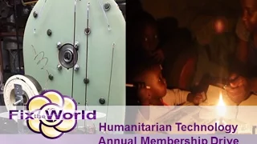
BREAK 3 MINUTE VIDEO: ABOUT THE FIX THE WORLD ORGANIZATION HUMANITARIAN TECHNOLOGY MEMBERSHIP DRIVE
Notes:
Humanitarian Technology Annual Membership Drive. 2016 Fix the World. https://www.youtube.com/watch?v=ji5ZJCWEV_E

Slide 29
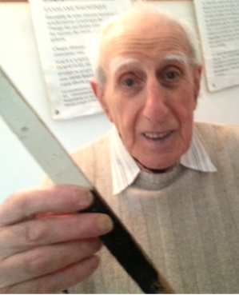
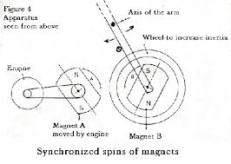
HATEM MAGNETIC FLYWHEEL
Leon Raoul Hatem is a French philosopher and inventor born in Paris in 1922, is the author of philosophical and scientific books. From the age of thirteen he began to question Newtonian gravity and how it supposed to govern planetary systems. In 1955, he discovered a phenomenon (which he calls degravitation) where he claims there is a release-of the attraction poles of two magnets simultaneously away from each other by their own kinetic action. His observations showed that under certain conditions, rotating, synchronized, magnetically attracted bodies begin to receive additional impulse from and external source when spun beyond a certain rpm (revolutions per minute). This lead him to conclude that gravity was the result of magnetic functions and contends that this effect can be used to understand all movements and all planetary and atomic functions. - Basically, that only magnetism is required for operation of the universe and all other visible forces arising.
Since 1955 he has written many theoretical works in the science and philosophy.

Slide 30
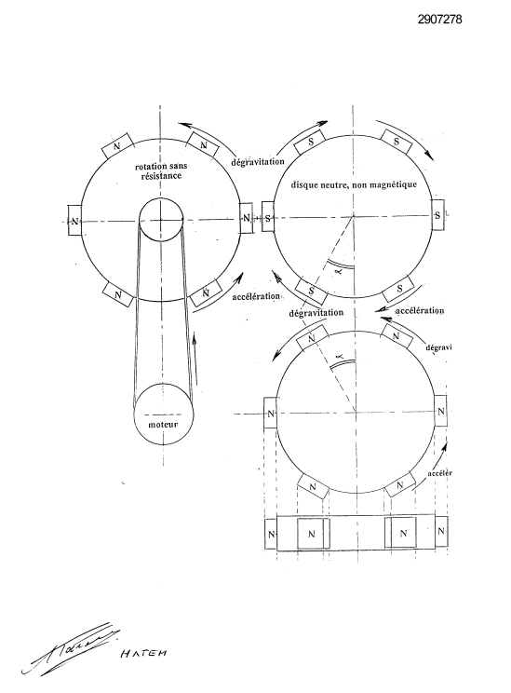
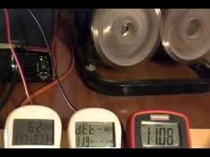
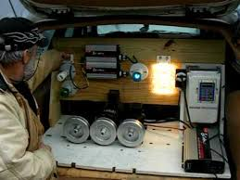
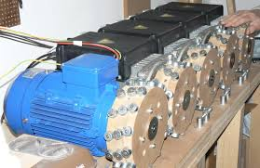
HATEM MAGNETIC FLYWHEEL
He is also the publisher of several patents: FR2826800A1 and FR2907278A3. Which are implementations of his theory in action. Basically, heavy magnetically coupled flywheels, when brought into synchronisation beyond a certain speed and coupled to generator (or alternator) start to generate more output power than initially takes to set the system in motion.
Below is an example of successful builds.

Slide 31
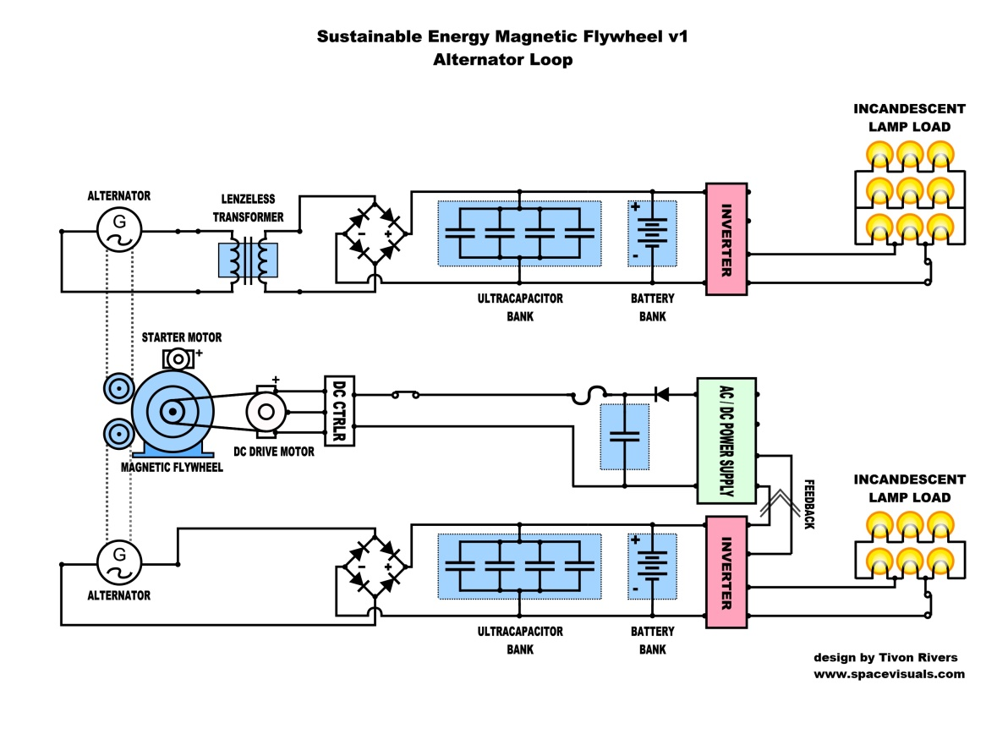
MOTOR GENERATOR LOOPING
Motor Generator Technologies / aka Qmogens – the use of a driving electric motor as a prime mover to a connected electric generator that is able to augment the input power to garner more usable electric power than what was consumed in the system. Over a dozen different videos from all over the world. At least a dozen separate patents filed citing such technology with the addition of flywheels and or weights.
Patents:
DE102011107976A1
WO2008076972A2
WO2014014368A1
Spanish-ES-2119690_B1
US7095126
US20030030331
US20050248321
US20060232068
US20080143302A1
US20120299425
US20130076182

Slide 32
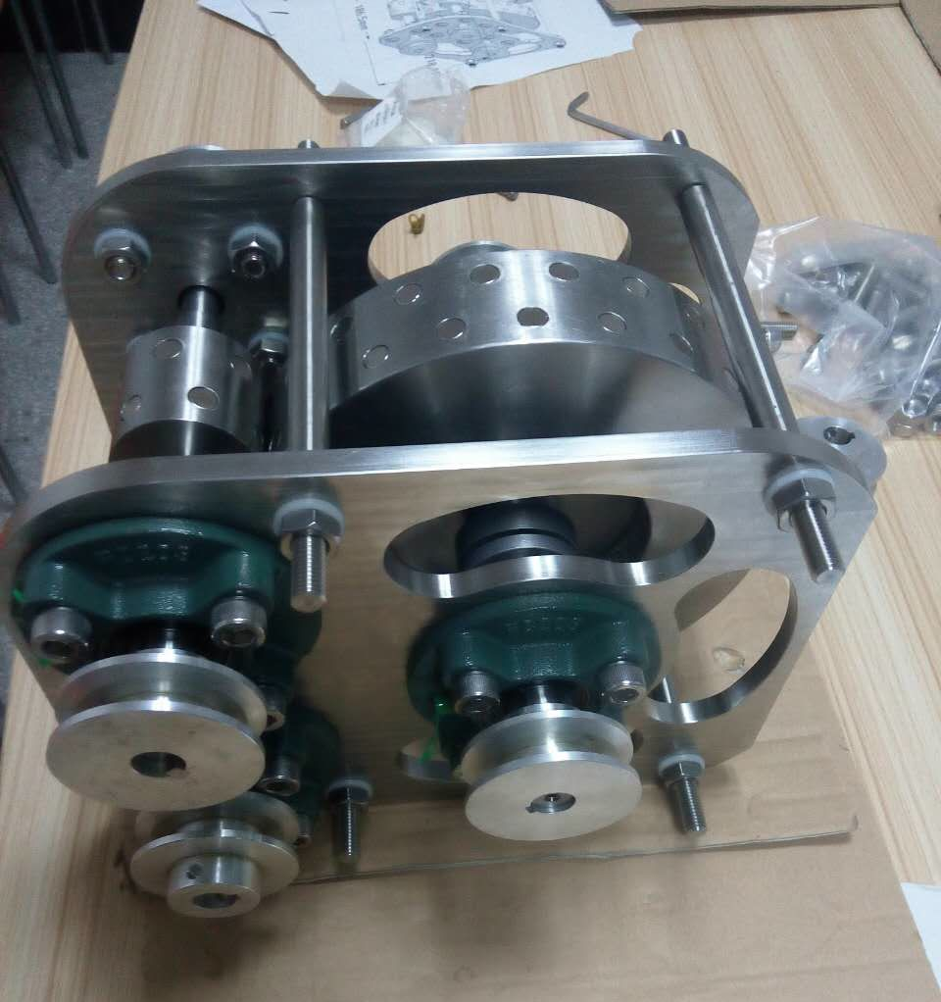
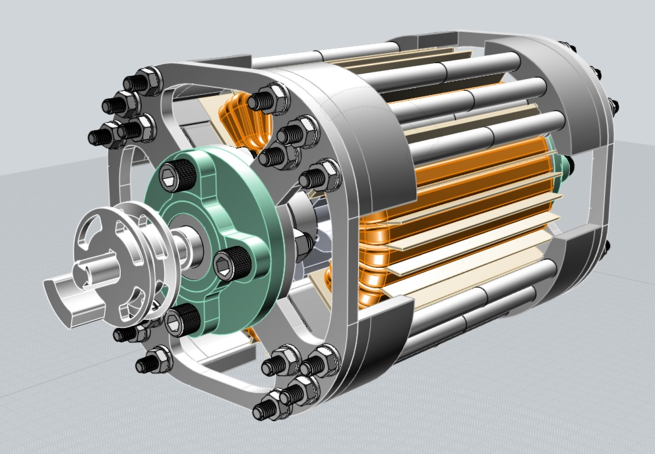
MOTOR GENERATOR LOOPING
Based on this information, we now believe not only our project, but many others around the world are employing these techniques to see tremendous gains in efficiency well over-unity in their motor generator builds. Therefore, we have decided to adopt these technologies with a design like shown here:

Slide 33
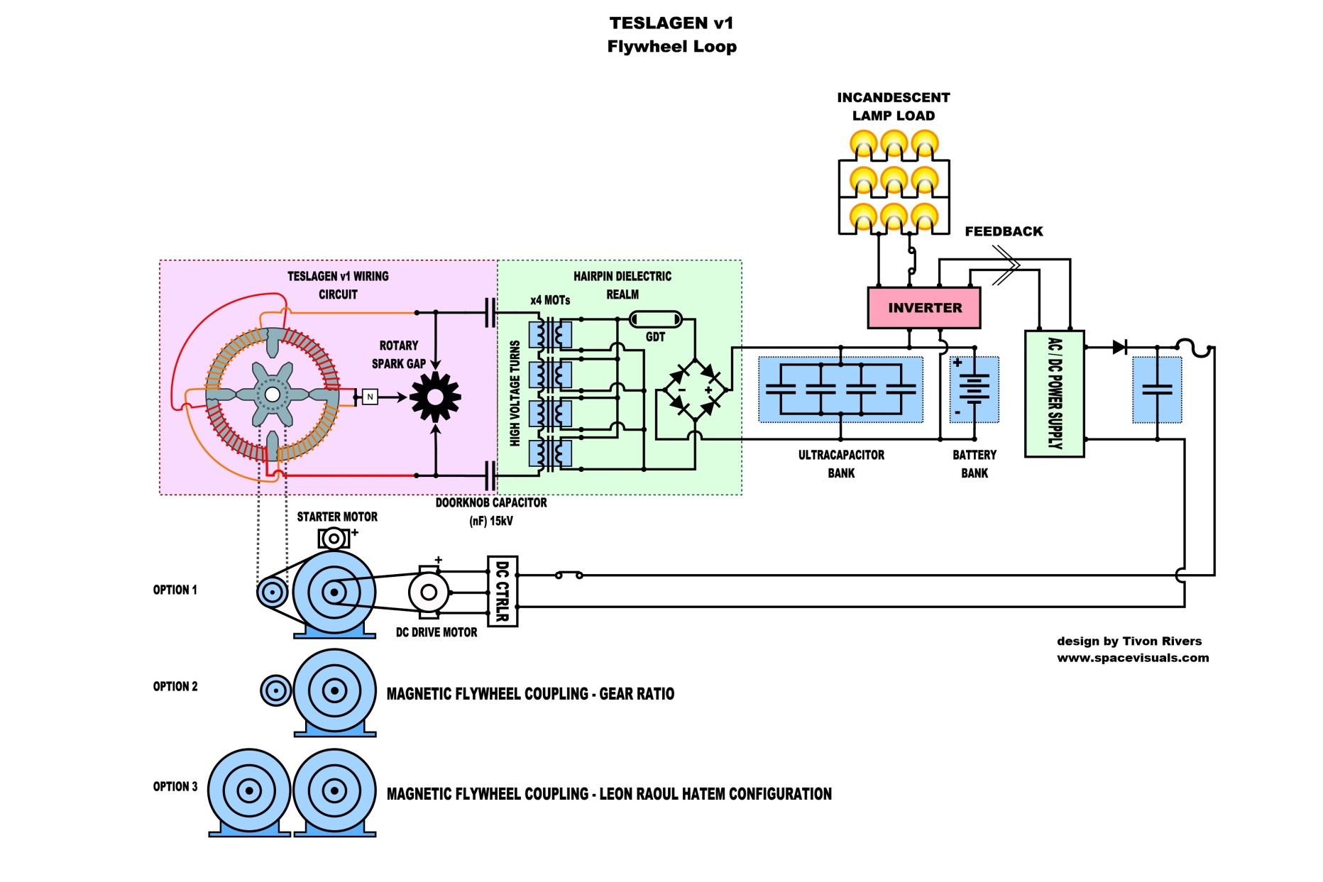
MOTOR GENERATOR LOOPING

Slide 34
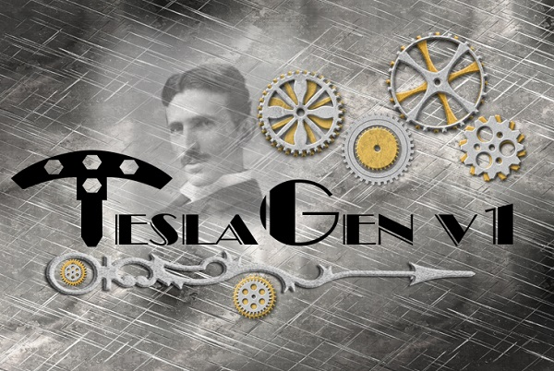
SUPPORT OUR CAMPAIGN !
Open Sourced Co-Development Tesla Technology
Flywheel
Hairpin Circuit
Tesla Coil & Nunez Coil
Lenzless Transformers:
Bi-Toroid Transformer
Markov Transformer
Rodin Coils
Leal & Barbosa Transformer
Phases of This Project:
1) Research phase
2) Design and Development phase
3) Cost of Production phase
4) Fabrication and Assembly phase
5) Build and Test to Resonance
6) Final Phase: Improve efficiency
The TeslaGen V1 mini QEG is a new open sourced co-development project intended on building a portable reluctance generator that can power loads between 700w-900w or more. This project is based around building, teaching and open sourcing instructions. This can help a wider array of DIY engineers learn formerly suppressed engineering skills based on the creation of electrical power through the phenomenon Nikola Tesla discovered, known as resonance and radiant energy. Some of the exciting key features of the TeslaGen v1 mini QEG are; lower price, smaller and lighter weight, CAD files made available, easier core winding, hot-swap rotor, easy experimentation with other popular “free energy” techniques.

Slide 35
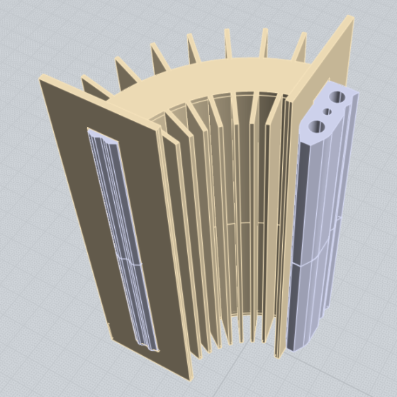
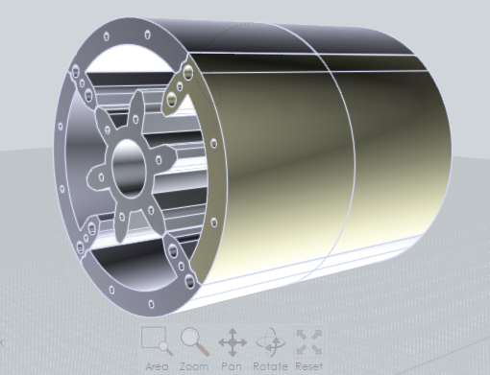
3D CAD PACKAGE NOW AVAILABLE!
When you donate $100 to the campaign
CAD Files for the TeslaGenv1 Mini QEG
As a special perk to help raise funds for the TeslaGenv1 mini QEG project, we are selling the CAD files for the parts to build the prototype. This CAD kit is a high quality professional CAD file package that includes everything you need to send to a manufacturer of your choice which will allow them to make your parts for you. As the project progresses over time, free updates to new CAD files will be made available to everyone who purchases these files from our Payloadz digital download product from the campaign: http://www.hopegirlblog.com/campaigns/mini-qeg-campaign/

Slide 36
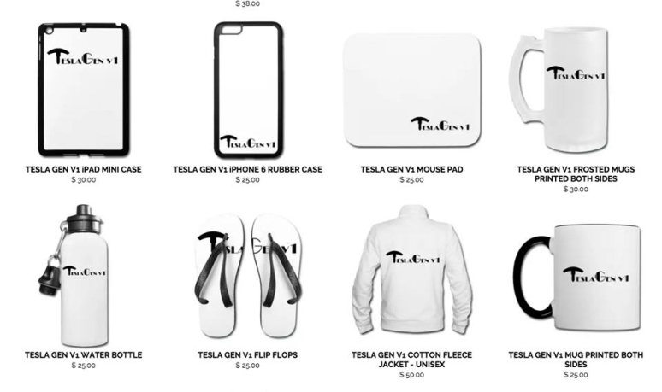
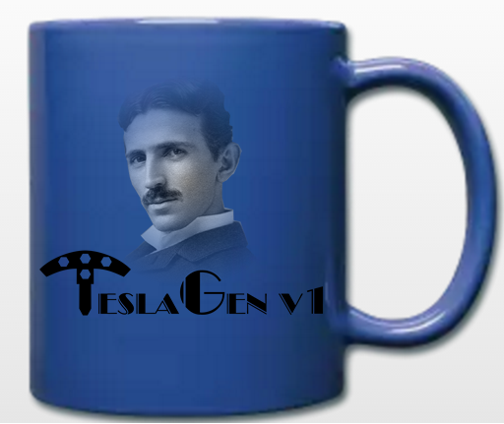
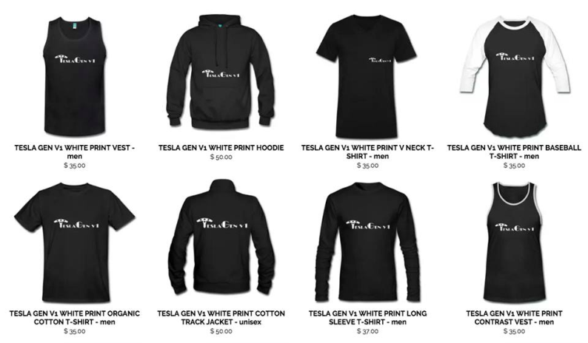
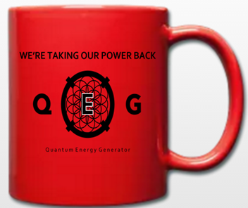
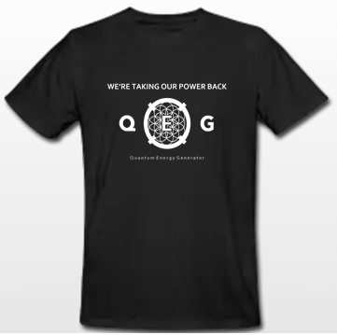
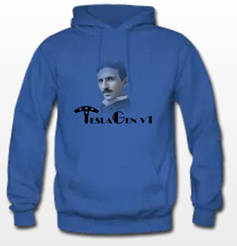
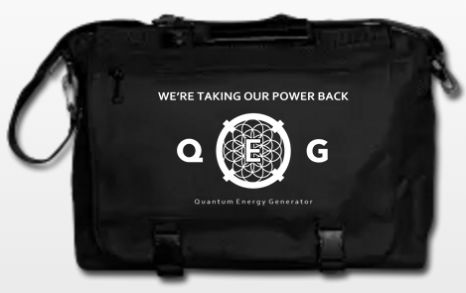
FREE ENERGY WEAR QEG / TESLA GENV1 AND MORE!
PROCEEDS GO TO HELP FUND OUR LIVE BROADCASTING PARTNERS CCN AND A GIVEBACK AMOUNT GOES TO SUPPORT HUMANITARIAN CAUSES.
http://shop.spreadshirt.com/ConsciousConsumerNetwork/
Notes:
http://shop.spreadshirt.com/ConsciousConsumerNetwork/

Slide 37
QUESTIONS FROM THE CHATROOM

